Slide 1
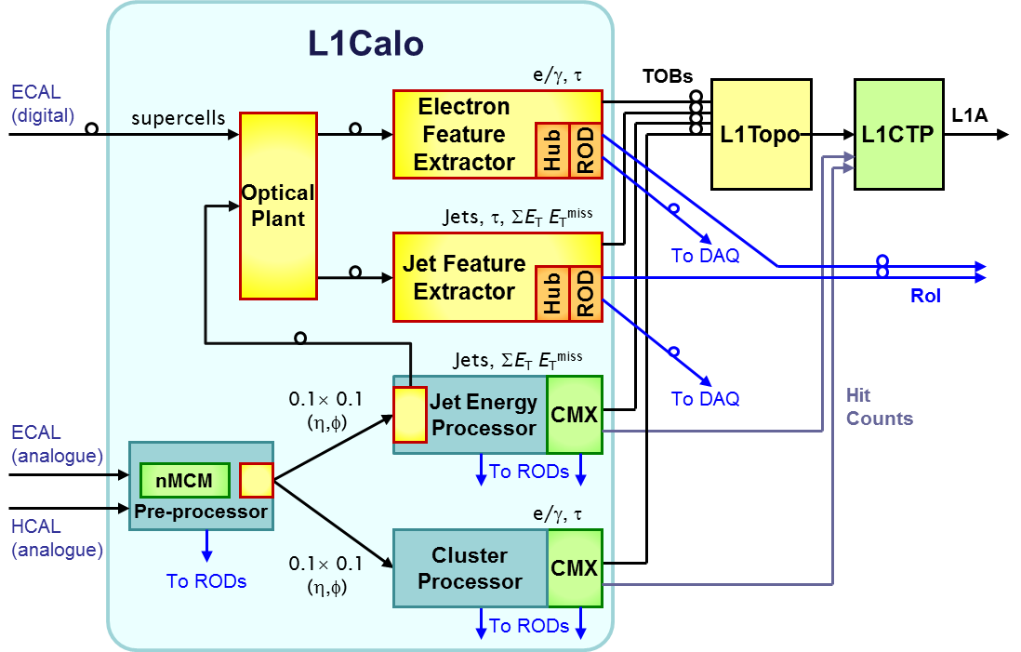
L1Calo @ ATLAS / LHC - phase 1
1st level calorimeter trigger (jets, e/m clusters, tau)
jFEX / custom hardware, ~8 ATCA modules (blades)
Opto fibre interconnect ~2.5 Tb/s per module
FPGA based, low latency feature identification (real-time)
Final trigger decision based on calorimetric and muon candidates at Central
Trigger Processor
h/w development
starting
now
jFEX
MZ

Slide 2
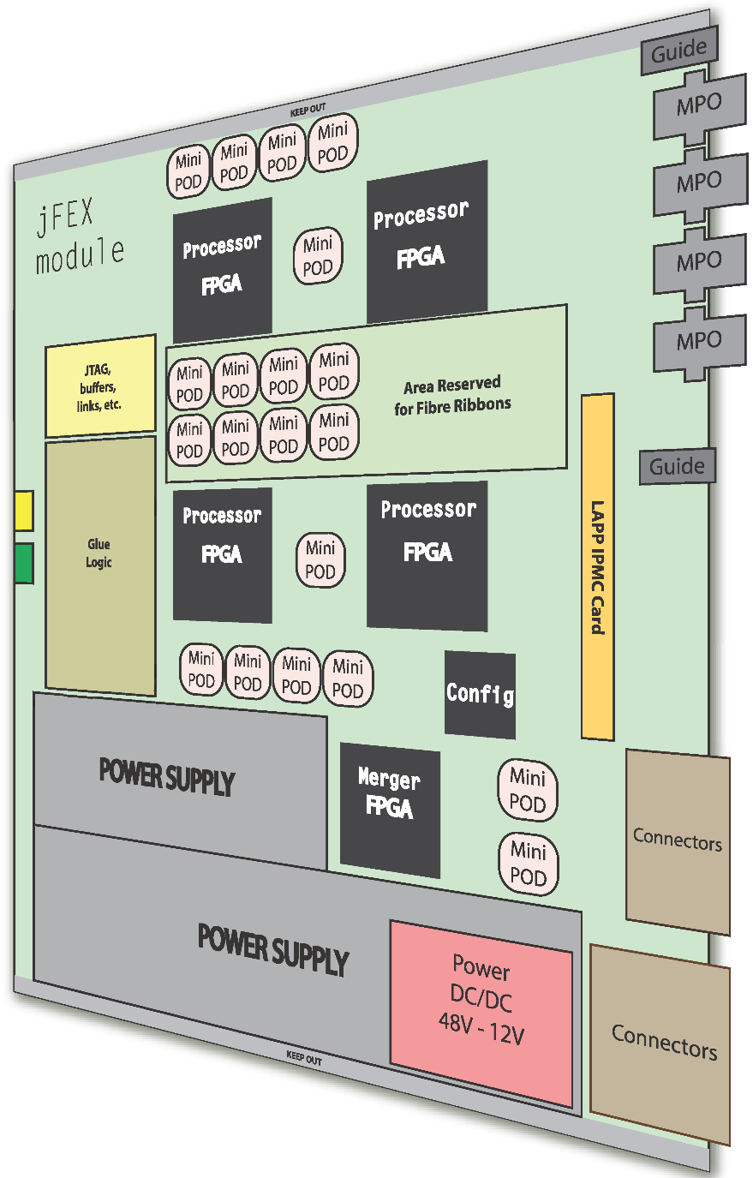

jFEX Prototype (mid 2015)
ATCA (8U *280mm) blade
Optical transmission from backplane to mPOD devices
~24 PCB layers
~500 high-speed links per blade
12.8 Gbit/s per link
Signal integrity at 12.8 Gb/s requiring proper PCB modelling:
PCB simulation with
Mentor Graphics HyperLynx
+ power modelling
+ thermal modelling
+…
Joint project with
PRISMA detector lab

Slide 3
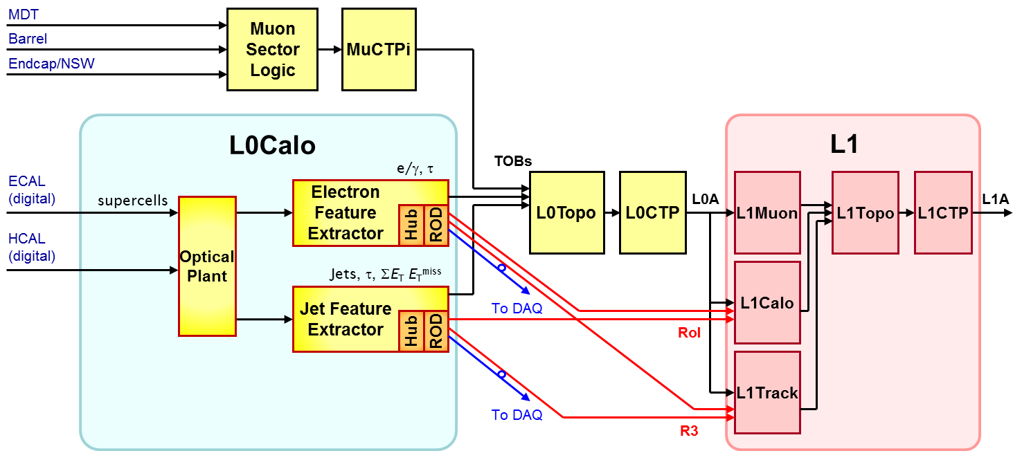
Phase-2
L1Calo re-baptised L0Calo (0-Level trigger)
Add new 1st level trigger
Higher latency budget (~30µs)
Still near real-time
Large switch box (event building, one full event per processor)
Many processors fed with select event data
Probably FPGA based / ATCA
Start assessing technologies / surveying markets now

