Slide 1
L*Topo
Run-2 → Phase-1 → Phase-2
Uli / Mainz

Slide 2
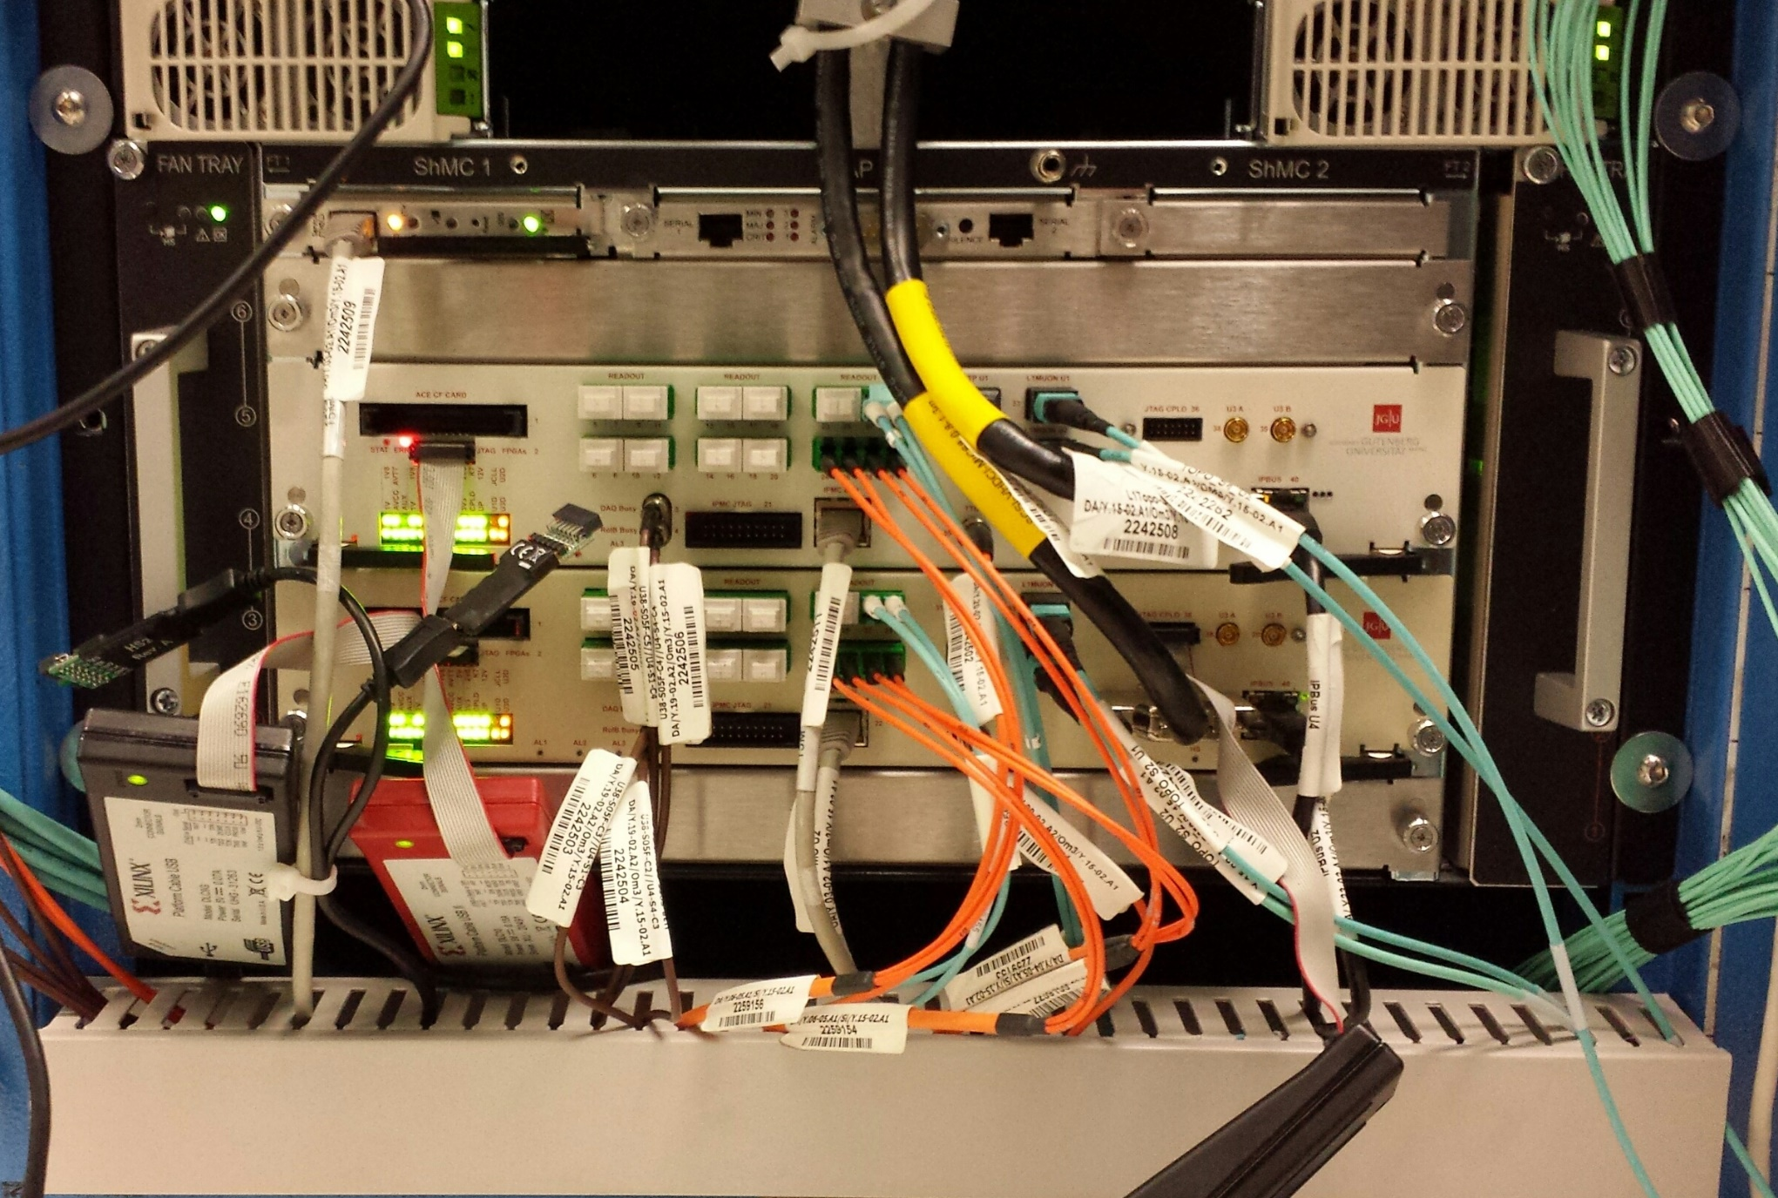
L1Topo in its habitat

Slide 3
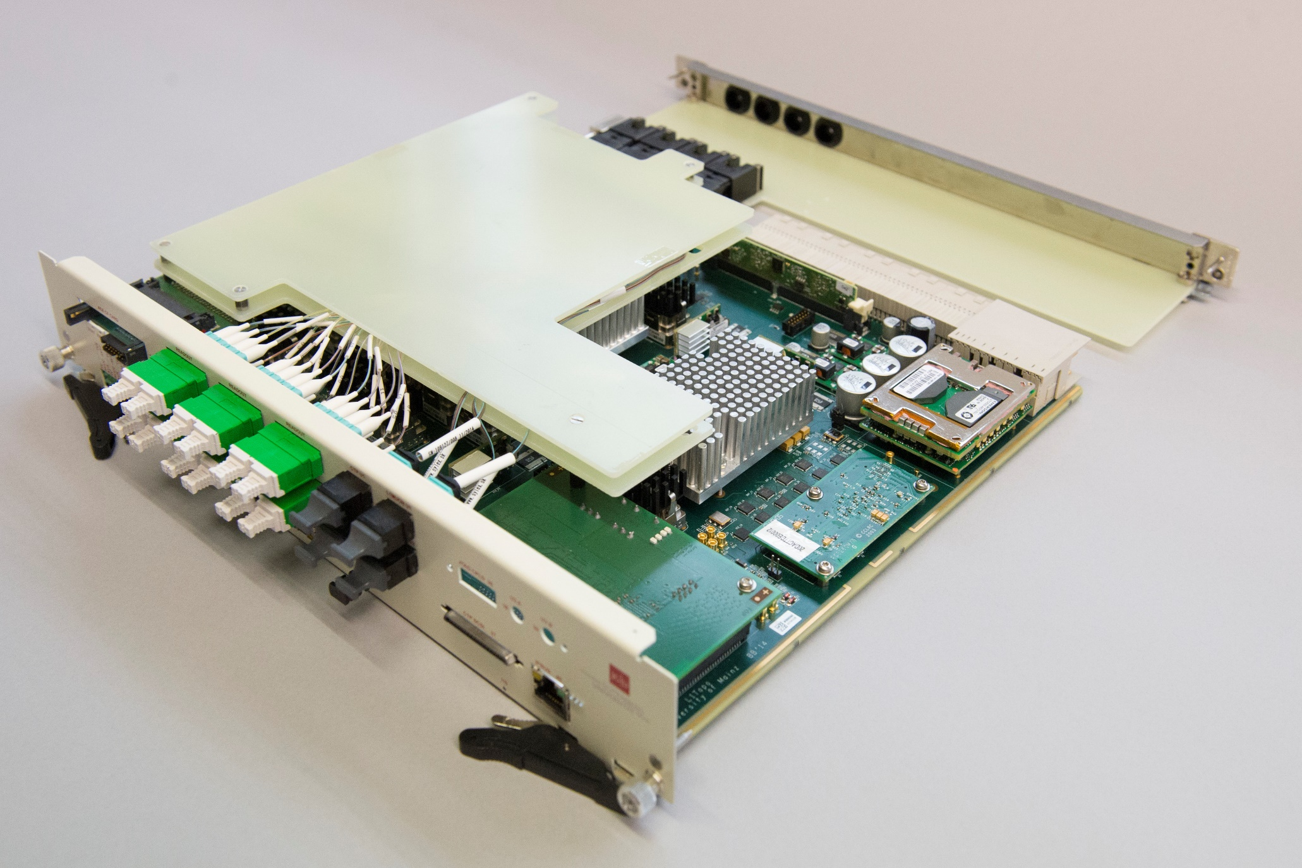
L1Topo / run 2

Slide 4
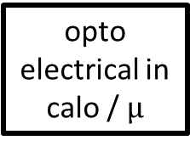
L1Topo / Run-2
module control
real-time path
algorithms
opto
electrical in
calo / $µ$
CTP
readout / embedded ROD
five modules built for run 2
  two algorithmic processors
  one DAQ/control FPGA
  designed for phase-1/phase-2 compatibility
two modules deployed at point 1

Slide 5
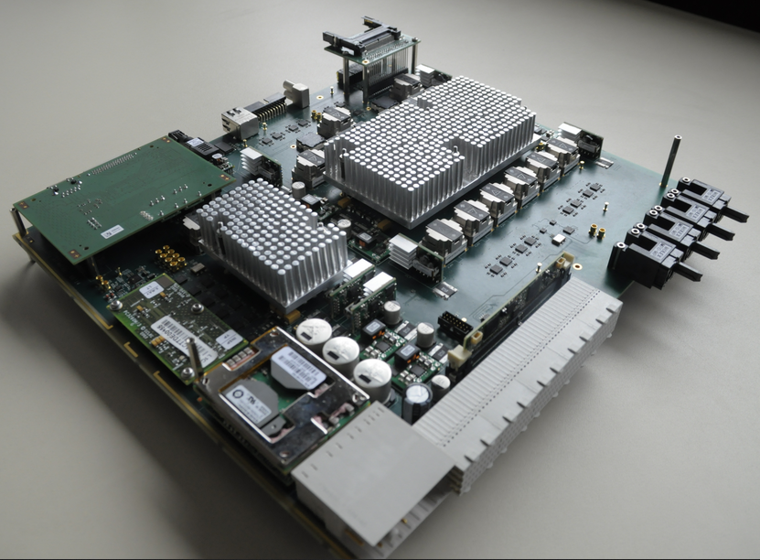
L1Topo unplugged

Slide 6
L1Topo floor plan / run-2
o/e
Real-time path
CMX/µ
ATCA zone 3
Readout
S-Link
zone 2
mezzanine
real-time path
CTP (electrical)
e/o

Slide 7
L1Topo → phase 1
New L1Topo production for phase 1
3 new modules were initially planned for phase 1
  2 × topology
  1 × hit merger for L1Calo multiplicity triggers
Current L1Topo can act as a prototype:
  Existent modules expected match needs for Phase-1
  No changes to concept
  Will need to run new PCB production anyway
  Will allow for improvements / adaptation to upcoming phase-2 requirements
Expected to live in an ATCA water cooled “standard” shelf
  Space
  Power / cooling

Slide 8
L1Topo floor plan / phase-1
o/e
Real-time path
FEXes/µ
activate inter-FPGA links
ATCA zone 3
add
optical real-time path
To CTP
zone 2
mezzanine
DAQ/ROI via
L1Calo ROD/HUB
electrical

Slide 9
Summary: Modifications wrt run-2
Connect to L1Calo hub/ROD modules via backplane
  Requires different extension mezzanine
  Basically route-through of 16 high-speed signals
  DAQ/ROI
  Clock / TTC data
Switch-on inter-processor communication
  Signals duplicated between FPGAs rather than forward duplication upstream
  Adds bandwidth for incoming signals
  Latency: be prepared to continue duplicating a fraction of signals upstream. The ones on latency critical path…
Add output bandwidth for signals into CTP
  Optical link
  No plan to remove electrical link (latency ?)
One possible modification under consideration already now:
  We might prefer the CERN recommended jitter cleaner (used on jFEX prototype) over the one used on L1Topo

Slide 10
Needs / changes for phase-2
… as known by now
Challenging processing: more/complex algorithms
Fortunately less stringent latency requirements
Far less duplication of resources required
Time multiplexing might be possible
Plus the need to supply ROIs to “Regional Readout Request” (R3) logic
  Near real-time
  Latency approximately on the same scale as L0 trigger
  Will not be possible through the backplane / L*Calo hub/ROD modules
  ROIs basically TOBs that fired topo algorithms
  … how many ?

Slide 11
L0Topo floor plan / phase-2
o/e
Real-time path
FEXes/µ
inter-FPGA links
ATCA zone 3
real-time to CTP
near-real-time
to R3 module
total: 24 × 12Gb/s
zone 2
mezzanine
To ROD/HUB

Slide 12
Summary of changes for phase-2
Optical output bandwidth needs to be shared between L0 and R3 data
  Total bandwidth available per module : 24 * ~10Gb/s
Algorithmic firmware will need to be modified to address
  Need for complex algorithms
  Need to identify TOBs that fired the triggers
  Involves tagging / pipelining the TOBs such that at time of decision the information is still available
  Route the TOBs / ROIs out to high-speed links
In the light of two well-filled L1Topo modules in run-2:
The system is scalable
  Standard ATCA crate has 12 slots available for processor blades
  Will allow for additional modules to be installed

Slide 13
Summary / outlook / discussion
The L1Topo module concept will allow smooth transition run-2 / phase-1 / phase-2
Hardware modifications will be possible
System is scalable, larger module count not ruled out
Upstream modules should allow for sufficient output bandwidth
Bandwidth for ROI data of ~200Gb/s per module probably adequate ?
If not: need to understand now
Spare output bandwidth on processor FPGAs available
Need to be routed out to additional opto/electrical converters
Firmware will require major changes to benefit from increased latency and to support R3 concept

