Slide 1
L1Topo for Phase-1
jFEX prototype currently under production. Highly modular design.
Equipped with large UltraScale and Ultrascale+ devices.
Expect completion next week
standalone tests in home lab in November
Initial CERN tests just before Christmas if things going smoothly
jFEX prototype can be turned L1Topo replacement by some mods along the lines of current L1Topo. Need Topo style mezzanine plus:
Fork the design:
jFEX with 4 FPGAs for maximum data duplication
L1Topo with 2 FPGAs for minimum latency and cost reduction. Output and electrical connectivity modified as for current L1Topo
→ Plan “B”
Current L1Topo can be made phase-1 compatible (standard L1Calo ROD/TTC interface)
Replace mezzanine
Verify inter-FPGA parallel link operation, qualify max. bandwidth/latency, verify ATCA fabric interfaces
Replace configurator module (SystemACE based)
→ Plan “A”

Slide 2
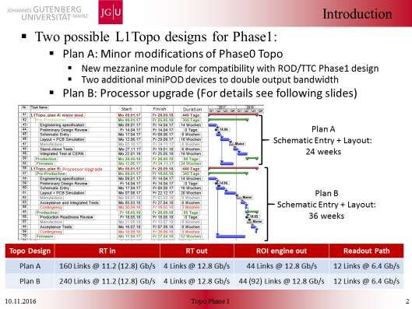

Slide 3
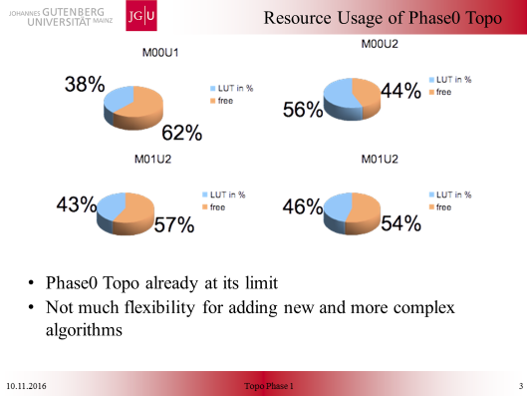
74% 2017 menu ???

Slide 4
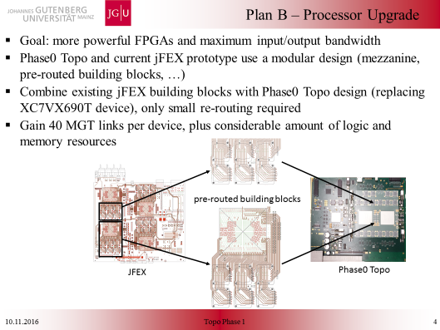

Slide 5
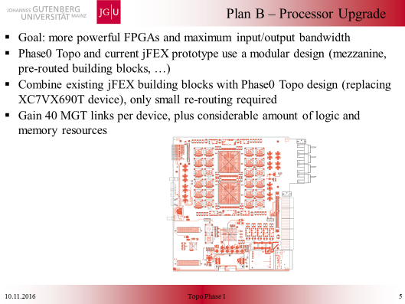

Slide 6
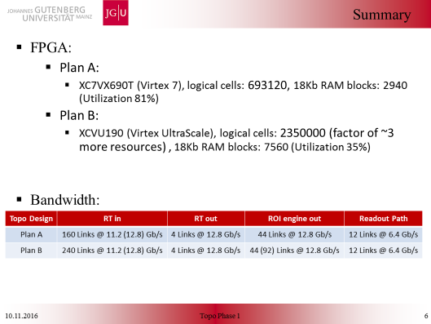

Slide 7
(My very personal) conclusion
We might well be short of resources on current L1Topo soon, if requests for menu changes continue to come in
Latency might be an issue on current module due to likely requirement of inter-FPGA links at phase-1.
→
Urgently start with jFEX based design work
Specs now
Schematics to start asap
Make sure that this more advanced, higher performance module is considered baseline → fall-back to older design always possible
At L1calo joint meeting support for this option
Early decision in this direction will allow for contingency in schedule

