Slide 1
DCS on jFEX and L1Topo in Phase-1
Christian/Duc/Uli, Mainz

Slide 2
Pre-history: Topo in Phase-0
LAPP IPMC available on L1Topo
Initial firmware work done by Adam
Readout of all sensors, handle switch, power negotiation
Not currently in use
Additional data available
Some environmental data collected by control and processor FPGAs
Direct FPGA-internal sensing of temperatures and voltages
Some devices controlled and monitored by I2C (opto devices, clock conditioners,…)
Sub-set of these data can be sent into DCS via IPbus/OPC server

Slide 3
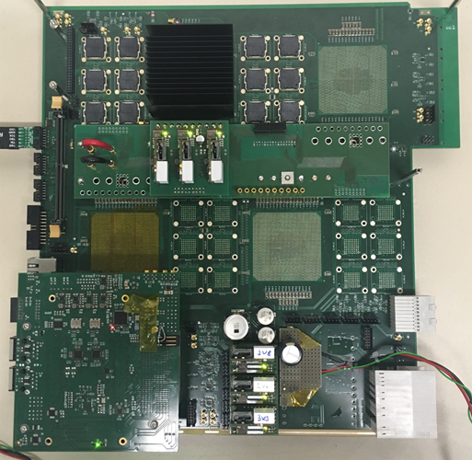
L1Topo / jFEX @ Phase-1
New L1Topo based on jFEX mainboard with
Two processors with twelve 12-way optos each
Extension mezzanine with added electrical out to CTP
← jFEX 1st prototype:
Final prototype in production
Available MZ this month
Both L1Topo and jFEX carry LAPP IPMC
Probably move to a more convenient place on L1Topo

Slide 4
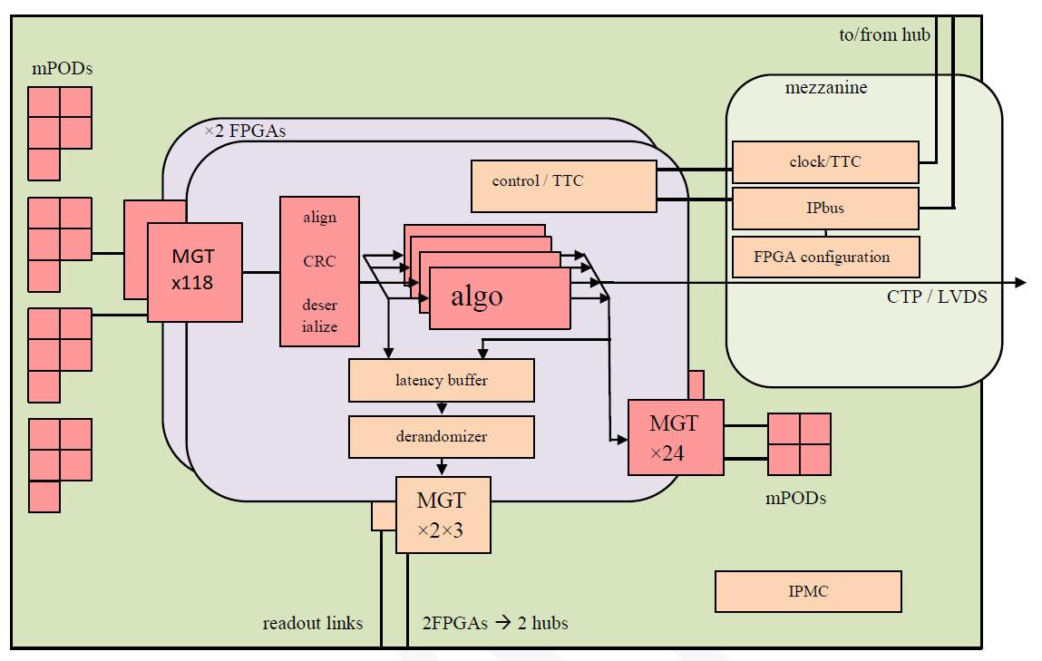
L1Topo module block diagram

Slide 5
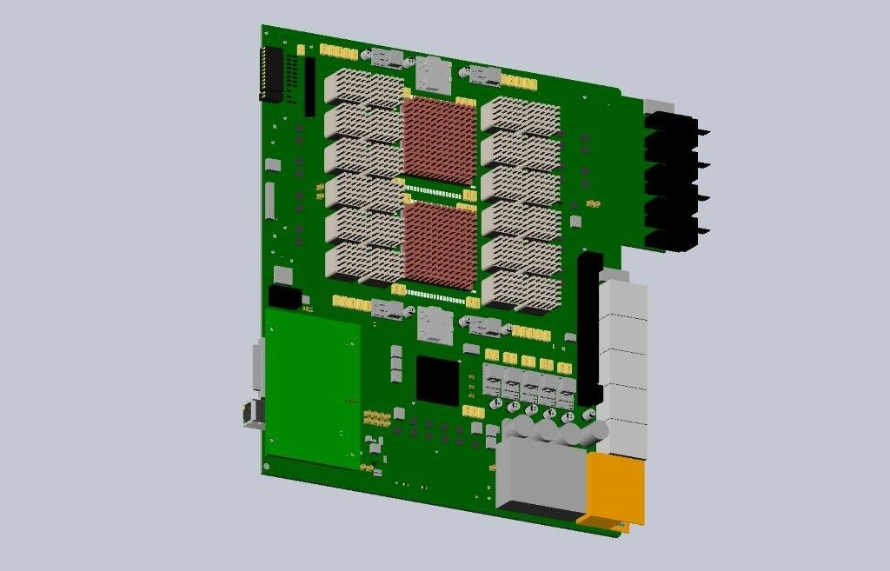
L1Topo components placement
IPMC

Slide 6
IPMC / Environmental sensors
IPMC design copied from current L1Topo
IPMC not yet functional on jFEX 1st prototype.
Under work. Adam + NN
Coherent scheme between jFEX and new L1Topo
All I2C sensing goes via mezzanine
Route any vital information to the IPMC
Probably small number of data only:
few voltages
FPGA temperatures
FPGA configuration status into DCS ???
Additional expert level interface into IPbus
Might not be exported to DCS (tbd)
Set of required DCS data and concept of expert level access to extended data set under discussion
… Shelf level monitoring should anyway complement module level monitoring…

