Slide 1
L1Topo Phase-1
Just meant to start the discussion
Specifications, status, review readiness
Uli / Mainz

Slide 2
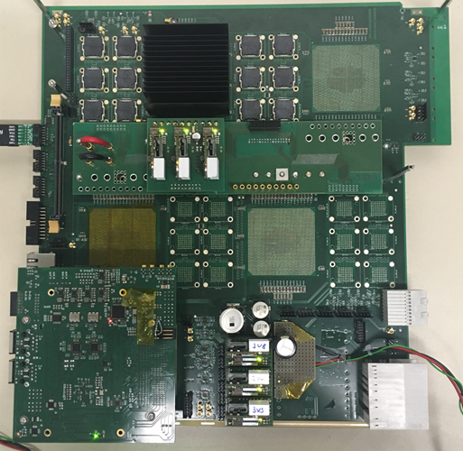
L1Topo @ Phase-1
New L1Topo based on jFEX mainboard with
Two processors with twelve 12-way optos each
Extension mezzanine with added electrical out to CTP
← jFEX prototype:
ATCA module
Input fibres via Zone 3
24 12-way opto devices
Four processor FPGAs
(one currently mounted)
Control on mezzanine
Successfully tested @CERN
Final prototype in production

Slide 3
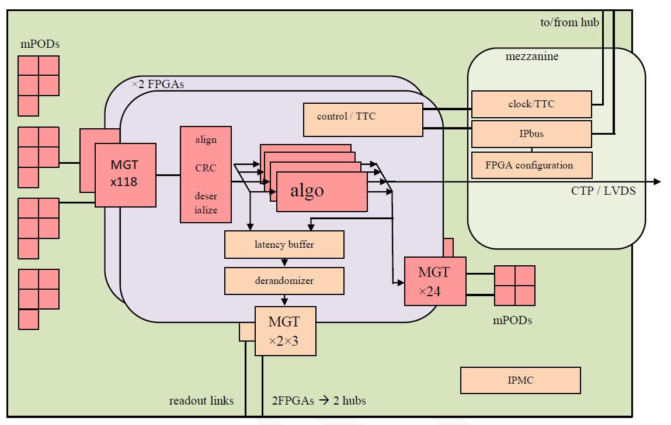
L1Topo module block diagram

Slide 4
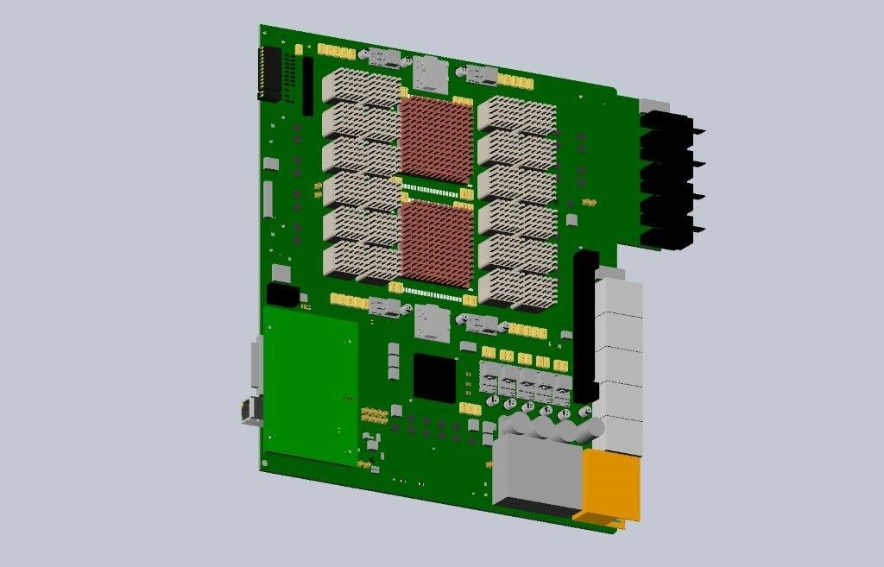
Components placement

Slide 5
L1Topo @ Phase 1, some details
ATCA modules compatible to the L1Calo Phase-1 ecosystem
L1Calo standard ROD & clock distribution
L1Calo standard Zone 3
118 input fibres per processor FPGA, 11.2/12.8 Gbps
24 output fibres per processor FPGA
Electrical and optical output to CTP
Electrical output via mezzanine / front panel
Inter-FPGA connectivity 64 Gb/s (latency!)
3 L1Topo modules for Phase-1, allocated as follows
hit merger for L1Calo multiplicity triggers plus gFEX
topology : jet/tau combinations
topology : electron combinations
See https://cds.cern.ch/record/2280978 (Steve H.)

Slide 6
Specifications
First public draft of specs made available Aug. 04
Review initially planned for Aug. 18
Some comments received
Just received a request to update the specs before review
Some major comments:
Firmware documentation, including resource use
Interface documentation
Data formats
Readout documentation
Latency
…
Dealing with that all before the review would move date into November

Slide 7
Status of h/w development
New L1Topo is jFEX based
jFEX schematics and layout done by Bruno B.
Some design work on mezzanines done by Julio
→ stick to that allocation for L1Topo
Bruno has recently restarted working on L1Topo, interleaved with jFEX work
Expect to finish jFEX activities soon and work on L1Topo at 100%
jFEX expected back from manufacture on Oct. 27 (so far very promising)
Any PCB and design issues with that module would affect L1Topo as well
Routing layer planning (which is basically done for jFEX style sequential build)
Block diagrams updated
Bruno’s last activity before holidays had been the MiniPOD wiring to the FPGAs (partially different from jFEX)

Slide 8
Firmware, effort etc.
Christian will re-join us on Nov. 2nd : infrastructure f/w, Ipbus
Johannes working on re-target of phase-0 L1Topo to UltraScale+ (resource use)
Holger will be looking into online software
… and Katharina taking over Topo project management again (now)…

