Slide 1
L1Topo Phase-1
Status & Plans
Uli / Mainz

Slide 2
Intro
Interfaces / Requirements
Status
People
Plans

Slide 3
L1Topo @ Run-2
Two modules running topological algorithms, Calo & Muons
(multiplicity based Calo triggers provided by CMX)

Slide 4
L1Topo module @ Run-2
module control
real-time path
algorithms
opto-
electrical in
calo / $µ$
CTP
two algorithmic processors
80 fibre inputs @ 6.4Gb/s each
optical and electrical to CTP
readout / embedded ROD

Slide 5
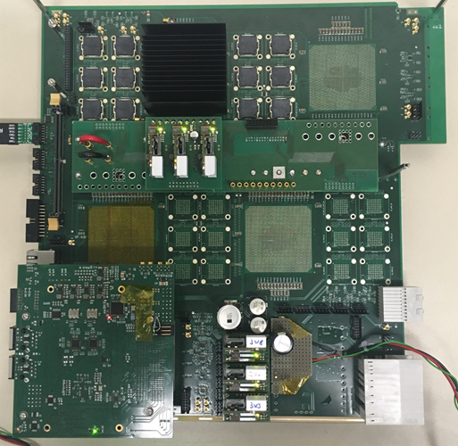
L1Topo @ Phase-1
New L1Topo based on jFEX mainboard with
Two processors with twelve 12-way optos each
Extension mezzanine with added electrical out to CTP
← jFEX prototype:
ATCA module
Input fibres via Zone 3
24 12-way opto devices
Four processor FPGAs
(one currently mounted)
Control on mezzanine
Successfully tested @CERN
Final prototype in production

Slide 6
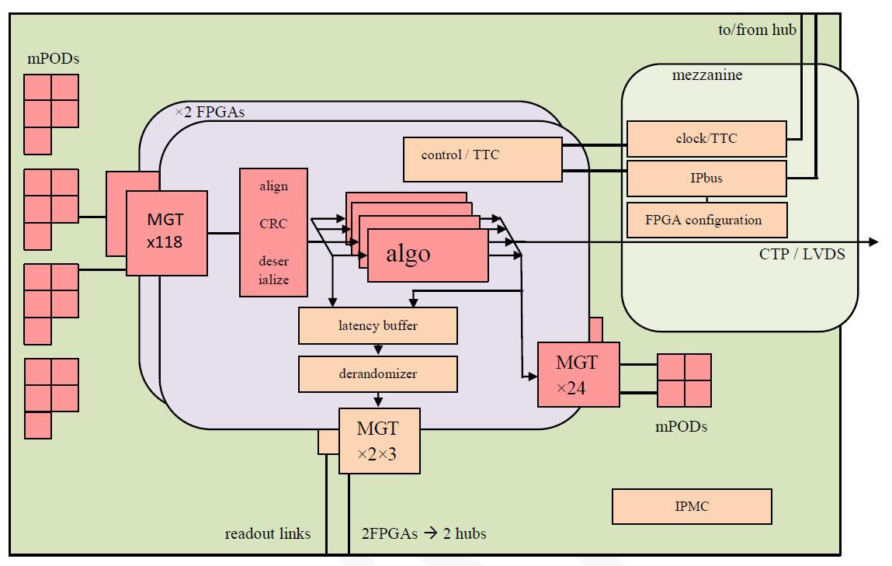
L1Topo module block diagram

Slide 7
L1Topo @ Phase 1, some details
ATCA modules compatible to the L1Calo Phase-1 ecosystem
L1Calo standard ROD & clock distribution
L1Calo standard Zone 3
118 input fibres per processor FPGA, 11.2/12.8 Gbps
24 output fibres per processor FPGA
Electrical and optical output to CTP
Electrical output via mezzanine / front panel
Inter-FPGA connectivity 64 Gb/s (latency!)
That’s basically the maximum possible with current technologies
3 L1Topo modules for Phase-1, allocated as follows (see below)
hit merger for L1Calo multiplicity triggers plus gFEX
topology : jet/tau combinations
topology : electron combinations

Slide 8
Interfaces to L1Calo and Muons
Optical multi fibre bundles, via MPO/MTP in Zone-3, received from some re-bundling box (as current L1Topo)
Receivers are Foxconn/Broadcom AFBR-824, 14 Gb/s
FPGAs support >16 Gb/s
System designed for mixed 11.2 and 12.8 Gb/s operation
Required by xFEX constraints
Muons ?
For latency reasons 8b/10b encoding supported only
Steve has worked out requirements regarding data volume into L1Topo from FEX/Muon sources
Finer details of data contents / Trigger Objects (TOBs) and formats to be defined
For details on requirements see Steve’s presentation:
https://indico.cern.ch/event/638444/contributions/2639285/attachments/1490897/2318031/topo170711.pdf

Slide 9
Status of h/w development
New L1Topo is jFEX based
jFEX shown to work well in current incarnation (1 FPGA)
jFEX programme ongoing ... Final prototype under way … review… preproduction… → further input into L1Topo programme
Real work:
transformation jFEX → L1Topo under way
Have been working on routing layer planning
Block diagrams updated to large extent
Incorporate very recent updates to jFEX
Few things missing, need to finalize clocking
Paper work: Engineering specs available soon, see below…

Slide 10
Who‘s who…
Katharina – primary contact from Oct. 2017 (Uli →)
Uli – hardware, DCS
Johannes – firmware
Holger – online software
Marek – readout
Rosa – permanently at CERN
L1Topo phase-1 is a reduced jFEX hardware-wise, and an re-use/upgrade of phase-0 Topo software/firmware.
Assume synergies with jFEX project and ongoing commitment by phase-0 simulation/validation crew.

Slide 11
Plans (hardware)
Hardware schedule updated
Specification document to be complete end July
PDR mid August
Schematics to be completed until mid October
Layout completed by end January
Final hardware in hand Oct. 2018
L1Topo and jFEX development/production cycles closely related and interleaved.

Slide 12
Further plans
Integration with external systems
Phase-0 topo is integrated with external systems
Some hardware interfaces need to be reworked
Software/firmware interfaces to be adapted
Assumption that for external links firmware blocks will be made available from designers of far end interface
Readout to be adapted to ROD/hub scheme (Marek)
Simulation
Simulation (low level, high level) exists and is being improved and maintained for current L1Topo. Will need to be continued for Phase-1 Topo. Assume that common framework will be made available for Phase-1.

Slide 13
Activities at Surface Test Facility
Prototypes (very soon !) and production modules to be run at STF
Mainz will supply
Modules
One PC specifically for Mainz controls
A set of USB boxes for specific controls/diagnostics (JTAG,I2C,…), probably small number of fibre bundles
Shelves, once production modules are there
Once production modules and their shelves are down the pit, only spare modules and PC/USB infrastructure will remain
Require 6-8 slots in common ATCA shelf permanently
Expect to have access to copies of all upstream / downstream modules and expertise/effort (!!!!)
Mainz participants in all joint STF tests: Julio, Marcel, Rosa, Uli

Slide 14
Schedule Test/Install/Commission
Schedule similar to jFEX schedule, just slightly behind
Initial (partial) system tests might be performed with Phase-0 Topo / Prototype.
No strict need to have final L1Topo system available before complete set of upstream systems.
People involved in CERN installations / commissioning, and long-term maintenance of Mainz built modules : Rosa, Uli

Slide 15
Backup slides

Slide 16
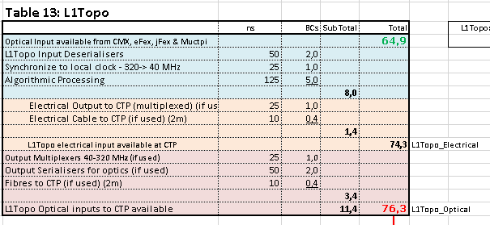
Latency at Phase-1
TDR figures
Latency is tight
Inter-FPGA fan-out is part of algo latency ! ~2BC ?
Incoming signals on latency critical path (Muons / NSW) might bypass inter-FPGA fan-out (upstream duplication)
Check input MGT/deserialization latency assumptions against current reality (Topo I)
Electrical fast output path available (limited bandwidth)

Slide 17
Phase-2
Seems that old plans for forward compatibility to Phase-2 have become obsolete.
Therefore no Phase-2 slides in this presentation
However, please note that there is plenty of optical output bandwidth available (up to 600Gb/s per L1Topo module) which is certainly not required into a Phase-1 style CTP.
So probably well prepared for a new lease of life at Phase-2

