Slide 1
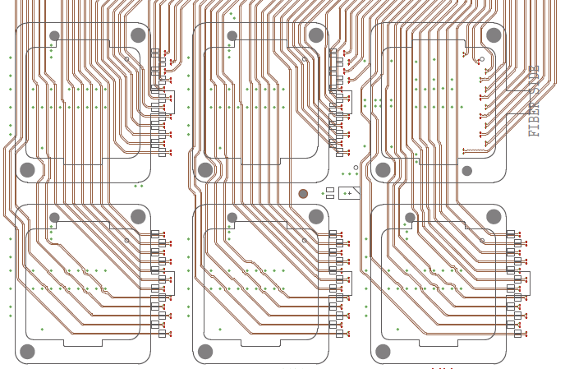
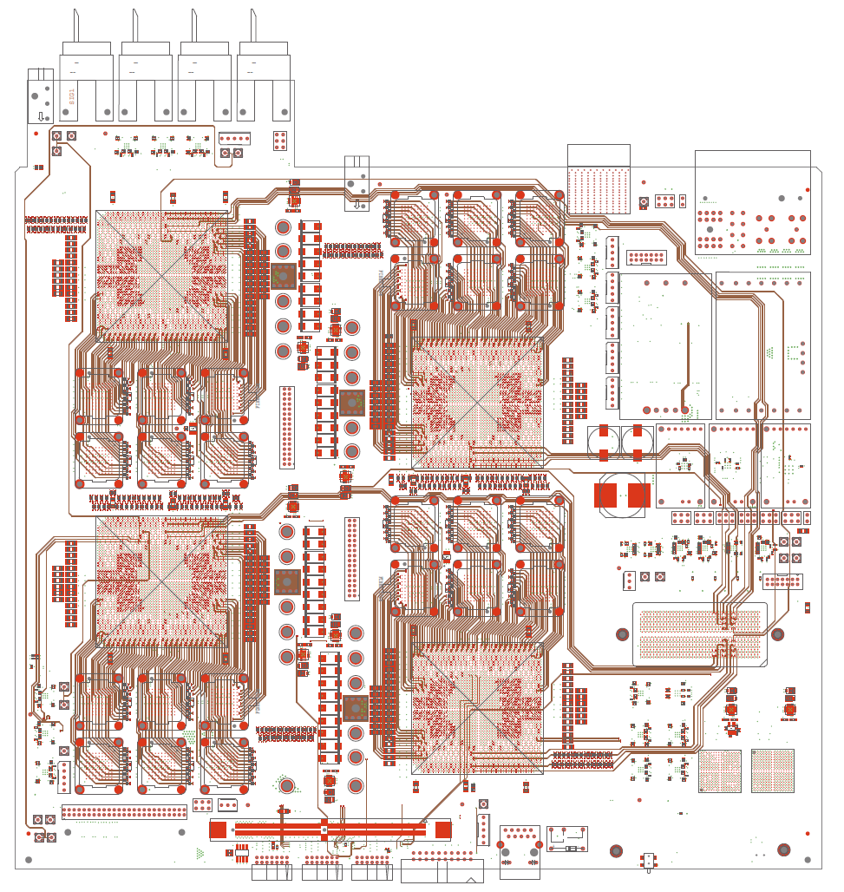
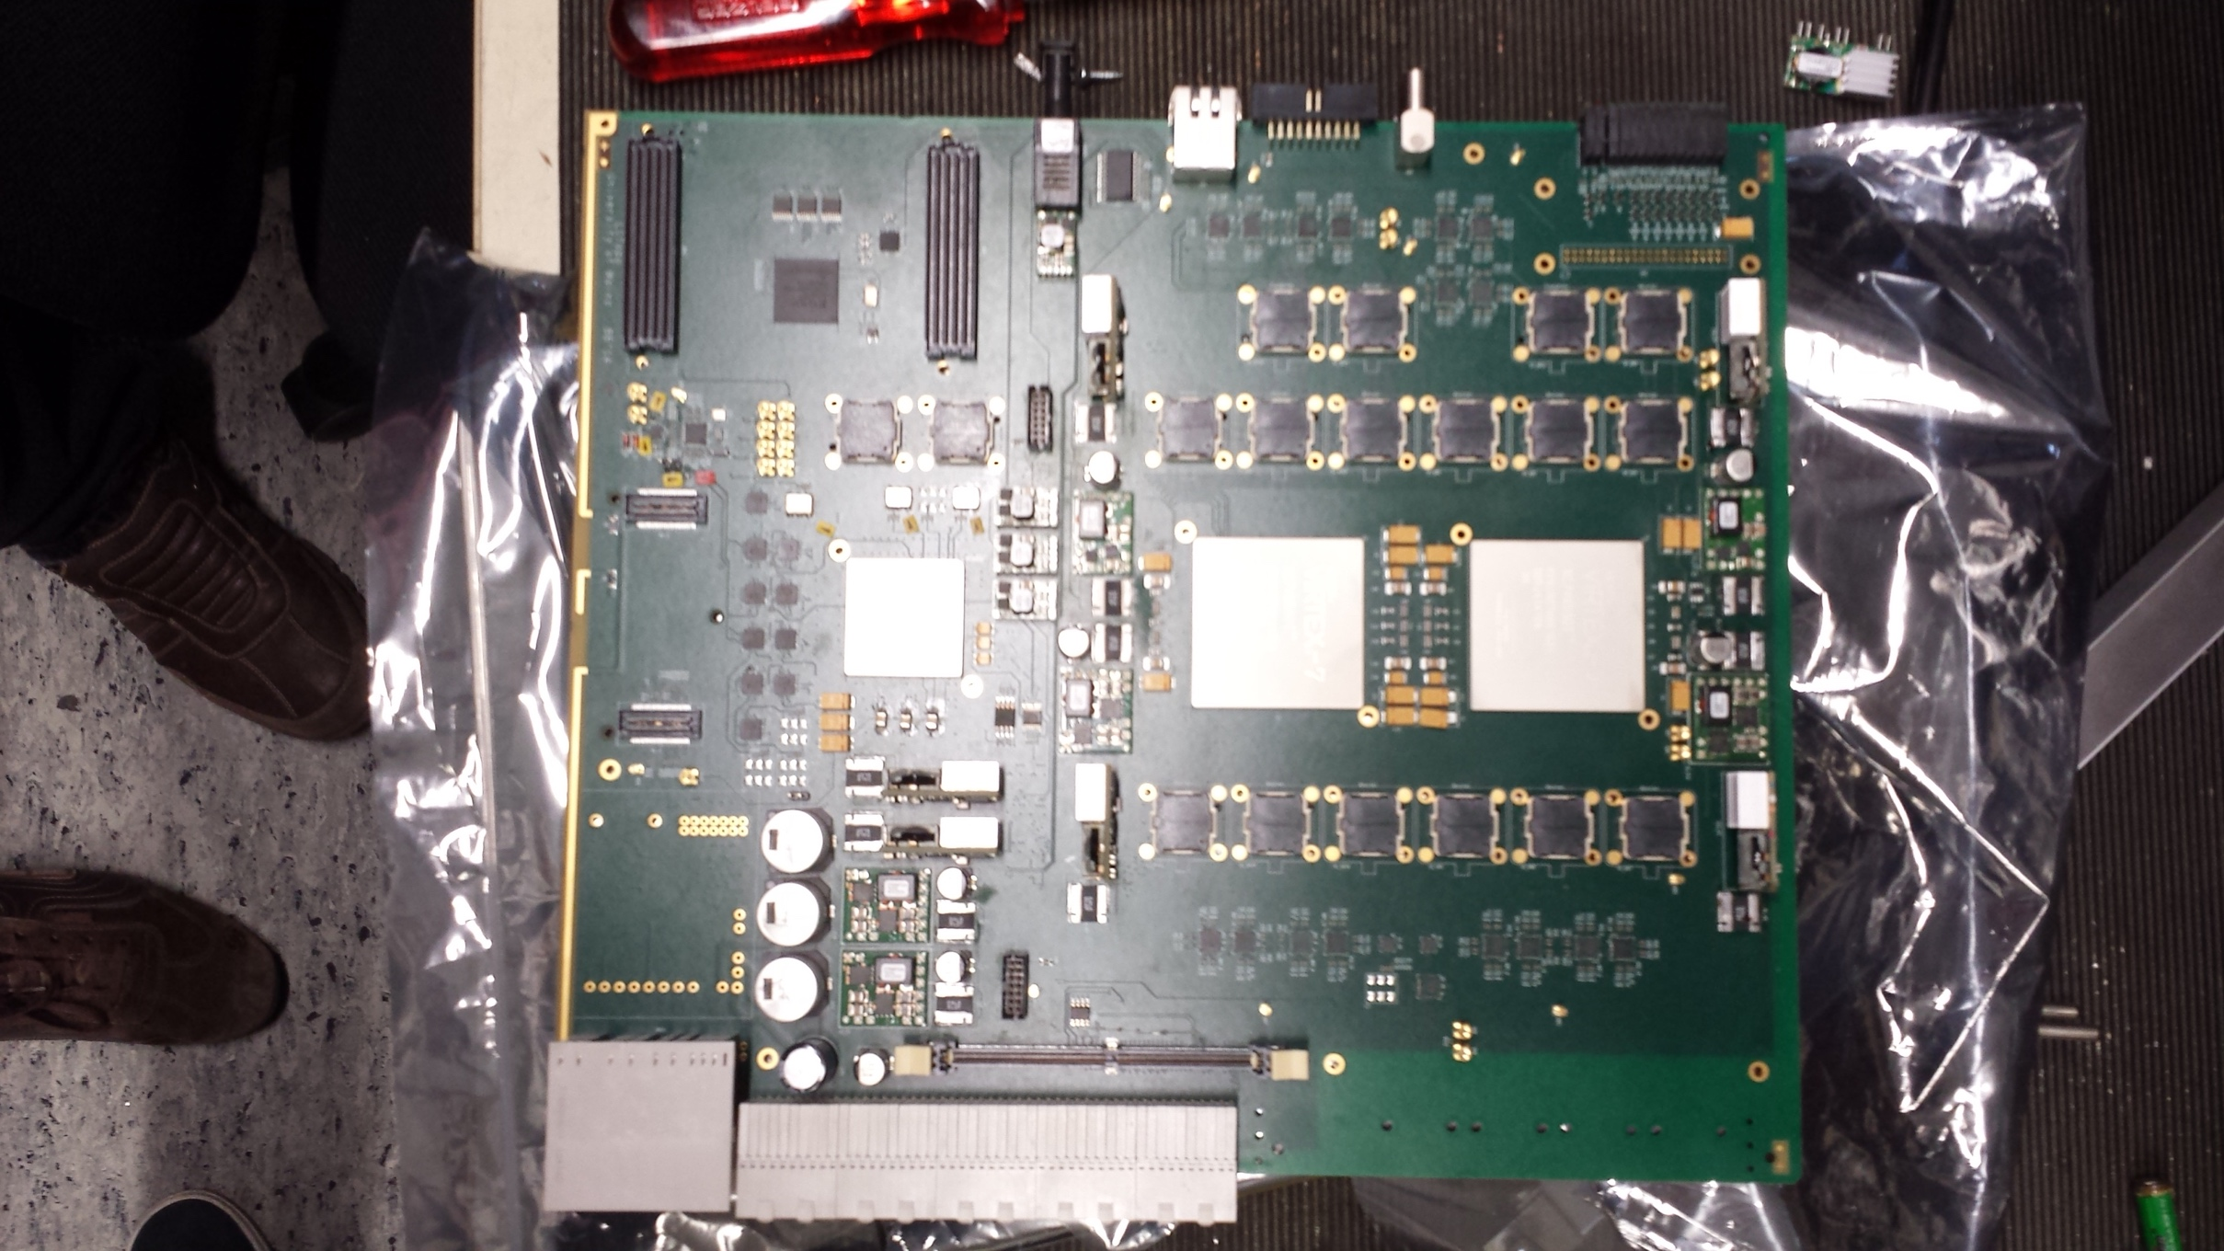
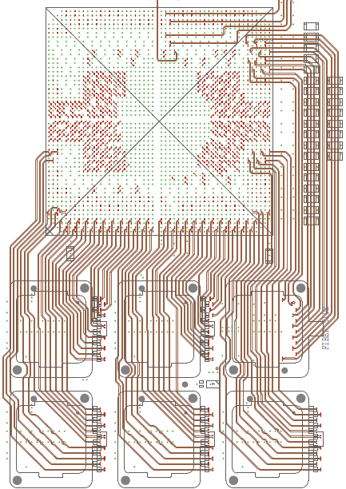
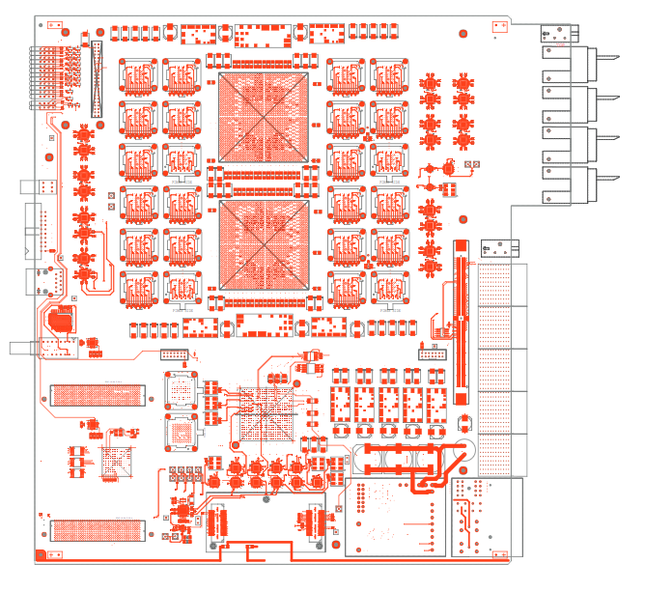
L1Topo Status
Combine existing jFEX building blocks with Phase0 Topo design
Recent progress
First draft for PDR in progress
Firmware
Large part can be adapted from Phase0 Topo and jFEX
pre-routed building blocks
jFEX
Phase0 Topo
Monday, January 23rd
Phase-I L1Topo
1
Notes:
1

Slide 2
L1Topo Planning
Near-term milestones
Preliminary design review (4/2017)
Firmware:
Basic high-speed link infrastructure (10/2017)
Basic monitoring and diagnostics (10/2017)
Engineering Effort
FTE required: 4.0
FTE available: 4.0
People: 16 (jFEX+L1Topo)
Challenges & Risks | Mitigation | Decision
Necessity for extra hardware design iteration | Use contingency in schedule Fall-back solution Plan A | September ’17
Under-estimated firmware workload | Increased code-sharing (& uniformity) Extra engineering effort | October ‘17
Monday, January 23rd
Phase-I L1Topo
2

