Slide 1


Topo Phase1
K. Bierwagen, V. Büscher, U. Schäfer
Johannes Gutenberg University Mainz
November 2, 2016

Slide 2
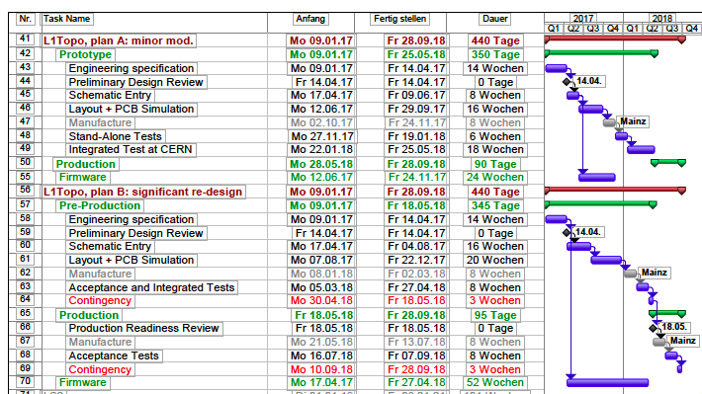
Introduction
Two possible L1Topo designs for Phase1:
  Plan A: Minor modifications of Phase0 Topo
    New mezzanine module for compatibility with ROD/TTC Phase1 design
    Two additional miniPOD devices to double output bandwidth
  Plan B: Processor upgrade (For details see following slides)
Start
Finish
Duration
Pre-Production
Plan A
Schematic Entry + Layout:
24 weeks
Processor Upgrade
Plan B
Schematic Entry + Layout:
36 weeks
Topo Design | RT in | RT out | ROI engine out | Readout Path
Plan A | 160 Links @ 11.2 (12.8) Gb/s | 4 Links @ 12.8 Gb/s | 44 Links @ 12.8 Gb/s | 12 Links @ 6.4 Gb/s
Plan B | 240 Links @ 11.2 (12.8) Gb/s | 4 Links @ 12.8 Gb/s | 44 (92) Links @ 12.8 Gb/s | 12 Links @ 6.4 Gb/s

Slide 3
Resource Usage of Phase0 Topo
Phase0 Topo already at its limit
Not much flexibility for adding new and more complex algorithms

Slide 4
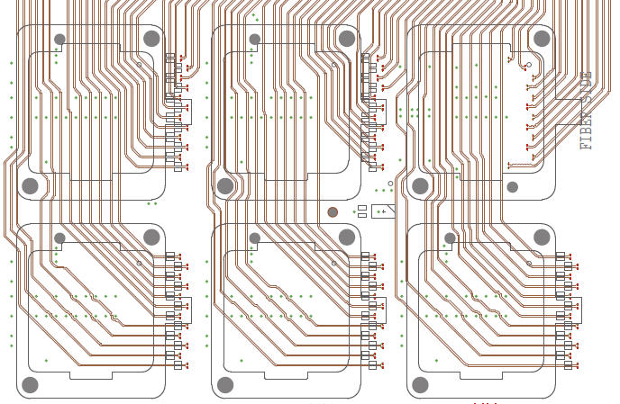
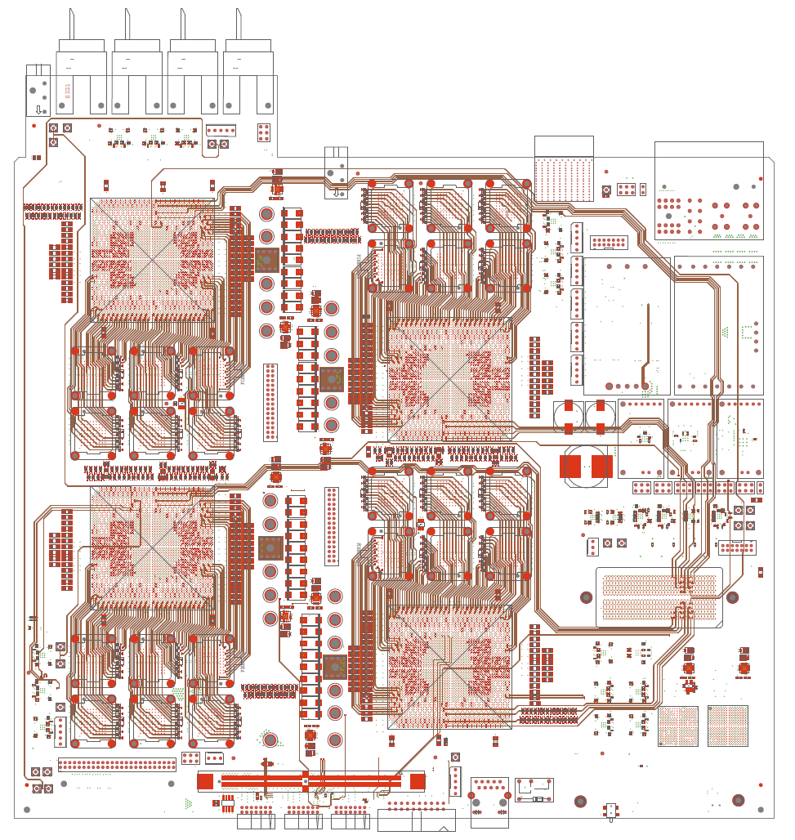
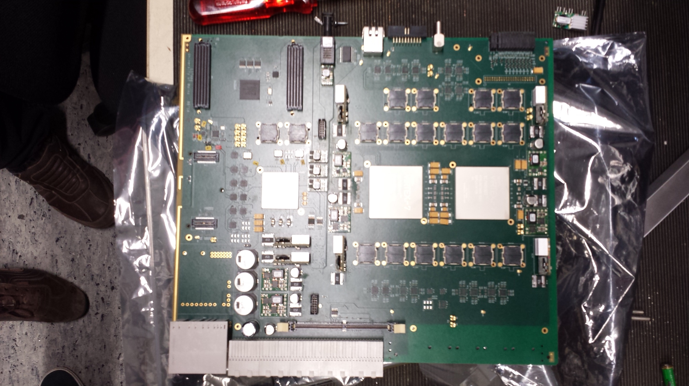
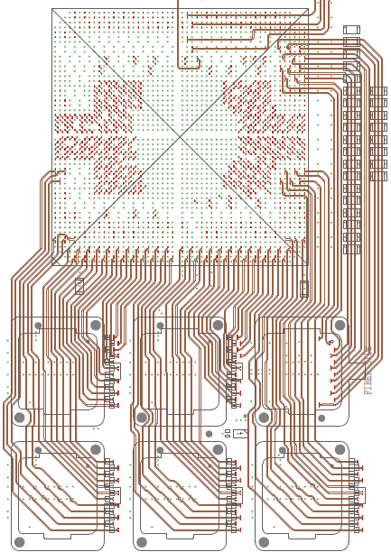
Plan B – Processor Upgrade
Goal: more powerful FPGAs and maximum input/output bandwidth
Phase0 Topo and current jFEX prototype use a modular design (mezzanine, pre-routed building blocks, …)
Combine existing jFEX building blocks with Phase0 Topo design (replacing XC7VX690T device), only small re-routing required
Gain 40 MGT links per device, plus considerable amount of logic and memory resources
pre-routed building blocks
JFEX
Phase0 Topo

Slide 5
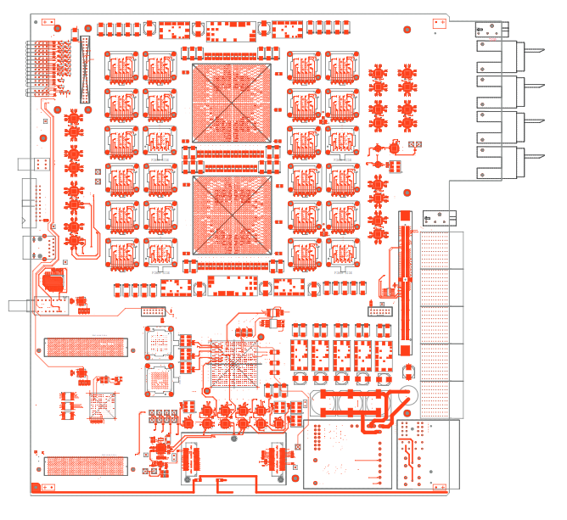
Plan B – Processor Upgrade
Goal: more powerful FPGAs and maximum input/output bandwidth
Phase0 Topo and current jFEX prototype use a modular design (mezzanine, pre-routed building blocks, …)
Combine existing jFEX building blocks with Phase0 Topo design (replacing XC7VX690T device), only small re-routing required
Gain 40 MGT links per device, plus considerable amount of logic and memory resources

Slide 6
Summary
FPGA:
  Plan A:
    XC7VX690T (Virtex 7), logical cells: 693120, 18Kb RAM blocks: 2940 (Utilization 81%)
  Plan B:
    XCVU190 (Virtex UltraScale), logical cells: 2350000 (factor of ~3 more resources) , 18Kb RAM blocks: 7560 (Utilization 35%)
Bandwidth:
Topo Design | RT in | RT out | ROI engine out | Readout Path
Plan A | 160 Links @ 11.2 (12.8) Gb/s | 4 Links @ 12.8 Gb/s | 44 Links @ 12.8 Gb/s | 12 Links @ 6.4 Gb/s
Plan B | 240 Links @ 11.2 (12.8) Gb/s | 4 Links @ 12.8 Gb/s | 44 (92) Links @ 12.8 Gb/s | 12 Links @ 6.4 Gb/s

