Slide 1
L1Topo Phase-1
Status & Interfaces
Uli / Mainz

Slide 2
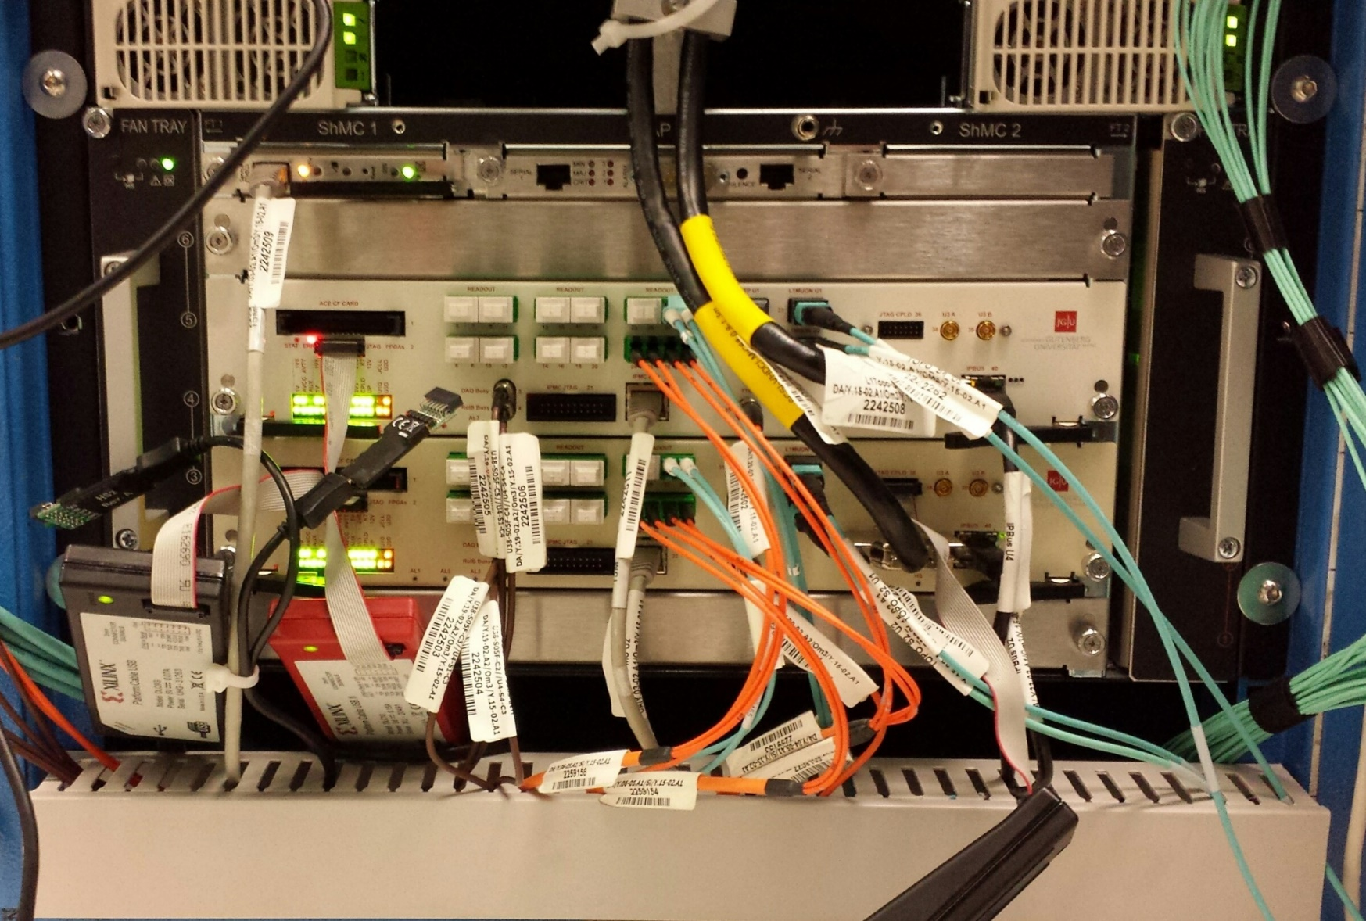
L1Topo @ Run-2
Two modules running topological algorithms, Calo & Muons
(multiplicity based Calo triggers provided by CMX)

Slide 3
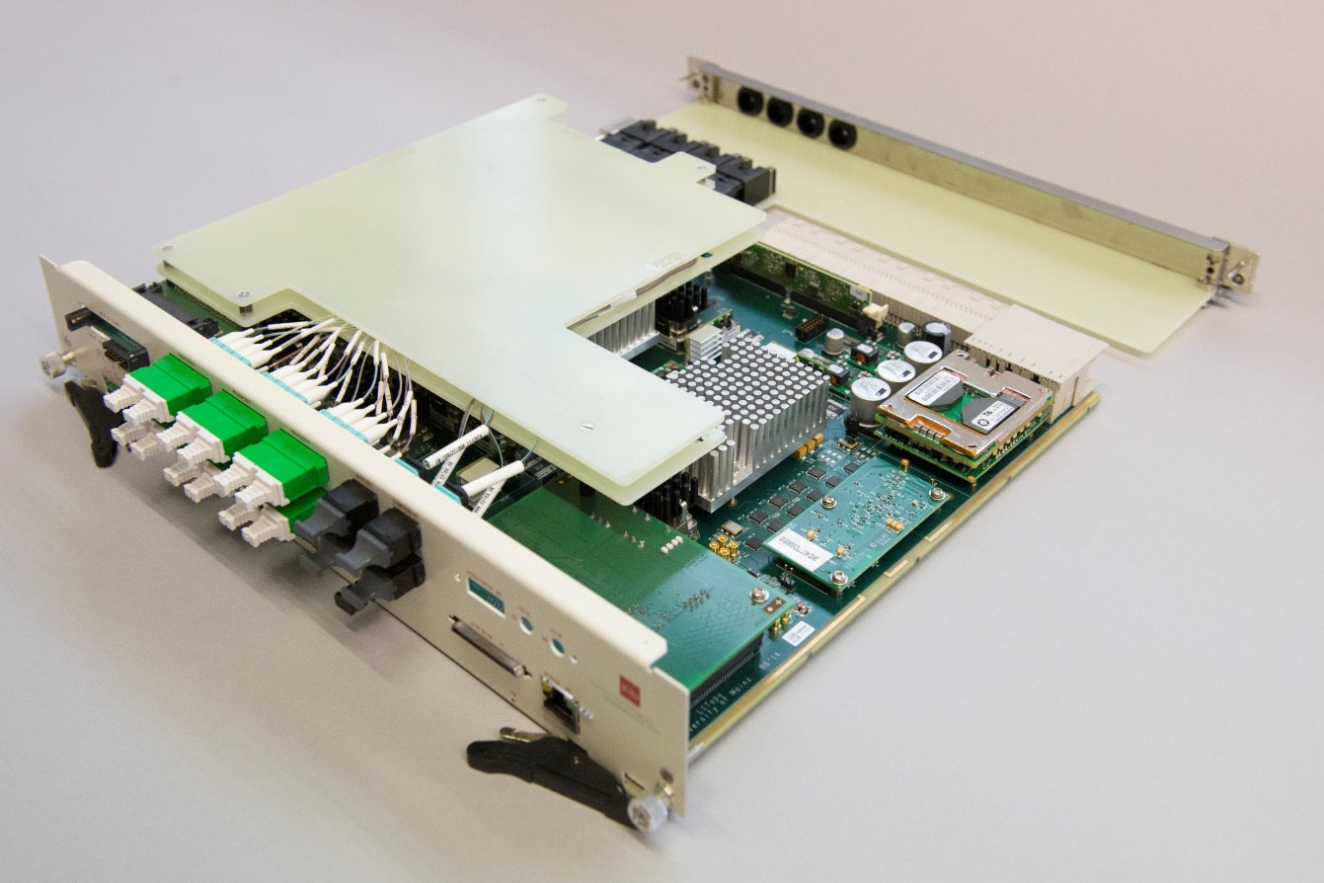
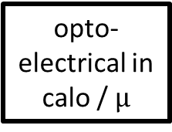
L1Topo module @ Run-2
module control
real-time path
algorithms
opto-
electrical in
calo / $µ$
CTP
two algorithmic processors
80 fibre inputs @ 6.4Gb/s each
optical and electrical to CTP
readout / embedded ROD

Slide 4
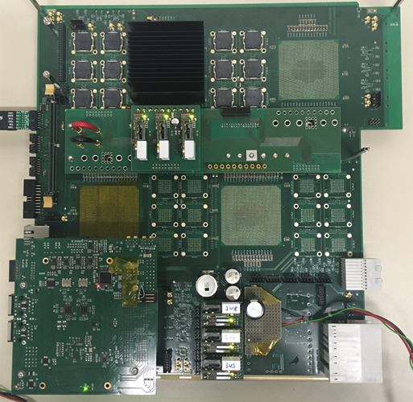
L1Topo @ Phase-1
← jFEX prototype
ATCA module
Input fibres via Zone 3
24 12-way opto devices
Four processor FPGAs
(one currently mounted)
Control on mezzanine
Successfully tested @CERN
New L1Topo based on jFEX mainboard with
Two processors with twelve 12-way optos each
Extension mezzanine with added electrical out to CTP

Slide 5
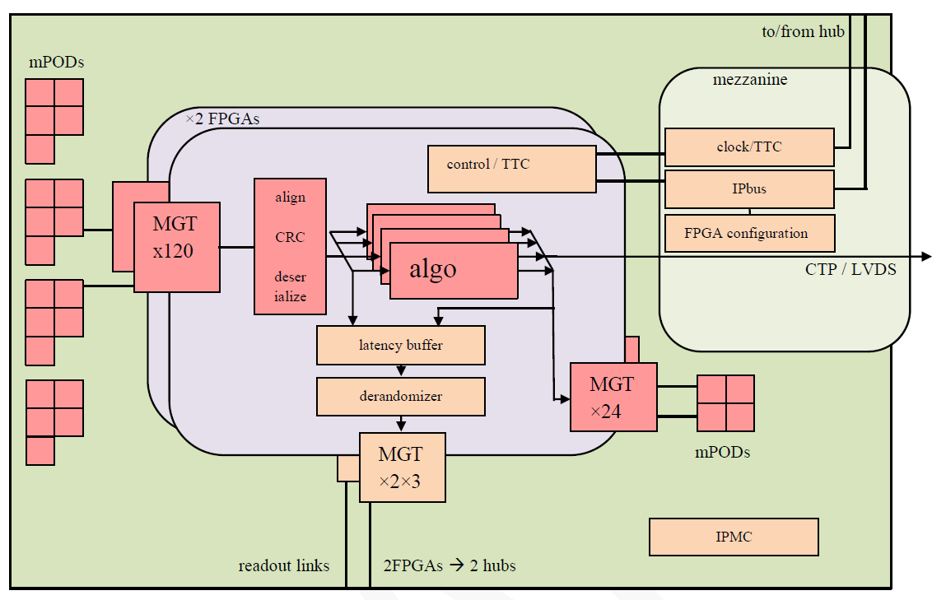
L1Topo module block diagram

Slide 6
L1Topo @ Phase 1, some details
ATCA modules compatible to the L1Calo Phase-1 ecosystem
L1Calo standard ROD & clock distribution
L1Calo standard Zone 3
120 input fibres per FPGA processor FPGA
24 output fibres per FPGA processor FPGA
Designed for mixed 11.2/12.8 Gbps environment
Electrical and optical output to CTP
Electrical output via mezzanine / front panel
Some, but limited inter-FPGA connectivity (latency!)
That’s basically the maximum possible with current technologies
3 L1Topo modules were initially planned for Phase-1
  2 × topology
  1 × hit merger for L1Calo multiplicity triggers
Further: see slides on L1Topo specification task force

Slide 7
Interfaces to L1Calo and Muons
Optical multi fibre bundles, via MPO/MTP in Zone-3
Receivers are Foxconn/Broadcom AFBR-824, 14 Gb/s
FPGAs support up to 16 Gb/s
System designed for mixed 11.2 and 12.8 Gb/s operation
  Required by xFEX constraints
  Muons ?
For latency reasons 8b/10b encoding supported only
L1Topo specifications task force (Steve H.) has set requirements regarding data volume into L1Topo
Finer details of data contents / Trigger Objects (TOBs) and formats to be defined
Report on specifications taskforce activities and results at recent L1Calo meeting, and draft requirements document:
https://indico.cern.ch/event/598198/contributions/2483149/attachments/1419514/2174908/topo170228.pdf
https://indico.cern.ch/event/598198/contributions/2483149/attachments/1419514/2174678/toporequirements.pdf

Slide 8
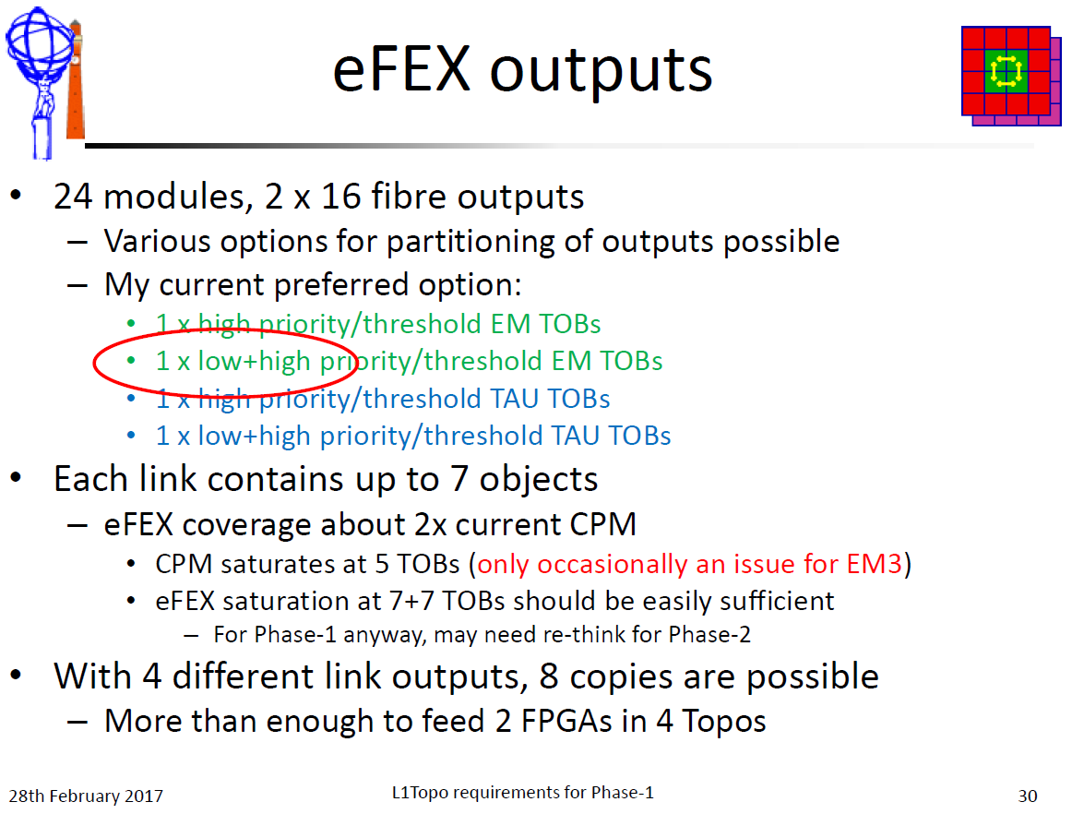
Data contents… example…

Slide 9
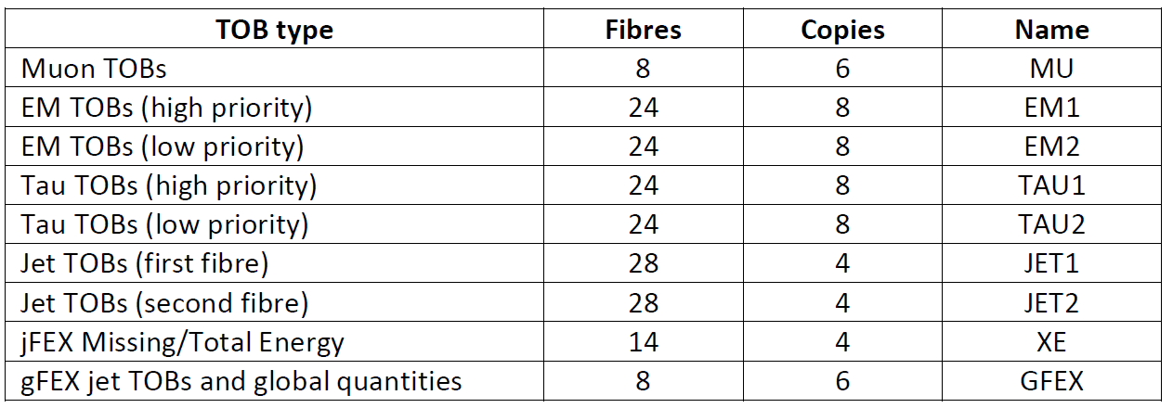
Data into L1Topo, summary
Maximum number of data (in terms of fibres) supplied by respective processor systems. Ideally one copy of data supplies one L1Topo processor FPGA exclusively.
Here direct outputs from upstreams processors are assumed. No optical splitting.

Slide 10
Allocation of L1Topo input bandwidth
Assume 3 L1Topo modules
Two processor FPGAs each
Allocation to modules:
Multiplicity based triggers
Simple, few-TOB-type algorithms
Heavy stuff, require it all…

Slide 11
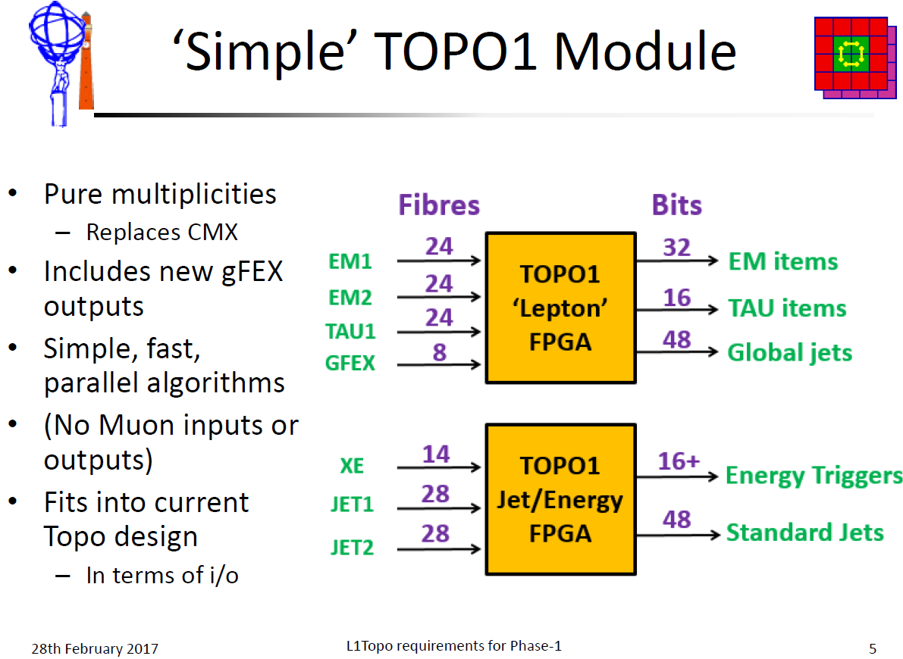
How to get data into L1Topo (1)

Slide 12
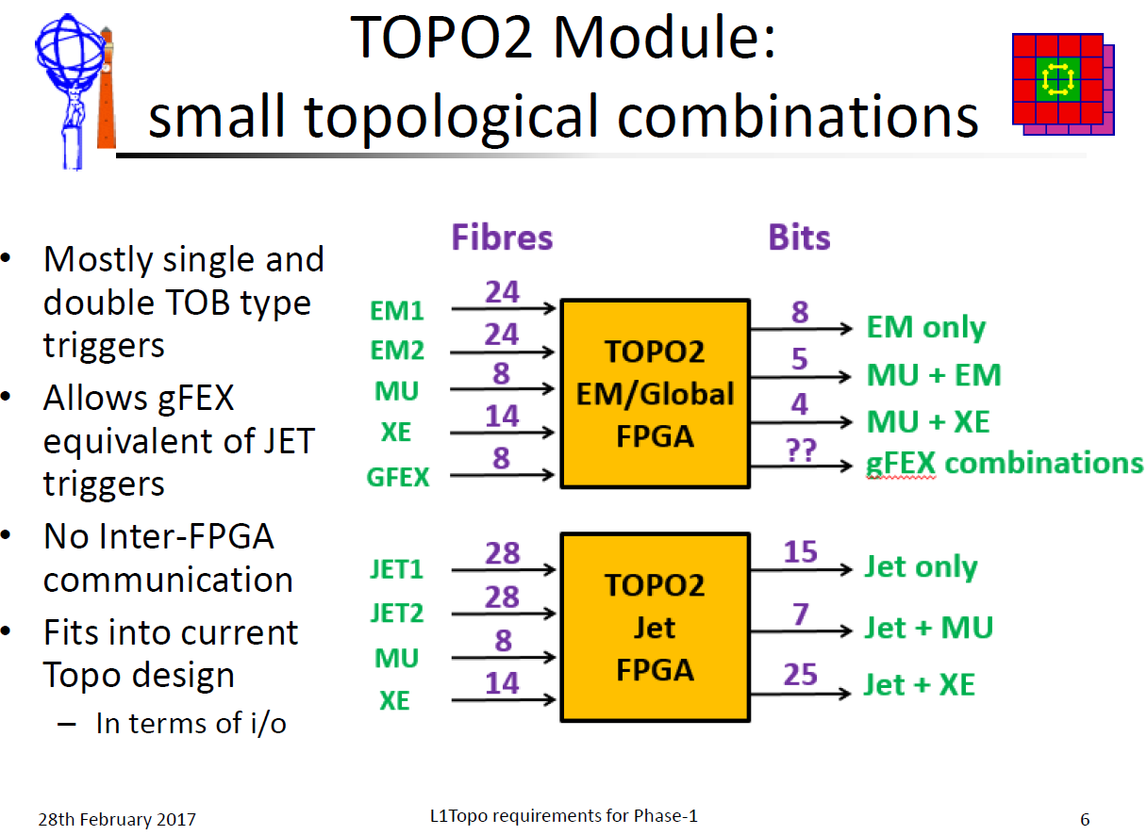
How to get data into L1Topo (2)

Slide 13
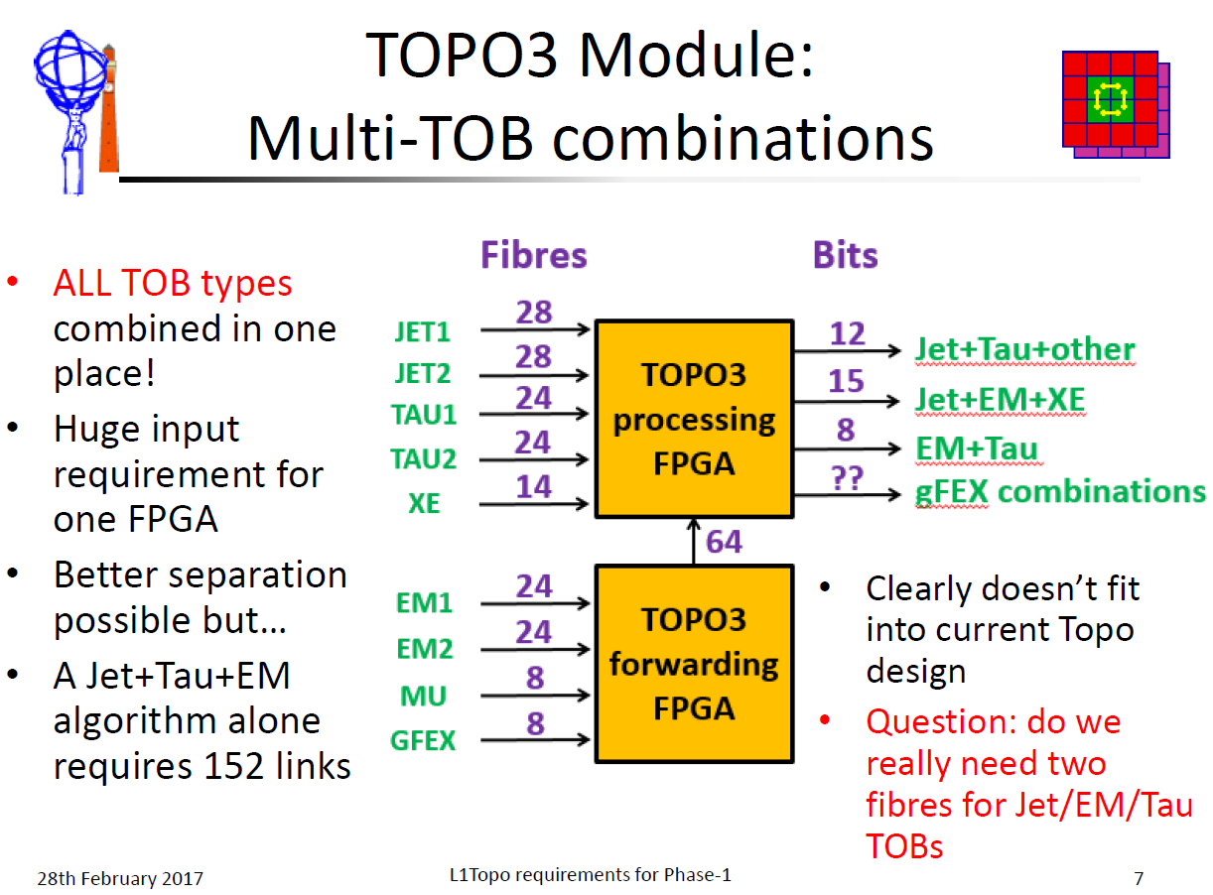
How to get data into L1Topo (3)

Slide 14
L1Topo input bandwidth
Current design is providing maximum bandwidth achievable with current technology
TOPO3 module “need it all” won’t work
requiring inter-FPGA bandwidth above 600 Gb/s
FPGAs have a maximum of ~200 Gb/s bandwidth in terms of parallel I/O.
Additional latency on inter-FPGA links is an issue anyway
Need to work out what data are actually required in trigger combinations with all/many TOB types.
Work ongoing

Slide 15
Status of h/w development
New L1Topo is jFEX based
jFEX shown to work well in current incarnation (1 FPGA)
jFEX programme ongoing ... Prototyping … review… preproduction… → further input into L1Topo programme
Real work:
transformation jFEX → L1Topo can start soon (B.B.)
Paper work:
Engineering specs meant to be available April, 2017 – slight delay…

Slide 16
Backup slides

Slide 17
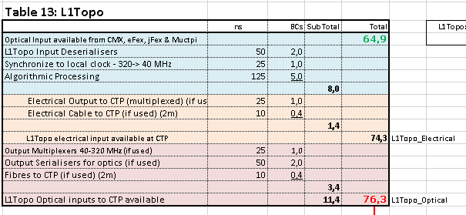
Latency at Phase-1
TDR
figures
Latency is tight
Inter-FPGA fan-out is part of algo latency ! ~2BC ?
Incoming signals on latency critical path (Muons / NSW) might bypass inter-FPGA fan-out (upstream duplication)
Check input MGT/deserialization latency assumptions against current reality (Topo I)
Electrical fast output path available (limited bandwidth)

Slide 18
Phase-2
Seems that old plans for forward compatibility to Phase-2 have become obsolete.
Therefore no Phase-2 slides in this presentation
However, please note that there is plenty of optical output bandwidth available (up to 600Gb/s per L1Topo module) which is certainly not required into a Phase-1 style CTP.
So probably well prepared for a new lease of life at Phase-2

