Slide 1
L1Topo requirements for Phase-1
Long established task-force to outline Topological Trigger module requirements in Run-3
There has been another long hiatus
But the end is (possibly) in sight
Many thanks to Ian and Robin for kicking me out of my previous lethargy
Summary
All information now gathered (almost)
Draft document complete (almost)

Slide 2
Outline of document
Topo input numerology
All the FEXes
Also MUCTPI
Trigger requirements
Topological Triggers
Non-topological triggers (thresholds, multiplicities)
Strawman Topo Connectivity
How does it fit into current design?
How does it fit into upgraded design?
How do we deal with commissioning period?
Red as currently missing!

Slide 3
Outline of Talk
Will only cover the newer material
Original details are provided in the backup slides
Previously covered:
FEX output content
Analysis of simple multiplicity trigger requirements
Covered today:
Analysis of current topological trigger usage
Assignment of topological triggers to Topo modules

Slide 4
‘Typical’ Topological Menu
TOB types | Approximate number of Algorithms | Physics Case | Location
MU only | 40 | B Physics and S.M. J/psi | MUCTPI
EM only | 8 | J/psi electron | TOPO 2
Jet only | 15* | SUSY, Exotics (MJJ) | TOPO 2
MU + XE | 4* | Exotics (Late) | TOPO 2
MU + EM | 5 | Exotics (LFV) | TOPO 2
MU + Jet | 7* | B-tag | TOPO 2
Jet + XE | 25* | Higgs, SUSY (KF) | TOPO 2
MU + Jet + Tau | 3* | Higgs (Disambiguation) | TOPO 3
EM + Jet + Tau | 3* | Higgs (Disambiguation) | TOPO 3
XE + Jet + Tau | 6* | Higgs (Disambiguation) | TOPO 3
XE + Jet + EM | 15* | J/psi electron (tag/probe) | TOPO 3
EM + Tau | 8 | Exotics (LLP) | TOPO 3
 | * plus more using gFex

Slide 5
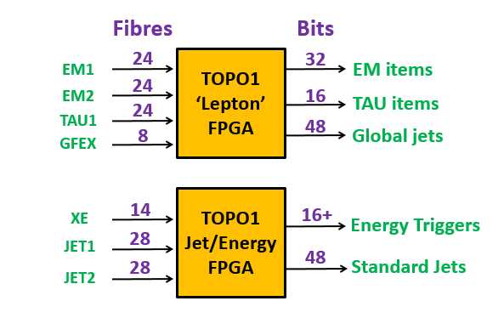
‘Simple’ TOPO1 Module
Pure multiplicities
Replaces CMX
Includes new gFEX outputs
Simple, fast, parallel algorithms
(No Muon inputs or outputs)
Fits into current Topo design
In terms of i/o

Slide 6
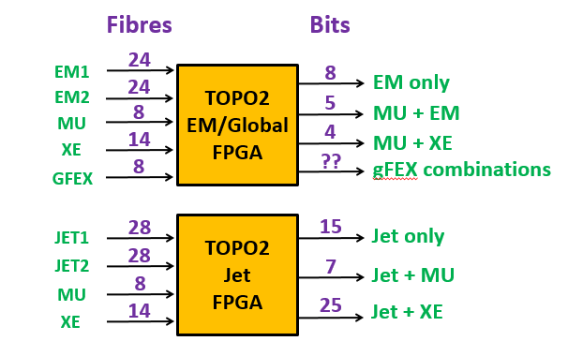
TOPO2 Module: small topological combinations
Mostly single and double TOB type triggers
Allows gFEX equivalent of JET triggers
No Inter-FPGA communication
Fits into current Topo design
In terms of i/o

Slide 7
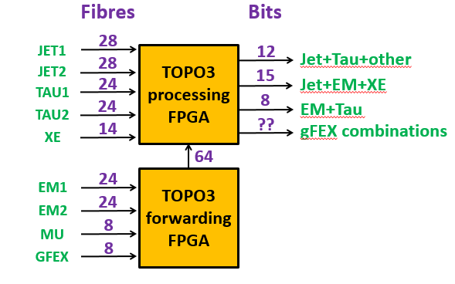
TOPO3 Module: Multi-TOB combinations
ALL TOB types combined in one place!
Huge input requirement for one FPGA
Better separation possible but…
A Jet+Tau+EM algorithm alone requires 152 links
Clearly doesn’t fit into current Topo design
Question: do we really need two fibres for Jet/EM/Tau TOBs

Slide 8
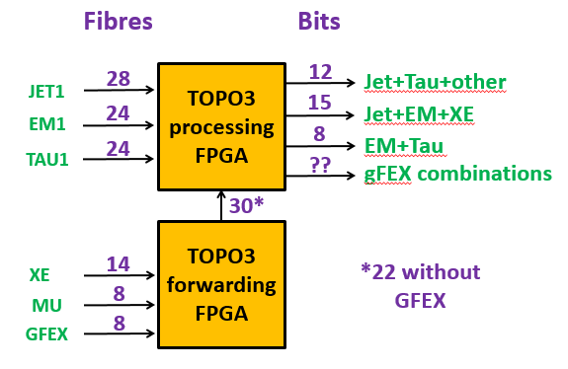
TOPO3 in current design
If we can get away with 6/7 TOBs per EM, TAU, JET…
Still a difficult ask for current Topo
Also requires data forwarding, many algorithms will be slow
Latency problems?

Slide 9
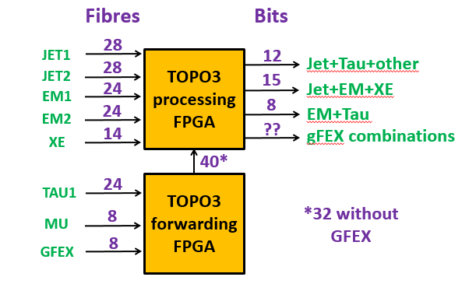
TOPO3 in upgraded design
TAU fibre is (probably) least sensitive to overflows
But Tau Higgs trigger is one of the big users of Topo, so be careful
Need to study algorithms and compromises
Most of these triggers using truncated lists anyway?

Slide 10
Commissioning at Phase-1
Legacy
Simple Items
CTP IN
CTP
Legacy
Topo Items
OLD TOPO
Proposal for first week, month (year?):
Old topo(s), maintain Run-2 Topo items
Topo 2+3, develop and test Run-3 Topo items
Topo 3, develop and test simple Run-3 items
Phase-1
Topo Items
TOPO2+3
Phase-1
Simple Items
TOPO1

Slide 11
First n days of Run-3
New MUCTPI will be in place
Timing in possible during LS2 (probably)
Muon multiplicities + topo algorithms available on day 1 via new route
Old style Muon to TOPO connectivity gone
Muon + other TOB triggers not possible in legacy Topo
FEXes and new Topo will be in place (hopefully!)
But my feeling is much calibration still required with beam
Individual super-cell timing calibration is basic minimum
Will need to verify that NO super-cells are triggering early
Beyond timing, many other ‘calibrations’ are necessary
Filters, energy, pedestal correction, threshold/isolation tuning
Until all these are studied with data, new system is unlikely to out-perform legacy trigger
How long will this take?

Slide 12
Conclusions
Draft document nearing completion
Current version attached to agenda
Next stage, feedback from task-force
Via email and a meeting soon…
General conclusions on Topo requirements
Current Topo design could be stretched to accommodate Phase-1 inputs
But with inevitable compromises in some algorithms
An upgraded design with more inputs resolves many of these issues
Maybe with some smaller compromises, should be studied
But latency is likely to be critical for some algorithms with either design

Slide 13
Backup
Talk from previous L1Calo Joint Meeting

Slide 14
L1Topo for Phase-1 Taskforce Latest News
Updated version of talk given in TDAQ week:
https://indico.cern.ch/event/538558/contributions/2287652/attachments/1345521/2028470/topo160929.pdf
Warning, much of that talk wrong
All errors/misunderstandings are/were mine
Taskforce has met three times so far
Still have work to do

Slide 15
Reminder: Topo Requirements Task Force - who not to blame
Physics and Trigger Requirements
Brian Petersen, Martin Zur-Nedden
Topo and Central Interfaces
Katharina Bierwagen, Thilo Pauly, Uli Shaeffer
FEX Interfaces
Michael Begel, Weiming Qian, Elena Rocco
Phase-2 and interested parties
David Sankey, Robin Middleton, Murrough Landon

Slide 16
Next steps (from 2nd meeting with notes)
I will set up twiki
Also will try to have a first shot at defining i/o for a ‘counting’ Topo module
Maybe some, but not all simple thresholds can be done here
Starts to define grouping of information on FEX outputs
Would still like more input on Topo/CTP i/o
Next meeting when I’ve made some progress!
Not done
First attempt will be presented today
I’m still a bit hazy here – next meeting
Held, now I have more to do…

Slide 17
(Most of) rest of today’s talk
Concentrate on Run-3 commissioning phase
In many ways the most demanding period before Phase 2
Are the current module specifications and numerology sufficient?
particularly 3 Topo Processors
What’s the best way to organise the Topo Modules and inputs
For convenience
For commissioning purposes
Do they fully address trigger needs?
Light on details of output, but hopefully good first guess at inputs to Topo

Slide 18
Commissioning at Phase-1
Is it feasible to start Run-3 with minimal legacy trigger items?
If so, for how long?
How do we commission new Topo algorithms?
Note that includes the trivial ones!
This has proved a difficult issue in Run-2
And we’ll be commissioning eFEXs, jFEXs, gFEX in parallel
How do we use (possibly) limited CTP inputs to do all of these things simultaneously?
Do we need a more flexible Level-1 menu?
Or, more ambitiously, run all relevant Run-2
Triggers, while also adding new ones

Slide 19
Phase-1 Commisioning
CMX x 12
electrical links
optical links
CTPIN
CTPIN
optical or
electrical links
CTPIN
CTP
MUCTPI
TOPO x 3 (+?)
Actually legacy Topos will run in parallel with three new Topos
EFEX x 24
JFEX x 7
GFEX

Slide 20
The big picture
Legacy
Simple Items
CTP IN
CTP
Proposal for first year:
Old topos, maintain Run-2 Topo items
Topo 1+2, develop and test Run-3 Topo items
Topo 3, develop and test simple Run-3 items
Legacy
Topo Items
OLD TOPO
Phase-1
Topo Items
TOPO * 2
Phase-1
Simple Items
TOPO 3

Slide 21
Assumptions
Phase-1 Legacy menu is broadly similar to current menu
Not too unreasonable, if LHC luminosity is really restricted to 1.7x10³⁴ for the next few years
Details will of course change, and there will be fine tuning
But in some ways things get simpler if luminosity has no big ramp-ups within one year
Legacy Topo may need streamlining
Perhaps more controversial
Probably needed to reduce number of Level-1 items, Topo outputs
My feeling is that once Topo usage becomes more standard, will focus in on ‘golden’ algorithms
Rather than having a range, to test out different options
You can see this sort of development in the stabilisation on ‘preferred’ non-Topo thresholds

Slide 22
Consequences
We don’t have to think too much about TOPO1 in the first year
Just consolidate key Topo algorithms into one (?) ‘traditional’ Topo processor
TOPO 1+2 can be used to mirror old Topo items, but with FEX inputs
The devil is in the details here…
…but not for this talk
TOPO3 should implement the Phase-1 equivalent of the legacy simple thresholds
With similar range and multiplicities to the current menu
Plus some extra ones due to new capabilities (eg gFEX)
Will concentrate on this for rest of talk
To do this we have to first understand the current menu

Slide 23
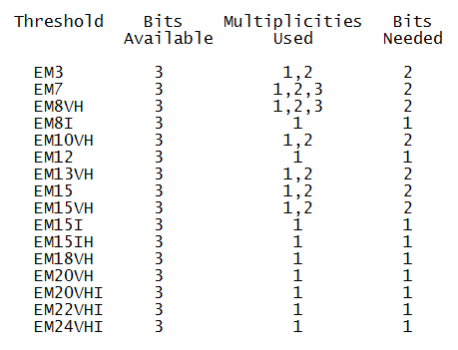
EM threshold usage
Electron/gamma CMX provides 48 bits
16 x 3
Multiplicities 4-7 are never used
Only 24 bits of the output are really used
Some thresholds are just alternatives for different luminosities
Would not really be needed if the menu could be changed more flexibly during year

Slide 24
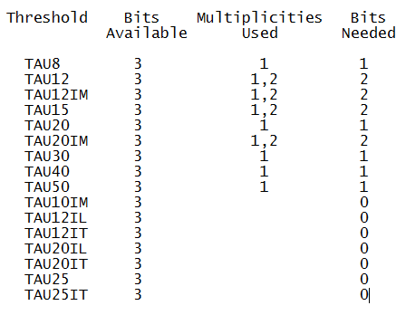
Tau threshold usage
Tau CMX provides 48 bits just like EM
Multiplicities 3-7 are never used
Only ~15 bits of the output are really used
The ‘IL’, ‘IT’ are useful labour saving devices for comparing isolation options
But can easily be done via emulation offline
TAU8 is just for Background
Other low thresholds soon to be superseded by Topo algorithms
NOT USED

Slide 25
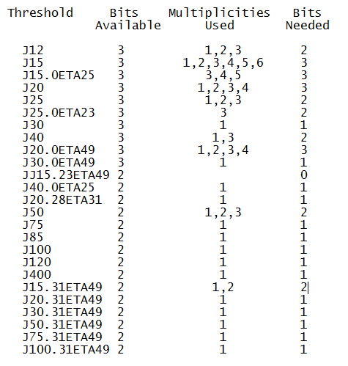
Jet threshold usage
Jet CMX provides 60 bits:
15 x 2 plus 10 x 3
More extensive usage of most thresholds, multiplicities
Still only ~40 bits of the output are really used
2-3 thresholds either not used, or for very specialised usage
Probably more naturally performed in a Topo algorithm

Slide 26
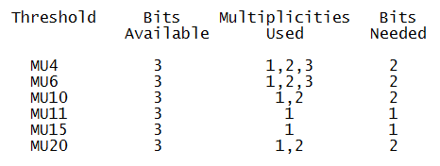
Muon threshold usage
MUCTPI provides 18 bits:
6 x 3
Also no usage of high multiplicity bit
Only 10 bits of the output are currently used

Slide 27
Energy Thresholds and Heavy Ions
Total Energy:
16 thresholds available
Rarely used in proton-proton
Probably too few for Heavy Ions
Missing Energy:
16 thresholds available
Only 8 are used in current menu
And half of them are back-up/fall-back thresholds
No real need for back-up if menu were more flexible
Missing Energy Significance:
8 thresholds available
Only 2 used in anger
Surely the natural territory of Topo and (eventually) gFEX
Note that the needs of Heavy Ions and proton running are quite different
But we only ever have to support one at a time (hopefully)
Prefer not to clutter up menu/Topo usage with both sets at the same time

Slide 28
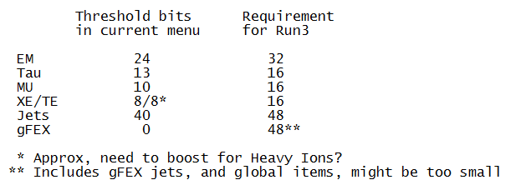
Summary of Lessons from current non-Topo items
The menu doesn’t come near to occupying all the bits we currently provide
Though it may very well be occupying all the CTP inputs!
Allowing some breathing space for the Run-3 TOPO 3 outputs, could look something like:
What about the inputs?

Slide 29
Overall strategy
Each type of FEX provides several copies of the same set of data (TOBs etc)
These copies can be sent to a individual Topo/FPGAs
But not necessarily ALL outputs to EVERY Topo/FPGA
Only those that need it for the algorithms they perform
Ideally can group algorithms into logical sets requiring subset of TOBs
To avoid extra latency in FPGA-FPGA link
Easy for simple thresholding algorithms in TOPO3
May be impossible to avoid in some more complex cases
FEX
TOPO
TOPO
FEX
TOPO

Slide 30
eFEX outputs
24 modules, 2 x 16 fibre outputs
Various options for partitioning of outputs possible
My current preferred option:
1 x high priority/threshold EM TOBs
1 x low+high priority/threshold EM TOBs
1 x high priority/threshold TAU TOBs
1 x low+high priority/threshold TAU TOBs
Each link contains up to 7 objects
eFEX coverage about 2x current CPM
CPM saturates at 5 TOBs (only occasionally an issue for EM3)
eFEX saturation at 7+7 TOBs should be easily sufficient
For Phase-1 anyway, may need re-think for Phase-2
With 4 different link outputs, 8 copies are possible
More than enough to feed 2 FPGAs in 4 Topos

Slide 31
jFEX outputs
7 modules, 4 x 12 Fibre outputs
2 x 12 from Jet/Energy FPGAs (Missing Energy etc)
2 x 12 from pure Jet FPGAs, separate regions
Suggest 1 link for Energy TOBs, 2 per jet TOBs
1st Jet link, all TOBs up to a limit
2nd Jet link, overflows, if any
Each Jet link contains up to 6 TOBs (??)
jFEX FPGA region is <2 x current JEM coverage
JEM saturates at 4 TOBs (currently rare except in HI)
Saturation at 6+6 should be sufficient in most regions
Probably also for Forward region
With 3 different link outputs per FPGA, only 4 full copies
Enough to feed 2 FPGAs in 2 Topos
Could sacrifice some overflow links for extra energy/priority jet links

Slide 32
gFEX outputs
1 module, 4 x 12 Fibre outputs
Similar to jFEX, 1 x 12 for global quantities and 3 x12 for jets, of various types
Not so easy to describe, as many different jet and global algorithms in parallel
However, Michael seemed happy with 8 Fibres to each Topo FPGA
2 from global, 2x3 from local
Less easy to predict link occupancy
No current system to make an educated guess
Many different objects
But hopefully 8 links is generous enough
With 2 different link outputs per FPGA, 6 copies are possible
Easily sufficient for 3 Topos

Slide 33
TOPO 3 Connectivity (aka Simple Topo)
Fibres
Bits
24
Topo 3
Lepton
FPGA
32
EM low
EM
24
EM high
16
TAU
24
TAU high
(16)
(8)
MU
(MUCTPI)
Need to work out CTP connectivity
electrical and/or
optical
Low latency not such an issue here (probably)
Note, no TAU low threshold/priority inputs
Only needed by Topo algorithms
14
j Energy
Topo 3
Jet/Energy
FPGA
16
28
Energy
jJET high
28
jJET low
48
j JETs
2
g Global
48
6
g JETs
g JET

Slide 34
Comments on Simple Topo
Looks feasible in terms of inputs
But already clear input fibre count is tight per FPGA
Already at ~80 inputs just for jet inputs
This looks tighter to me now I’ve understood the jFEX outputs more fully
Note that already reduced maximum required FEX output copies from 6 to 5
Further reduction possible:
eg don’t need high priority EM/TAU elsewhere (?)

Slide 35
Topo Topos Connectivity
Next stage of the process
Need to understand what inputs needed by each Topo algorithm
Partition similar algorithms into FPGAs
Use input link numerology suggested by TOPO 3, see if it is suitable for Topo Topos
Some algorithms require many inputs
But there mayb be restrictions too in terms of unnecessary combination
Are high priority/threshold EM objects need at all?
But jets on their own already take up a large number of links
Do any algorithms overflow the 80 link input per FPGA?
I’m hoping not many
In these cases FPGA-FPGA link is required, plus extra latency
Or some other alternative…

Slide 36
A new Topo revision
Already decided to increase Topo output bandwidth
For Phase-2 compatibility
Could also augment Topo capacity
Move to Ultrascale FPGA
120 fibre inputs
More processing resources
Current Topo is already very stretched
Obviously a ‘bigger’ Topo is going to be easier to handle
Less concern about input intricacies
Probably removes need for FPGA-FPGA added latency
But is it necessary?
Difficult to be sure, we need to study further

Slide 37
A brief slide on Phase-2
The Task Force is meant to have at least one eye on Phase-2
Future re-usability, of Topo, if possible
My Opinion
Topo (Level-0/1 or whatever) is NOT so important to architectural decisions
Compared to the rest of ATLAS, it’s not a cost driver
Complex and costly, yes, but small in number
Compared to replacing millions of channels of readout, etc
If you need a new module with a few more links and a bigger FPGA, it’s probably not such a big issue in terms of hardware design
Once the initial design is well validated
The real difficulty in Topo is not the hardware, it’s the firmware
This is probably true independently of the exact number of i/o links etc
Replacement strategy for ATLAS lifetime
OPAL had working lifetime of 10 years, also one complete CTP replacement after ~5 years
We have no experience (yet) of the working lifetime of these complex modules
Replacing FEXes/Topo/CTP and similar every few years may be a worthwhile exercise anyway

Slide 38
A brief slide on Phase-2
The Task Force is meant to have at least one eye on Phase-2
Future re-usability, of Topo, if possible
My Opinion
Topo (Level-0/1 or whatever) is NOT so important to architectural decisions
Compared to the rest of ATLAS, it’s not a cost driver
Complex and costly, yes, but small in number
Compared to replacing millions of channels of readout, etc
If you need a new module with a few more links and a bigger FPGA, it’s probably not such a big issue in terms of hardware design
Once the initial design is well validated
The real difficulty in Topo is not the hardware, it’s the firmware
This is probably true independently of the exact number of i/o links etc
Replacement strategy for ATLAS lifetime
OPAL had working lifetime of 10 years, also one complete CTP replacement after ~5 years
We have no experience (yet) of the working lifetime of these complex modules
Replacing FEXes/Topo/CTP and similar every few years may be a worthwhile exercise anyway
Recent News, Phase-2 Decision:
Phase-2 Topo architecture
likely to be new/different
No need to think too hard
about forward compatibility

Slide 39
Conclusions
Proposal for Simple Topo connectivity made
Had one iteration with the task force, leading to some updates
Need to understand connectivity to CTP
If reasonable can move onto Topo algorithm connectivity
Starting to look at current and potential future Topo algorithms
Run 3 setup seems feasible with current module specifications
But recent understanding of jFEX outputs makes it look tighter than I’d originally thought
One potential big pitfall: latency
it might all be a lot easier with new modules containing more links
Would probably lead to simpler cabling, and less need to distinguish dedicated Topo modules
SIMPLE IS GOOD
Maybe some need for fibre spaghetti remains

