Slide 1
Installation and Commissioning Plans for the jFEX
(Katharina Bierwagen)
Uli/Julio

Slide 2
Agenda
Introduction
jFEX Status
Hardware Availability
Surface Test Facility
Installation
Commissioning
Summary

Slide 3
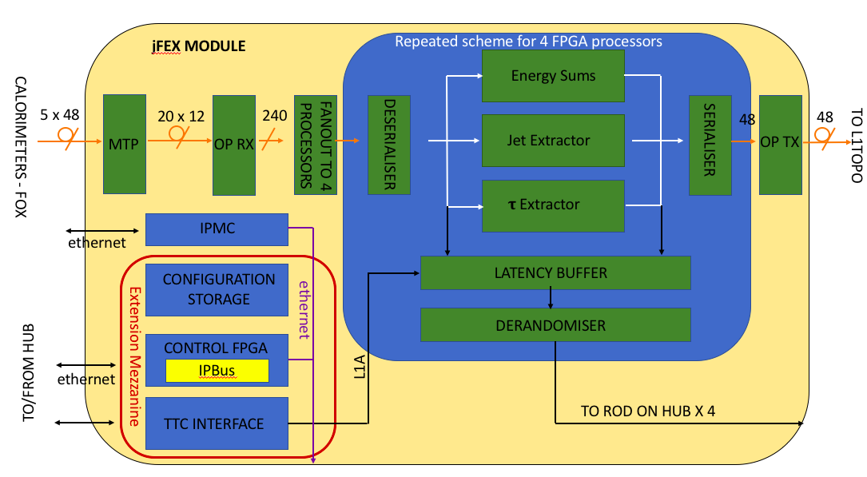
Introduction
jFEX identifies jet candidates and calculates ${Σ\text{E}}_{T}$and $E_{T}^{miss}$ for each BC
|η|< 4.9 with different granularities
6 modules to be built
Hardware details
ATCA board
4 Xilinx UltrascalePlus FPGAs per module
XCVU9P-2FLGA2577E
Up to 120 MGTs per FPGAs
24 MiniPOD: 20 RX + 4 TX
Modular design
Mezzanines
Power
Control
jFEX functionality – Block Diagram

Slide 4
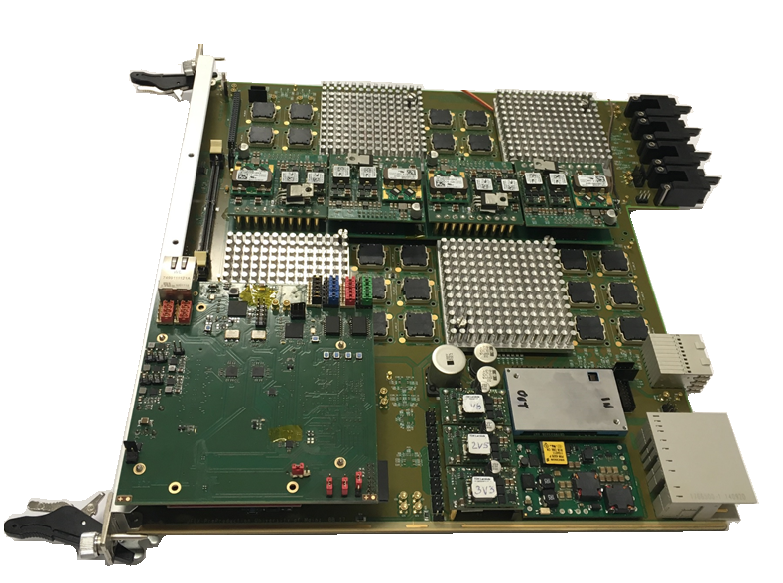
jFEX Status
jFEX Final Prototype
Final Design Review took place end of May
Firmware: May 29
https://indico.cern.ch/event/728398/
Hardware: May 30
https://indico.cern.ch/event/728400/
Green light for producing the jFEX Pre-Production modules on June 12
Ongoing PCB production
Order of all components placed
Expect delivery from assembly company: beginning of October
Firmware
Ongoing integration of infrastructure firmware (MGTs, board control, IOs and etc.) and algorithms

Slide 5
Hardware Availability (Plan)
jFEX First Prototype – Currently at CERN (STF)
Equipped with one UltraScale FPGA
jFEX Final Prototype – Currently in Mainz
Equipped with four UltraScale+ FPGAs
jFEX Pre-Production Module – Available from November 2018 onwards
Pre-Production module will be used as spare
jFEX Production Modules – Available from May 2019 onwards
9 (+ 1) modules
6 to be installed
3 (+ 1) spares

Slide 6
Surface Test Facility (1)
Final Prototype = Pre-Production Module = Production Module
No hardware changes are foreseen from prototype to production module
Initial integration tests with other systems can start at anytime with Final Prototype
And with Pre-Production by November
Combined tests with TREX schedule for beginning of September (in Heidelberg)
Combined tests with ROD (Hub) to take place soon

Slide 7
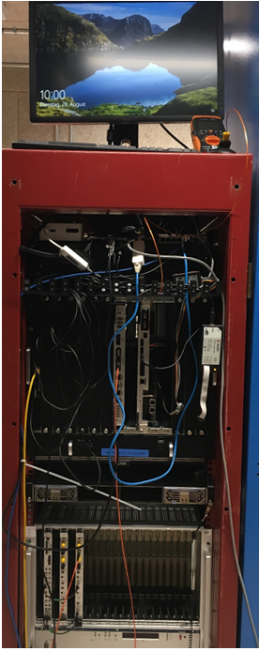
Surface Test Facility (2)
jFEX setup on the STF
Setup ready for tests with jFEX First Prototype and FTM since July
Tests of optical links, TTC clock reception, IPBus and etc. were performed
jFEX Final Prototype is currently in Mainz, but will be shipped back to CERN soon
What can and cannot be done elsewhere?
Will we be able to perform tests with some calorimeter boards?
How/what will be the DCS setup on the STF?
FTM
jFEX
“TTC system”

Slide 8
Surface Test Facility Pre-Production Module
Validation of Pre-Production module will take place at the STF
Smoke tests and basic validation of board optical/electrical links (IBERT) to be done in Mainz
Validation of all optical/electrical inputs/outputs simultaneously (IBERT and formatted data)
Power consumption
Ripple measurement
Thermal dissipation
LHC clock reception
MGTREF clock jitter measurement
Validation of the backplane high-speed links
Readout and TTC data
Latency measurement
IPMC
Firmware consolidation
Tests with integrated firmware (infrastructure and algorithms)
Latency measurement
Combined tests with other parts of the system

Slide 9
Surface Test Facility Production Module
Initial production modules acceptance tests will take place in Mainz
Smoke tests and basic validation of board optical/electrical links (IBERT)
Finalization of production modules acceptance tests on ATCA crate with HUB/ROD and/or FTM
Same test list of the Pre-Production module
Full slice test from Latome/TREX via jFEX to Topo
As much as possible inputs
Formatted data
With all possible infrastructure parts
Hub/ROD, FELIX, IPBus, DCS and etc.
Final evaluation on power consumption and cooling with closed shelf
Integration with “L1Calo STF partition”

Slide 10
USA15 Installation (1)
PC*
jFEX
Topo
TileFOX E or TileFOX F
4 fibres through the backplane
1 fibre via front panel
RTM
jFEX connections
LATOME
TREX
FOX
Hub/ROD
FELIX
Topo
Installation schedule for December 2019
Initial tests
Verification of board functioning after transport
Establishment of board communication and control
IPbus and DCS
Integration tests with HUB/ROD
Combined tests with calorimeters
TTC data, LHC clk, IPbus and etc.
To be defined?
HUB/
ROD
To be installed before jFEX
ATCA
1 fibre via front panel
FELIX
* To be used during standalone tests at the beginning of installation
Ideally, similar to what was done in STF during 2018 and 2019

Slide 11
USA15 Installation (2)
Starts in November 2019
Followed by 3 months re-integration & commissioning
What is the installation sequence?
Will the crate be already in USA15?
With all FOX connections done?
Or will it be transported from the STF with all boards?
When will the Hub/ROD be installed?
Will we take care of transportation and fibre connection ourselves?
Should we perform tests with the Prototype/Pre-Production module in USA15 before installation?

Slide 12
Commissioning
Validation of (FOX) input mapping
Integration with ATLAS partition
Online monitoring
Combined tests with calorimeter
Timing calibrations
Pre-beam commissioning with cosmics
Commissioning with beam
Validation with bit-wise simulation
Cross-comparison with legacy system

Slide 13
Summary
Ongoing production of the jFEX Pre-Production module
Pre-Commissioning to take place during 2018 and 2019 at the STF
Setup ready on the STF for jFEX
Finalization of production modules acceptance tests
Installation in USA15 scheduled for November 2019

Slide 14
jFEX Schedule

