Slide 1


Phase-I L1Topo
Status and Plans
K. Bierwagen
Johannes Gutenberg University Mainz
For the L1Topo Phase-1 Team
November 26, 2018

Slide 2
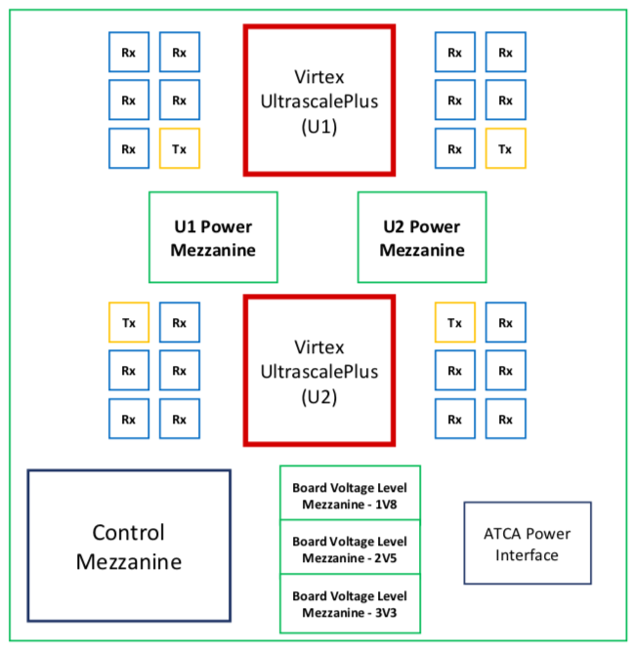
Introduction
L1Topo based on jFEX hardware-wise
  2 Ultrascale+ FPGAs per module
  118 input fibres per processor FPGA (6.4, 11.2 and 12.8 Gb/s)
  24 output fibres per processor FPGA (6.4 and 12.8 Gb/s)
Inter-FPGA connectivity 64 Gb/s (latency!)
Control on mezzanine
Electrical and optical output to CTP
3 ATCA modules
Prototype at CERN since end of October `18

Slide 3
L1Topo Status
Preliminary design review took place in November 2017
  https://indico.cern.ch/event/676491/
L1Topo currently at STF for testing together with the jFEX final prototype
Final design review scheduled on January 23rd 2019
Firmware
  Ongoing integration of infrastructure firmware (MGTs, board control, IOs and etc.) and algorithms

Slide 4
Surface Test Facility (1)
Final Prototype = Pre-Production Module = Production Module
No hardware changes are foreseen from prototype to production module
Initial integration tests with other systems can start at anytime with prototype
Combined tests with jFEX already ongoing
  Scheduled dedicated test week for software and firmware mid of December with all experts present
Combined tests with MUCTPI and CTP still need to be scheduled

Slide 5
Surface Test Facility (2)
Setup ready for tests with L1Topo prototype, jFEX and FTM since beginning of November
  Tests of optical links, TTC clock reception, IPBus and etc. were performed
Aim to test and validate full module functionality at STF except:
  Concurrent operation of all FEXes (all modules), MUCTPI and CTP
  Validation of input mapping
  Final timing calibration

Slide 6
Major Milestones for L1Topo towards Installation
Sep
2018
Nov
2018
Jan
2018
Mar
2019
Mai
2019
Dec
2019
Start of Run-3
0
1
2
3
4
5
0
Prototype in Mainz
Prototype available at CERN/STF
Final Design Review
Production Readiness Review
Production modules available at CERN/STF
Installation in USA15
1
2
3
4
5

Slide 7
Prototype at STF/CERN
Sep
2018
Nov
2018
Jan
2018
Mar
2019
Mai
2019
Dec
2019
Start of Run-3
0
1
2
3
4
5
Prototype in Mainz
Prototype at CERN/STF
Initial validation tests of prototype has been done in Mainz
  Smoke tests and basic validation of board optical/electronical links
Prototype available at CERN since end of October 2018
Validation of prototype currently ongoing at STF/CERN
Integrated test with FTM and jFEX
Validation of all input and output links concurrently
TTC and ROD links
Latency measurement
I2C/IPBus/OPC/DCS tests
Power tests with all interfaces fully active
FDR scheduled for January 23rd 2019

Slide 8
Prototype at STF/CERN
Prototype at STF/CERN
Sep
2018
Nov
2018
Jan
2018
Mar
2019
Mai
2019
Dec
2019
Start of Run-3
0
1
2
3
4
5
Prototype at CERN/STF
Final Prototype = Pre-Production Module = Production Module
Continue validation of prototype/pre-production module at STF/CERN
Integrated test with FTM, FEXes, MUCTPI and CTP
Aim for PRR end of March 2019

Slide 9
Production modules at STF/CERN
Sep
2018
Nov
2018
Jan
2018
Mar
2019
Mai
2019
Dec
2019
Start of Run-3
0
1
2
3
4
5
Production modules at CERN/STF
Installation
Initial acceptance tests will be done in Mainz
  Smoke tests and basic validation of board optical/electronical links
Production modules will be available at CERN Mai 2019
Finalization of acceptance tests on ATCA crate in the STF
Full slice test with all FEXes via Topo to CTP
Integration with „L1Calo STF partition“
Final installation steps planned for December 2019 to maximize time for pre-commissioning at STF
  Followed by 3 month re-integration & commissioning

Slide 10
Summary
Prototype at CERN since end of October
  Integrated tests currently ongoing
  FDR planned for January 23rd 2019
Production modules available at STF/CERN Mai 2019 (Schedule includes 7 weeks contigency)
Final installation steps planned for Dezember 2019

Slide 11
Back-Up

Slide 12
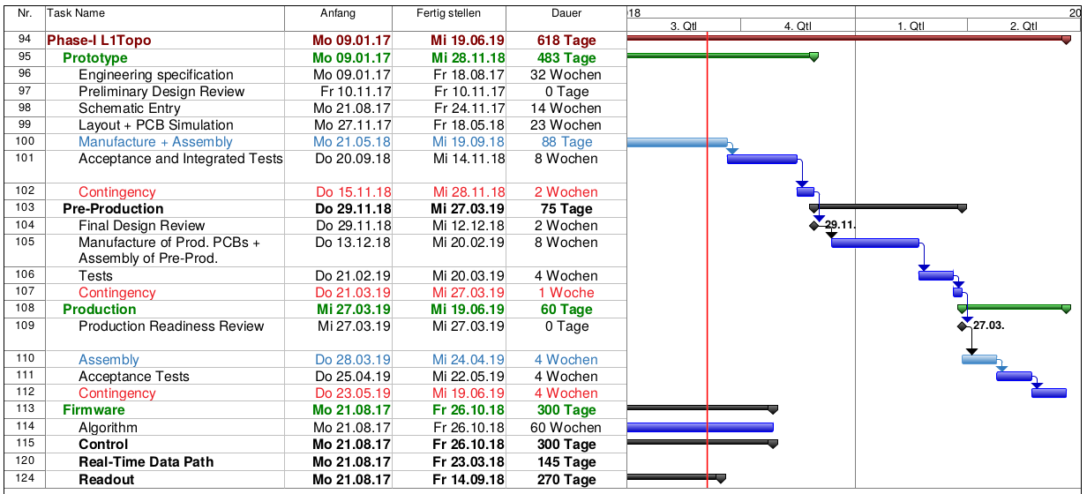
Phase-1 L1Topo Schedule

