Slide 1
jFEX / L1Topo
– Status & Plans (medium term) –
Uli / MZ
Slides by Julio, Katharina

Slide 2
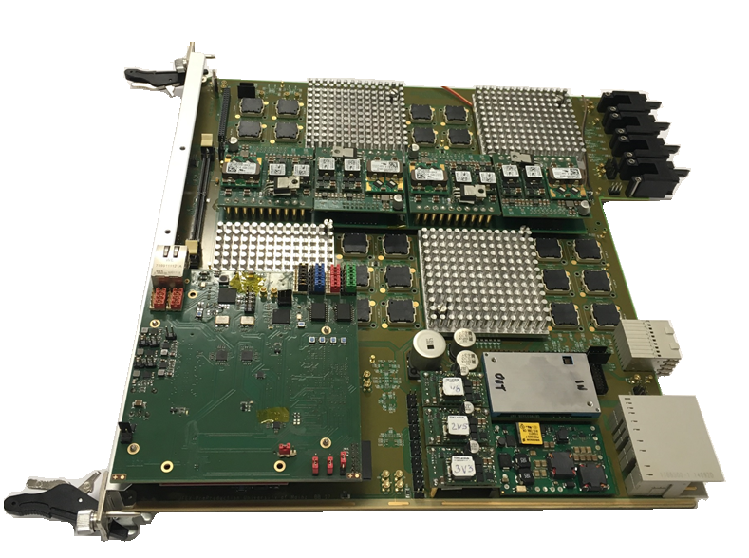
jFEX Status
jFEX Final Prototype
Pre-Production module
Ordered full set of production PCBs (10 pieces),
because of no significant cost impact
Delay at PCB manufacturer, because of long
lead time of PCB material
PCBs at assembly company
Assembly (SMT) being worked on
Some components (THT) were difficult to procure, going out to assembly company today. THT components last assembly step anyway.
Expect to have the board in Mainz early December
Tests of Pre-Production board will be only verification along the lines of prototype tests
No design changes wrt Final Prototype
All components for final production in hands, therefore NO further DELAYS expected at next stage…
Firmware
Ongoing integration of infrastructure firmware (MGTs, board control, IOs and etc.) and algorithms

Slide 3
Hardware Availability (Status/Plan)
jFEX First Prototype – Currently at CERN (STF)
Equipped with one UltraScale FPGA
jFEX Final Prototype – Currently at CERN (STF)
Equipped with four UltraScale+ FPGAs
jFEX Pre-Production Module – Available from mid December 2018 onwards
Pre-Production module will be used as a spare, once production modules have been built
jFEX Production Modules – Available from May 2019 onwards
9 (+ 1) modules
6 to be installed
3 (+ 1) spares

Slide 4
Module tests
Final Prototype = Pre-Production Module = Production Module
No hardware changes are expected from prototype through production modules
Rigorous tests of first and final prototype taken place
in Mainz (power-up, local loopback IBERT, power drain / thermal tests)
In Heidelberg (TREX link tests, IBERT, in September)
At STF (see next slide)
Final Prototype available for system-level tests (integration tests)
Pre-Production from December/ January

Slide 5
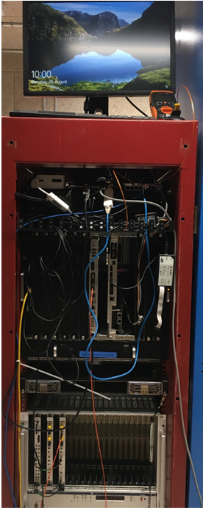
Surface Test Facility
jFEX setup on the STF
Setup ready for tests with jFEX First Prototype and FTM since July
Tests of optical links, TTC clock reception, IPBus and etc. were performed
jFEX Final Prototype was shipped to CERN along with L1Topo prototype. Initial tests done.
Joint test week for jFEX final prototype ≡ Pre-Production and L1Topo with software/firmware integration in week Dec. 10
Expecting to run formatted data jFEX→L1Topo
FTM
jFEX
“TTC system”

Slide 6
Next tests @ STF
System-level tests with all interfacing modules
jFEX and L1Topo (prototype) meant to be at the STF long-term, joint tests possible over long periods . Starting wk. Dec. 10.
IPbus being exercised during all tests
DCS – make use of it as it becomes available. Initial steps (test wk. Dec. 10):
Read some environmental conditions via IPbus
Start using IPMC for reading some basic I2C sensor data
Initial readout tests with Hub/ROD planned for wk. Dec. 10 (Marek)
Start LATOME → jFEX integration asap
Need to discuss LATOME availability and required tests pre-PRR
NEED TO SCHEDULE TESTS WITH THE RESPECTIVE MODULES

Slide 7
Production modules
Expect to get through volume production quickly: No more delays due to component procurement issues
As soon as we get the go-ahead, assembly can start
Bruno expecting to complete ~ 2 modules per week
Going through established test routine in Mainz won‘t take much time
→ expect the production modules to populate the STF quickly once we are through the PRR
AGAIN, NEED TO SCHEDULE TESTS

Slide 8
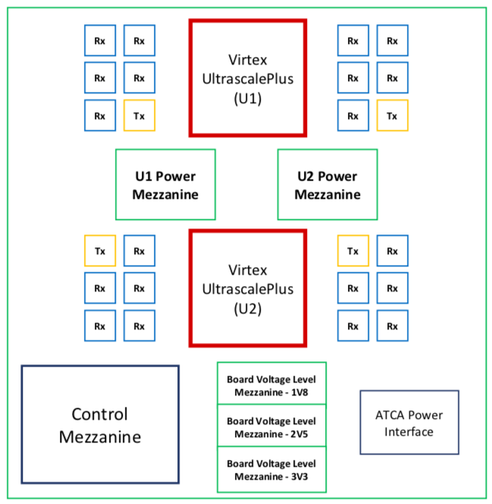
L1Topo Introduction
L1Topo based on jFEX hardware-wise
2 Ultrascale+ FPGAs per module
118 input fibres per processor FPGA (6.4, 11.2 and 12.8 Gb/s)
24 output fibres per processor FPGA (6.4 and 12.8 Gb/s)
Inter-FPGA connectivity 64 Gb/s (latency!)
Control on mezzanine
Electrical and optical output to CTP
3 ATCA modules at Point 1
Prototype at CERN since end of October `18

Slide 9
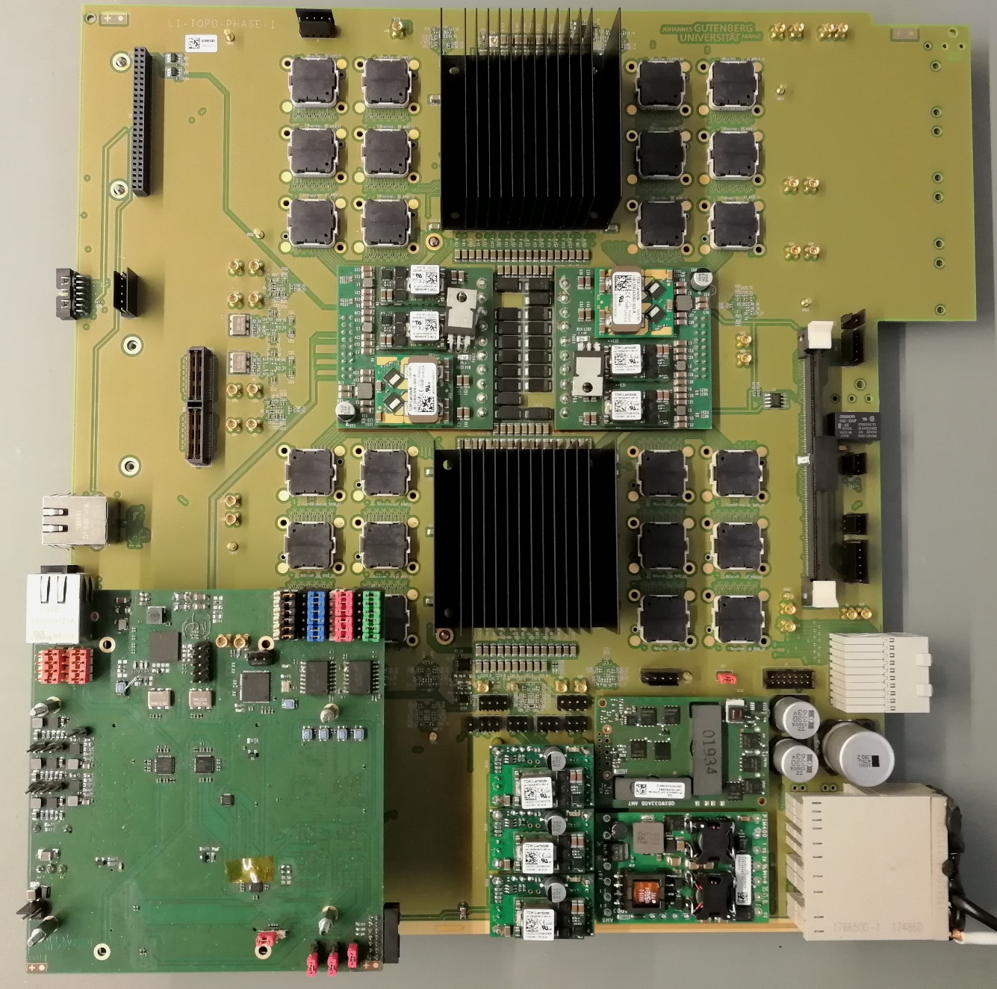
L1Topo prototype
In Mainz…
… initial smoke tests…
..without optics…

Slide 10
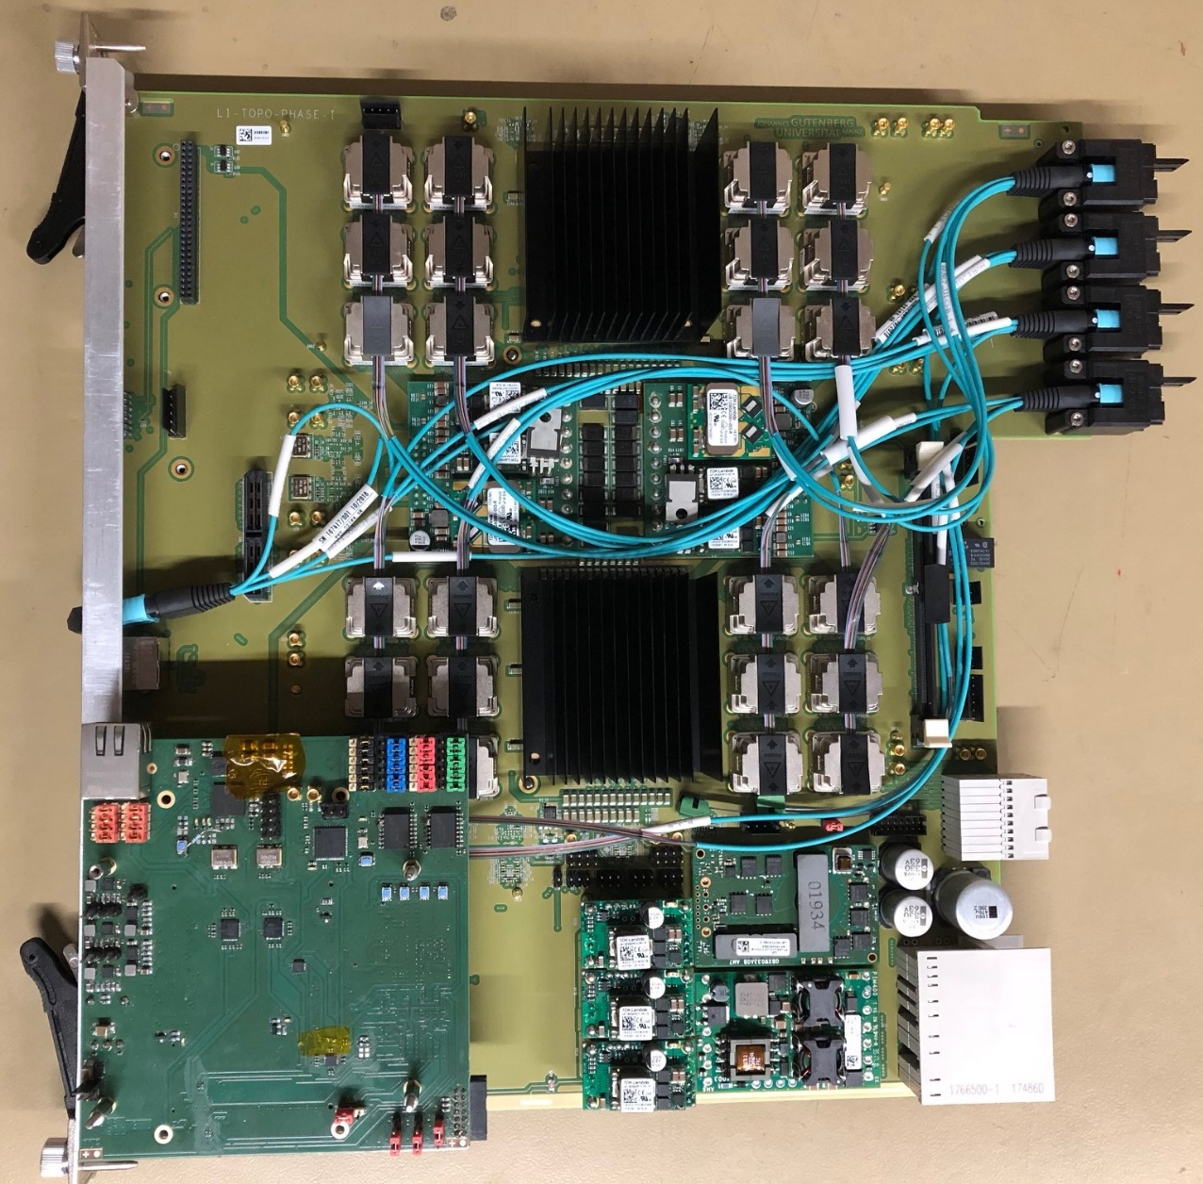
Fibred… and at STF finally …

Slide 11
L1Topo Status
Preliminary design review took place in November 2017
https://indico.cern.ch/event/676491/
L1Topo currently at STF for testing together with the jFEX final prototype
Final design review scheduled on January 23rd 2019
Firmware
Ongoing integration of infrastructure firmware (MGTs, board control, IOs and etc.) and algorithms

Slide 12
Surface Test Facility (1)
Final Prototype = Pre-Production Module = Production Module
No hardware changes are foreseen from prototype to production module
Initial integration tests with other systems can start at anytime with prototype
Combined tests with jFEX already ongoing
Scheduled dedicated test week for software and firmware mid of December with all experts present
Combined tests with eFEX, gFEX, MUCTPI and CTP still need to be scheduled

Slide 13
Surface Test Facility (2)
Setup ready for tests with L1Topo prototype, jFEX and FTM since beginning of November
Tests of optical links, TTC clock reception, IPBus and etc. were performed
Aim to test and validate full module functionality at STF except:
Concurrent operation of all FEXes (all modules), MUCTPI and CTP
Validation of input mapping
Final timing calibration

Slide 14
Major Milestones for L1Topo towards Installation
Sep
2018
Nov
2018
Jan
2018
Mar
2019
Mai
2019
Dec
2019
Start of Run-3
0
1
2
3
4
5
0
Prototype in Mainz
Prototype available at CERN/STF
Final Design Review
Production Readiness Review
Production modules available at CERN/STF
Installation in USA15
1
2
3
4
5

Slide 15
Prototype at STF/CERN
Sep
2018
Nov
2018
Jan
2018
Mar
2019
Mai
2019
Dec
2019
Start of Run-3
0
1
2
3
4
5
Prototype in Mainz
Prototype at CERN/STF
Initial validation tests of prototype has been done in Mainz
Smoke tests and basic validation of board optical/electronical links
Prototype available at CERN since end of October 2018
Validation of prototype currently ongoing at STF/CERN
Integrated test with FTM and jFEX
Validation of all input and output links concurrently
TTC and ROD links
Latency measurement
I2C/IPBus/OPC/DCS tests
Power tests with all interfaces fully active
FDR scheduled for January 23rd 2019

Slide 16
Prototype/Preproduction @ STF/CERN
Sep
2018
Nov
2018
Jan
2018
Mar
2019
Mai
2019
Dec
2019
Start of Run-3
0
1
2
3
4
5
Prototype at CERN/STF
Final Prototype = Pre-Production Module = Production Module
Continue validation of prototype/pre-production module at STF/CERN
Integrated test with FTM, FEXes, MUCTPI and CTP
Aim for PRR end of March 2019

Slide 17
Production modules at STF/CERN
Sep
2018
Nov
2018
Jan
2018
Mar
2019
Mai
2019
Dec
2019
Start of Run-3
0
1
2
3
4
5
Production modules at CERN/STF
Installation
Initial acceptance tests will be done in Mainz
Smoke tests and basic validation of board optical/electronical links
Production modules will be available at CERN Mai 2019
Finalization of acceptance tests on ATCA crate in the STF
Full slice test with all FEXes via Topo to CTP
Integration with „L1Calo STF partition“
Final installation steps planned for December 2019 to maximize time for pre-commissioning at STF
Followed by 3 month re-integration & commissioning

Slide 18
Summary
jFEX and L1Topo prototypes at CERN / STF
Integrated tests currently ongoing
System level tests starting wk Dec. 10
L1Topo FDR planned for January 23rd 2019
L1Topo Production modules available at STF/CERN Mai 2019 (Schedule includes 7 weeks contigency)
Work towards final installation steps Dec. 2019

Slide 19
Back-Up

Slide 20
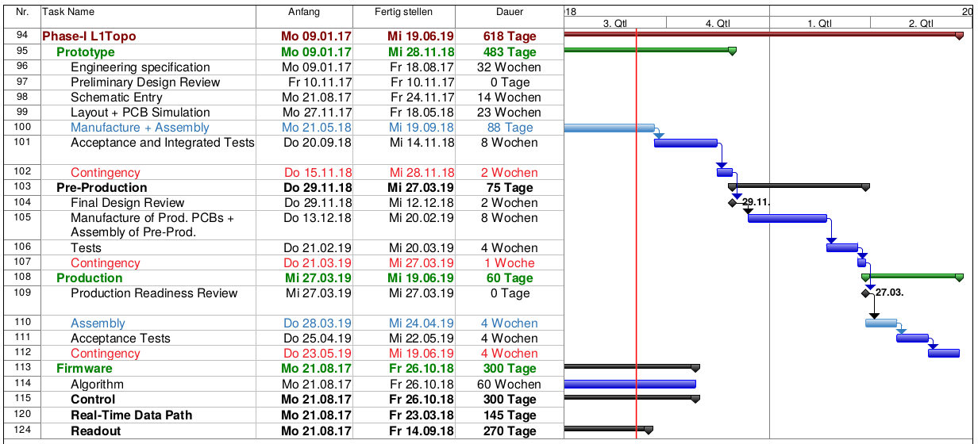
Phase-1 L1Topo Schedule

Slide 21
jFEX Schedule

