Slide 1
Installation and Commissioning Plans for the jFEX
Katharina Bierwagen

Slide 2
Agenda
Introduction
jFEX Status
Hardware Availability
Surface Test Facility
Installation
Commissioning
Summary

Slide 3
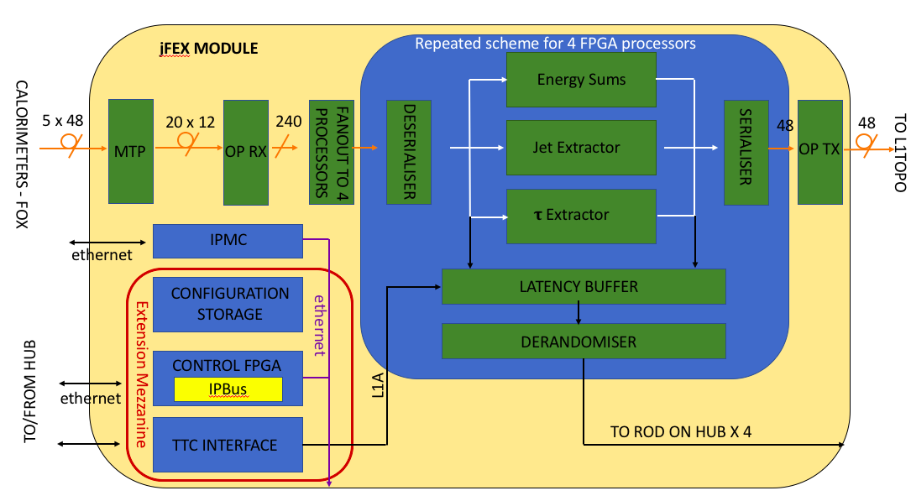
Introduction
jFEX functionality – Block Diagram
jet, large tau,
energy sums
6 modules,
1 ATCA shelf
4 x UltrascalePlus
Up to 120 MGTs
each
24 MiniPODs
Power and
control mezzanines

Slide 4
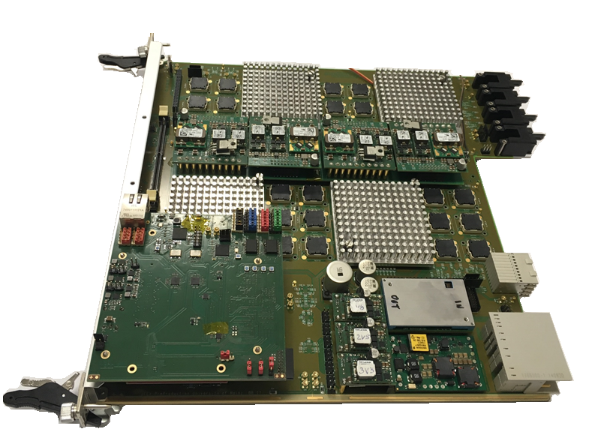
jFEX Status
jFEX Final Prototype
Final Design Review took place end of May
  Firmware: May 29
    https://indico.cern.ch/event/728398/
  Hardware: May 30
    https://indico.cern.ch/event/728400/
Green light for producing the jFEX Pre-Production modules on June 12
Ongoing PCB production
Order of all components placed
Expect delivery from assembly company: beginning of October
Firmware
  Ongoing integration of infrastructure firmware (MGTs, board control, IOs and etc.) and algorithms

Slide 5
Hardware Availability (Plan)
jFEX First Prototype – Currently at CERN (STF)
  Equipped with one UltraScale FPGA
jFEX Final Prototype – Currently in Mainz
  Equipped with four UltraScale+ FPGAs
jFEX Pre-Production Module – Available from November 2018 onwards
  Pre-Production module will later be used as spare
jFEX Production Modules – Available from May 2019 onwards
  9 (+ 1) modules
    6 to be installed
    3 (+ 1) spares

Slide 6
Surface Test Facility (1)
Final Prototype = Pre-Production Module = Production Module
No hardware changes are foreseen from prototype to production module
Initial integration tests with other systems can start at anytime with Final Prototype
  And with Pre-Production by November
Combined tests with TREX in Heidelberg this week
Combined tests with ROD (Hub) to take place soon

Slide 7
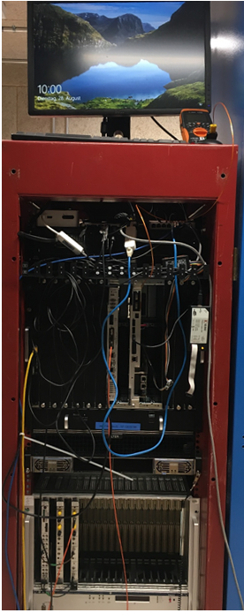
Surface Test Facility (2)
jFEX setup on the STF
Setup ready for tests with jFEX First Prototype and FTM since July
  Tests of optical links, TTC clock reception, IPBus and etc. were performed
  jFEX Final Prototype is currently in Mainz, but will be shipped back to CERN soon
Aim to test and validate full module functionality at STF except:
  Concurrent operation of all calorimeter inputs, all modules
  Channel mapping
  Final timing calibration
FTM
jFEX
“TTC system”

Slide 8
Surface Test Facility
Pre-Production Module
Validation of Pre-Production module will take place at the STF
    Smoke tests and basic validation of board optical/electrical links (IBERT) to be done in Mainz
  Validation of all optical/electrical inputs/outputs simultaneously (IBERT and formatted data)
  Power consumption under full load
    Ripple measurement
    Thermal dissipation
  LHC clock reception
    MGTREF clock jitter measurement
  Validation of the backplane high-speed links
    Readout and TTC data
    Latency measurement
    IPMC
Firmware consolidation
  Tests with integrated firmware (infrastructure and algorithms)
  Latency measurement
  Combined tests with other parts of the system

Slide 9
Surface Test Facility
Production Module
Initial production modules acceptance tests will take place in Mainz
  Smoke tests and basic validation of board optical/electrical links (IBERT)
Finalization of production modules acceptance tests on ATCA crate with HUB/ROD and/or FTM
  Same test list of the Pre-Production module
Full slice test from Latome/TREX via jFEX to Topo
  As much as possible inputs
    Formatted data
  With all possible infrastructure parts
    Hub/ROD, FELIX, IPBus, DCS and etc.
  Final evaluation on power consumption and cooling with closed shelf
Integration with “L1Calo STF partition”

Slide 10
USA15 Installation (1)
PC*
jFEX
Topo
TileFOX E or TileFOX F
4 fibres through the backplane
1 fibre via front panel
RTM
jFEX connections
  LATOME
  TREX
  FOX
  Hub/ROD
    FELIX
  Topo
    Installation schedule for December 2019
Initial tests
  Verification of board functioning after transport
  Establishment of board communication and control
    IPbus and DCS
  Integration tests with HUB/ROD
  Combined tests with calorimeters
TTC data, LHC clk, IPbus and etc.
HUB/
ROD
Scheduled to be installed before jFEX
ATCA
1 fibre via front panel
FELIX
* To be used during standalone tests at the beginning of installation
similar to what was done in STF during 2018 and 2019

Slide 11
USA15 Installation (2)
Expect to be available for cable installations and mapping tests from June 2019 (1 jFEX sliding)
Final installation (full set of modules) starting in November 2019
Followed by 3 months re-integration & commissioning

Slide 12
Commissioning
Final validation of (FOX) input mapping
Integration with ATLAS partition
Online monitoring
Combined tests with calorimeter
Timing calibrations
Pre-beam commissioning with cosmics
Commissioning with beam
Validation with bit-wise simulation
Cross-comparison with legacy system

Slide 13
Summary
Ongoing production of the jFEX Pre-Production module
Pre-Commissioning to take place during 2018 and 2019 at the STF
  Setup ready on the STF for jFEX
  Finalization of production modules acceptance tests
Final installations in USA15 scheduled for November 2019

Slide 14
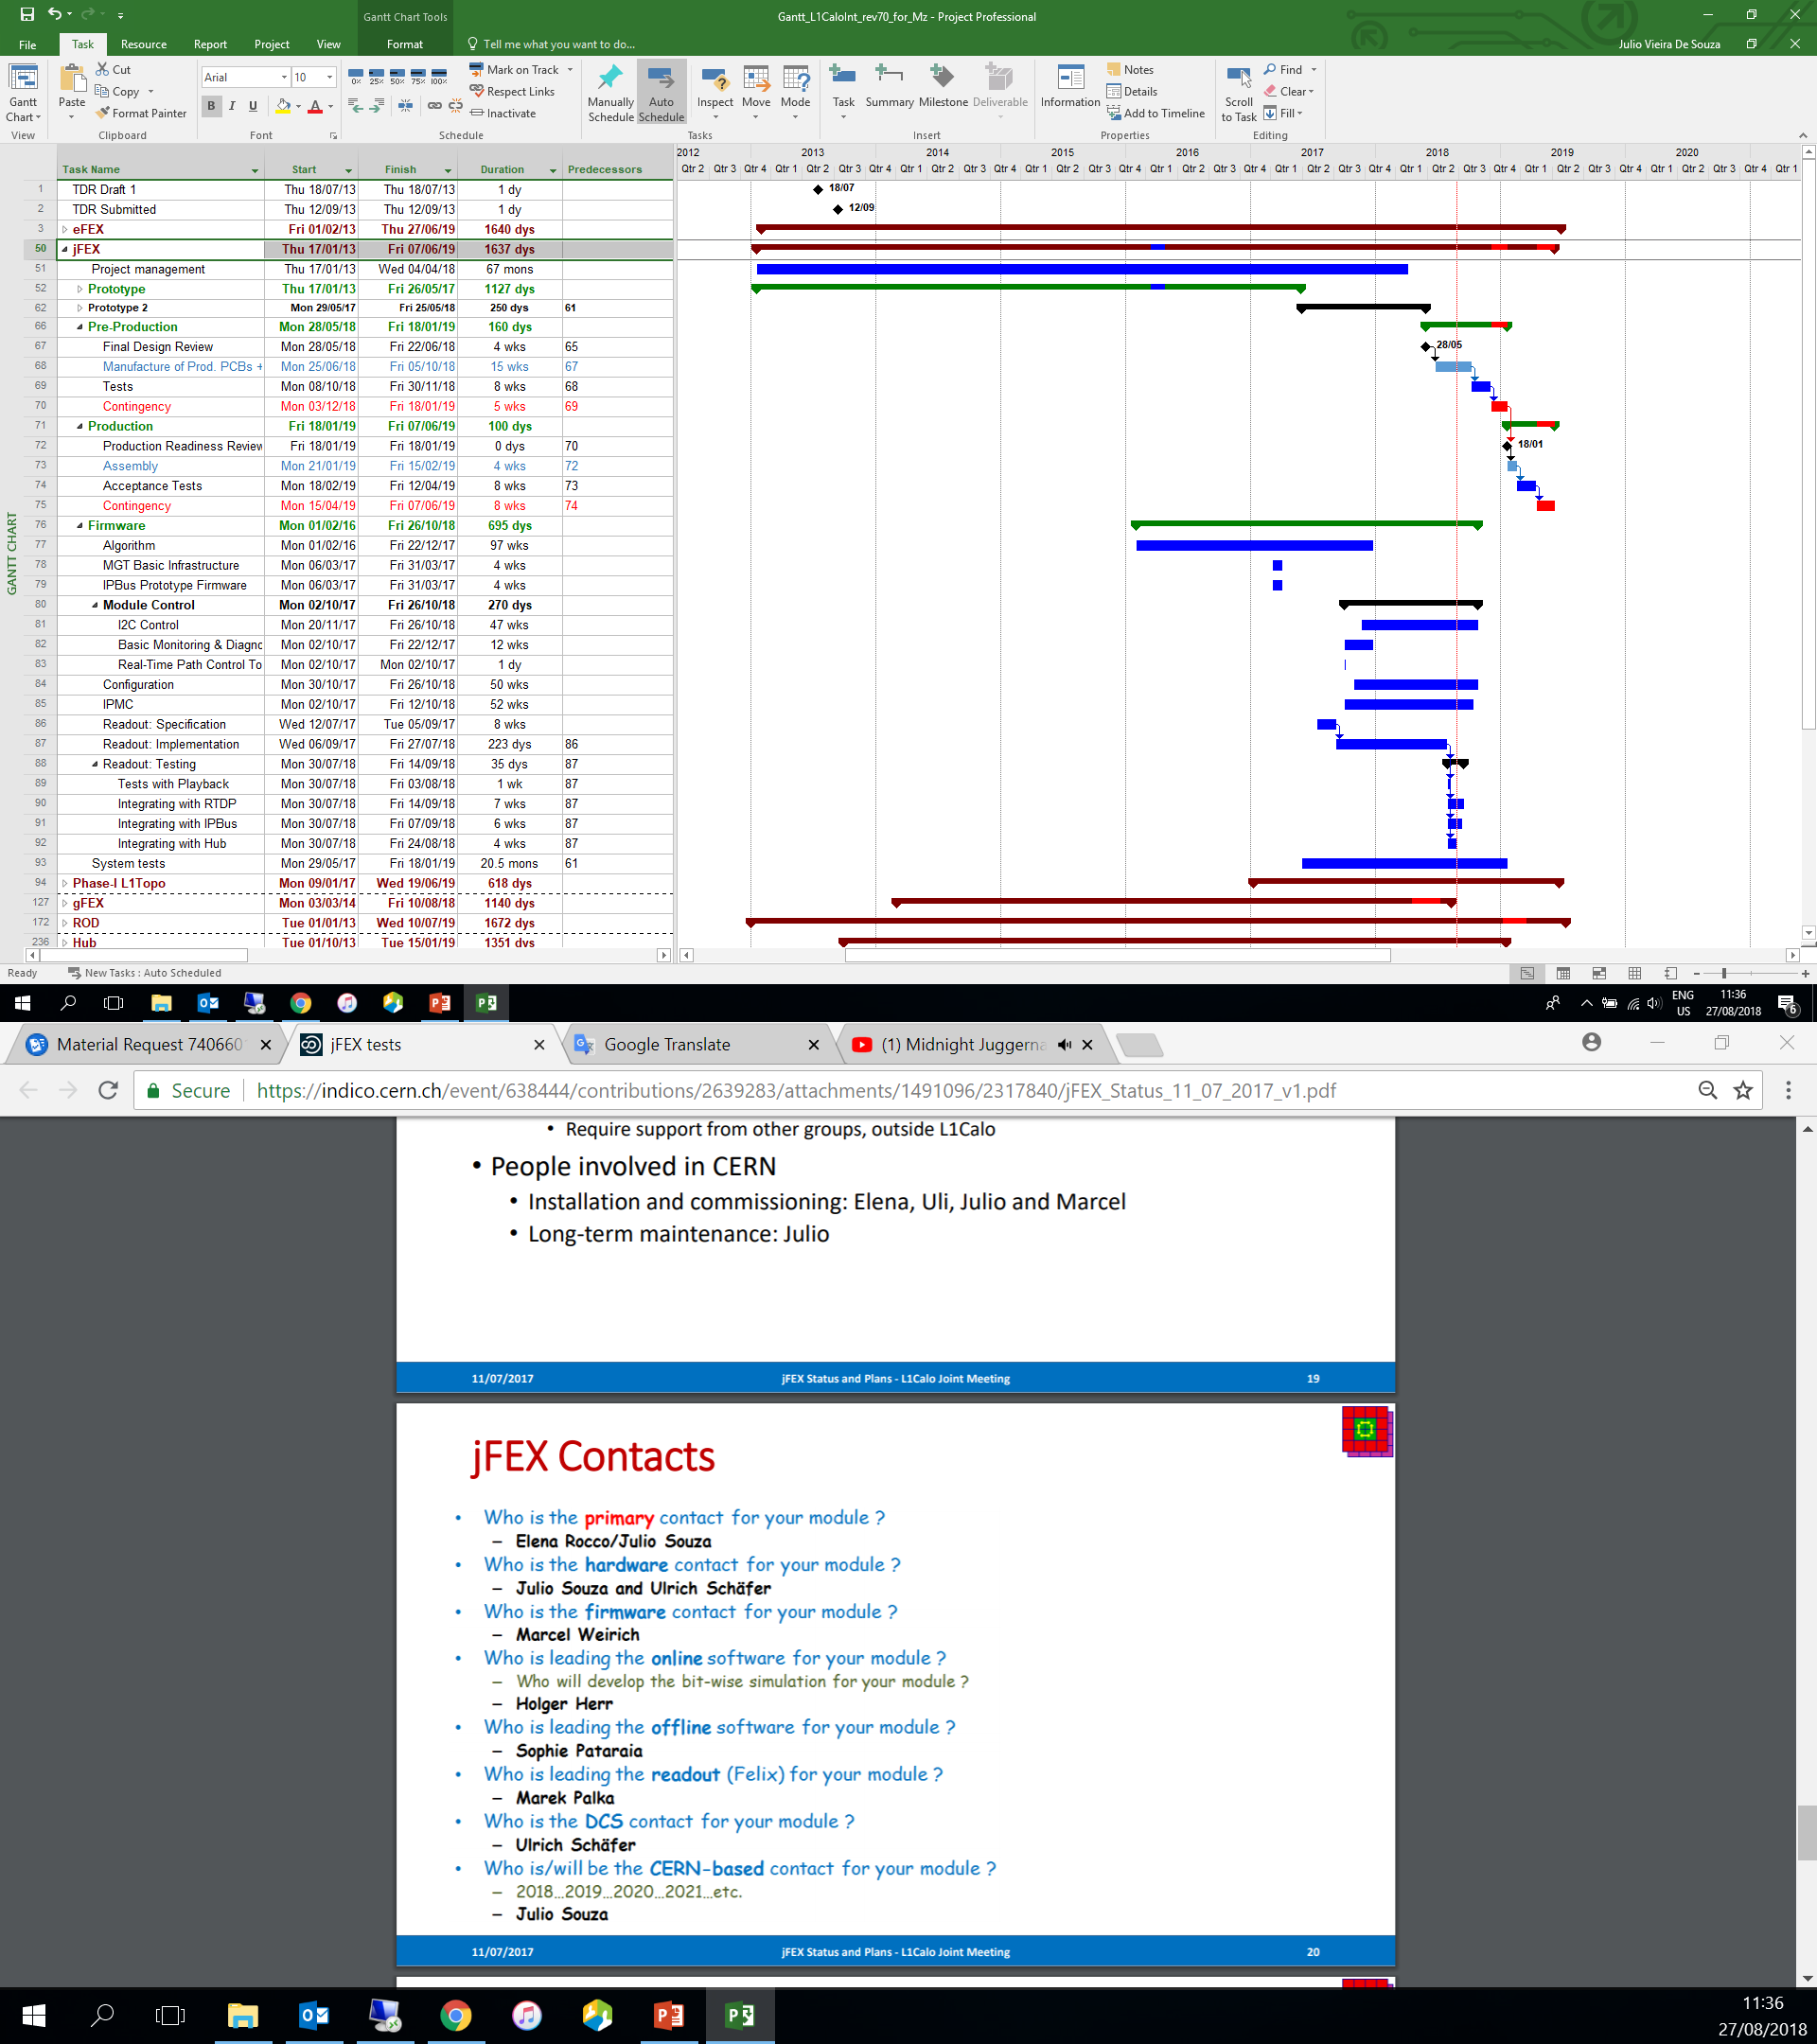
jFEX Schedule

