Slide 1
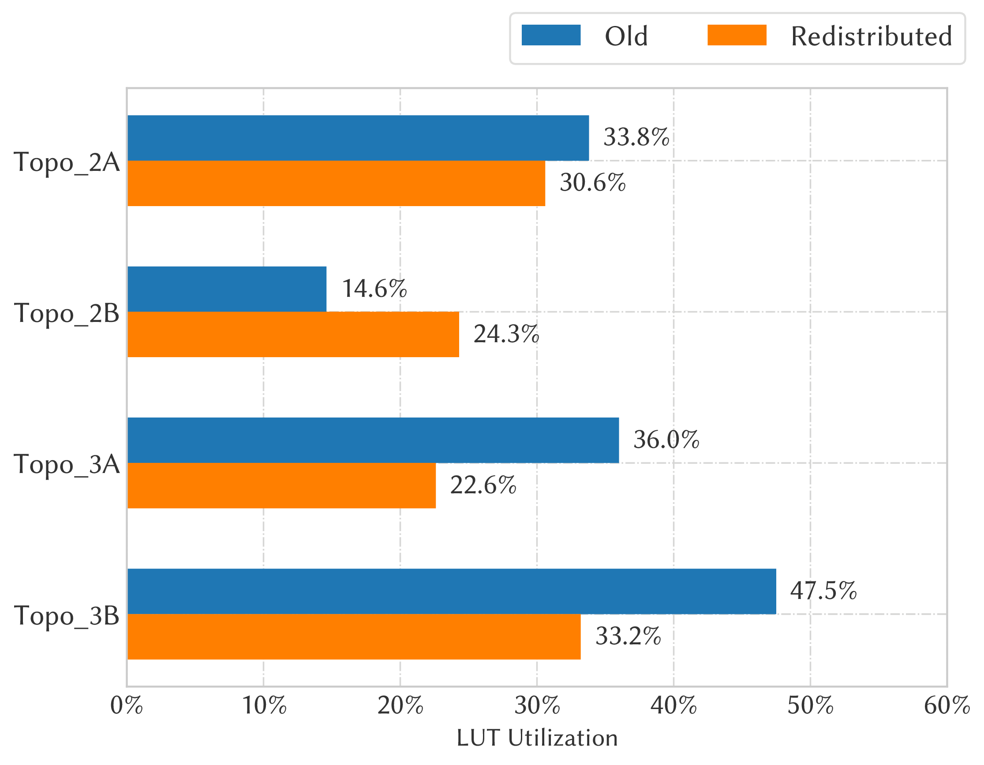
L1Topo Firmware
Proc FPGA Development status
Realtime data path 90%
MGTs 100% / Under Test
Decoding of input TOBs 85%
Baseline Algorithms 100%
Readout path
Data Merging 80%
Packet creation 60%
Register definitions 70%
ROD interface 60%
Control Under test
Control FPGA (v.2=7-series, v.3=UltraScale+)
Ethernet / IPbus v.2 100% v.3 50%
Board Monitoring (v.3) 50%
Status summary
Redistribution of algorithms studied
Interfaces successfully tested
Control F/W activities on v.3 will resume once new Topo module is running w. mezzanine v.3 (Nov.)
Next steps
Finalizing decoding of input TOBs
Final integration Infrastructure, Algos, Readout
Resource utilization: Topological Algorithms
Compare old and new distribution
Goal to distribute resource utilization evenly
Topo LUT utilization for the topological FPGAs
9th April 2019
Ian Brawn on behalf of TDAQ
Notes:
Status:
If item is in development, make a rough estimate of how complete development is, and colour-code it:
0-30% = red
40-70% = amber
80-100% = green
Under test or tested (where applicable) means development is complete excepting minor debug, and testing is in progress/completed
Utilisation bar charts are clipped from Vivado

Slide 2
L1Topo Software, Documentation & Integration
Software
Register map (XML) 50%
Module Control Package 50%
Calibration Database Tools ?????
Connectivity Database Tools ?????
SW-ROD Plugin ?????
Diagnostics Tools 50%
Monitoring Histograms 0%
Test Vector Generation 0%
Bit-wise simulation * %
Documentation
User Manual 0%
Data Formats 70% ?
Algorithm Specification 80%
Integration
eFEX 90 % jFEX 98 % gFEX 80 % CTP/MUCTPI 30 %
DCS 0 %
Hub/ROD TTC ?? %
Hub/ROD readout ?? %
FELIX 0 %
SwROD 0 %
TDAQ 0 %
Note: L1Topo Software derived from jFEX. Please refer to jFEX status. We expect to have it migrate to Topo in 1st week of November. Fall-back: standalone control and monitoring tools.
Notes:
Status:
If item is in development, make a rough estimate of how complete development is, and colour-code it:
0-30% = red
40-70% = amber
80-100% = green
Under test or tested (where applicable) means development is complete excepting minor debug, and testing is in progress/completed
Utilisation bar charts are clipped from Vivado

Slide 3
STF Slice Tests
TREX–eFEX protocol test Not Done/ In progress / Done
TREX–gFEX protocol test Not Done/ In progress / Done
TREX–jFEX protocol test Not Done/ In progress / Done
eFEX–Topo protocol test Done +
gFEX–Topo protocol test Almost done *
jFEX–Topo protocol test Done
eFEX Readout RT data → ROD Not Done/ In progress / Done
gFEX Readout RT data → FELIX Not Done/ In progress / Done
jFEX Readout RT data → ROD Not Done/ In progress / Done
Topo Readout RT data → ROD In progress
TREX Readout RT data → FELIX Not Done/ In progress / Done
eFEX data → FELIX Not Done/ In progress / Done
jFEX/Topo data → FELIX Not Done
FELIX → SW ROD Not Done/ In progress / Done
Data extraction from SW ROD Not Done/ In progress / Done
Full eFEX readout path Not Done/ In progress / Done
Full jFEX readout path Not Done/ In progress / Done
Full Topo readout path Not Done/ In progress / Done
Full gFEX readout path Not Done/ In progress / Done
Full TREX readout path Not Done/ In progress / Done
eFEX–Topo–Readout test Not Done/ In progress / Done
gFEX–Topo–Readout test Not Done/ In progress / Done
jFEX–Topo–Readout test Not Done/ In progress / Done
TREX–eFEX–Readout test Not Done/ In progress / Done
TREX–gFEX–Readout test Not Done/ In progress / Done
TREX–jFEX–Readout test Not Done/ In progress / Done
TREX–eFEX–Topo Slice Not Done/ In progress / Done
TREX–gFEX–Topo Slice Not Done/ In progress / Done
TREX–jFEX–Topo Slice Not Done/ In progress / Done
Full Slice test Not Done/ In progress / Done
+: might wish to test for larger channel count, *: waiting for final agreement on exact CRC
Notes:
Mark in Not Done, In Progress or Done,
Where “Done” means you don’t need to repeat any aspect of this test before moving to the next stage

