Slide 1
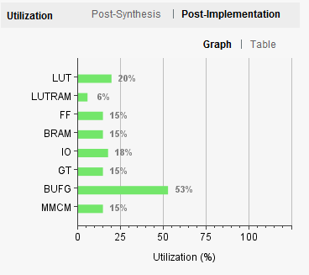
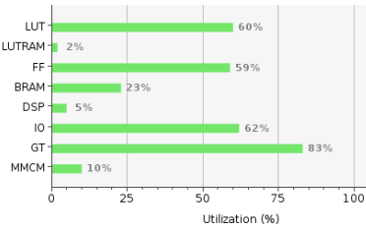
eFEX Firmware
Proc FPGA Development status
IPBus 90%
Infrastructure 70%
Real Time path 60%
MGTs Tested
Synchronisation 70%
e/γ algorithm 70%
Tau algorithm 40%
Sorting 90%
Readout path Under test
TOB Flow Control 60%
RAW Flow Control 80%
Control FPGA interface 85%
Control Tested
Control FPGA
ROD Aurora interface 100%
TTC Interface 100%
Readout path
Flow Control 30%
Control 90%
Control FPGA Utilisation
Proc FPGA Utilisation
Status summary
Control FPGA Infrastructure completed
Real Time Path Test – Two pFPGAs tested
Readout Path – TOB 50% & RAW 70% tested
ROD interface verified
Next steps
Complete real-time path tests with 4 pFPGAs
Complete readout tests for both TOB and calorimeter readout
Bug fix generic IPBus mapping for all pFPGAs
Notes:
Status:
If item is in development, make a rough estimate of how complete development is, and colour-code it:
0-30% = red
40-70% = amber
80-100% = green
Under test or tested (where applicable) means development is complete excepting minor debug, and testing is in progress/completed
Utilisation bar charts are clipped from Vivado

Slide 2
eFEX Software, Documentation & Integration
Software
Register map (XML) xx%
Module Control Package xx%
Calibration Database Tools xx%
Connectivity Database Tools xx%
SW-ROD Plugin xx%
Diagnostics Tools xx%
Monitoring Histograms xx%
Test Vector Generation xx%
Bit-wise simulation xx%
Documentation xx%
User Manual xx%
Data Formats xx%
Algorithm Specification xx%
Integration
LATOME/LAr xx%
TREX/Tile xx%
L1Topo xx%
DCS xx%
Hub/ROD TTC xx%
Hub/ROD readout xx%
FELIX xx%
SwROD xx%
TDAQ xx%
Status Summary
…
…
Next Steps
…
…
Notes:
Status:
If item is in development, make a rough estimate of how complete development is, and colour-code it:
0-30% = red
40-70% = amber
80-100% = green
Under test or tested (where applicable) means development is complete excepting minor debug, and testing is in progress/completed
Utilisation bar charts are clipped from Vivado

Slide 3
jFEX Firmware
Proc FPGA Development status
Real-time data path
MGTs 100% / Under Test
Jet, ET/MET, Pileup algorithm 100%
Large-R Jet, Tau algorithm 70% (1st version implemented)
Readout path
Data Merging 90%
Packet creation 80%
Register definitions 80%
ROD interface 60%
Control Under test
Control FPGA
Ethernet / IPbus Under test
Board Monitoring Under test
Status summary / Recent news
Significant improvement on the forward region…
Integration is well-advanced…
Next steps
Commission w/ ROD interface
Commission w/ TREX, LATOME, L1Topo
Notes:
Status:
If item is in development, make a rough estimate of how complete development is, and colour-code it:
0-30% = red
40-70% = amber
80-100% = green
Under test or tested (where applicable) means development is complete excepting minor debug, and testing is in progress/completed
Utilisation bar charts are clipped from Vivado

Slide 4
jFEX Software, Documentation & Integration
Software
Register map (XML) xx%
Module Control Package xx%
Calibration Database Tools xx%
Connectivity Database Tools xx%
SW-ROD Plugin xx%
Diagnostics Tools xx%
Monitoring Histograms xx%
Test Vector Generation xx%
Bit-wise simulation xx%
Documentation xx%
User Manual xx%
Data Formats xx%
Algorithm Specification xx%
Integration
LATOME/LAr xx%
TREX/Tile xx%
L1Topo xx%
DCS xx%
Hub/ROD TTC xx%
Hub/ROD readout xx%
FELIX xx%
SwROD xx%
TDAQ xx%
Status Summary
…
…
Next Steps
…
…
Notes:
Status:
If item is in development, make a rough estimate of how complete development is, and colour-code it:
0-30% = red
40-70% = amber
80-100% = green
Under test or tested (where applicable) means development is complete excepting minor debug, and testing is in progress/completed
Utilisation bar charts are clipped from Vivado

Slide 5
gFEX Firmware
Proc FPGA Development status
Real time path Under test
LAr/Tile Inputs Under test
Synchronisation Under test
Large-R jets algorithm Under test
Global algorithms Under test
Readout path Under test
Flow Control N/A
Control FPGA interface Under test
Control Under test
Control FPGA
Real time path 60%
Synchronisation Under test
Readout path
Flow Control 60%
FELIX interface Under test
Control 50%
Status summary
Testing taking place with gFEX ←→ FELIX setup at BNL using dummy input data loaded into playback memories
Next step(s)
Test algorithms on 10⁷ events with simplified timing
Incorporate realistic flow control into readout
Incorporate forward region (|η| > 2.4)
Test readout with algorithmic (MC) data
Proc FPGA Utilisation
Latency Measurement: 280 MHz clock
Time label and description | Time (clks) | Time (ns)
T0 – output of skew compensation block | 0 | 0
T1 – output of gTower builder (calibr. gTowers) | 19 | 67.9
T2 – partial sum for neighbor calculated | 31 | 110.7
T3 – partial sum TX output | 36 | 128.6
T4 – partial sum RX input | 40 | 142.9
T5 – partial sum input to jet engine | 44 | 157.1
T6 – Large R jet sum output | 46 | 164.3
T7 – TOB_1 ready signal | 61 | 217.9
Notes:
Status:
If item is in development, make a rough estimate of how complete development is, and colour-code it:
0-30% = red
40-70% = amber
80-100% = green
Under test or tested (where applicable) means development is complete excepting minor debug, and testing is in progress/completed
Utilisation bar charts are clipped from Vivado

Slide 6
gFEX Software, Documentation & Integration
Software
Register map (XML) xx%
Module Control Package xx%
Calibration Database Tools xx%
Connectivity Database Tools xx%
SW-ROD Plugin xx%
Diagnostics Tools xx%
Monitoring Histograms xx%
Test Vector Generation xx%
Bit-wise simulation xx%
Documentation xx%
User Manual xx%
Data Formats xx%
Algorithm Specification xx%
Integration
LATOME/LAr xx%
TREX/Tile xx%
L1Topo xx%
DCS xx%
FELIX TTC xx%
FELIX readout xx%
SwROD xx%
TDAQ xx%
Status Summary
…
…
Next Steps
…
…
Notes:
Status:
If item is in development, make a rough estimate of how complete development is, and colour-code it:
0-30% = red
40-70% = amber
80-100% = green
Under test or tested (where applicable) means development is complete excepting minor debug, and testing is in progress/completed
Utilisation bar charts are clipped from Vivado

Slide 7
L1Topo Firmware
Proc FPGA Development status
Realtime data path 90%
MGTs 100% / Under Test
Decoding of input TOBs 75%
Baseline Algorithms 100%
Readout path
Data Merging 80%
Packet creation 60%
Register definitions 70%
ROD interface 40%
Control Under test
Control FPGA
Ethernet / IPbus Under test
Board Monitoring Under test
Status summary
Integration well advanced
Submission deadline for new algorithms: 30.6.19
Next steps
Finalizing decoding of input TOBs
Commissioning of interfaces
Resource utilization: Multiplicity Topo
Use Topo1b, assume all 110 output bits are jets
40 × 2 bit and 10 × 3 bit jet multiplicities
Numbers of input jets: 64 Jets, 128 Jets and 256 Jets
Topo LUT utilisation for different jet implementations
Notes:
Status:
If item is in development, make a rough estimate of how complete development is, and colour-code it:
0-30% = red
40-70% = amber
80-100% = green
Under test or tested (where applicable) means development is complete excepting minor debug, and testing is in progress/completed
Utilisation bar charts are clipped from Vivado

Slide 8
L1Topo Software, Documentation & Integration
Software
Register map (XML) xx%
Module Control Package xx%
Calibration Database Tools xx%
Connectivity Database Tools xx%
SW-ROD Plugin xx%
Diagnostics Tools xx%
Monitoring Histograms xx%
Test Vector Generation xx%
Bit-wise simulation xx%
Documentation xx%
User Manual xx%
Data Formats xx%
Algorithm Specification xx%
Integration
eFEX xx%
jFEX xx%
gFEX xx%
CTP xx%
DCS xx%
Hub/ROD TTC xx%
Hub/ROD readout xx%
FELIX xx%
SwROD xx%
TDAQ xx%
Status Summary
…
…
Next Steps
…
…
Notes:
Status:
If item is in development, make a rough estimate of how complete development is, and colour-code it:
0-30% = red
40-70% = amber
80-100% = green
Under test or tested (where applicable) means development is complete excepting minor debug, and testing is in progress/completed
Utilisation bar charts are clipped from Vivado

Slide 9
Hub Firmware
Design Area 1
Item 1
Item 2
…
Design Area 3
Item 1
Item 2
Status summary / Recent news
…
…
Next steps
…
…
Utilisation chart from Vivado, etc.
Notes:
Status:
If item is in development, make a rough estimate of how complete development is, and colour-code it:
0-30% = red
40-70% = amber
80-100% = green
Under test or tested (where applicable) means development is complete excepting minor debug, and testing is in progress/completed
Utilisation bar charts are clipped from Vivado

Slide 10
Hub Software, Documentation & Integration
Software
Register map (XML) xx%
Module Control Package xx%
Calibration Database Tools xx%
Connectivity Database Tools xx%
SW-ROD Plugin xx%
Diagnostics Tools xx%
Monitoring Histograms xx%
Test Vector Generation xx%
Bit-wise simulation xx%
Documentation xx%
User Manual xx%
Data Formats xx%
Algorithm Specification xx%
Integration
ROD xx%
eFEX xx%
jFEX xx%
L1Topo xx%
DCS xx%
TTC xx%
FELIX xx%
SwROD xx%
TDAQ xx%
Status Summary
…
…
Next Steps
…
…
Notes:
Status:
If item is in development, make a rough estimate of how complete development is, and colour-code it:
0-30% = red
40-70% = amber
80-100% = green
Under test or tested (where applicable) means development is complete excepting minor debug, and testing is in progress/completed
Utilisation bar charts are clipped from Vivado

Slide 11
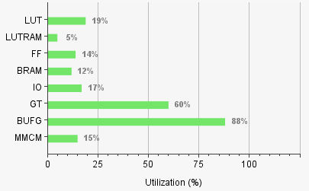
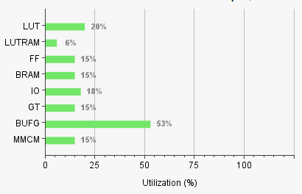
ROD Firmware
Backplane Interface Development status
eFEX interface 80%
Aurora (3 channels) Tested
All channels 70%
Readout/CTTC 80%
Status Registers 60%
jFEX interface
Aurora 80%
Bus width adapter 80%
All channels 50%
Status Registers 60%
Testing in jfex shelf 10%
Topo interface not started
Packet Processor
TOB/xTOB packets
Event building 80%
All header/trailer fields 70%
Control/Status registers 70%
Debug Queue 10%
Bulk Data Handling
Specification 80%
Design 50%
Status summary / Recent news [optional]
1st HW test with eFEX packets complete
Next step(s)
PRR, Bulk Data implementation, Debug Queue
eFEX-ROD FPGA Utilisation
jFEX-ROD FPGA Utilisation
Notes:
Status:
If item is in development, make a rough estimate of how complete development is, and colour-code it:
0-30% = red
40-70% = amber
80-100% = green
Under test or tested (where applicable) means development is complete excepting minor debug, and testing is in progress/completed
Utilisation bar charts are clipped from Vivado

Slide 12
ROD Software, Documentation & Integration
Software
Register map (XML) xx%
Module Control Package xx%
Calibration Database Tools xx%
Connectivity Database Tools xx%
SW-ROD Plugin xx%
Diagnostics Tools xx%
Monitoring Histograms xx%
Test Vector Generation xx%
Bit-wise simulation xx%
Documentation xx%
User Manual xx%
Data Formats xx%
Algorithm Specification xx%
Integration
Hub xx%
eFEX xx%
jFEX xx%
L1Topo xx%
DCS xx%
TTC xx%
FELIX xx%
SwROD xx%
TDAQ xx%
Status Summary
…
…
Next Steps
…
…
Notes:
Status:
If item is in development, make a rough estimate of how complete development is, and colour-code it:
0-30% = red
40-70% = amber
80-100% = green
Under test or tested (where applicable) means development is complete excepting minor debug, and testing is in progress/completed
Utilisation bar charts are clipped from Vivado

Slide 13
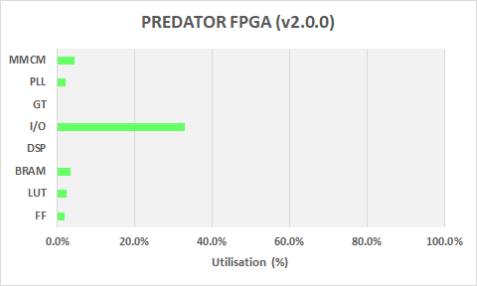
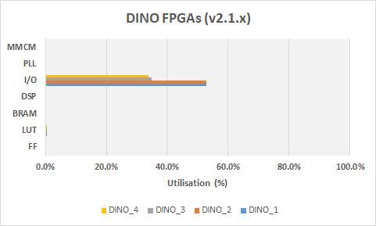
TREX Firmware (1)
PREDATOR FPGA (Kintex UltraScale) Development status
Real-time path
LVDS data reception Tested
Autom. input delay scan 10%
De-BCMUX-ing Tested
Data formatting 40%
Transmission to FEXes 40%
Readout path
G-Link formatting 80%
Transmission to legacy ROD 30%
Transmission to FELIX 30%
Configuration, Control & Monitoring
System monitoring (SYSMON) Tested
Interface to VME (via PPM/ExtReM) Tested
Interface to FireFly transc. (I2C master) Tested
Interface to Zynq+ MPSoc (I2C slave) 20%
DINO FPGAs (4x Artix-7)
Real-time path
LVDS duplication Tested
Transmission to CP & JEP Tested
Routing to PREDATOR FPGA Tested
Monitoring
System monitoring (XADC) Tested
Interface to VME/Zynq+ (I2C slave) To be tested
FPGA & MPSoC Utilisation (master/official releases only)
Notes:
Status:
If item is in development, make a rough estimate of how complete development is, and colour-code it:
0-30% = red
40-70% = amber
80-100% = green
Under test or tested (where applicable) means development is complete excepting minor debug, and testing is in progress/completed
Utilisation bar charts are clipped from Vivado

Slide 14
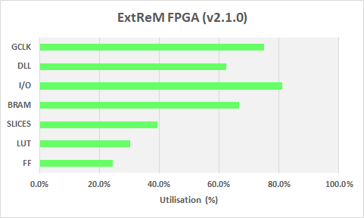
TREX Firmware (2)
ExtReM FPGA (Virtex-1000E, on PPM) Development status
Readout path
Remove G-Link formatting Tested
Route TTC signals to PREDATOR Tested
Configuration & Control (from VME)
Interface to PREDATOR Tested
Interface to Zynq+ To be tested
Register model for PREDATOR Tested
Register model for Zynq+ 80%
I2C master interface to TREX 90%
Zynq+ MPSoC (from TREX pre-production only)
Configuration, Control & Monitoring (PL)
Interface to VME (via PPM/ExtReM) 70%
Interface to PS Not started
I2C master interf. (slow-control) 30%
System monitoring (SYSMON) 30%
Slow-ctrl data storage & analysis 30%
Slow-control Monitoring (PS)
JTAG master Not started
OPC/UA server Not started
Communication w/ DCS (Ethernet) Not started
FPGA & MPSoC Utilisation (master/official releases only)
Status summary
Zynq+ MpSoC to be implemented on the TREX pre-production module (TREX v2; June19)
Currently, main focus on finalising the implementation of the real-time interface to FEXes and of the readout interface to the legacy ROD
Next step(s)
Test legacy real-time path to CP & JEP (CERN bat-104)
Test legacy readout interface to legacy ROD (CERN bat-104)
Test real-time interface to FEXes (CERN STF)
Notes:
Status:
If item is in development, make a rough estimate of how complete development is, and colour-code it:
0-30% = red
40-70% = amber
80-100% = green
Under test or tested (where applicable) means development is complete excepting minor debug, and testing is in progress/completed
Utilisation bar charts are clipped from Vivado

Slide 15
TREX Software, Documentation & Integration
Software
Register map xx%
Module Control Package xx%
Calibration Database Tools xx%
Connectivity Database Tools xx%
SW-ROD Plugin xx%
Diagnostics Tools xx%
Monitoring Histograms xx%
Test Vector Generation xx%
Bit-wise simulation xx%
Documentation xx%
User Manual xx%
Data Formats xx%
Algorithm Specification xx%
Integration
PPM xx%
eFEX xx%
jFEX xx%
gFEX xx%
DCS xx%
TTC xx%
Legacy ROD xx%
FELIX xx%
SwROD xx%
TDAQ xx%
Status Summary
…
…
Next Steps
…
…
Notes:
Status:
If item is in development, make a rough estimate of how complete development is, and colour-code it:
0-30% = red
40-70% = amber
80-100% = green
Under test or tested (where applicable) means development is complete excepting minor debug, and testing is in progress/completed
Utilisation bar charts are clipped from Vivado

Slide 16
STF Slice Tests
TREX–eFEX protocol test Not Done/ In progress / Done
TREX–gFEX protocol test Not Done/ In progress / Done
TREX–jFEX protocol test Not Done/ In progress / Done
eFEX–Topo protocol test Not Done/ In progress / Done
gFEX–Topo protocol test Not Done/ In progress / Done
jFEX–Topo protocol test Not Done/ In progress / Done
eFEX Readout RT data → ROD Not Done/ In progress / Done
gFEX Readout RT data → FELIX Not Done/ In progress / Done
jFEX Readout RT data → ROD Not Done/ In progress / Done
Topo Readout RT data → ROD Not Done/ In progress / Done
TREX Readout RT data → FELIX Not Done/ In progress / Done
eFEX data → FELIX Not Done/ In progress / Done
jFEX/Topo data → FELIX Not Done/ In progress / Done
FELIX → SW ROD Not Done/ In progress / Done
Data extraction from SW ROD Not Done/ In progress / Done
Full eFEX readout path Not Done/ In progress / Done
Full jFEX readout path Not Done/ In progress / Done
Full Topo readout path Not Done/ In progress / Done
Full gFEX readout path Not Done/ In progress / Done
Full TREX readout path Not Done/ In progress / Done
eFEX–Topo–Readout test Not Done/ In progress / Done
gFEX–Topo–Readout test Not Done/ In progress / Done
jFEX–Topo–Readout test Not Done/ In progress / Done
TREX–eFEX–Readout test Not Done/ In progress / Done
TREX–gFEX–Readout test Not Done/ In progress / Done
TREX–jFEX–Readout test Not Done/ In progress / Done
TREX–eFEX–Topo Slice Not Done/ In progress / Done
TREX–gFEX–Topo Slice Not Done/ In progress / Done
TREX–jFEX–Topo Slice Not Done/ In progress / Done
Full Slice test Not Done/ In progress / Done
Notes:
Mark in Not Done, In Progress or Done,
Where “Done” means you don’t need to repeat any aspect of this test before moving to the next stage

