Slide 1
Status L1Topo
Uli, Julio / Mainz
Hardware
Tests
Readiness for slice test

Slide 2
Hardware Overview
ATCA board based on jFEX design
2 Virtex UltrascalePlus
Two iterations
Prototype (FDR 01/2019)
Final design presented at PRR 08/2019

Slide 3
Hardware Overview
ATCA board based on jFEX design
Modular design
2 Virtex UltrascalePlus FPGAs
XCVU9P-2FLGA2577E
120 MGTs (GTY) per FPGA
118 input fibres per processor FPGA
24 MiniPOD: 20 RX + 4 TX
Mezzanines
Control & Power
Both compatible with jFEX
Rx
Rx
Virtex
UltrascalePlus (U1)
Rx
Rx
Rx
Rx
Rx
Rx
Rx
Tx
Rx
Tx
U1 Power Mezzanine
U2 Power Mezzanine
Tx
Rx
Virtex
UltrascalePlus (U2)
Tx
Rx
Rx
Rx
Rx
Rx
Rx
Rx
Rx
Rx
Control Mezzanine
Board Voltage Level Mezzanine - 1V8
Board Voltage Level Mezzanine - 2V5
ATCA Power Interface
Board Voltage Level Mezzanine - 3V3

Slide 4
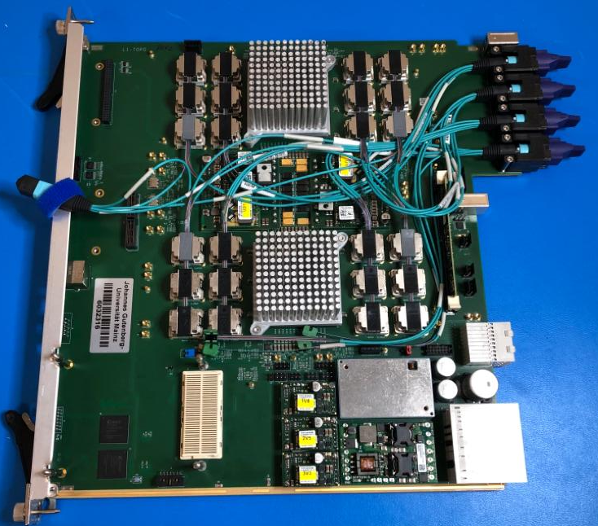
Hardware Overview
ATCA board based on jFEX design
Modular design
2 Virtex UltrascalePlus FPGAs
XCVU9P-2FLGA2577E
120 MGTs (GTY) per FPGA
118 input fibres per processor FPGA
24 MiniPOD: 20 RX + 4 TX
Mezzanines
Control & Power
Both compatible with jFEX
L1Topo 1st production module was delivered in September!!
Main change from prototype: correction of GTY calibration circuit

Slide 5
Module tests
The prototype module was successfully used in
Interface tests with all sources (FEXes, MUCTPI) and ROD/hub
Clock synchronization tests with all sources
Formatted data / protocol tests with all FEXes
The new production-grade module is being subjected to the full test programme established for the prototype
Standalone tests at home lab
System level tests at the STF

Slide 6
Mainz Test List
Smoke tests
Special power sequencing using push-button (step by step), monitoring output current on all voltage rails
Final power sequencing
JTAG boundary scan
JTAG chain 1: processor FPGAs
JTAG chain 2: CPLDs
Connect control mezzanine to L1Topo
Power tests
Monitoring voltages and currents (including FPGA AUX voltages)
Ripple measurements
Program all processor FPGAs with a test bit file
XADC monitoring with automatic shutdown
Short term IBERT tests

Slide 7
Optical Inputs Validation
L1Topo
Rx
Rx
U1
Rx
FTM1
Rx
FTM2
Rx
Setup
Data sources:
2 FTMs: 98+48 outputs
jFEX: 48 outputs
L1Topo: 48 Tx
@12.8 Gbps
PRBS31
DFE disabled
Evaluate power consumption
Not a long term test (BER < ${5.0 x 10}^{−15}$)
Rx
Rx
Rx
Rx
Rx
Tx
Tx
Rx
U2
Rx
FTM1
Rx
Rx
jFEX
Rx
Rx
Rx
Rx
Rx
Rx
Tx
Tx
ATCA FABRIC (BACKPLANE)
TTC Clock
Source
Hub
FTM1
ATCA FABRIC (BACKPLANE)
Key
All links error free!!
LTP
ALTI
FTM2
FANOUT
12 Ch (Optical)
12 Ch (Electrical)

Slide 8
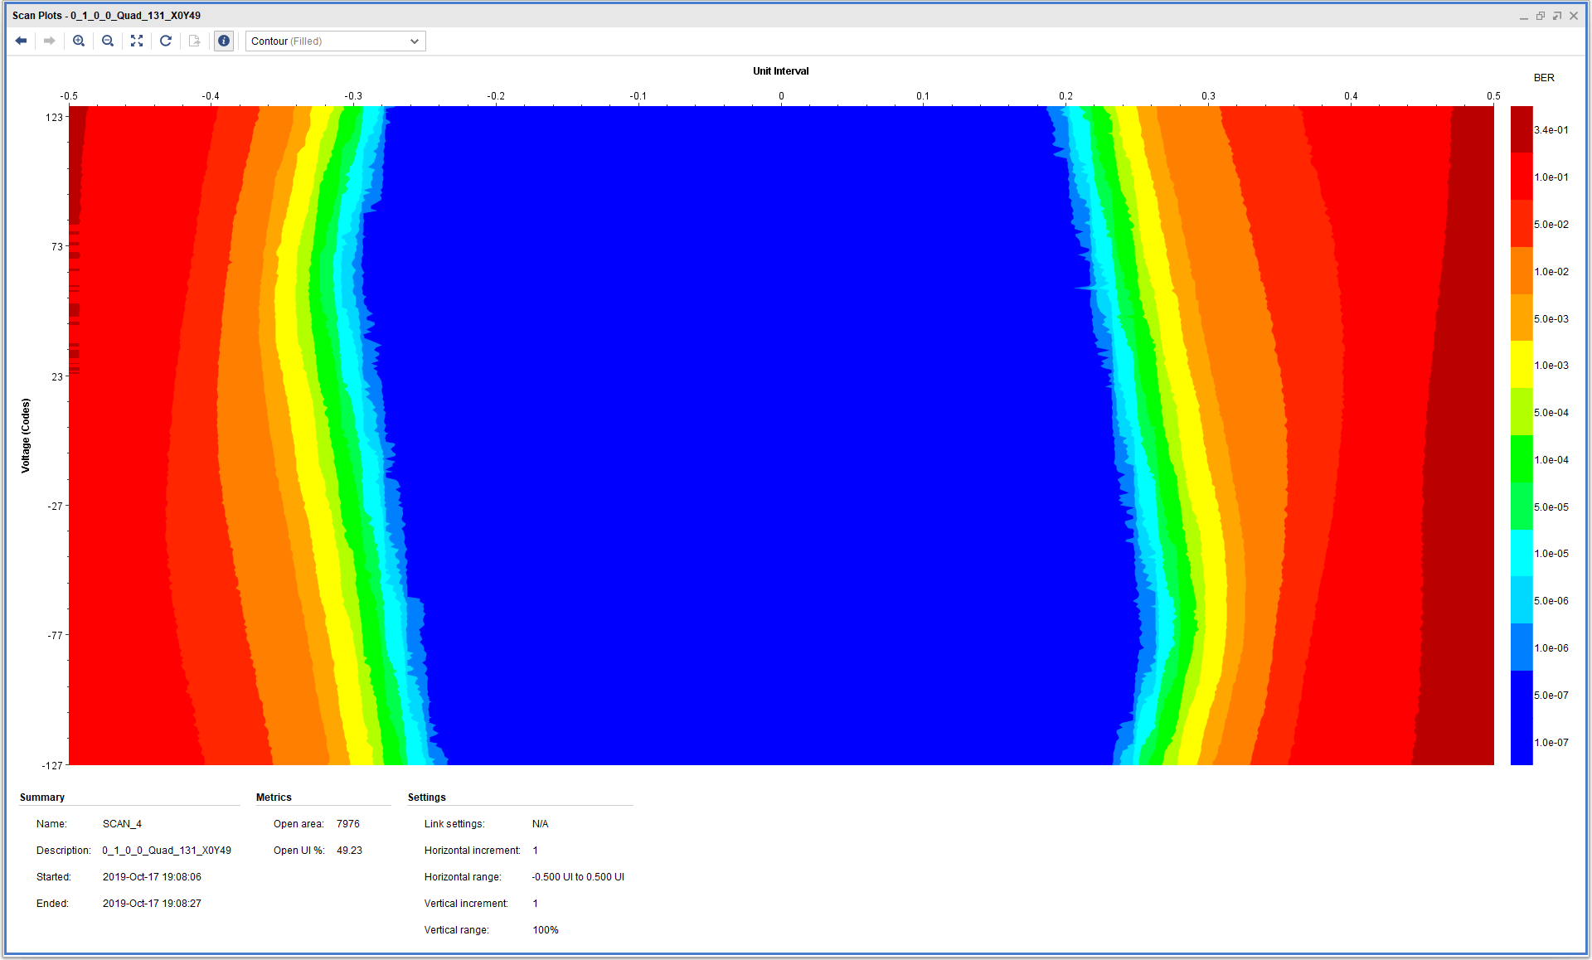
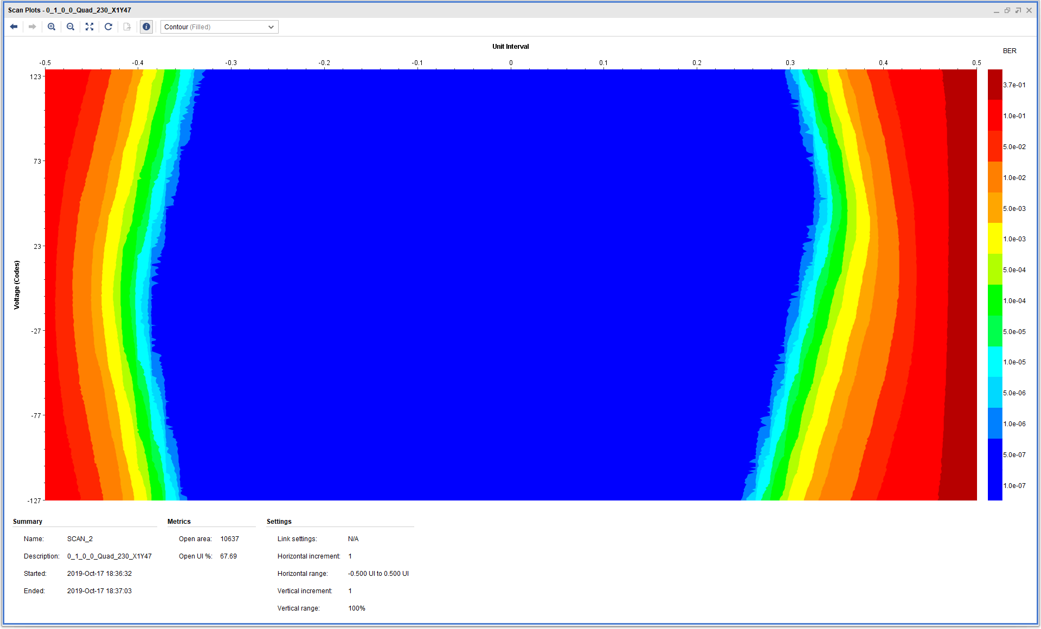
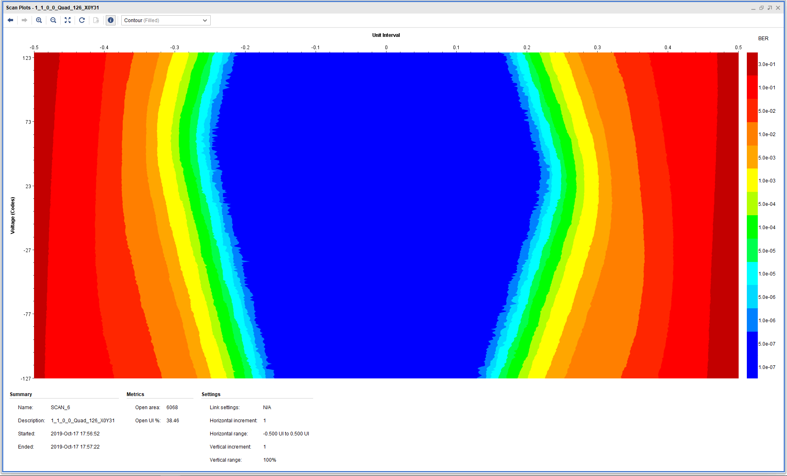
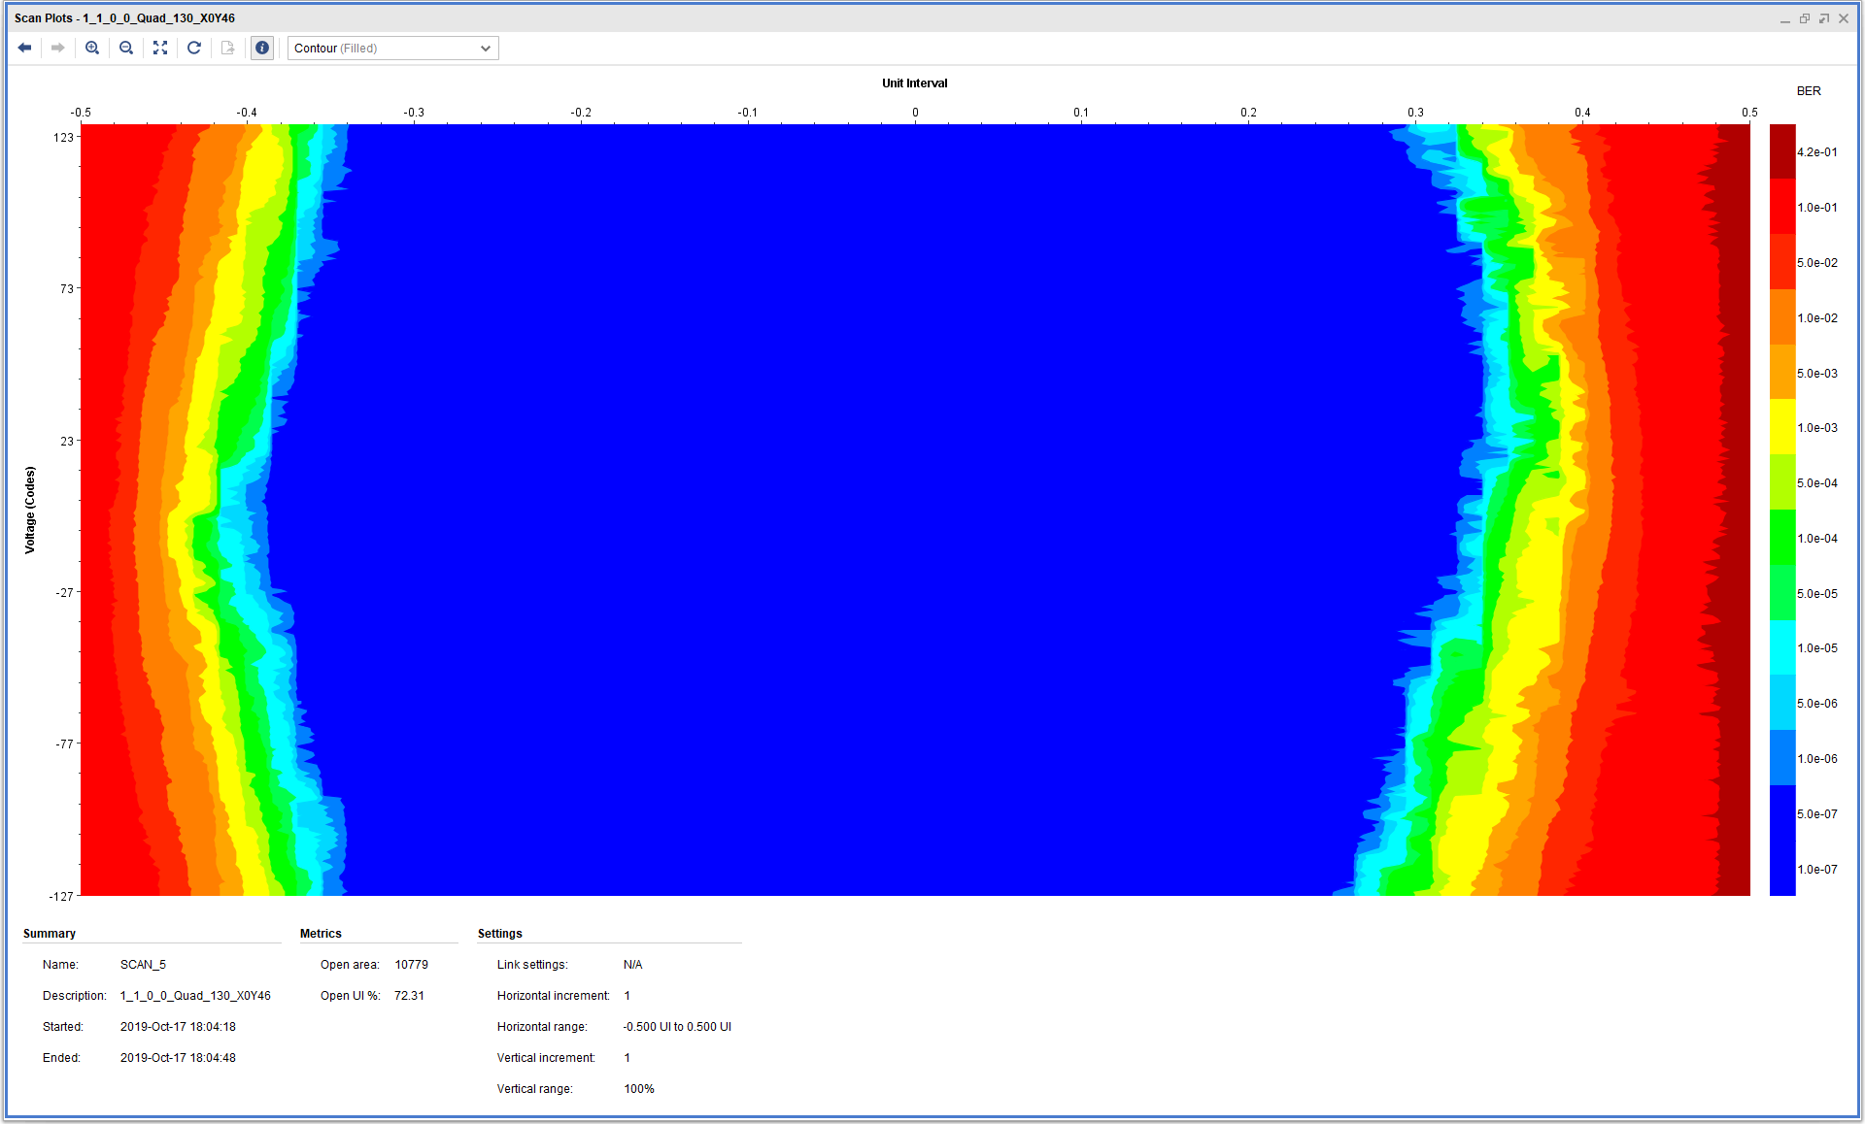
Summary of Eye Scans
U1 worse and best eye scan
U2 worse and best eye scan
Significant improvement of the eye opening on almost all channels, after correction of the GTY calibration circuit

Slide 9
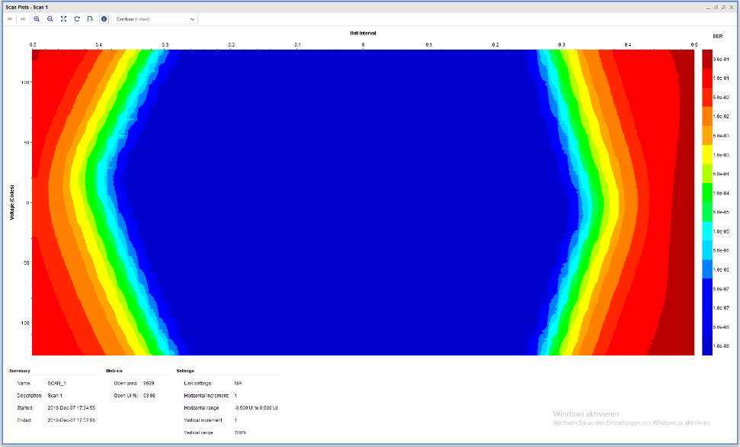
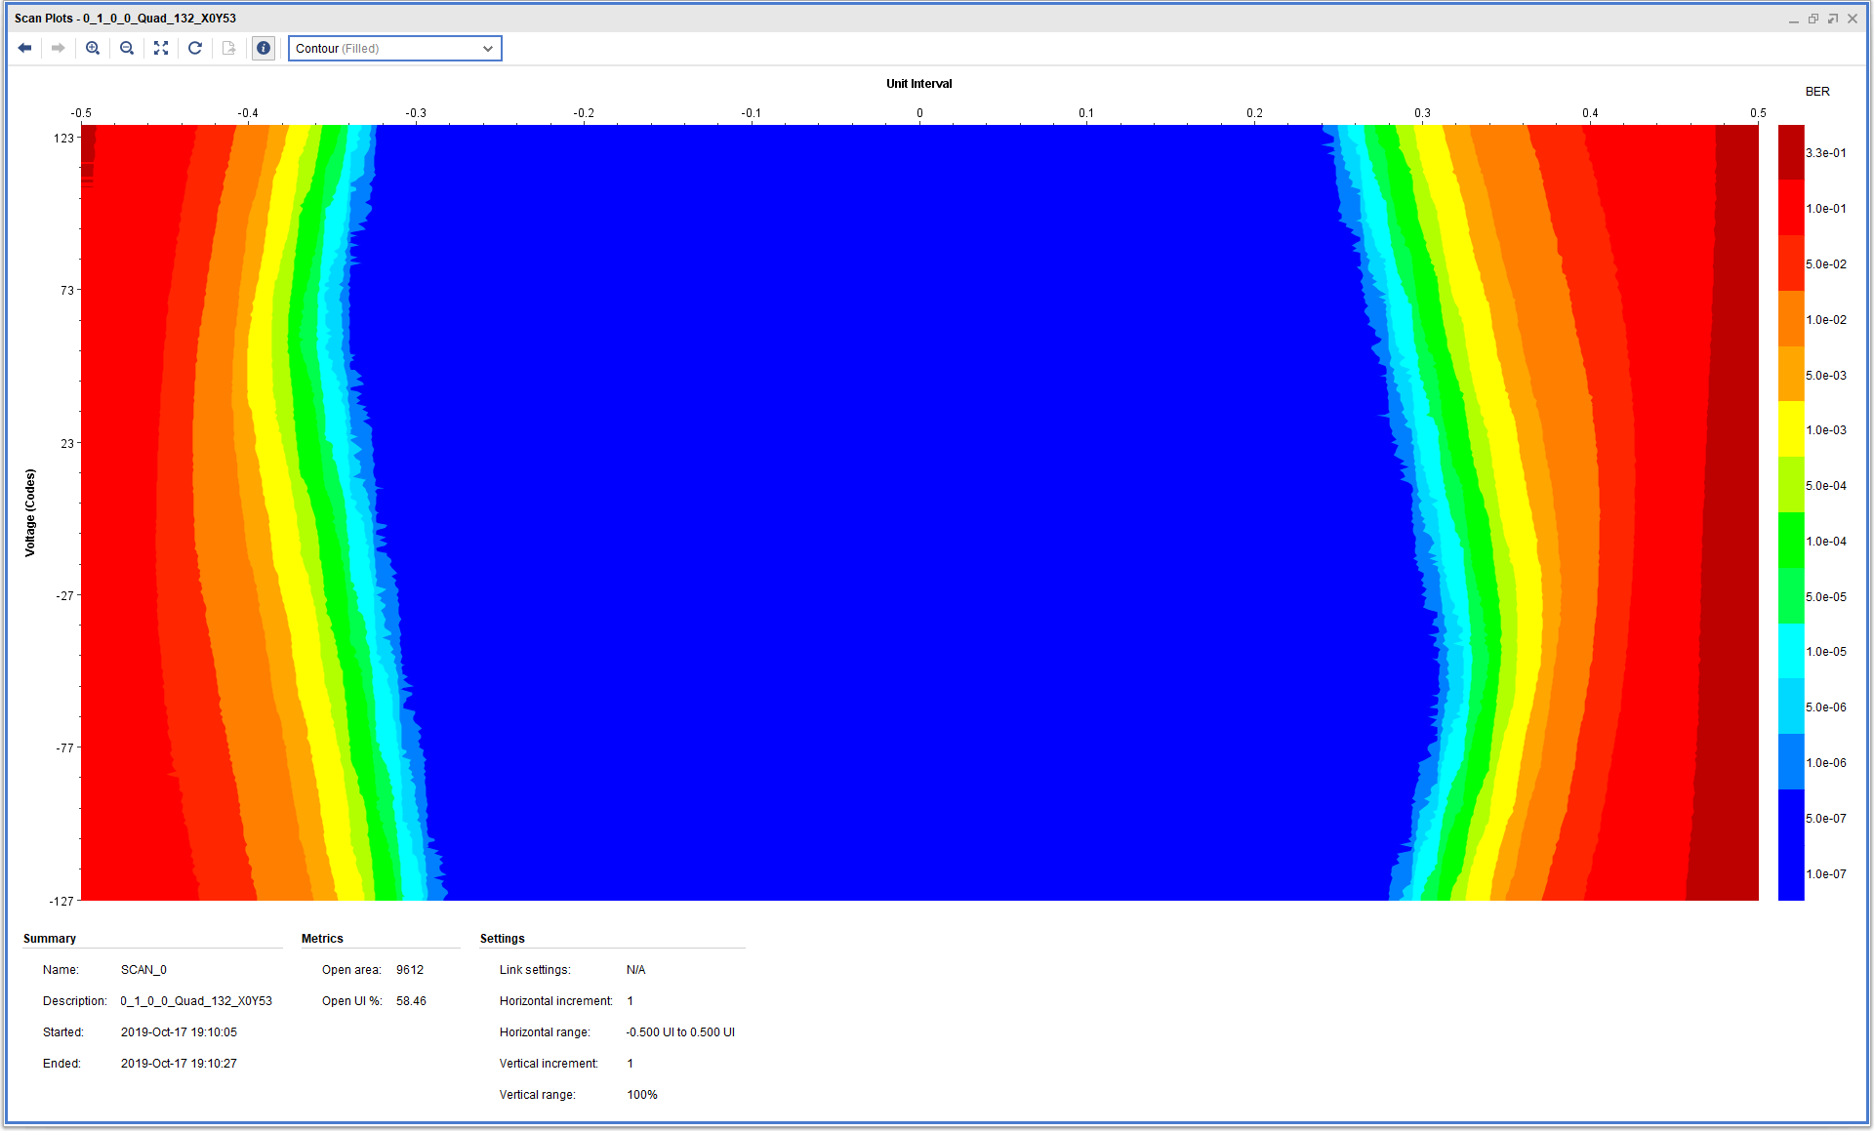
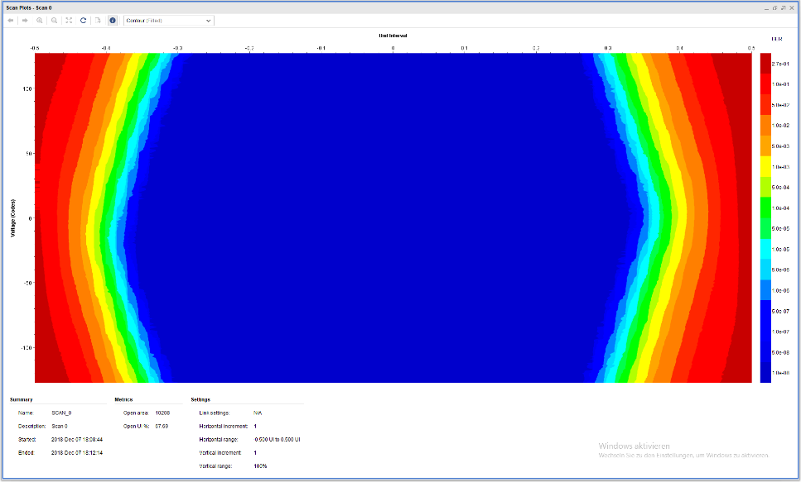
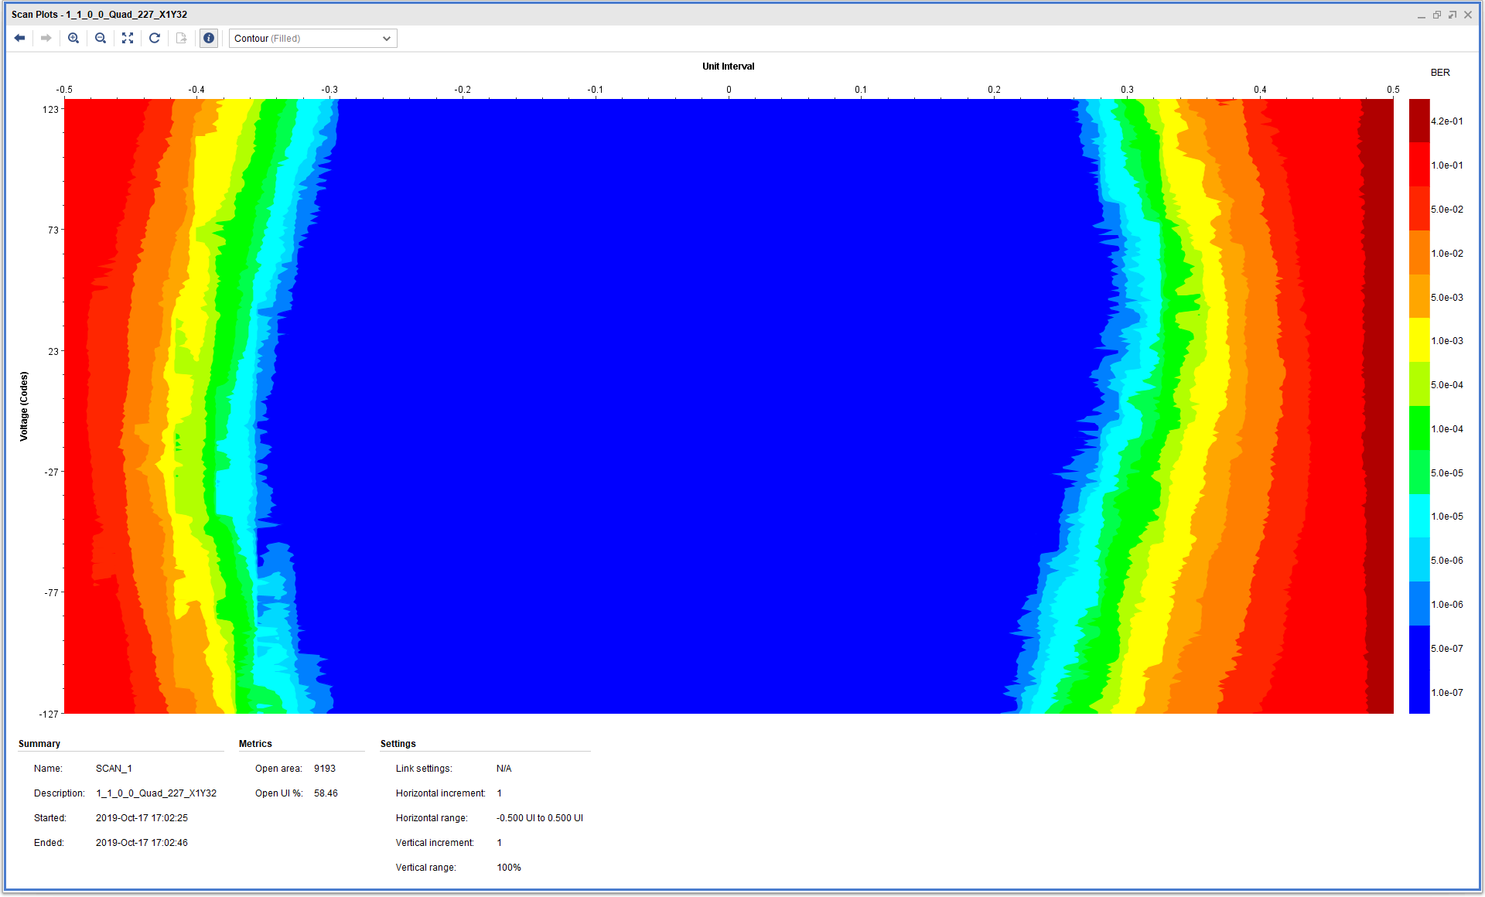
Eye Scans - Example
Prototype
Pre Production
U1
QUAD_132_CH1
Tx WRONG -> Rx WRONG
U2
QUAD_227_CH0
Tx OK -> Rx WRONG
11/10/2019
L1Topo Status - L1Calo Joint Meeting
9

Slide 10
Power Measurement During IBERT Tests
* Extracted from DC/DC converter datasheet
All values within the estimations and in agreement with prototype measurements!!

Slide 11
Ripple Measurements
Evaluate the ripple with different conditions
Measurements for VCCINT, VCCAUX, MGTAVTT, MGAVCC and MGTVCCAUX on U1 and U2
Oscilloscope setup
AC coupling with external 50 ohm termination
Timescale
2 us/div
200 us/div
1 ms/div
Oscilloscope bandwidth: 1 GHz
MGT voltage rails specification (UG578): “The noise at the power pins should be less than 10 mVpp over the band from 10 kHz to 80 MHz”

Slide 12
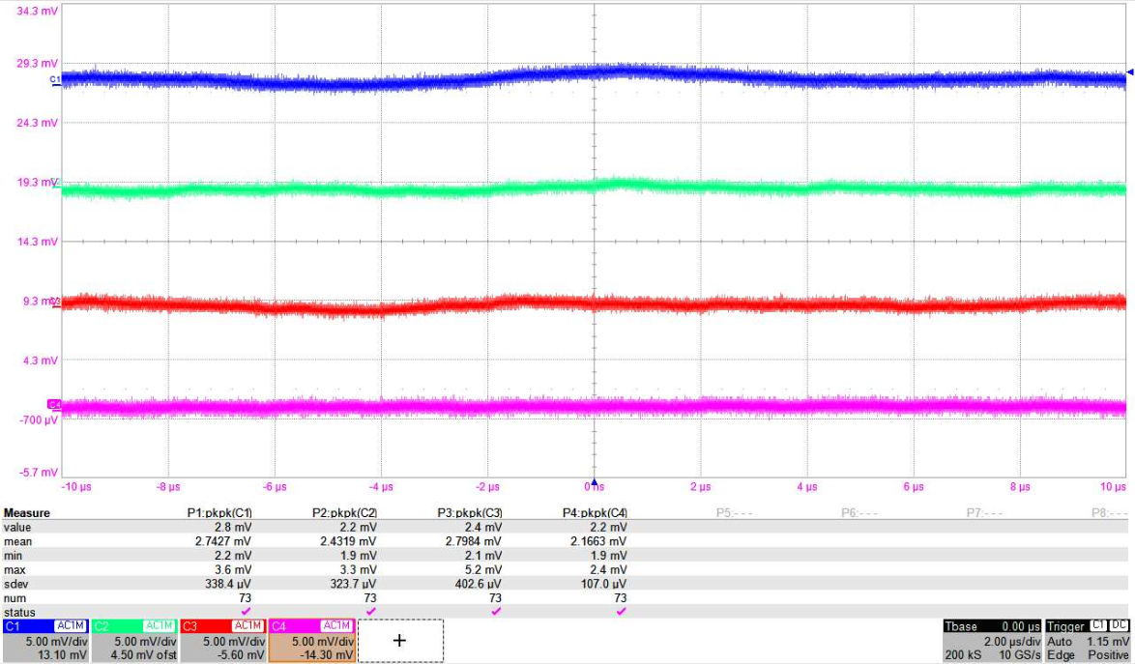
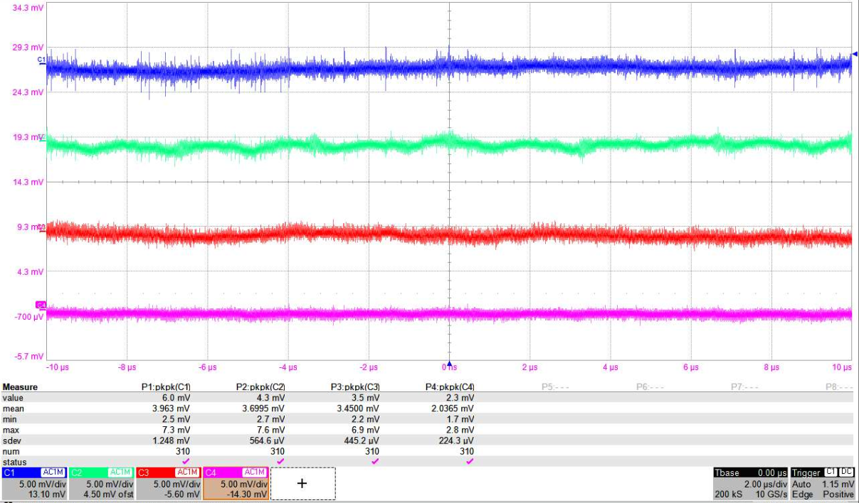
Vout Ripple Results
VCCINT
MGTAVCC
MGTAVTT
MGTVCCAUX
U1
U2
All values within the Xilinx specs!!

Slide 13
Status summary / slice test readiness
L1Topo has been successfully operated with all interfacing modules - eFEX, jFEX, gFEX, MuCTPI, hub/ROD to various degrees
For all FEX sources formatted data transmission has been successful
Both prototype and 1st production module (few mods) well tested
Hardware ready for slice test
Algo status → see Johannes
Firmware integration of all components almost complete: Christian and Marek still busy on their respective ends
Software : initial tests have been done with standalone software, data streams looked at via spy memory
Significant fraction of IPbus register set implemented
Integration in L1Calo/TDAQ world under way (Holger)

