Slide 1
L1Topo recent work / status / plans
Uli, Julio / Mainz
Hardware
Firmware (infrastructure/control)
Tests

Slide 2
Hardware Overview
ATCA board (based on jFEX design)
Modular design
2 Virtex UltrascalePlus FPGAs
Two iterations
Prototype (FDR 01/2019)
Final design presented at PRR 08/2019
Fix on MGT calibration

Slide 3
Hardware Overview
ATCA board (based on jFEX design)
Modular design
2 Virtex UltrascalePlus FPGAs
XCVU9P-2FLGA2577E
120 MGTs (GTY) per FPGA
118 input fibres per processor FPGA
24 MiniPOD: 20 RX + 4 TX
Mezzanines
Control & Power
Both compatible with jFEX
CTP interface module (LVDS drivers)
Rx
Rx
Virtex
UltrascalePlus (U1)
Rx
Rx
Rx
Rx
Rx
Rx
Rx
Tx
Rx
Tx
U1 Power Mezzanine
U2 Power Mezzanine
Tx
Rx
Virtex
UltrascalePlus (U2)
Tx
Rx
Rx
Rx
Rx
Rx
Rx
Rx
Rx
Rx
Control Mezzanine
Board Voltage Level Mezzanine - 1V8
Board Voltage Level Mezzanine - 2V5
ATCA Power Interface
Board Voltage Level Mezzanine - 3V3

Slide 4
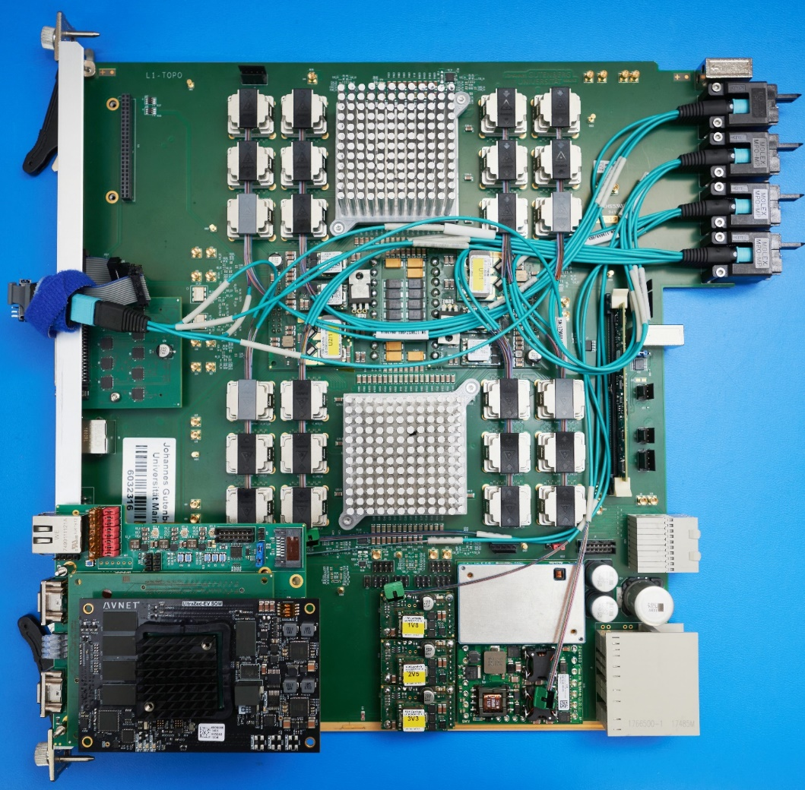
Hardware Overview
ATCA board (based on jFEX design)
Modular design
2 Virtex UltrascalePlus FPGAs
XCVU9P-2FLGA2577E
120 MGTs (GTY) per FPGA
118 input fibres per processor FPGA
24 MiniPOD: 20 RX + 4 TX
Mezzanines
Control & Power
Both compatible with jFEX
CTP interface module
new
L1Topo 1st production module with control mezzanine v3.0

Slide 5
Control Mezzanine v3.0 General Functionalities
new
Carrier board for the UltraZed-EV
Functionalities
Hosts the control module of the jFEX/L1Topo mainboard
Zynq Ultrascale+ ZU7EV-FBV900
LHC clock cleaning and distribution to processor FPGAs
Si5345
Hosts the MasterSPI configuration circuitry for processors
MT25QU02GCBB8E12-0SIT
IPBus master
Hosts the PHY chip (transformer-less scheme)
VSC8221
TTC data reception and distribution to processor FPGAs
HUB1: Using fanout NB7VQ1006M
HUB2: Reception on one MGT and distribution to processors via IOs
Communication to mainboard CPLDs (PWR and CTRL_CLK)
Monitoring and slow control
MiniPODs (Avago) monitoring viaI2C
PMBus monitoring

Slide 6
Control Mezzanine v3.0 validation status
Carrier board for the UltraZed-EV
Functionalities
Hosts the control module of the jFEX/L1Topo mainboard
Zynq Ultrascale+ ZU7EV-FBV900
LHC clock cleaning and distribution to processor FPGAs
Si5345
Hosts the MasterSPI configuration circuitry for processors
MT25QU02GCBB8E12-0SIT
IPBus master
Hosts the PHY chip (transformer-less scheme)
VSC8221
TTC data reception and distribution to processor FPGAs
HUB1: Using fanout NB7VQ1006M
HUB2: Reception on one MGT and distribution to processors via IOs
Communication to mainboard CPLDs (PWR and CTRL_CLK)
Monitoring and slow control
MiniPODs (Avago) monitoring viaI2C
PMBus monitoring
All functionalities have been fully validated on both jFEX and L1Topo!
Ongoing production of final PCBs – total lead time, including assembly: 8 weeks

Slide 7
L1Topo Module tests / mainboard
The production module was stand-alone tested in the home lab
Power consumption and ripple fully measured and reported
Full Ibert tests of all interfaces at the STF
Ipbus subsystem successfully tested (w. control mezzanine 3.0) at STF
System-level tests at the STF successfully run
Formatted TOB data successfully received from the FEXes
Spy data BCReset sync’ed
L1Accept recorded along with real-time data
Stable data transmission
Trailer handling understood, final agreement required (see below)
MUCTPI → L1Topo formatted data transmission tests yet to be done
Recently (double check on prototype → production fixes)
Further link qualification tests: e/o MGT transmitter tests
Keysight DSA91204 – 12 GHz bandwidth
Differential probe soldered on the miniPOD connector
Optical transceiver for direct fibre connection
12.8Gb/s PRBS-7 pattern chosen (→ reference for jFEX design update)

Slide 8
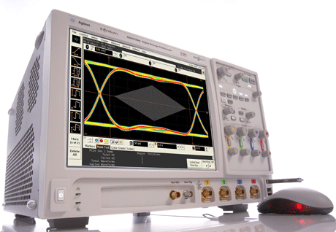
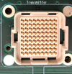
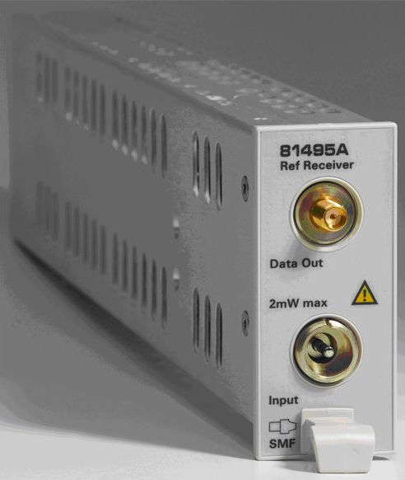
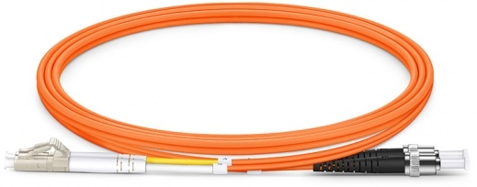
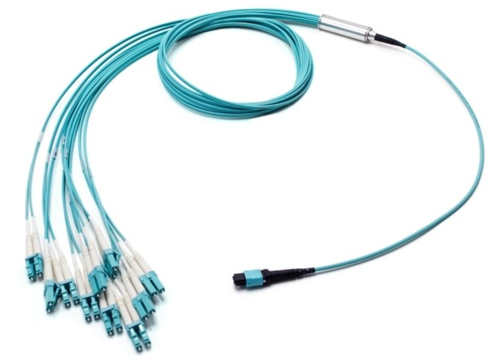
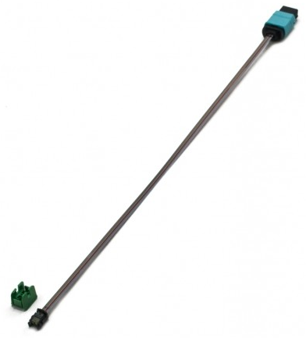
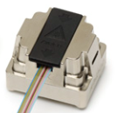
Last open issue wrt real-time data transmission: Confirm TX link performance
Agilent/Keysight DSA91204
MiniPOD
Receptacle
InfiniiMax II Amplifier
5425B Diff Probe Heads
N5426B ZIP Tip
(Soldered on a MiniPOD adapter)
81495A Reference
Receiver
Agilent/Keysight DSA91204
LC to ST
MTP to LC
MiniPOD
PRIZM to MTP

Slide 9
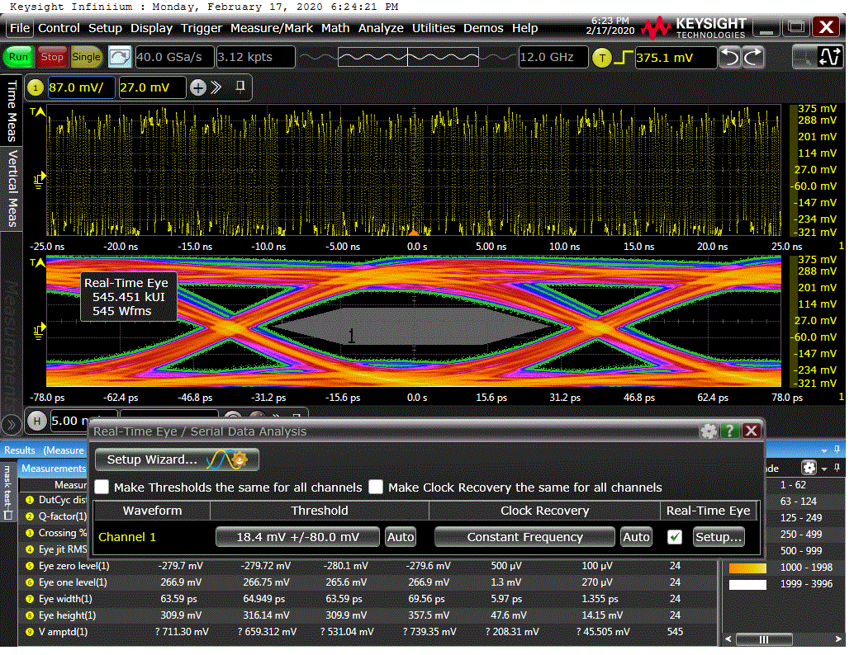
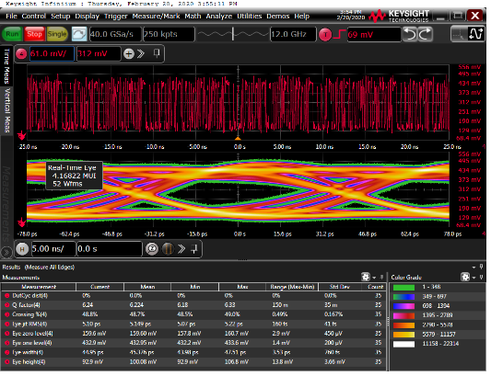
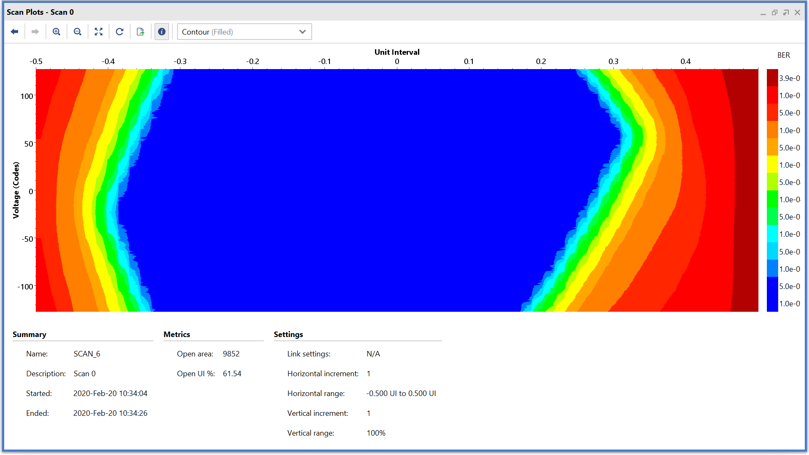
Results – Channel X1Y21
A channel that had hadn’t been well understood in previous tests
Tune the MGT parameters
Make sure we are within MiniPOD specs (reduced swing)
Electrical; TX Setup 3; PRBS7
Optical; TX Setup 3; PRBS7
IBERT; TX Setup 3; PRBS7
Eye opening within miniPOD mask specification

Slide 10
Conclusions on link data integrity
Very good eye opening for the L1Topo outputs, after properly setting the TX Pre-Emphasis parameters
Within the miniPOD specification
Validation of the L1Topo Pre-Production module and the GTY calibration circuit
No significant difference wrt to Prototype
→ consider design fully validated

Slide 11
Firmware status
Algorithms and input mapping has been reported on (Johannes) https://indico.cern.ch/event/884278/contributions/3745259/attachments/2004273/3346895/talk.pdf
Real-time infrastructure (MGTs/SerDes) exists
Tested with FEXes at STF (protocol tests)
Module control (Ipbus)
First version exists
Successfully operated with standalone software throughout STF tests
Recent improvement on play/spy module (BCR syc)
Being turned into a common framework L1Topo/jFEX
Online software for common scheme under way
Along with control mezzanine v3.0 comes a set of f/w
I2C based monitoring of environmental data
Readout firmware will be ported from jFEX soonish
→ Full integration yet to be accomplished: real-time infrastructure / algorithms / control / readout

Slide 12
A few discussions on input TOB data formats…
Had some initial issues with data formats from FEXes at early STF tests
Mainly sorted out
Some modifications to format specs still possible, not finally signed off
Discussion on optimal CRC scheme (Jira)
Request to add BCR bit to trailer of FEX TOBs
jFEX requested some of the "reserved“ bits in trailer for overflow indication
→ Can be sorted out quickly → finalize input firmware soonish

Slide 13
L1Topo production status
The production PCBs exist
First module has been assembled, successfully been tested and reported on in this presentation
Components available for remaining modules
Expect assembly to take ~ 1 Month after green light from reviewers
Production of a small batch of control mezzanines v.3.1 under way
No issues with PCB production expected
Assembly needs to be sorted out (previous batch assembled at CERN !)
CTP interface module exists, ready for tests with CTP and volume production at any time

Slide 14
Summary / plans
First L1Topo production board successfully tested
Basically ready for production of remaining modules
Firmware components in good shape
Algorithms see Johannes
Realtime infrastructure done and tested, minor fixes
Control firmware being restructured
Readout under way for jFEX (see Ren-Jie) → port to Topo
Firmware integration time-consuming (multi-die FPGAs)
Ready to install in USA15 in summer

