Slide 1
Status L1Topo
Uli, Julio / Mainz
Hardware
Firmware
Tests

Slide 2
Hardware Overview
ATCA board (based on jFEX design)
2 Virtex UltrascalePlus
Two iterations
Prototype (FDR 01/2019)
Final design presented at PRR 08/2019

Slide 3
Hardware Overview
ATCA board (based on jFEX design)
Modular design
2 Virtex UltrascalePlus FPGAs
XCVU9P-2FLGA2577E
120 MGTs (GTY) per FPGA
118 input fibres per processor FPGA
24 MiniPOD: 20 RX + 4 TX
Mezzanines
Control & Power
Both compatible with jFEX
Rx
Rx
Virtex
UltrascalePlus (U1)
Rx
Rx
Rx
Rx
Rx
Rx
Rx
Tx
Rx
Tx
U1 Power Mezzanine
U2 Power Mezzanine
Tx
Rx
Virtex
UltrascalePlus (U2)
Tx
Rx
Rx
Rx
Rx
Rx
Rx
Rx
Rx
Rx
Control Mezzanine
Board Voltage Level Mezzanine - 1V8
Board Voltage Level Mezzanine - 2V5
ATCA Power Interface
Board Voltage Level Mezzanine - 3V3

Slide 4
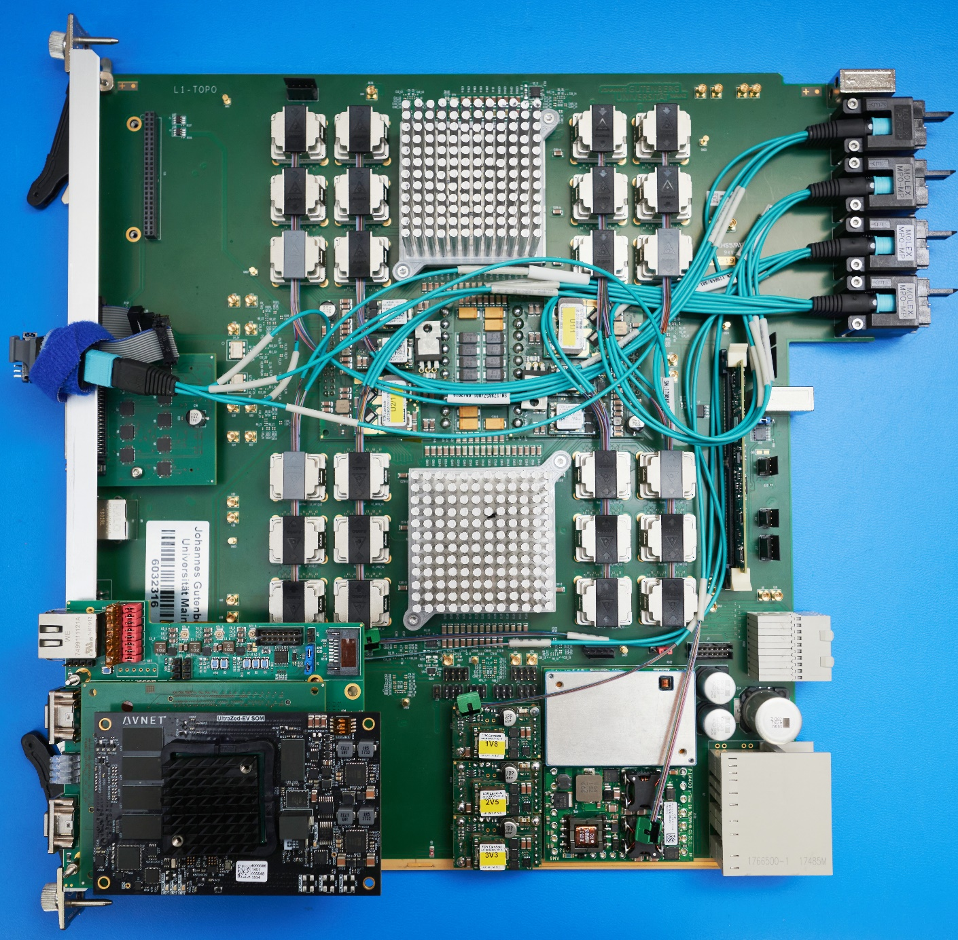
Hardware Overview
ATCA board (based on jFEX design)
Modular design
2 Virtex UltrascalePlus FPGAs
XCVU9P-2FLGA2577E
120 MGTs (GTY) per FPGA
118 input fibres per processor
FPGA
24 MiniPOD: 20 RX + 4 TX
Mezzanines
Control & Power
Both compatible with jFEX
L1Topo 1st production module with “new” mezzanine

Slide 5
Control Mezzanine v3.0 - General Functionalities
Carrier board for the UltraZed-EV
Functionalities
Hosts the control module of the jFEX/L1Topo mainboard
Zynq Ultrascale+ ZU7EV-FBV900
LHC clock cleaning and distribution to processor FPGAs
Si5345
Hosts the MasterSPI configuration circuitry for processors
MT25QU02GCBB8E12-0SIT
IPBus master
Hosts the PHY chip (transformerless scheme)
VSC8221
TTC data reception and distribution to processor FPGAs
HUB1: Using fanout NB7VQ1006M
HUB2: Reception on one MGT and distribution to processors via IOs
Communication to mainboard CPLDs (PWR and CTRL_CLK)
Monitoring and slow control
MiniPODs (Avago) monitoring viaI2C
PMBus monitoring

Slide 6
Control Mezzanine v3.0 - General Functionalities
Carrier board for the UltraZed-EV
Functionalities
Hosts the control module of the jFEX/L1Topo mainboard
Zynq Ultrascale+ ZU7EV-FBV900
LHC clock cleaning and distribution to processor FPGAs
Si5345
Hosts the MasterSPI configuration circuitry for processors
MT25QU02GCBB8E12-0SIT
IPBus master
Hosts the PHY chip (transformerless scheme)
VSC8221
TTC data reception and distribution to processor FPGAs
HUB1: Using fanout NB7VQ1006M
HUB2: Reception on one MGT and distribution to processors via IOs
Communication to mainboard CPLDs (PWR and CTRL_CLK)
Monitoring and slow control
MiniPODs (Avago) monitoring viaI2C
PMBus monitoring
All functionalities have been fully validated on both jFEX and L1Topo!!!
Ongoing production of final PCBs – total lead time, including assembly: 8 weeks

Slide 7
Recent firmware updates
Controller firmware adapted to new mezzanine
Includes I2C handling for Ipbus readout to OPC server
TTC data handling included
BCReset and L1Accept forwarded from controller to processors
Infrastructure complete, but expect minor trailer format related changes
Algorithm firmware status reported in different place
Full integration real-time infrastructure / algorithms / control / readout yet to be accomplished

Slide 8
Module tests
The production module was stand-alone tested in the home lab
Power consumption and ripple fully measured and reported
Full Ibert tests of all interfaces at the STF
Currently under system-level tests at the STF
Formatted TOB data successfully received from the FEXes
Spy data now BCReset sync’ed
L1Accept recorded along with real-time data
Trailer handling understood, final agreement required (see below)

Slide 9
A few recent results on link data integrity
While most of the tests were made last year, and results have been reported, we did dig deeper on a few issues recently:
Timing data reception from the backplane (detailed measurements actually made on jFEX, but Topo affected just the same):
FTM shown to lack pre-emphasis from fanout drivers, resulting in bad eyes
Hub-driven lines yield good data eyes
MGT transmitter signals into MiniPODs been measured again
….

Slide 10
Setup (1)
Eye measurement of Tx on L1Topo (only) with oscilloscope - Agilent/Keysight DSA91204 – 12 GHz bandwidth
Differential probe soldered on the miniPOD connector
Or with optical transceiver for direct fibre connection
Goal: Compare the eye diagrams of two channels
One with errors (“Bad” Channel X1Y21) and one error free (“Good” Channel X0Y21)
Evaluate impact of Tx pre-emphasis on the eye diagram

Slide 11
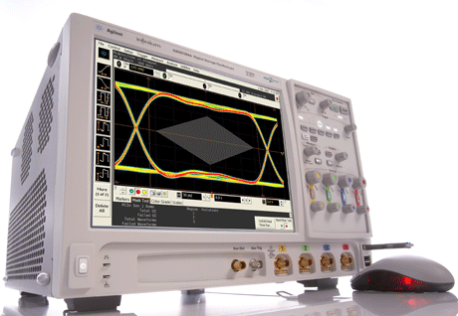
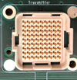
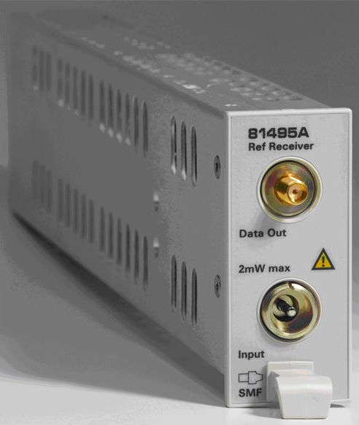
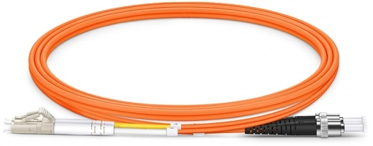
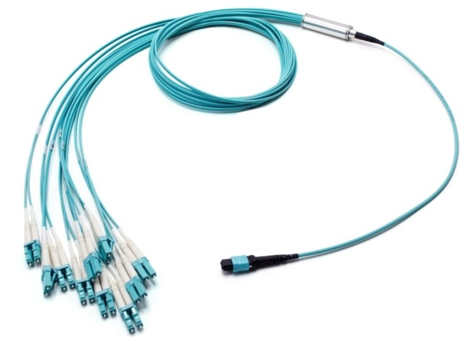
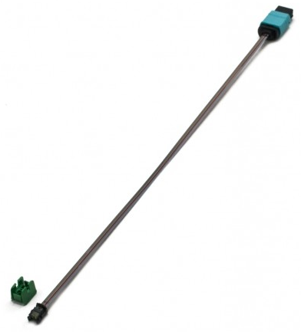
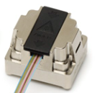
Setup (2)
Setup 1
Agilent/Keysight DSA91204
MiniPOD
Receptacle
InfiniiMax II Amplifier
5425B Diff Probe Heads
N5426B ZIP Tip
(Soldered on a MiniPOD adapter)
Setup 2
81495A Reference
Receiver
Agilent/Keysight DSA91204
LC to ST
MTP to LC
MiniPOD
PRIZM to MTP

Slide 12
Setup (2)
Tx pre-emphasis*
Default
TX DIFF Swing: 950 mV
TX Pre-Cursor: 0 dB
TX Post-Cursor: 0 dB
Setup 1
TX DIFF Swing: 950 mV
TX Pre-Cursor: 4.44 dB
TX Post-Cursor: 4.44 dB
Setup 2
TX DIFF Swing: 870 mV
TX Pre-Cursor: 0 dB
TX Post-Cursor: 9.12 dB
Setup 3
TX DIFF Swing: 730 mV
TX Pre-Cursor: 0 dB
TX Post-Cursor: 13 dB
L1Topo
Optics and electric signal
@12.8 Gbps
PRBS7
On link X1Y21, errors are observed only with the default setup (IBERT)
Link X0Y21 is error free with all setups (IBERT)
Tests performed on L1Topo Prototype (without GTY calibration circuit)
and on L1Topo Pre-Production (with GTY calibration circuit)
No significant difference observed between both boards
All results shown on this presentation are related to L1Topo Pre-Production
*Details on the GTY datasheet.
This white paper provides a very nice explanation

Slide 13
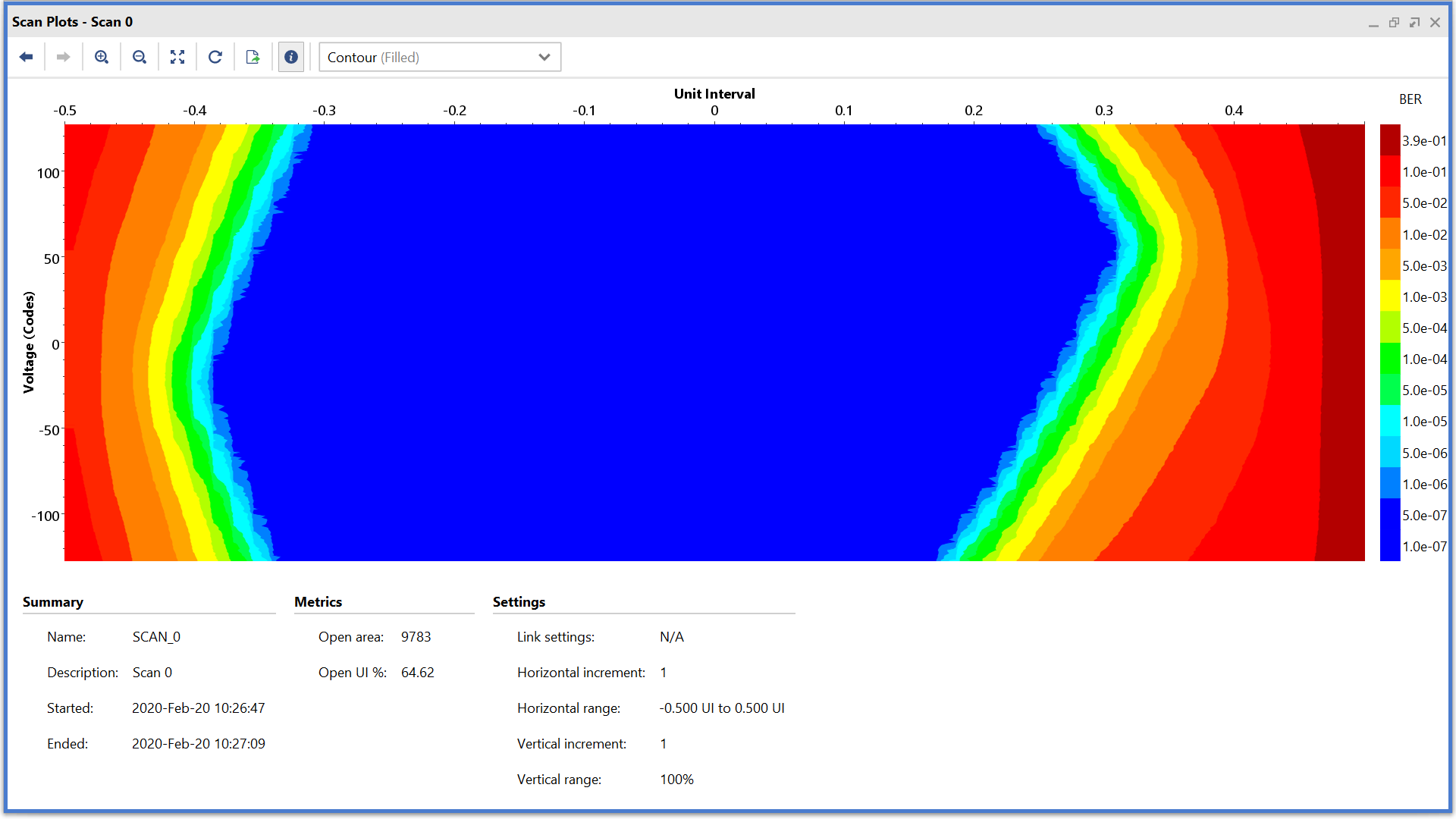
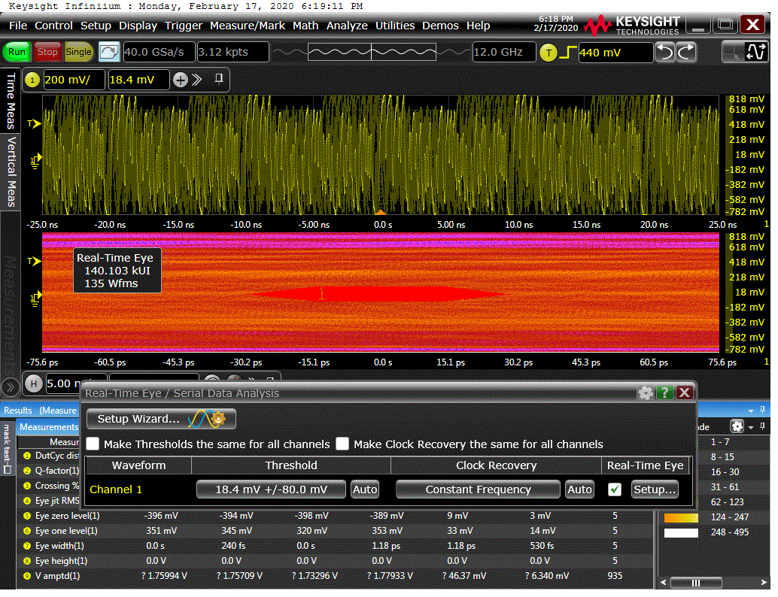
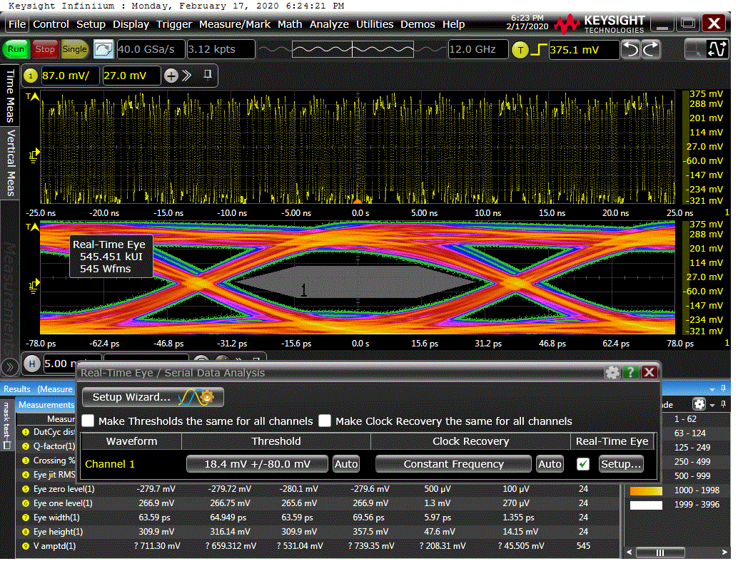
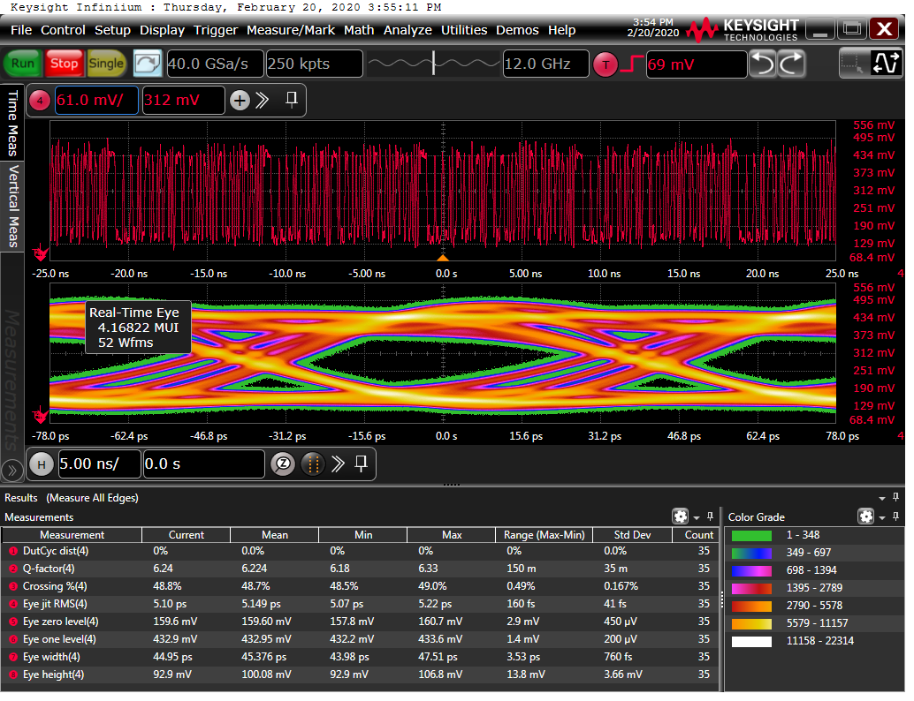
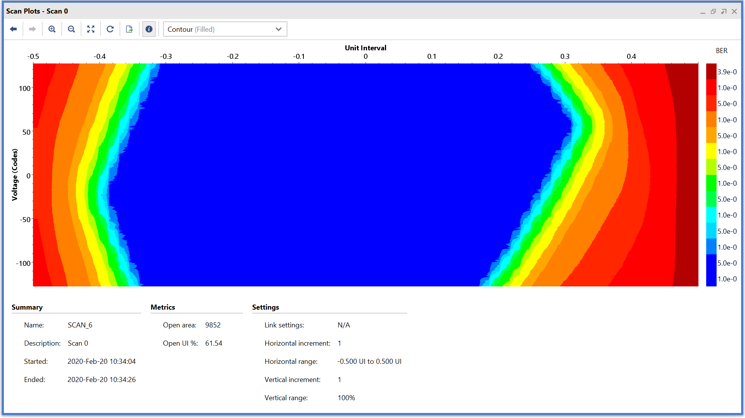
Results – “Bad” Channel X1Y21
IBERT; TX Default; PRBS7
Electrical; TX Default; PRBS7
Optical; TX Default; PRBS7
Eye closed, due to the poor electrical connection
Good eye opening on Vivado Eye Scans with both setups
Electrical; TX Setup 3; PRBS7
Optical; TX Setup 3; PRBS7
IBERT; TX Setup 3; PRBS7
Eye opening within miniPOD mask specification

Slide 14
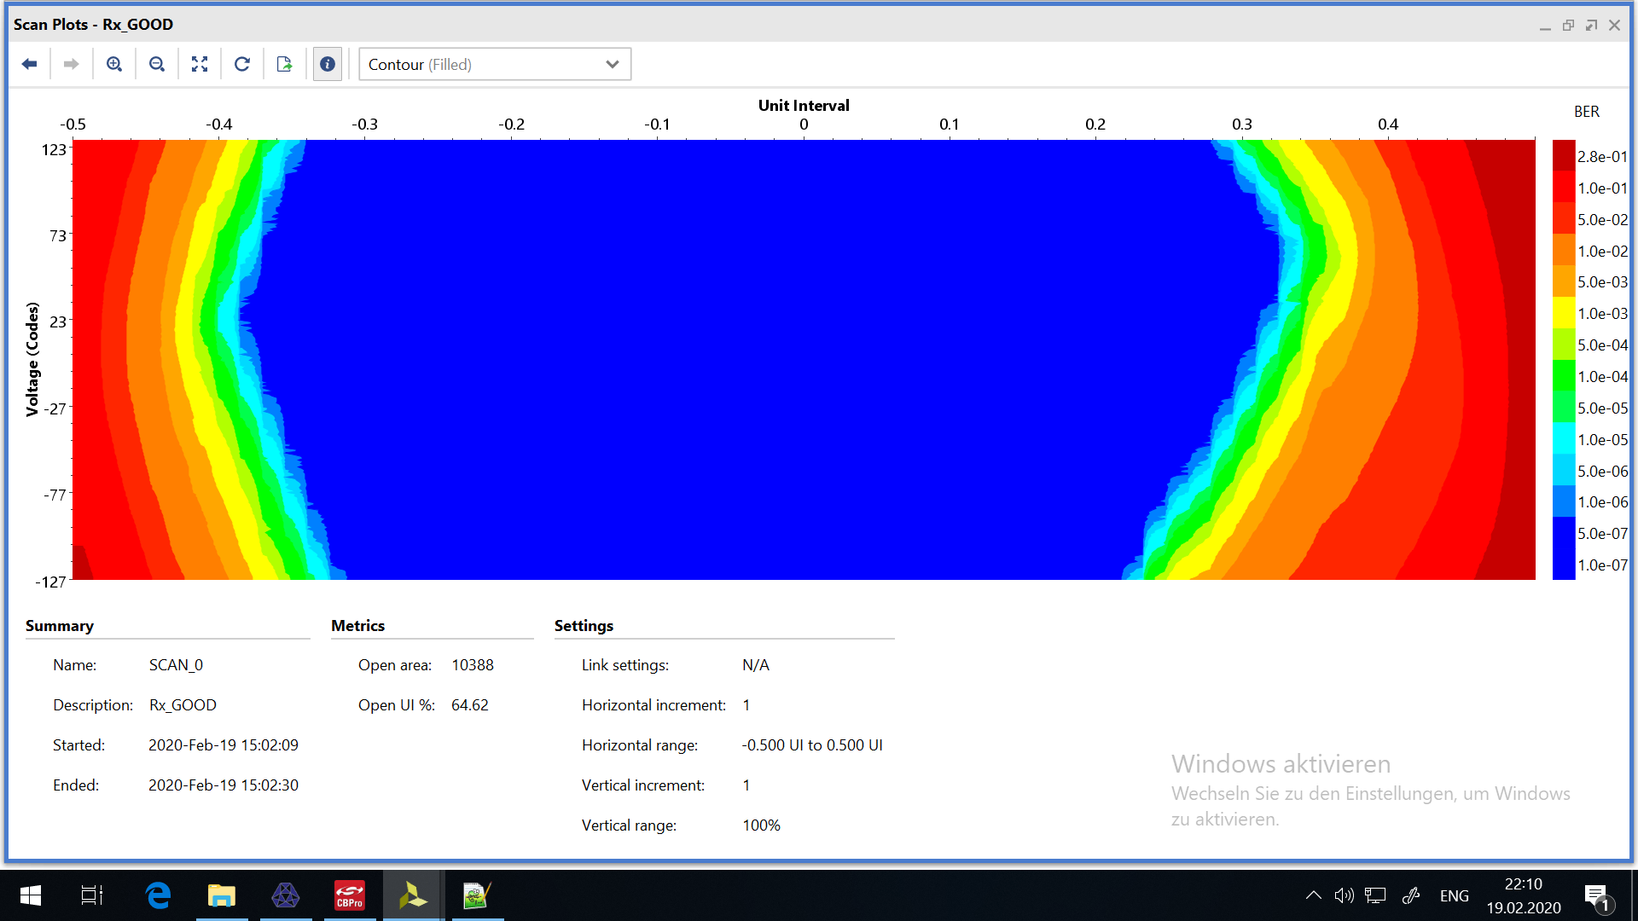
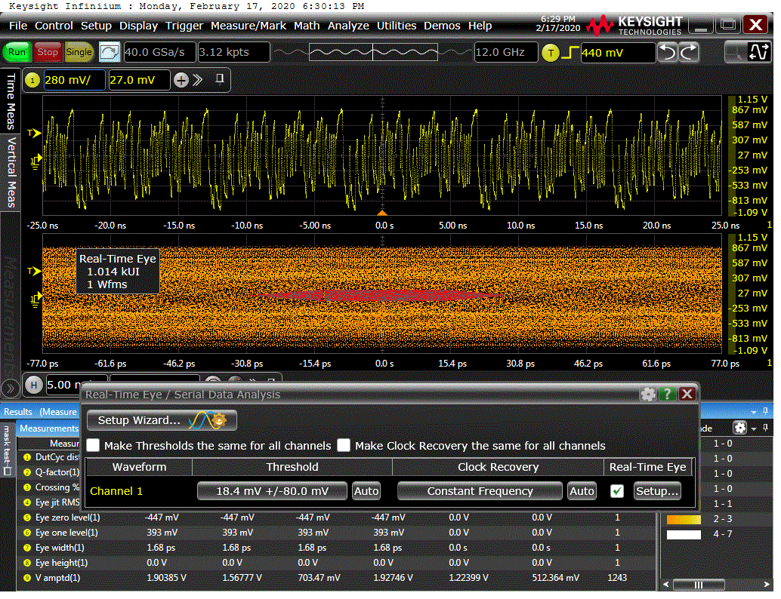
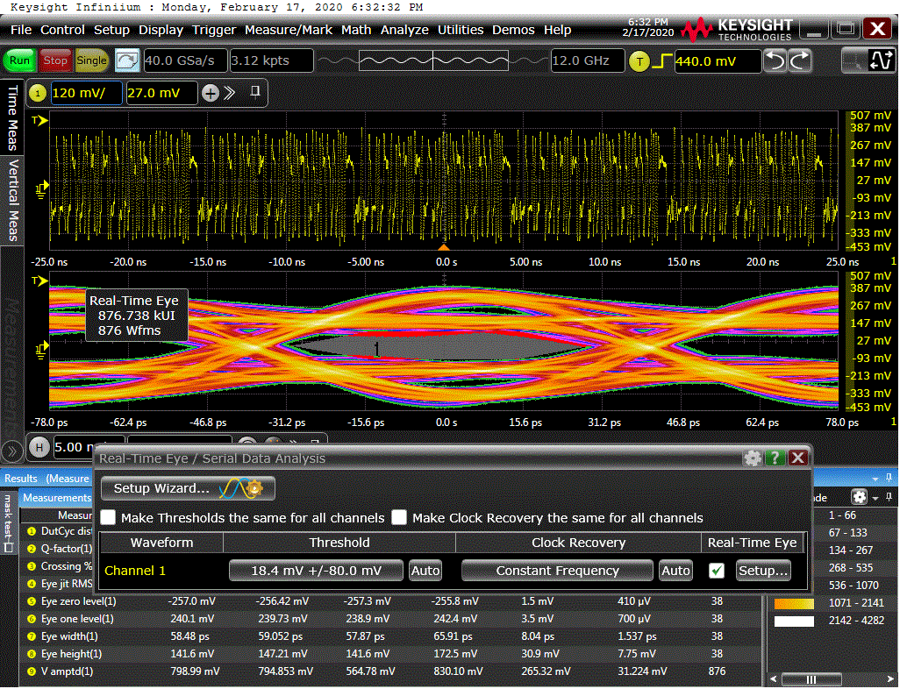
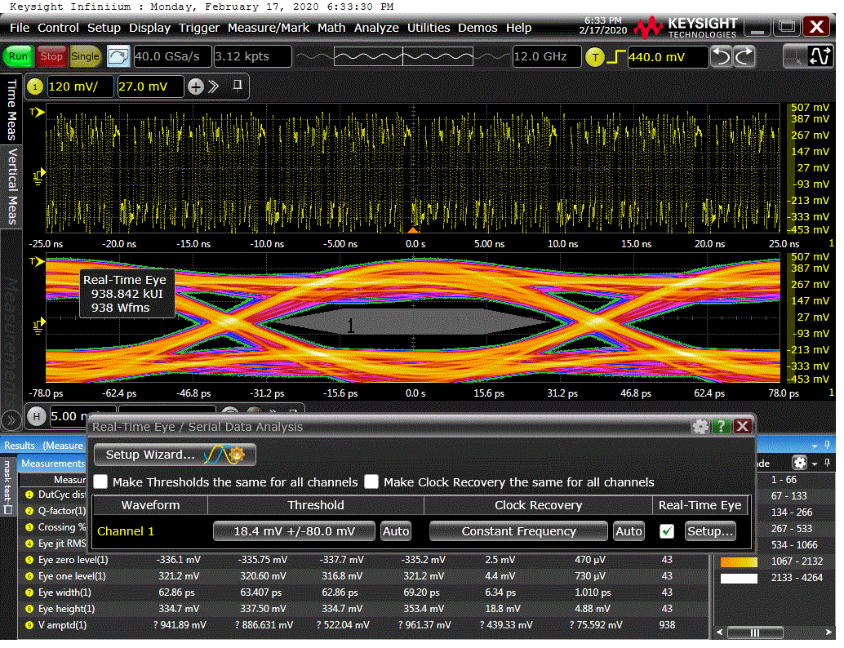
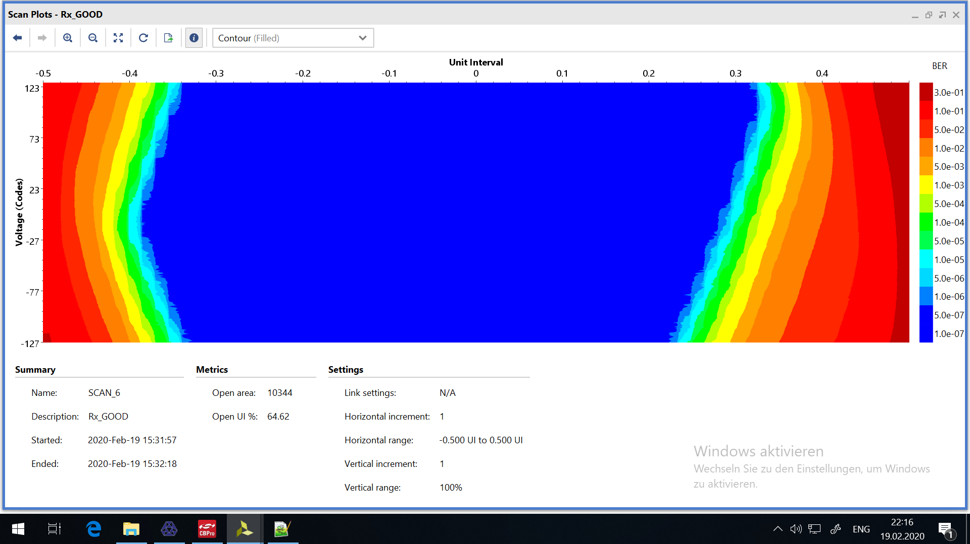
Results – “Good” Channel X0Y21
IBERT; TX Default; PRBS7
Electrical; TX Default; PRBS7
Electrical; TX Setup 2; PRBS7
Eye closed, due to the poor electrical connection
Good eye opening on Vivado Eye Scans with both setups
Eye opening within miniPOD mask specification
Electrical; TX Setup 1; PRBS7
Electrical; TX Setup 3; PRBS7
IBERT; TX Setup 3; PRBS7

Slide 15
Conclusions on link data integrity
Very good eye opening for the L1Topo outputs, after properly setting the TX Pre-Emphasis parameters
Within the miniPOD specification
Validation of the L1Topo Pre-Production module and the GTY calibration circuit
No significant difference wrt to Prototype

Slide 16
Ongoing discussions on TOB data formats
Discussion on optimal CRC scheme (Jira)
Request to add BCR bit to trailer of FEX TOBs
jFEX requested some of the "reserved“ bits in trailer for overflow indication

Slide 17
Plans
Adapt IPbus register map to common L1Topo/jFEX scheme
And finally…
Full integration of all firmware components including readout
Note: timing closure is expected to require quite some effort:
Super logic region crossing might still require quite some massaging !!!

Slide 18
Backup

Slide 19
Link data integrity – TTC combined data
Check the backplane signals – TTC combined data (for jFEX, only)
Differential probe soldered on the zone 2 connector
Evaluate impact of Tx pre-emphasis on the eye diagram
Eye measurement of Tx on L1Topo (only) with oscilloscope - Agilent/Keysight DSA91204 – 12 GHz bandwidth
Using Hub and FTM (on slot 1) as data sources
jFEX on slots 4 (short trace) and 11 (long trace)

Slide 20
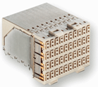
Setup – jFEX
Tx pre-emphasis*
Default
TX DIFF Swing: 950 mV
TX Pre-Cursor: 0 dB
TX Post-Cursor: 0 dB
Setup 1
TX DIFF Swing: 950 mV
TX Pre-Cursor: 4.44 dB
TX Post-Cursor: 4.44 dB
Setup 2
TX DIFF Swing: 950 mV
TX Pre-Cursor: 0 dB
TX Post-Cursor: 9.12 dB
Setup 3
TX DIFF Swing: 950 mV
TX Pre-Cursor: 0 dB
TX Post-Cursor: 13 dB
Data generated on Hub or FTM, from slot 1
jFEX on slot 4 and 11
@6.4 Gbps
PRBS7
*Details on the GTY datasheet.
This white paper provides a very nice explanation
Agilent/Keysight DSA91204
Zone 2
Connector
InfiniiMax II Amplifier
5425B Diff Probe Heads
N5426B ZIP Tip
(Soldered on a MiniPOD adapter)

Slide 21
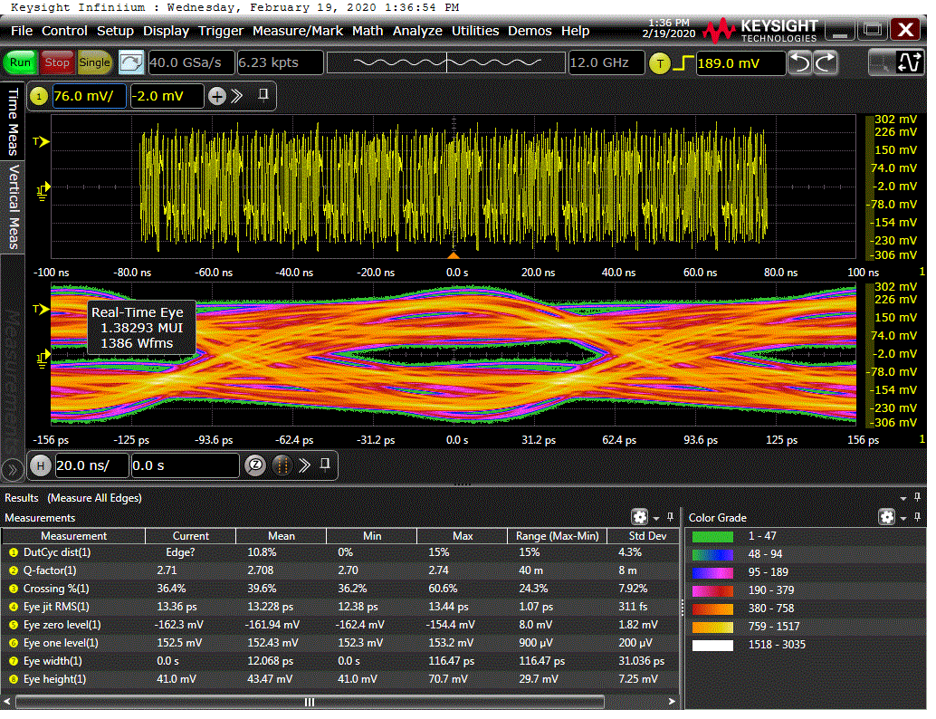
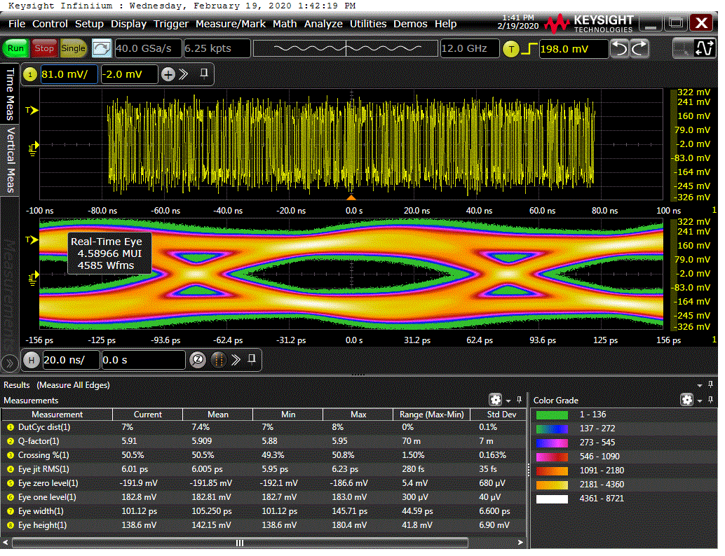
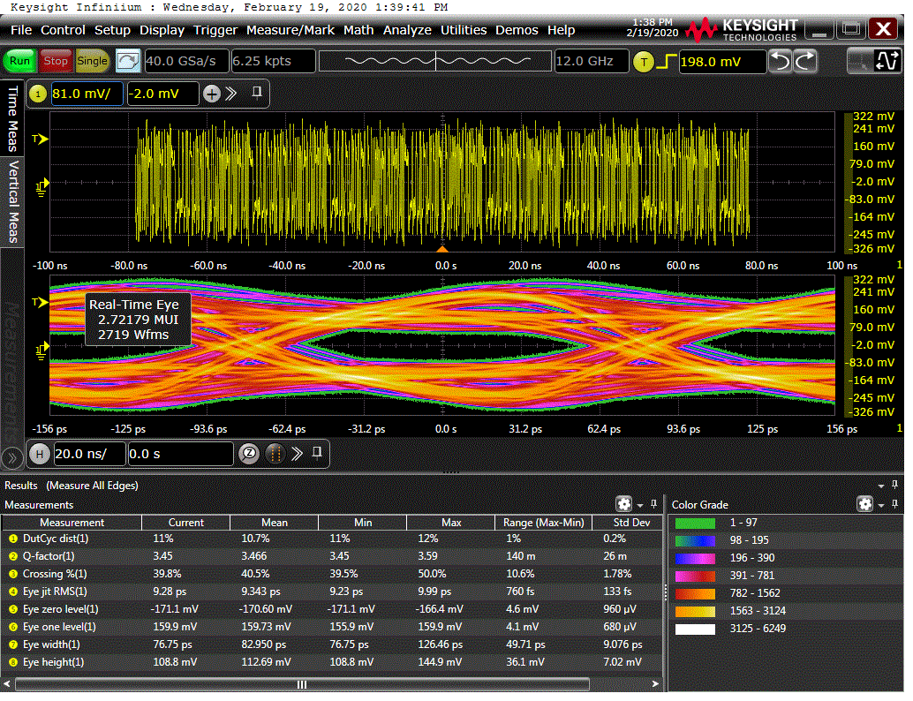
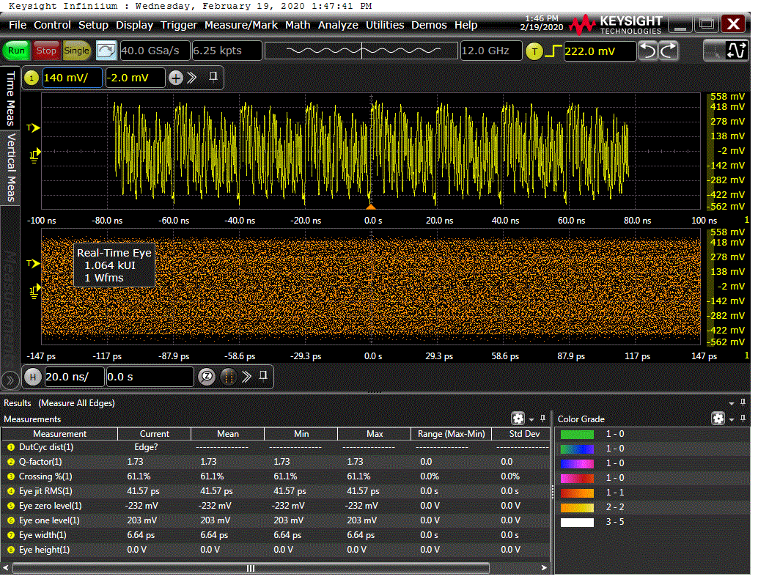
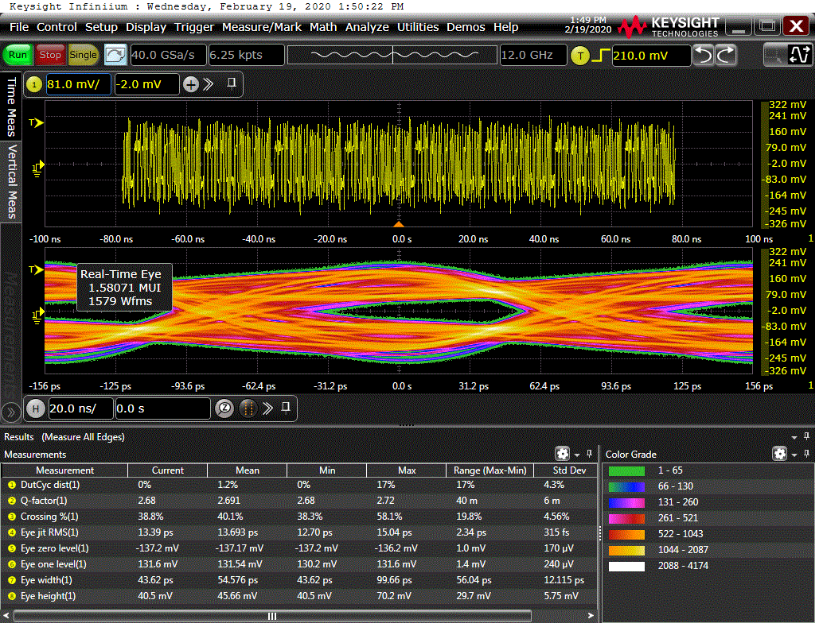
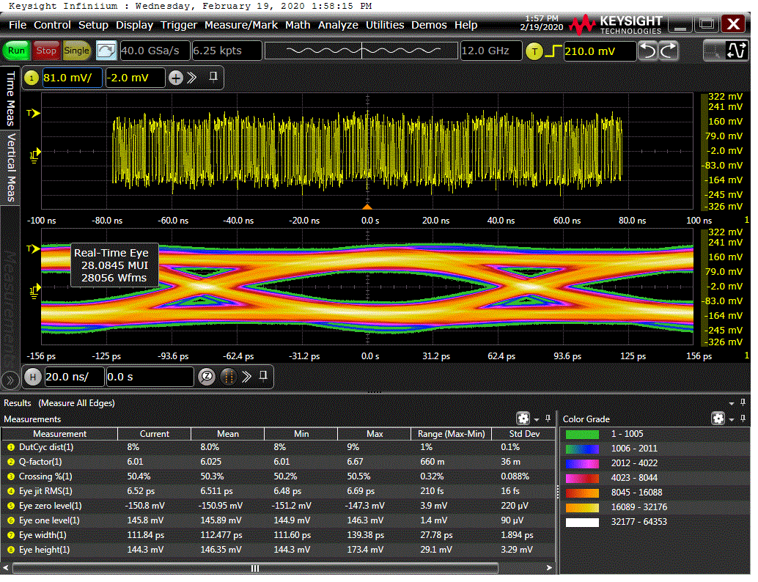
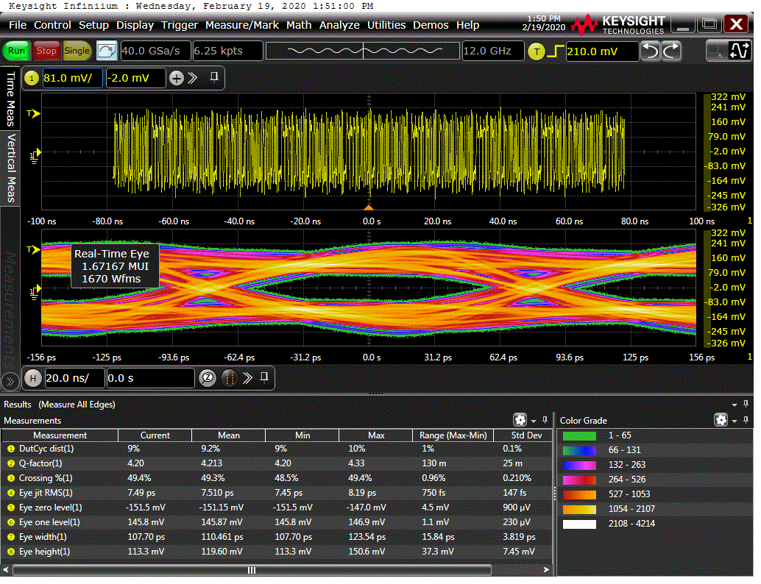
Results – Hub -> jFEX
IBERT test result:
All links were error free (short term test), even though not all eyes are open with “Default” TX pre-emphasis settings
Hub (1) -> jFEX (4); TX Default; PRBS7
Hub (1) -> jFEX (4); TX Setup 1; PRBS7
Hub (1) -> jFEX (4); TX Setup 2; PRBS7
Hub (1) -> jFEX (4); TX Setup 3; PRBS7
Hub (1) -> jFEX (11); TX Default; PRBS7
Hub (1) -> jFEX (11); TX Setup 1; PRBS7
Hub (1) -> jFEX (11); TX Setup 2; PRBS7
Hub (1) -> jFEX (11); TX Setup 3; PRBS7

Slide 22
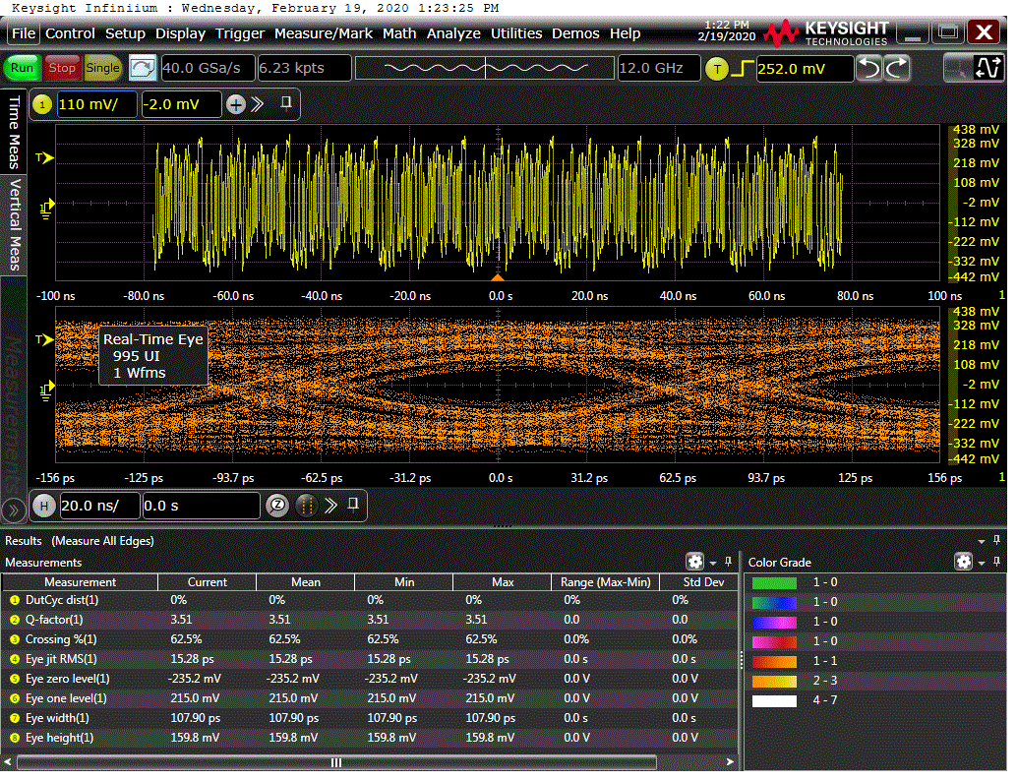
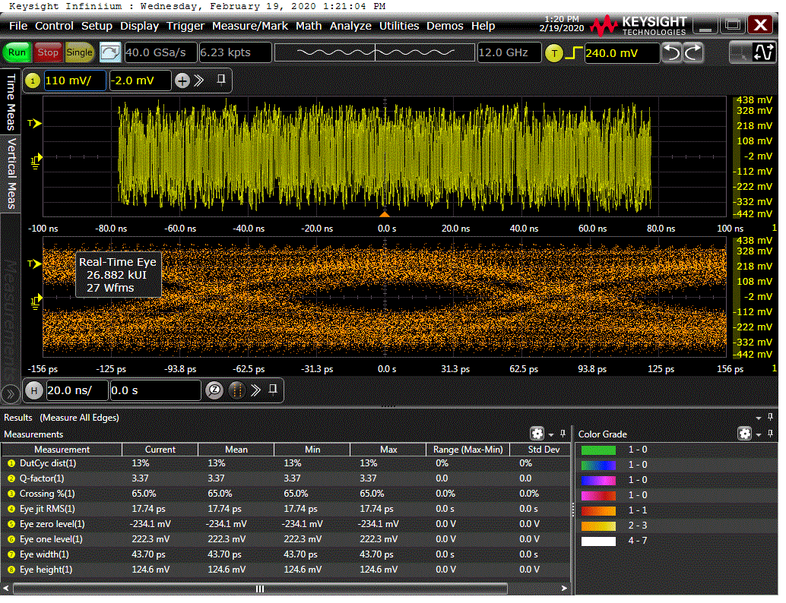
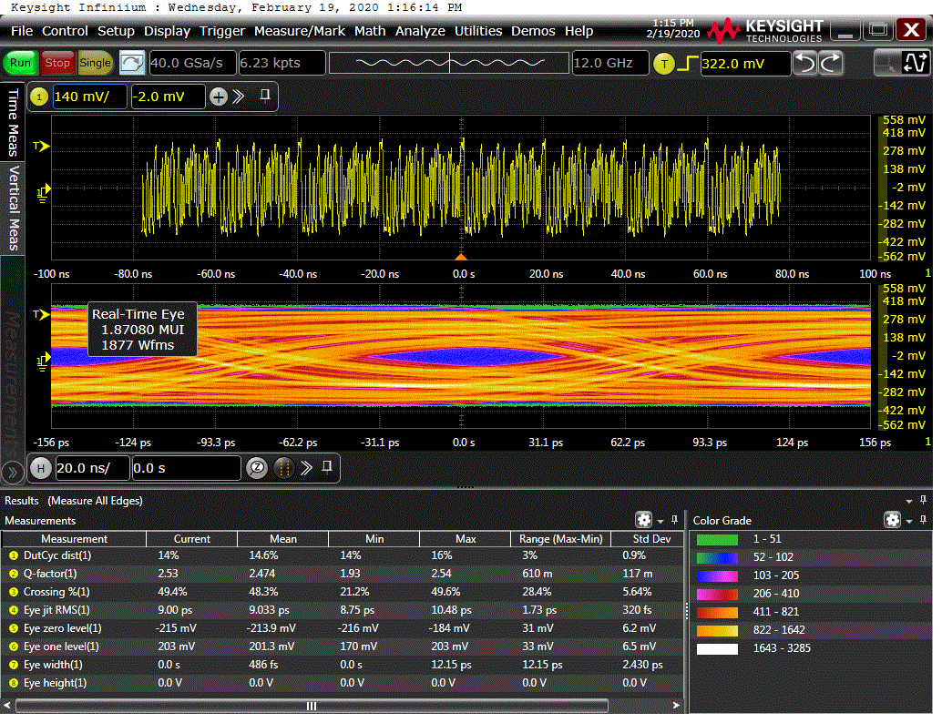
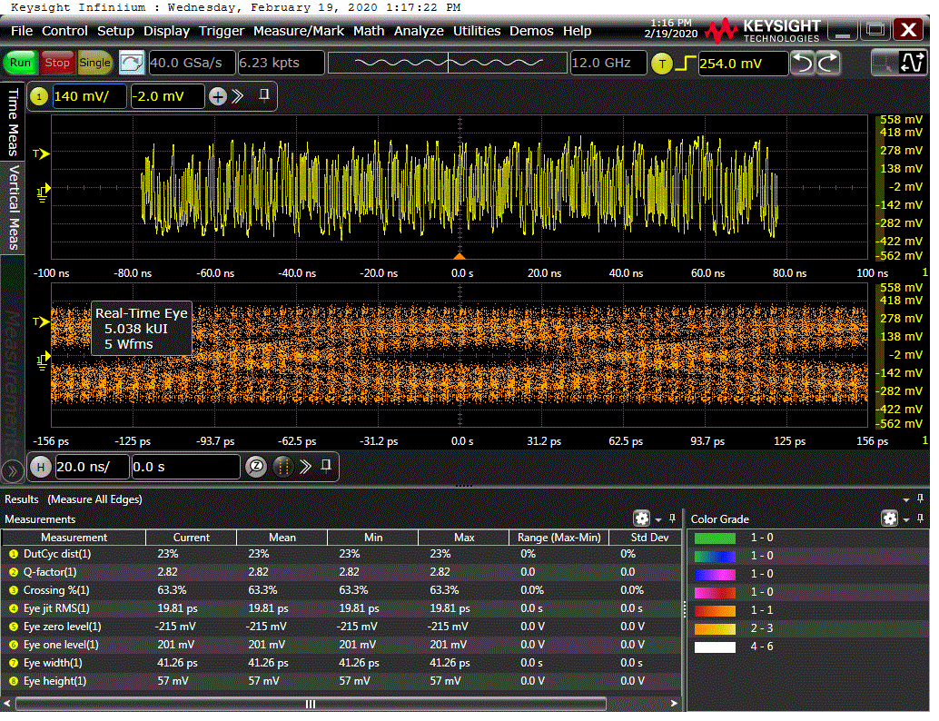
Results– FTM -> jFEX
IBERT test result:
All links were error free (short term test), even though not all eyes are open with PRBS7. Errors with PRBS31.
FTM uses an 14 ways fanout to forward the TTC combined data to the node slots
So we can’t see any impact of the TX Pre-Emphasis on the receiver side
Hub has a direct MGT connection
FTM (1) -> jFEX (4); TX Default; PRBS7
FTM (1) -> jFEX (4); TX Default; PRBS31
FTM (1) -> jFEX (11); TX Default; PRBS7
FTM (1) -> jFEX (11); TX Default; PRBS31

Slide 23
Conclusions
Very good eye opening for TTC combined data links coming from the Hub, after properly setting the TX Pre-Emphasis parameters
Compared the results for two different node slots – long/short backplane trace
No significant difference was observed
IBERT test result Hub to jFEX
All links were error free (short term test), even though not all eyes are open with “Default” TX pre-emphasis settings
IBERT test result FTM to jFEX
All links were error free (short term test), even though not all eyes are open with PRBS7. Errors with PRBS31.

