Slide 1
Status L1Topo
Uli, Julio / Mainz
Hardware
Firmware
Tests

Slide 2
Hardware Overview
ATCA board (based on jFEX design)
2 Virtex UltrascalePlus
Two iterations
Prototype (FDR 01/2019)
Final design presented at PRR 08/2019

Slide 3
Hardware Overview
ATCA board (based on jFEX design)
Modular design
2 Virtex UltrascalePlus FPGAs
XCVU9P-2FLGA2577E
120 MGTs (GTY) per FPGA
118 input fibres per processor FPGA
24 MiniPOD: 20 RX + 4 TX
Mezzanines
Control & Power
Both compatible with jFEX
Rx
Rx
Virtex
UltrascalePlus (U1)
Rx
Rx
Rx
Rx
Rx
Rx
Rx
Tx
Rx
Tx
U1 Power Mezzanine
U2 Power Mezzanine
Tx
Rx
Virtex
UltrascalePlus (U2)
Tx
Rx
Rx
Rx
Rx
Rx
Rx
Rx
Rx
Rx
Control Mezzanine
Board Voltage Level Mezzanine - 1V8
Board Voltage Level Mezzanine - 2V5
ATCA Power Interface
Board Voltage Level Mezzanine - 3V3

Slide 4
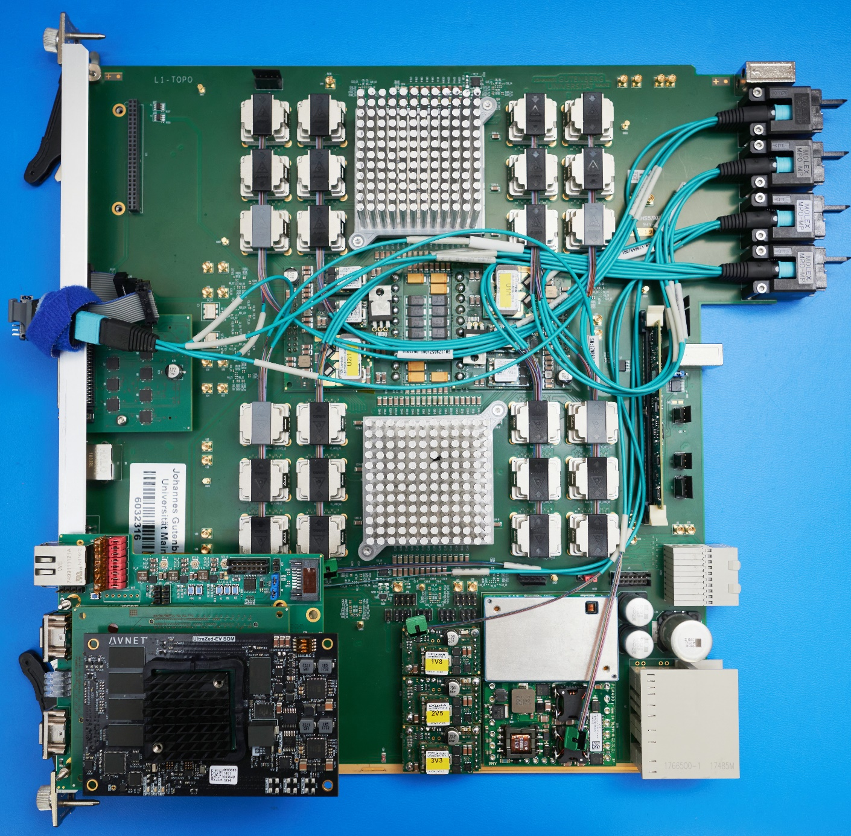
Hardware Overview
ATCA board (based on jFEX design)
Modular design
2 Virtex UltrascalePlus FPGAs
XCVU9P-2FLGA2577E
120 MGTs (GTY) per FPGA
118 input fibres per processor FPGA
24 MiniPOD: 20 RX + 4 TX
Mezzanines
Control & Power
Both compatible with jFEX
L1Topo 1st production module with “new” mezzanine

Slide 5
Recent firmware updates
Controller firmware adapted to new mezzanine
Includes I2C handling for Ipbus readout to OPC server
TTC data handling included
BCReset and L1Accept forwarded from controller to processors
Infrastructure complete, but expect minor trailer format related changes
Algorithm firmware status reported in different place
Full integration real-time infrastructure / algorithms / control / readout yet to be accomplished

Slide 6
Module tests
The production module was stand-alone tested in the home lab
Power consumption and ripple fully measured and reported
Full Ibert tests of all interfaces at the STF
Currently under system-level tests at the STF
Formatted TOB data successfully received from the FEXes
Spy data now BCReset sync’ed
L1Accept recorded along with real-time data
Trailer handling understood, final agreement required (see below)

Slide 7
A few recent results on link data integrity
While most of the tests were made last year, and results have been reported, we did dig deeper on a few issues recently:
Timing data reception from the backplane (detailed measurements actually made on jFEX, but Topo affected just the same):
FTM shown to lack pre-emphasis from fanout drivers, resulting in bad eyes
Hub-driven lines yield good data eyes
MGT transmitter signals into MiniPODs been measured again
….

Slide 8
Ongoing discussions on TOB data formats
Discussion on optimal CRC scheme (Jira)
Request to add BCR bit to trailer of FEX TOBs
jFEX requested some of the "reserved“ bits in trailer for overflow indication

Slide 9
Plans
Adapt IPbus register map to common L1Topo/jFEX scheme
And finally…
Full integration of all firmware components including readout
Note: timing closure is expected to require quite some effort:
Super logic region crossing might still require quite some massaging !!!

