Slide 1
Referring to Julian‘s slide:

Slide 2
fFEX – towards the specs
Some initial discussions last year (Arno)
25(.78125 ?) Gbps, 64/67 encoding, 246 links per side.
Includes 100% duplication at source
Go for phi quadrant per processor FPGA |η| > 2.2
Core of $π/2$ and a jet environment of $π/4$
That’s what we have on jFEX
Same lateral granularity for e and j algos: ~ .1 in η,φ
Initial attempt to map the two detector sides to modules
Two modules per detector side, four total
Each module carries two large FPGAs
Xilinx ? Intel ?
Plenty of 12-way optical receivers (Firefly?)
What is the required optical output bandwidth ?
We expect a need for maximum possible algorithmic resources, with 100% upstream duplication
Restricted to max. 4 FPGAs per side for sliding window algorithms with given environment

Slide 3
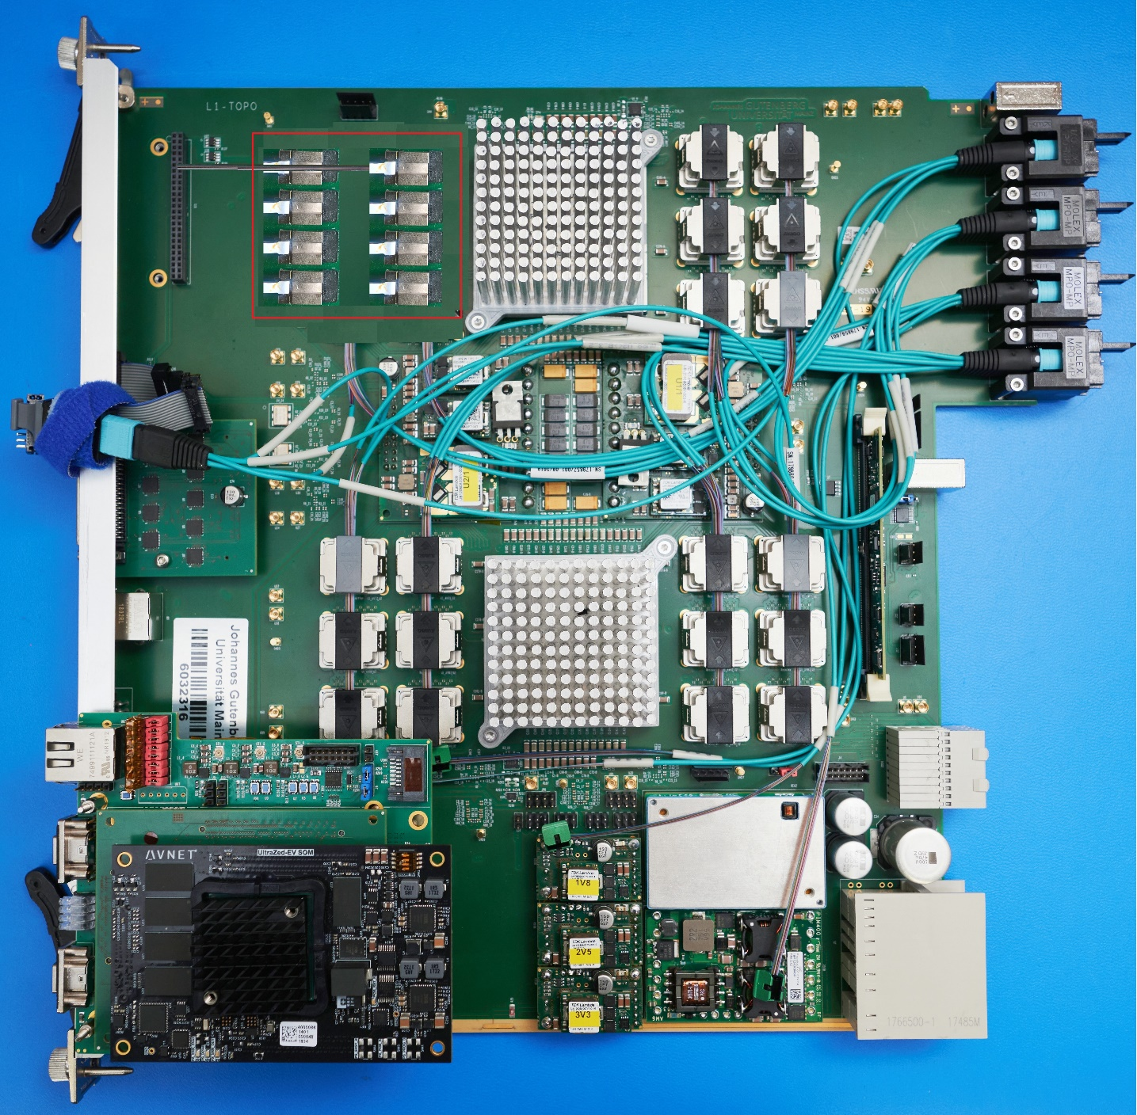
fFEX
Initial thoughts
MiniPOD → Firefly
MTP-CPI → front MTP
R/O, timing → FELIX
Module controller TBD
?

Slide 4
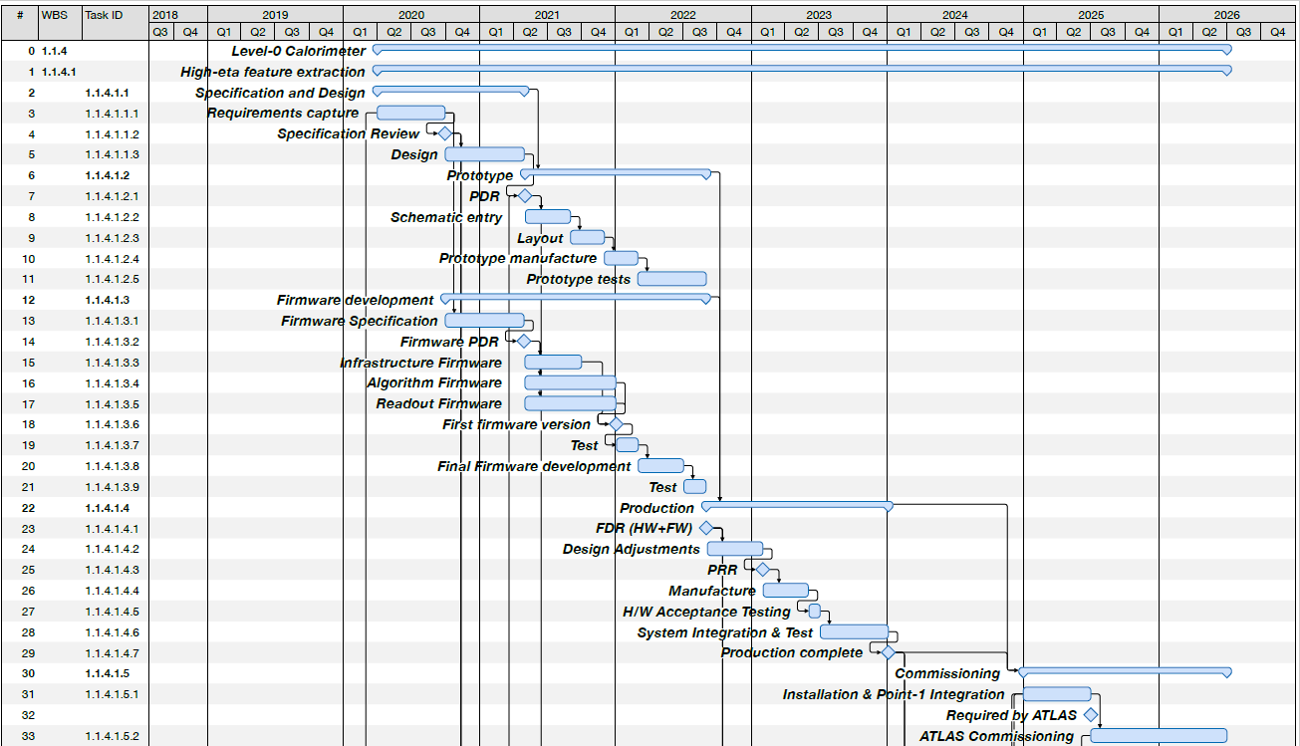
Official schedule

