Slide 1
Post PRR Status L1Topo
Uli / Mainz
Hardware overview
Tests
PRR Recommendations

Slide 2
Hardware Overview
ATCA board (based on jFEX design)
2 Virtex UltrascalePlus
Two iterations
Prototype (FDR 01/2019)
Final design presented at PRR 08/2019

Slide 3
Hardware Overview
ATCA board (based on jFEX design)
Modular design
2 Virtex UltrascalePlus FPGAs
XCVU9P-2FLGA2577E
120 MGTs (GTY) per FPGA
118 input fibres per processor FPGA
24 MiniPOD: 20 RX + 4 TX
Mezzanines
Control & Power
Both compatible with jFEX
Rx
Rx
Virtex
UltrascalePlus (U1)
Rx
Rx
Rx
Rx
Rx
Rx
Rx
Tx
Rx
Tx
U1 Power Mezzanine
U2 Power Mezzanine
Tx
Rx
Virtex
UltrascalePlus (U2)
Tx
Rx
Rx
Rx
Rx
Rx
Rx
Rx
Rx
Rx
Control Mezzanine
Board Voltage Level Mezzanine - 1V8
Board Voltage Level Mezzanine - 2V5
ATCA Power Interface
Board Voltage Level Mezzanine - 3V3

Slide 4
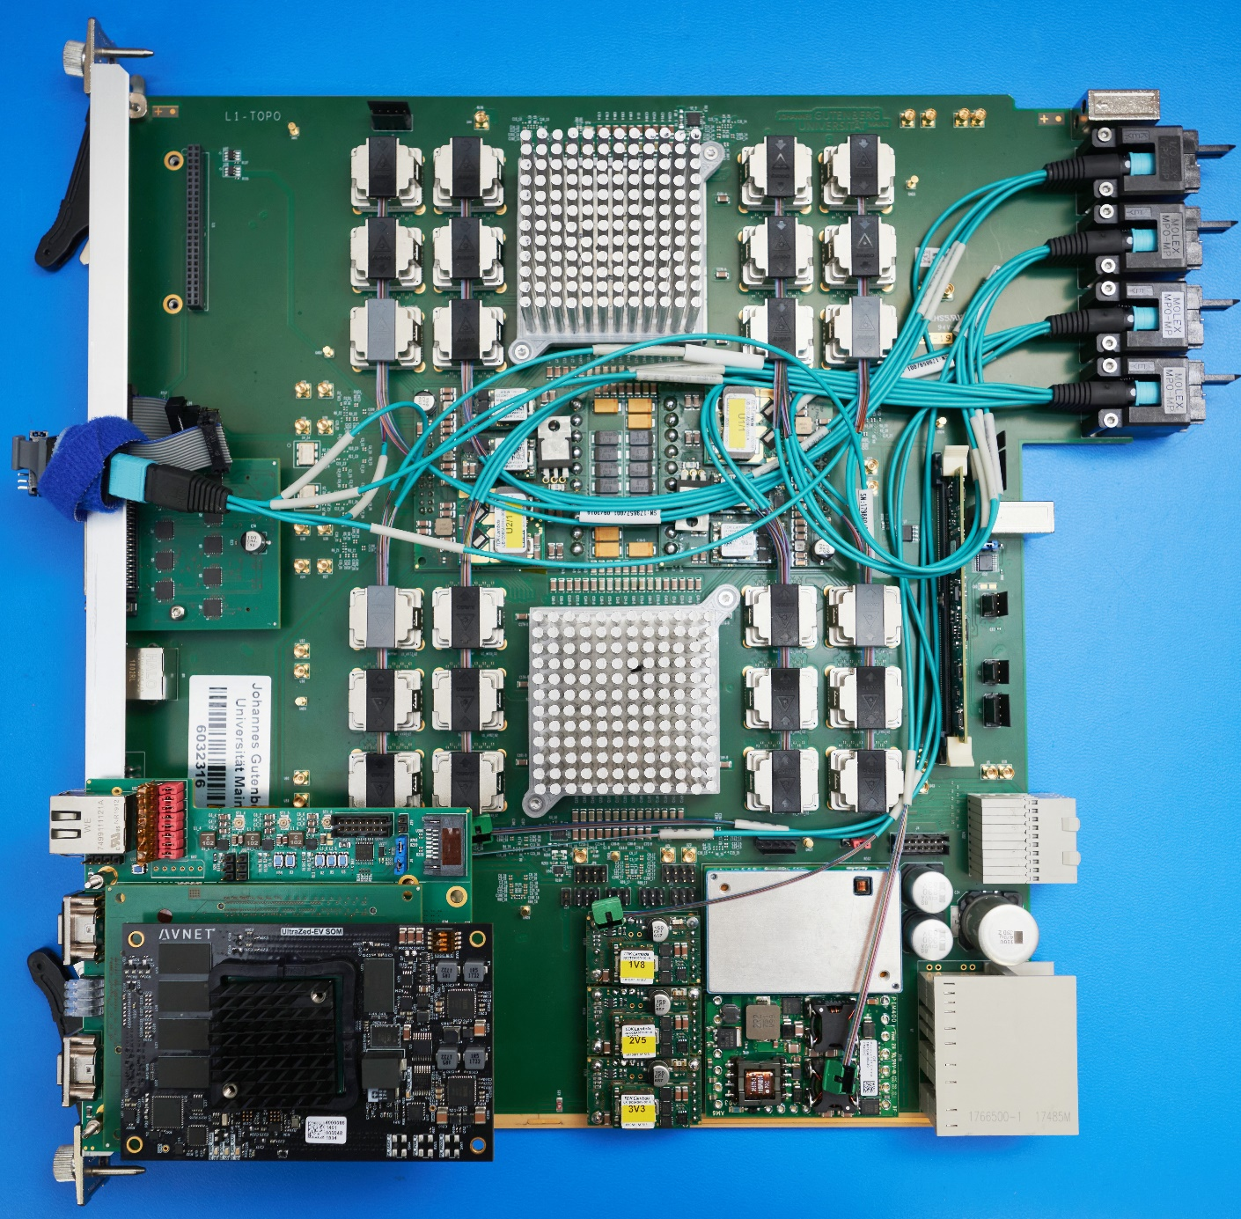
Hardware Overview
ATCA board (based on jFEX design)
Modular design
2 Virtex UltrascalePlus FPGAs
XCVU9P-2FLGA2577E
120 MGTs (GTY) per FPGA
118 input fibres per processor FPGA
24 MiniPOD: 20 RX + 4 TX
Mezzanines
Control & Power
Both compatible with jFEX
L1Topo 1st production module with “new” mezzanine

Slide 5
History: L1Topo post-FDR design modifications
Production vs. prototype, presented at PRR 08/2019
Mainboard-only
Correction of MGT termination calibration scheme
Correct a few items on the assembly list (resistor, capacitor values)
Specify single ended clock lines to 50 Ω impedance
Advise assembly company on backplane connector handling (solder vs press-fit)
Add JTAG TCK fanout buffer to allow for proper 50 Ω series termination
Correct Sysmon ADC pin VP/VN connection scheme / define unique I2C addresses for the two processor FPGAs
Correct clock pair choice (non-) issue on MGT QUAD232
Mainboard-mezzanine interface (pinout to be consistent with the jFEX since the mezzanine is a common item)
Correction of proper differential routing of spare lines between processor FPGAs and extension mezzanine
Add module type coding on the mezzanine interface: selectively ground two as yet unused pins on connector
Add further signal return GND connections to the mezzanine connector
Connect Mainboard JTAG chain to mezzanine
Adapt IPM controller scheme to CERN IPMC and correct a few errors
Correct and slightly extend USER_IO connectivity for purpose of IPMC / module controller data exchange
Remove a few links that are unconnected on the CERN IPMC footprint
Change JTAG header to Microsemi interface standard and connect reset line
Remove spare connectivity for external, mezzanine based IPMC
Move IPMC temperature sensors for better accessibility and functionality

Slide 6
History: control mezzanine
Functionality:
Module controller (IPbus) with bridge to processor FPGAs
Clock cleaning/synthesis and 1st stage of fanout
Extended monitoring / I2C (-> IPbus)
Configuration storage (SPI/SD)
Versions:
- Initially Zynq 7 based
UltraZed module, change of Ethernet Phy (device recommended for magnetics-free backplane operation)
IPbus in PL
Housekeeping / I2C in PS
Currently Petalinux
Looking into alternatives (some work done on kernel compilation and Debian & Centos rootfs)

Slide 7
Test, firmware, software status
Module successfully tested with formatted input from all FEXes @ STF
All real-time hardware interfaces successfully tested including CTP port
Clocking, TTC data, and readout paths successfully tested
Successful operation of IPbus, I2C subsystem, IPMC
Algorithms status see Johannes
V.1 Real-time infrastructure well tested
V.1 Control firmware well tested
Restructuring of firmware (V.2, common jFEX/Topo code) well advanced
Integration with readout to be done as soon as readout firmware can be ported from jFEX code
Online software (compatible to v.2 firmware) to be ported from jFEX asap

Slide 8
PRR recommendations, May 4, 2020
The inter-FPGA parallel LVDS connectivity should be tested. Even though it has been stated there is currently no plan to use it, this may change.
→ to be done in Mainz soon
A test of the interface between L1Topo and CTP should be carried out.
→ to be done at CERN asap
The protocol test between MUCTPI and L1Topo should be performed.
→ to be done at CERN asap
An optical attenuation test should be performed between gFEX and L1Topo in order to assess the optical power margin as for the other modules.
→ to be done at CERN asap
The end-to-end link latency measurements should also be performed at the link speeds of 6.4 Gb/s and 11.2 Gb/s.
→ We are not assuming the MUCTPI to run at 6.4 Gb/s, but we will be able to do latency measurements along with MUCTPI tests
The module power consumption and FPGA temperatures should be measured under realistic conditions using a complete, close to final, processing FPGA firmware.
→ Will be done once we have a fully integrated, final firmware
The mapping of the TopoFOX fibers to the GT groups in the FPGAs should be checked at STF in order to make sure that the are no unexpected swaps.
→ Details to be discussed
The assembled boards should go through a burn-in test with temperature cycles as stress screening.
→ Details to be discussed

Slide 9
PRR recommendations, continued…
A few unfinished jobs, generally rather trivial and quickly done once we can make full use of the STF again
The last two items on the list:
Input fibre mapping to quads: That comment was referring to some statement on bitrate mixing in quads we once made in an early version of our specifications which was actually referring to an initial pre-UltraScale+ design
The fibre mapping has been confirmed and understood to the extent possible at the STF
Final mapping tests will not be possible until installed at point 1
We do not want to show that there is no mixing, we want to show that mixed bitrate quads work properly without any concern
The assembled boards should go through a burn-in test with temperature cycles as stress screening.
My personal opinion: I am not going to destroy an expensive module in a burn-in procedure myself. A burn-in should be done only to an extent that the assembly company is ready to do and take responsibility for.
L1Calo: Risk of damaging one module unrecoverable during burn-in vs. possible infant death
Note: no money available to produce additional modules beyond nominal 3+2

