Slide 1
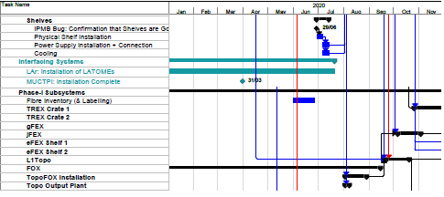
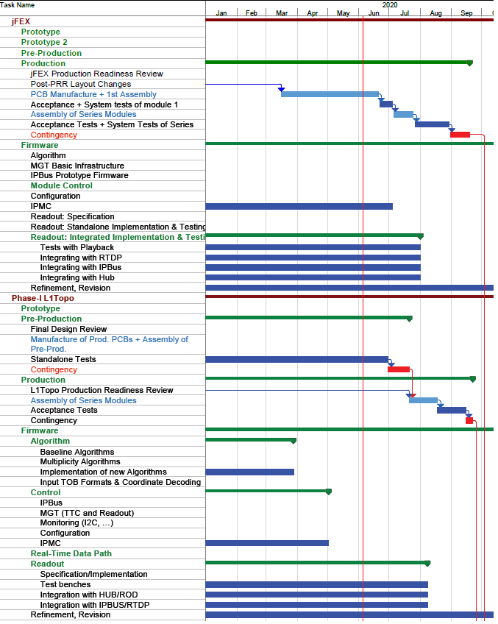
jFEX/L1Topo Installation
Uli / Mainz

Slide 2
What’s Installation ?
Install hard and heavy infrastructure and services
Racks
Cooling
Power
Shelves
PCs
Install (fibre) cabling, terminate into RTMs (with dust caps)
Provide basic services
Networking
Module control
Debug tools
Some level of environmental monitoring
Safety mechanisms
Slide in modules <<<<<<<�
Many threads in parallel:
Validate connectivity
Complete services
Get firmware, software, databases ready for physics

Slide 3
Requirements for module installation
All heavy items in
Some connectivity available
One module will be the first one with nothing to talk to
Basic networking
We have many layers of protection
FPGA unconfigure on over-temperature
Local monitoring on IPMC
Data from IPMC into DCS
I2C based monitoring via module controller (Zynq)
Zynq I2C data can be read out directly from Zynq PS
Same data read out via IPbus
Some of that needs to be available before 1st module goes in
Need some personal equipment laptop, JTAG, meters, …

Slide 4
Grow the system
No desire to chuck large numbers of modules into freshly installed shelves
Start with individual modules, prototype/pre-production first
Assume that possibly jFEX-L1Topo might be the first interface to be tested under ground
Need to find out a few facts about MUCTPI and CTP
Include further module types as they arrive
The assumption here is that for quite a while activities in USA15 and STF are being run concurrently
Reduce clashes between various test requirements
Few people available for installing/maintaining modules & systems
Ideally plenty of people working at both P1 and STF remotely
Full shelf of modules (3×L1Topo, 6×jFEX) operation at P1 is certainly a milestone, though not an exciting one. Expect shelves full of modules to be in full operation at STF prior to that.

