Slide 1
Latencies jFEX / L1Topo
2020-09-04

Slide 2
jFEX - Aug 5 2020

Slide 3
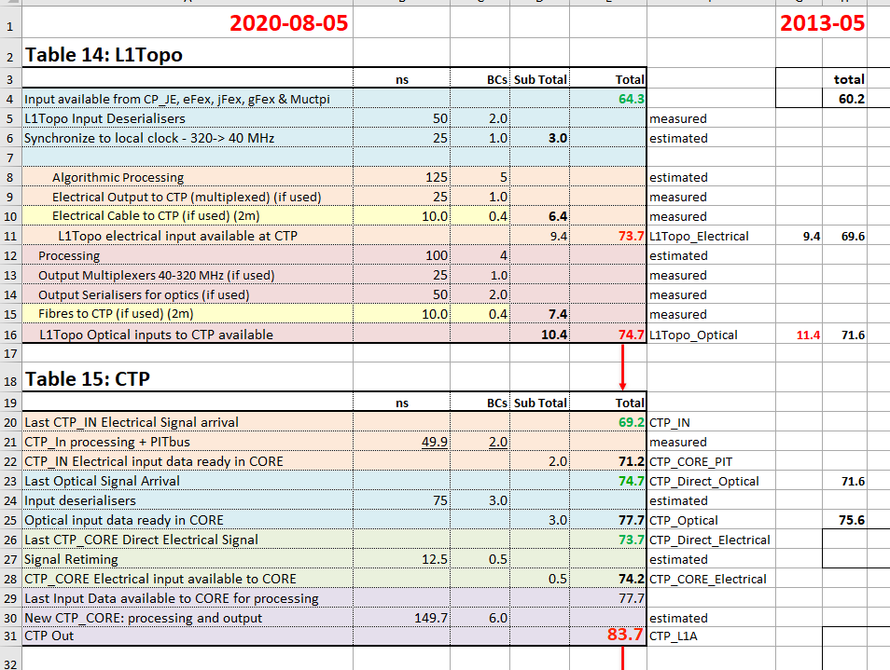
L1Topo

Slide 4
Latencies – some thoughts
jFEX latency hasn’t changed for five years
Continuing to work on latency minimization (sub-ticks)
L1Topo latency (electrical nor optical path) hadn’t changed for more than 7 years
Currently working on L1Topo latency reduction
optical path / multiplicities
Processing latency down by one tick in August 5 estimate
Let’s be optimistic : get processing latency down a further few sub-ticks?
But:
Any correlations between different object types difficult for results on the optical path !
Generally:
Latencies cannot be determined by breaking down to individual contributions inside an FPGA, as they do not add up: t1, t2 → t1+t2+X
Total latency is known once it has been measured in fully implemented firmware
Neither infrastructure nor algorithms firmware 100% complete
We are still fighting at the timing closure front
Super logic region concept of large Xilinx FPGAs makes it more difficult than ever before → expect significant SLR crossing latency

Slide 5
Backup slides

Slide 6
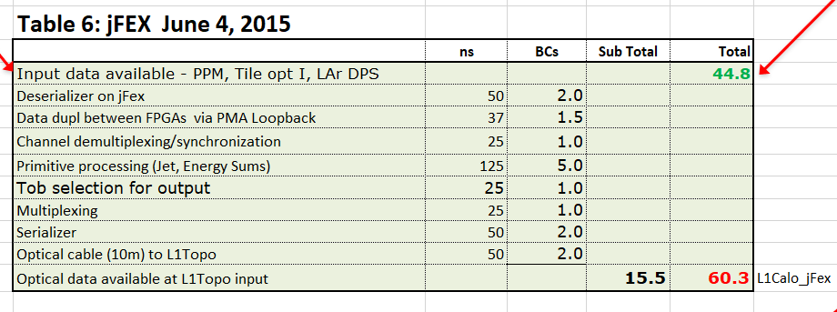
jFEX, June 2015
edms.cern.ch/file/1256858/1/Working_Draft_Latency_Envelope_4Jun2015.xlsm

Slide 7
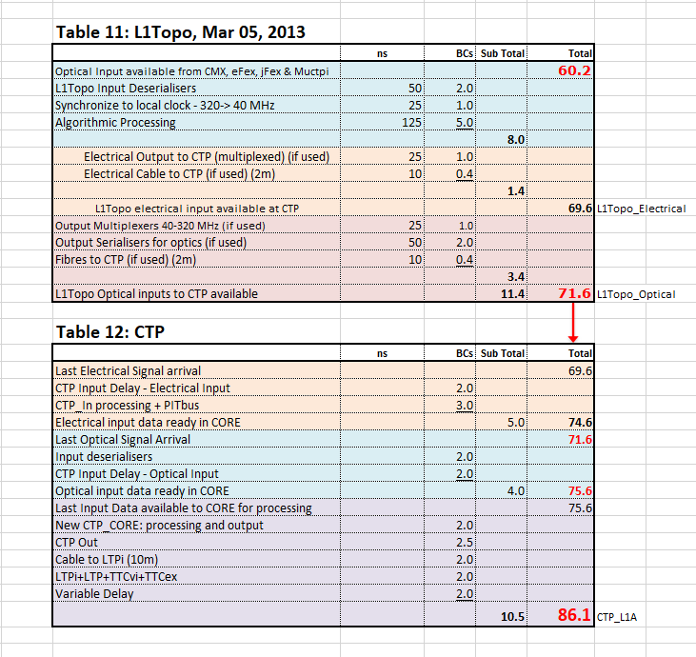
L1Topo, March 2013
edms.cern.ch/file/1256858/1/Working_Draft_Latency_Envelope_05Mar2013.xlsm

