Slide 1
L1Topo status: hardware / tests / production / …
Uli / Mainz

Slide 2
Hardware Overview
ATCA board (based on jFEX design)
Modular design
2 Virtex UltrascalePlus FPGAs
Two iterations
Prototype (FDR 01/2019)
Final design presented at PRR 08/2019
Fix on MGT calibration

Slide 3
Hardware Overview
ATCA board (based on jFEX design)
Modular design
2 Virtex UltrascalePlus FPGAs
XCVU9P-2FLGA2577E
120 MGTs (GTY) per FPGA
118 input fibres per processor FPGA
24 MiniPOD: 20 RX + 4 TX
Mezzanines
Control & Power
Compatible with jFEX
CTP interface module (LVDS drivers)
Rx
Rx
Virtex
UltrascalePlus (U1)
Rx
Rx
Rx
Rx
Rx
Rx
Rx
Tx
Rx
Tx
U1 Power Mezzanine
U2 Power Mezzanine
Tx
Rx
Virtex
UltrascalePlus (U2)
Tx
Rx
Rx
Rx
Rx
Rx
Rx
Rx
Rx
Rx
Control Mezzanine
Board Voltage Level Mezzanine - 1V8
Board Voltage Level Mezzanine - 2V5
ATCA Power Interface
Board Voltage Level Mezzanine - 3V3

Slide 4
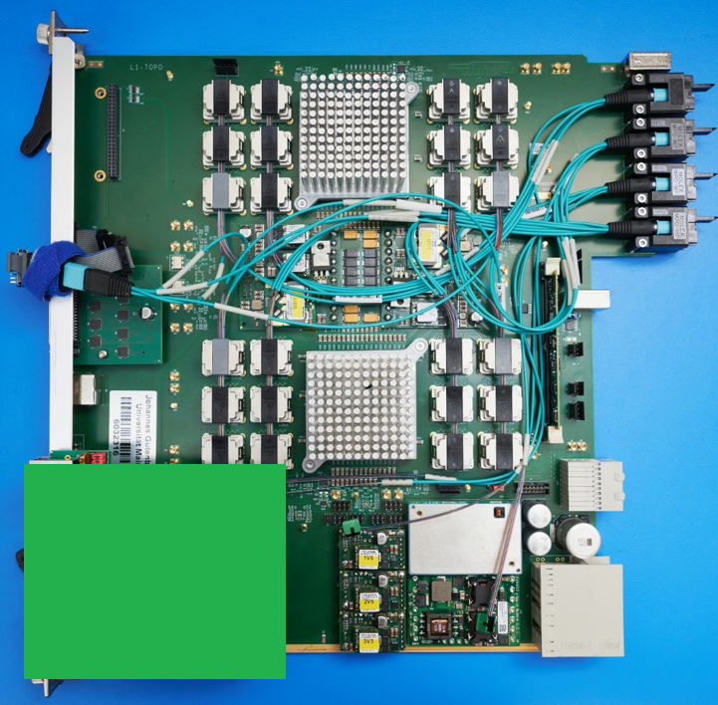
Hardware Overview
ATCA board (based on jFEX design)
Modular design
2 Virtex UltrascalePlus FPGAs
XCVU9P-2FLGA2577E
120 MGTs (GTY) per FPGA
118 input fibres per processor FPGA
24 MiniPOD: 20 RX + 4 TX
Mezzanines
Control & Power
Compatible with jFEX
CTP interface module (LVDS drivers)
new
L1Topo 1st production module with control mezzanine v3.1

Slide 5
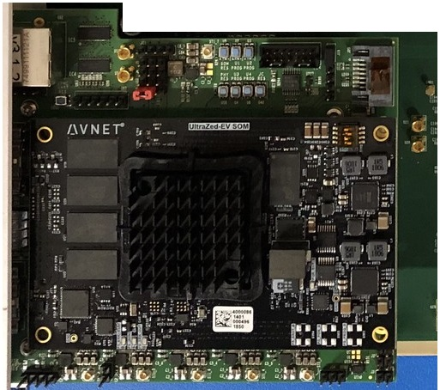
Control mezzanine v3.1
new
Carrier board for UltraZed-EV SoM
Functionality equivalent to v3.0 shown in March TDAQ week, with minor fixes
3 modules produced
Currently in use at STF on both jFEX and L1Topo
During last slice week
Functionalities
Hosts the control module of the jFEX/L1Topo mainboard
Zynq Ultrascale+ ZU7EV-FBV900
LHC clock cleaning and distribution to processor FPGAs
Si5345
Hosts the MasterSPI configuration circuitry for processors
MT25QU02GCBB8E12-0SIT
IPBus master
Port selection between backplane or front-panel RJ45 with ETH MUX
Hosts the PHY chip (transformerless scheme)
VSC8221
TTC data reception and distribution to processor FPGAs
HUB1: Using fanout NB7VQ1006M
HUB2: Reception on one MGT and distribution to processors via parallel I/Os
Monitoring and slow control
MiniPODs (Avago) monitoring via I2C
PMBus monitoring

Slide 6
Controller test status
Smoke tests, power sequencing
Ripple measurement (MGT)
Power up with UltraZed connected
Re-check ripple for MGT power rails
JTAG access to Zynq
Booting and configuring from SD card
Ethernet MUX
Zynq PL (IPBus)
Backplane / front RJ45
Zynq PS
I2C access to Si5345 (jitter cleaner)
Monitor status of inputs and outputs
Reception of TTC clock via backplane with Si5345
Check clock reception at FPGA from Si5345
SPI configuration of processor FPGAs
TTC combined data reception from Hub slot 1
To be done
Monitoring and slow control of Si5345 and mainboards MiniPODs, DC/DC converters
Reception of TTC combined data from Hub slot 2 and distribution to processors via I/Os
Slot dependent IP/MAC
IPBus stress test
→ Production
All 3 modules tested:
Done ✓

Slide 7
Mainboard test status
One prototype, one production module so far, minor differences
Both generations of modules thoroughly tested in home lab and at the STF (standalone and slice)
Modules successfully tested with formatted input from all FEXes @ STF
Data reception confirmed by (BC sync’ed) spy mem readout
Specific optical attenuation tests done, the last missing one (reviewers’ request) quite recently
All real-time hardware interfaces successfully tested in-depth, including CTP port
Clocking, TTC data, and readout paths successfully tested
Successful operation of IPbus, I2C subsystem, IPMC
Some interfaces tested standalone / IBERT / electrical/optical only
System tests done with non-final firmware

Slide 8
Further steps
Need to make progress on firmware completion
Due to menu dependency, algorithms will never be “final”, just frozen.
Finalize infrastructure firmware (common code base with jFEX)
Adapt readout firmware (common code)
Integrate infrastructure, readout, frozen algorithms (timing closure)
Then
Repeat slice tests
Confirm latency at system and link level
Some specific tests as requested in the PRR report May 4, 2020
Interface test L1Topo / CTP
Protocol test between MUCTPI / L1Topo
Power consumption and FPGA temperatures under full firmware load
Inter-FPGA parallel LVDS connectivity verification.

Slide 9
And yet further…
Once tests are finished…
“Volume production”, for a total of 5 modules
PCBs available
Components available
Should take ~6 weeks
Completing the modules in the home lab and testing should happen at less than a week per module
Installation
Installation is what happens before the modules slide in…
Rack situation still unclear (?)
Don’t expect any commuters to go out to CERN any time soon
→ Limited effort available at CERN, needs careful planning

Slide 10
Summary
L1Topo and its mezzanines well and tested
Ready to go into production as soon as:
A few PRR recommended tests done
Firmware considerably improved and completed
Final tests at STF done … including final (*) latency figures
Perhaps some open questions about installation at P1
(*) final = determined for a snapshot of algorithms integrated with high-speed infrastructure, control, and readout

