Slide 1
fFEX input data
Some initial discussions last year (Arno)
Link speed 25(.65065/.78125 ?) Gbps
64/67bit encoding
Link count : 3 options as of Oct. 16, 2019. Favourite option 2
„2) 0.1 x 0.1 E-Sums for 2.2<eta<2.5 separate per layer in EMEC and HEC; and all cells from eta>2.5: 492 fibres“
Includes 100% duplication at source
Required for mapping sliding window type algorithms to a set of FPGA processors
Map a core plus an environment shared with neighbour onto given processor
Allows for getting full eta x $π/2$ core into a processor (phi quadrant)
With an environment of +/- $π/4$
Each processor covering full eta range per detector side
>> confirm link parameters and define data mapping << see below

Slide 2
fFEX Module
Minimum eta,phi coverage per FPGA defined by required environment in jet algorithm, and data duplication at source
Large numbers of high speed links per FPGA
→ large number of opto link devices
Reasonable partitioning into modules
Two FPGAs per module (phi quadrant each)
Two modules covering each detector end
Four modules in full fFEX system
ATCA based
… let’s have a look →

Slide 3
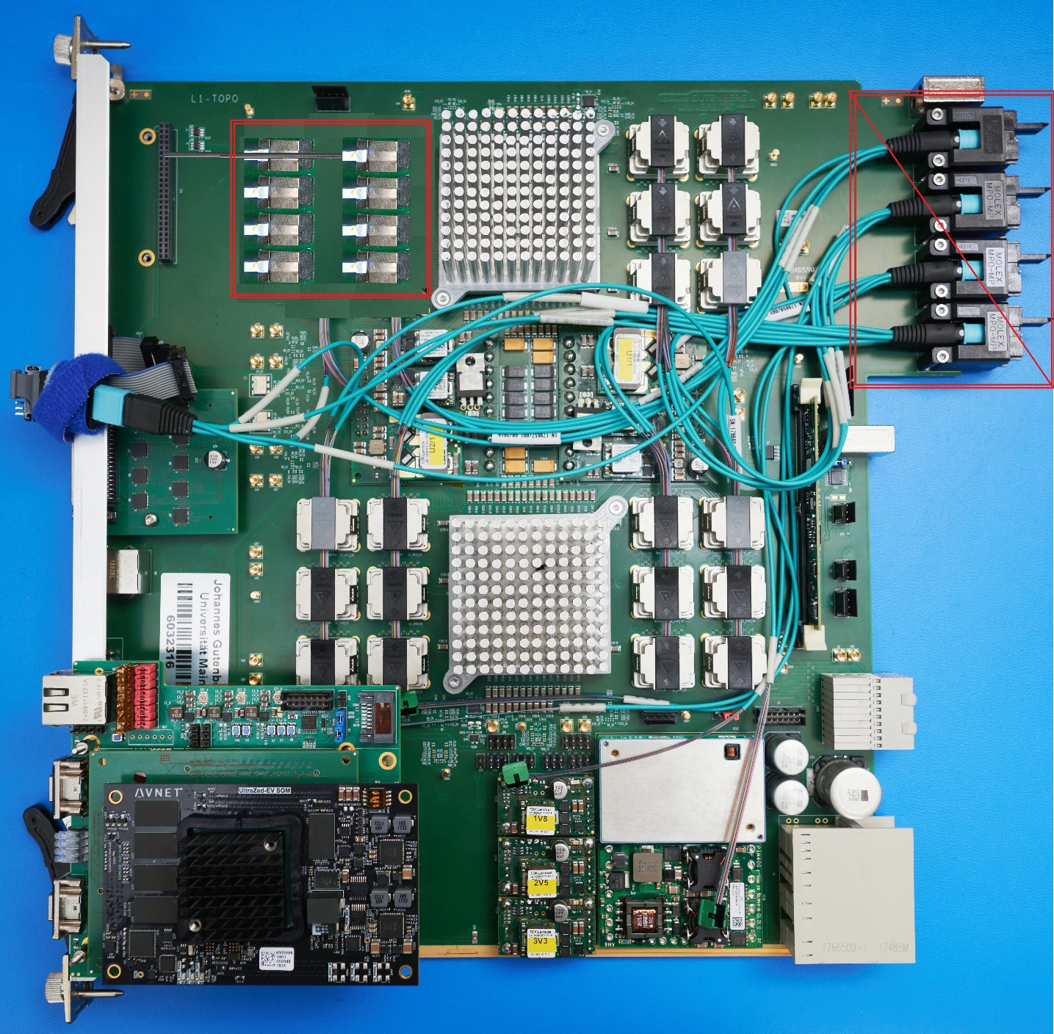
fFEX… looking a bit like L1Topo
But just a bit:
MiniPOD → Firefly
No solution for fibre aggregation from FireFly
➔ MTP-CPI → front MTP
R/O, timing → FELIX
Module controller TBD
Real-time output TBD

Slide 4
Urgent: Input link specification
Upstream duplication: each data link sent twice
Link speed to be confirmed
Encoding to be confirmed
(Calo data granularity to be agreed on) →
Data volume to be confirmed
Data format to be defined
Payload
bit count per channel
Can we gain from higher resolution?
Non? Linear? Encoding
Channel count per link
Channel mapping
Trailer
Choice of FPGA/MGT type should be transparent: Xilinx, Intel
Choice of opto link type should be transparent, but should probably be discussed: baseline FireFly

