Slide 1
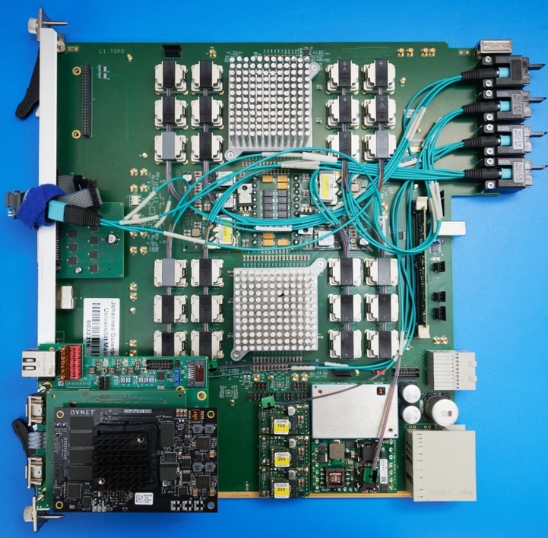
L1Topo Installation Commissioning
Uli / Mainz

Slide 2
Installation
Effort available: Ren-Jie and Julio
Need to cover jFEX, L1Topo, legacy L1Topo
…will keep them quite busy…
Requires careful planning
Intend to send more people once COVID travel restrictions lifted
Quite some infrastructure at P1 required before we can go down with the first module >> see slides from last joint meeting
Shelf
Fibering
Source/sink systems
DCS/hub/clocking/computing/control/JTAG
Two modules currently available:
1 production, PRRed 2019.08
1 prototype (functionally near identical)
Equipped with new mezzanine v 3.1
Well tested at hardware level (though firmware development and tests ongoing)
Total quantity of production modules required
3 modules at point 1
2 spares
All being well tested in home lab (except full link count concurrent test) and STF
Assume no spares of infrastructure (cables, …)

Slide 3
Module production and installation…
Expect to move one module to point 1 as early as possible to get tests going there
Assembly and basic tests of further modules assumed to go fast and smoothly (PCBs and components available, established test procedure)
However, further system level tests required at STF to deal with PRR recommendations before starting production
MUCTPI
CTP
Power/temperature test under full firmware load
…
Still some work to be done on readout → a bit of uncertainty on the production schedule
We are currently assuming to have modules available for firmware development and system tests with L1Calo at STF and P1 concurrently
Both STF and P1 testing assumed to be mainly remote controlled
Need to arrive at fully remote operation at P1 anyway
COVID is an excellent reason to prioritize that goal

Slide 4
Commissioning of modules at P1
Module health monitoring via DCS (plus automatic-over temperature shutdown of processors)
Link error monitoring in firmware
Fibre mapping tests with automated / scripted IBERT (Emanuel, jFEX)
Fibre mapping tests with playback from source systems (plus meta frames, eg. from jFEX)
Timing checks in firmware (BCIDs in trailer)
Expect to receive TOBs from calorimeters/FEXes early on
FEX playback
Hot towers (noise / lowered thresholds)
Cosmics / splashes…
Comparison with bitwise simulation
Monitoring plots ??? Inspired from legacy Topo
As soon as useful data coming from the detectors, compare to legacy system
Running parasitically without triggering
-->where to sample trigger bits for disabled triggers ?
In terms of triggers, any (physics like) should do, obviously legacy topo triggers most useful

Slide 5
Commissioning of algorithms
L1Topo is special in a sense that individual new algorithms need to be commissioned for inclusion in the menu in irregular intervals anyway
Simulation in HDL
Comparison to software model (bitwise)
Include in firmware build
Test rig playback/spy standalone validation vs. software
Validation at P1 outside physics run in ATLAS partition
Validation of freshly included algorithms in physics runs with triggers disabled (parasitic)
While timing calibration / validation used to be crucial and difficult in run 2, we’d assume that this step is eased significantly with BCID information in trailer of TOBs

