Slide 1
fFEX / status
Slides by Adrian / Julian / Uli
for Mainz fFEXers

Slide 2
Introduction
fFEX new addition to L0Calo (eFEX, gFEX, jFEX) trigger system for fwd. jets/EM objects
  EM trigger (η|>2.5): interesting for fwd. electrons (e.g. sin²θW)
  Jet trigger (|η|>3.2): interesting e.g. for VBF processes
Advantage: finer granularity than jFEX (full detector granularity)
fFEX crucial addition to L0Calo for precision measurements utilizing fwd. objects

Slide 3
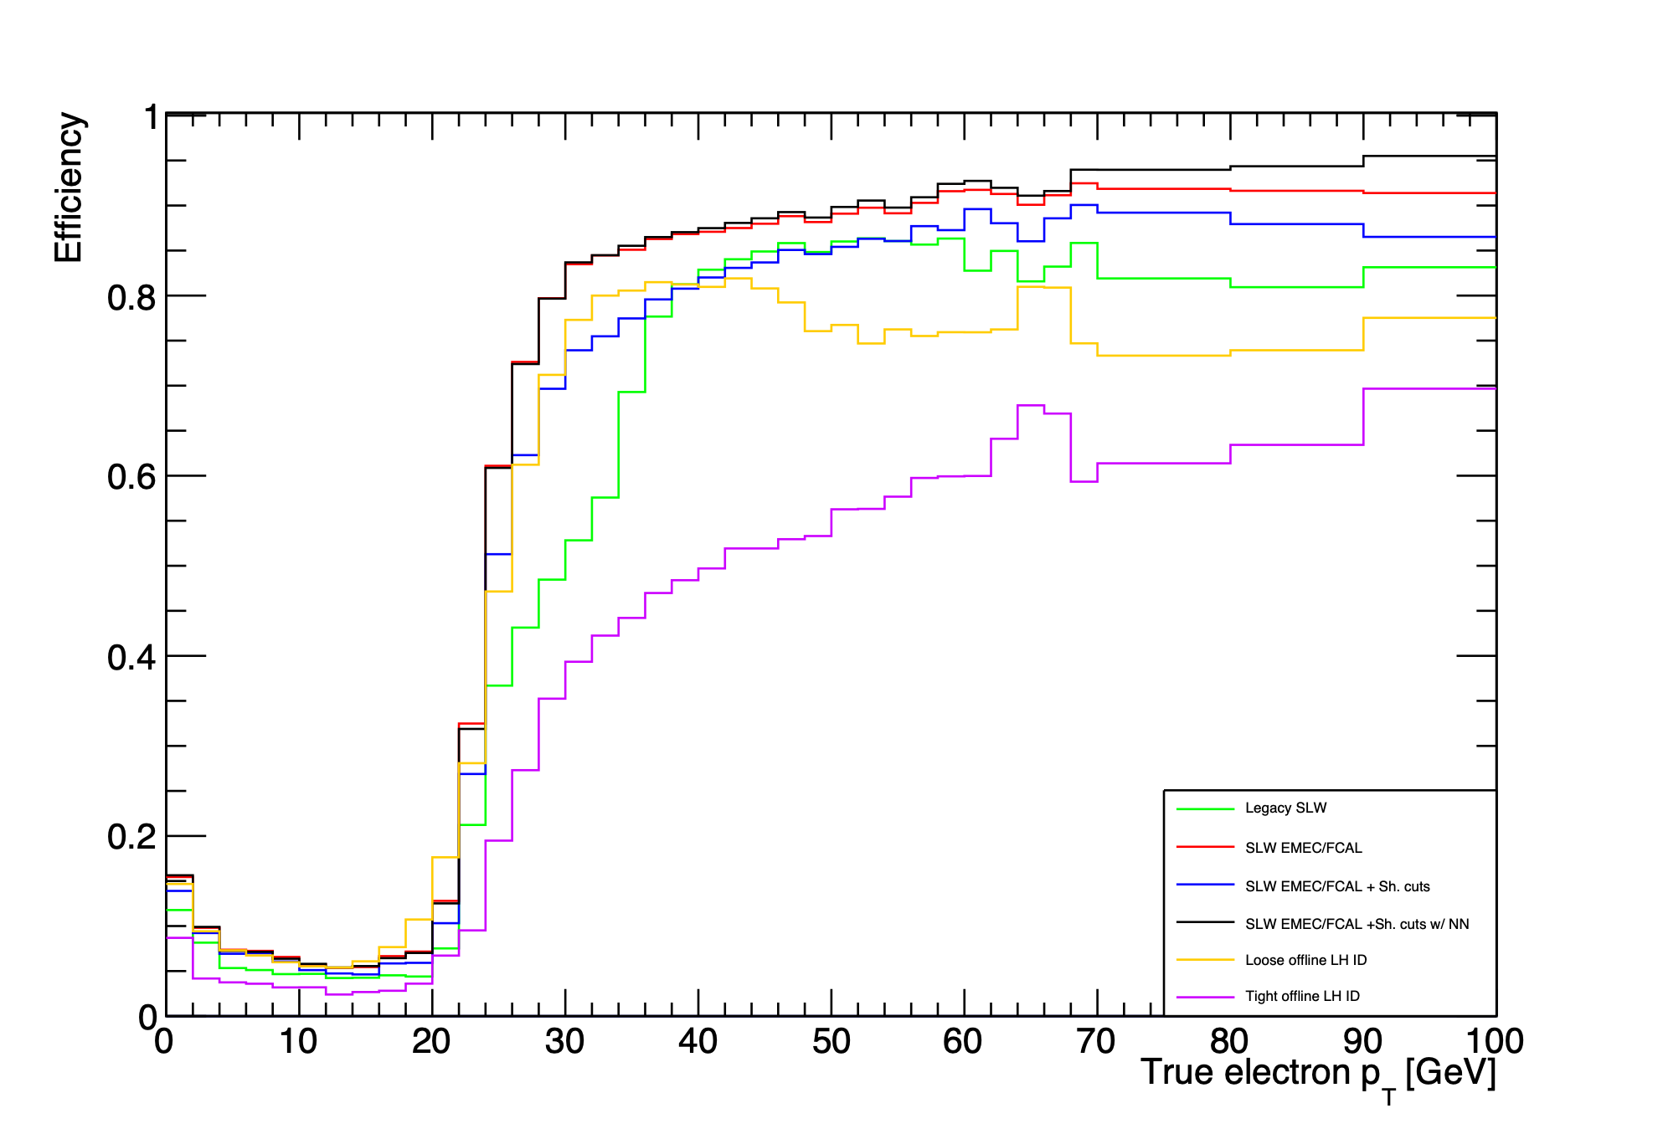

EM trigger studies
Link for more details
Full fwd. region
25 GeV trigger
MC based on Run 2 pileup
fex EM Legacy-like
ffex EM SLW
ffex EM SS
ffex EM MV
Loose LH ID
Tight LH ID
‘trigger energy scale’ shifted to roughly match ‘offline energy scale’

Slide 4
Baseline algorithms
Sliding window algorithms refined wrt Phase-1 modules
Basic processing unit:
  FPGA covering a quadrant in phi (core)
  Requiring core data and environment
  Environment provided by upstream duplication
    From one neighbouring octant in phi each side
    100% duplication of all data
    → to separate data on fibres by octant

Slide 5
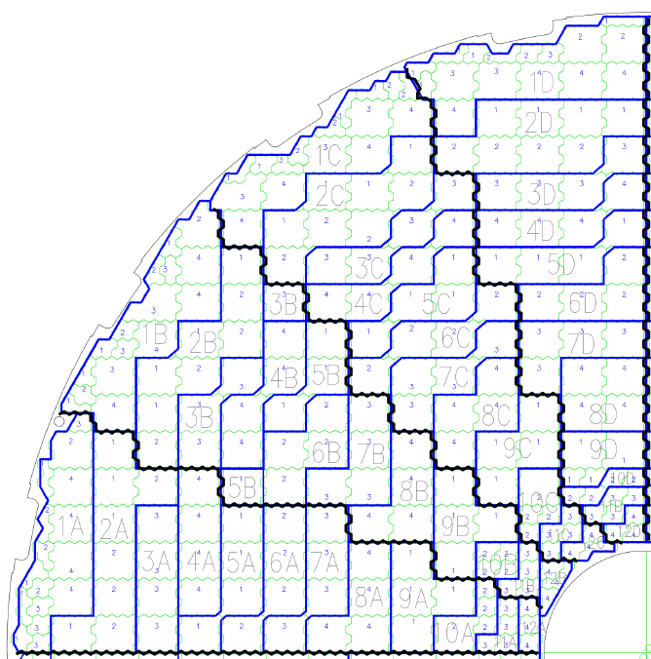
Jets at phase 1 → phase 2
Sliding window algorithm basically at 0.1 x 0.1 (eta, phi)
  Regular towards small eta
  Irregular in forward region (cell geometry)
    Find local maximum in a sliding window
    Sum up energies in a given environment
    → jet
|η| = 2.5 3.1 / 3.2 4.9
Super Cell
3.2
1.6
jFEX
forward
module
3.3
4.1

Slide 6
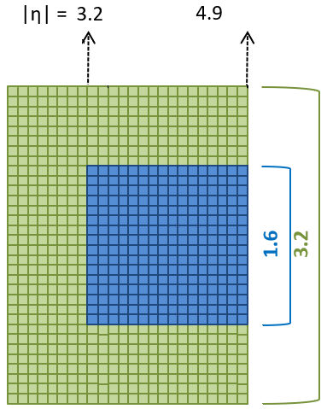
Jets at phase 1 → phase 2
Sliding window algorithm basically at 0.1 x 0.1 (eta, phi)
  Regular towards small eta
  Irregular in forward region (cell geometry)
    Find local maximum in a sliding window
    Sum up energies in a given environment
    → jet
Readout Cell
fFEX
true cell positions to be used in f/w

Slide 7
Mapping data onto fibres
Assuming 25Gb/s opto fibre links
Cell level information for core data, some pre-summing for eta environment only
100% duplication (basically half a detector side worth of data into each FPGA)
Initial estimate at ~65 fibres per FPGA (ie. quadrant)
More recent estimates ~80 → 96 abs max.
Mapping exercises ongoing
  Data bits per cell (encoding, see below)
  Payload vs. bitrate (protocol)
    End-to end synchronized to LHC clock !
    Interlaken
    Hermes
    …
    → Go for common protocol with LAr/Global interface if possible

Slide 8
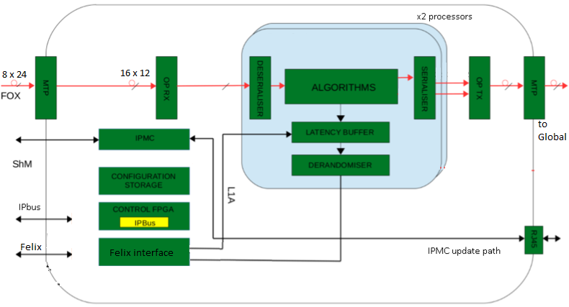
fFEX Module
ATCA module derived from Phase-1 modules (jFEX, L1Topo)
  Four modules total
  Two FPGAs per module (baseline XCVU13P)
  Large numbers of high speed links per FPGA
  → large number of (Firefly) opto devices (12-way)

Slide 9
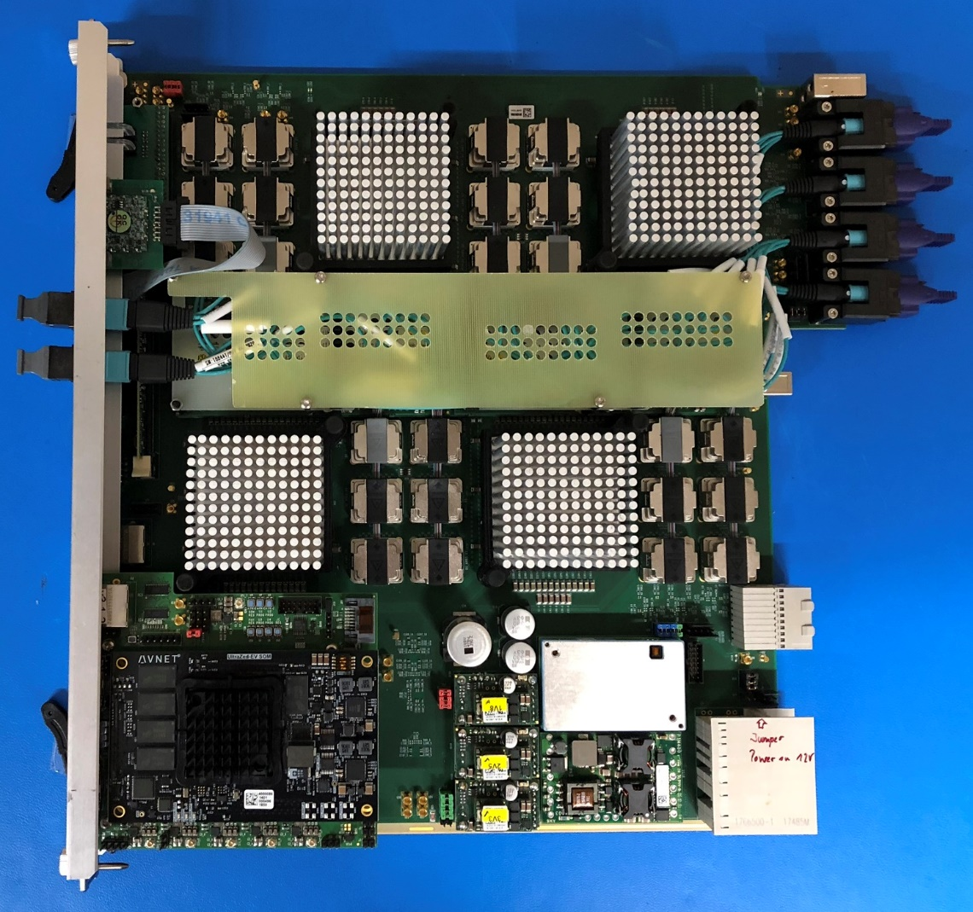
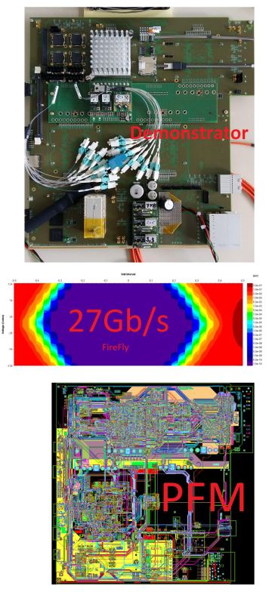
Equivalent to half a jFEX, with higher speed links…
… as explored on U. Mainz L1Global/fFEX technology demonstrator
+
jFEX

Slide 10
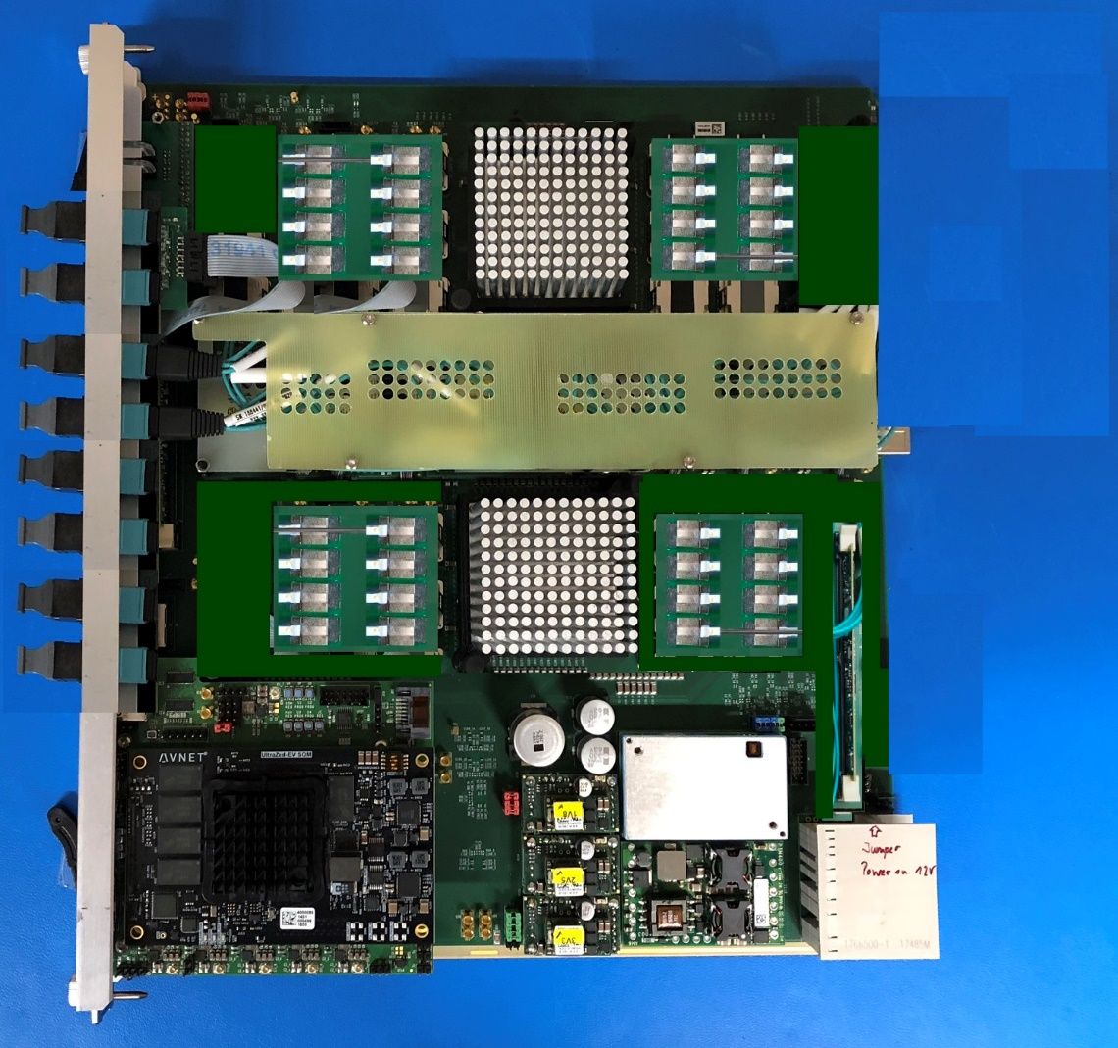
Equivalent to half a jFEX, with higher speed links…
… as explored on U. Mainz L1Global/fFEX technology demonstrator

Slide 11
Status and work in progress
Work on
  Module design
    block diagram level
    some detailed design: jFEX/L1Topo building blocks
  Documentation
    Interfaces !!!!
    Iterate on LAr/fFEX mapping
    Aim at participation in link/protocol test activities
    Data encoding : 11-bit, multi-linear (see below)

Slide 12
fFEX encoding
Information of cell E_{T} transmitted between LAr →fFEX
Multilinear encoding scheme
  Independent for each detector region (EMEC, HEC, FCal)
    Separating between some layers also considered
  Cover a large energy range (maximum ~500 GeV)
  Include negative energy values
    Level of PU noise used to estimate the minimum energy
  Minimum granularity comparable to the electronics noise
    Energy range size of other linear regions proportional to the minimum
Optimisation of the scheme ongoing
  Figure of merit used is the ratio between the stochastic error after/before encoding
  Number of linear regions and their size are the variables to optimise

Slide 13
fFEX encoding example: EMEC 1 scheme (6 linear regions)
Code | Energy range in MeV | Range size in MeV
0 | No data available | -
1 | < -5000 | -
2 | [-5000, -4984) | 16
... | ... | ...
251 | [-1016,-1000) | 16
252 | [-1000, -996) | 4
... | ... | ...
751 | [996, 1000) | 4
752 | [1000, 1016) | 16
... | ... | ...
776 | [1384, 1400) | 16
Code | Energy range in MeV | Range size in MeV
777 | [1400, 1464) | 64
... | ... | ...
1231 | [30456, 30520) | 64
1232 | [30520, 30776) | 256
... | ... | ...
1676 | [144184, 144440) | 256
1677 | [144440, 145464) | 1024
... | ... | ...
2041 | [517176, 518200) | 1024
2042 | > 518200 | -
Rest | Reserved | -
Simplifications and optimisation of the encoding scheme ongoing

Slide 14
Backup

Slide 15
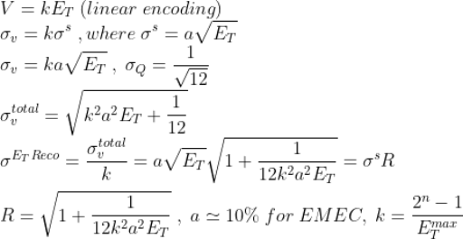
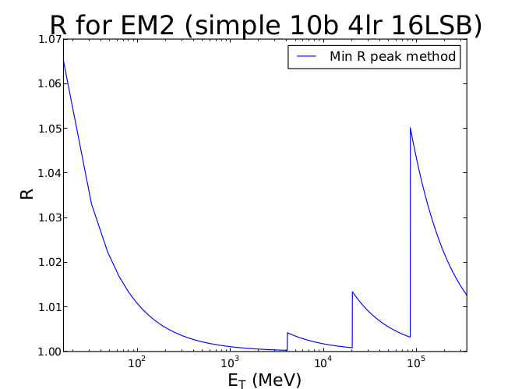
Optimising the encoding scheme
The figure of merit used is the ratio between the stochastic error (sampling term) after/before encoding
a ~ 0.1 for EMEC
0.7 for HEC
0.3 for FCal 1
1 for FCal 2 and 3
Look for the scheme which minimises R
Scan over many possible schemes
Previous FEXes encoding studies used R as well

