Slide 1
Latency / Tilecal o/e converters VME extender

Slide 2
Tilecal o/e converters
https://indico.cern.ch/getFile.py/access?contribId=101&sessionId=8&resId=1&materialId=slides&confId=158040

Slide 3
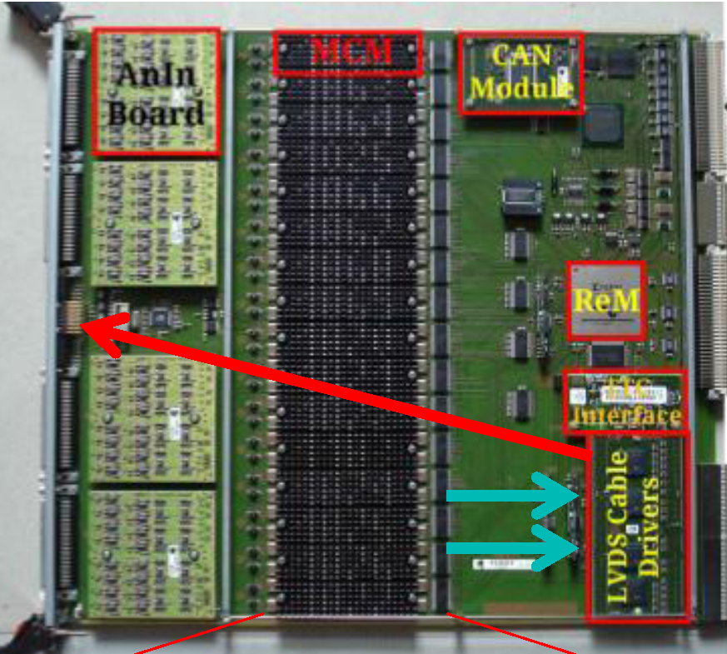
The two L1Calo based options (2, 3)

Slide 5
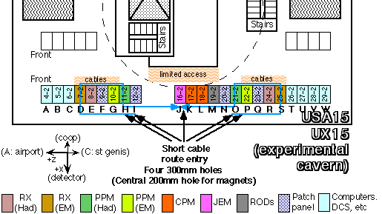
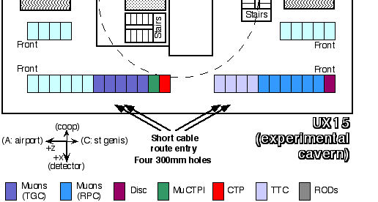
Cable/fibre routing USA15
For phase-1 with FEX:
Route analogue data via PPr-JEM-FEX
Or rather PPr-FEX ?
Latency ?!?!
Route via JEM needs to go up and down twice (rack-false floor)
FEX
Where are the DPS ?

Slide 6
Latencies (from “Report of the ATLAS Calorimeter & Trigger Working Group”)
What is the latency of the PPr / JEM path wrt the Lar DPS path ?

Slide 7
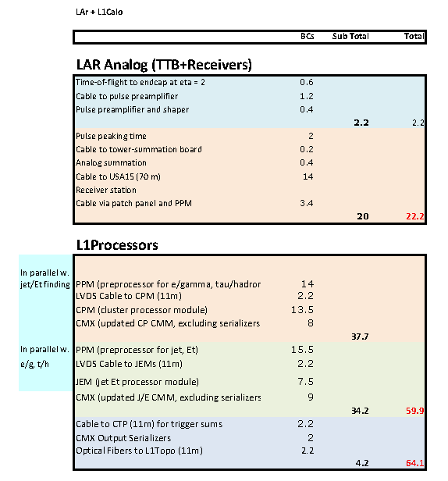
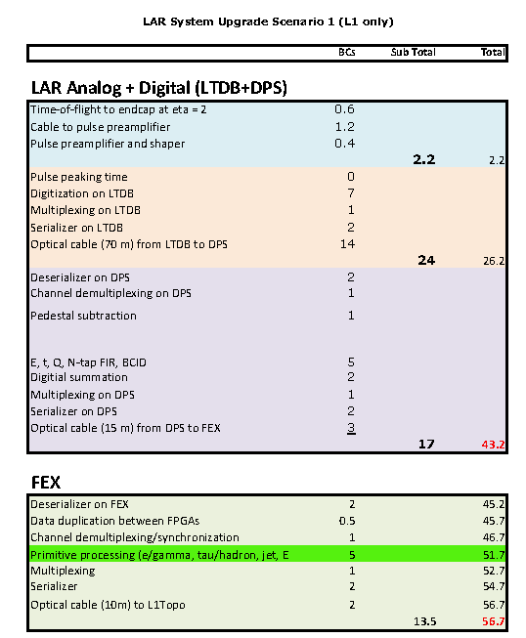
latencies
???
+3
41.4 + opt cable
+3

Slide 8
Latency
3 ticks have been assumed for the e/o conversion including serialisation
Depends on exact data format on incoming electrical stream.
Larger, if de-serialisation to 40 Mb/s required
Slightly smaller if data can be packed into 320Mb/s words on-the-fly
Possibly even smaller if going to more than the baseline rate of 6.4Gb/s
Optical cable length probably 3 ticks.
PPM nMCM specs talking about 16 ticks for MCM and nMCM ! (previous slide: 14 / 15.5)
Where are the DPS ? Is their 15m fibre length realistic ?
F. Lanni: assumes that DPS path has higher latency than PPr path

Slide 9
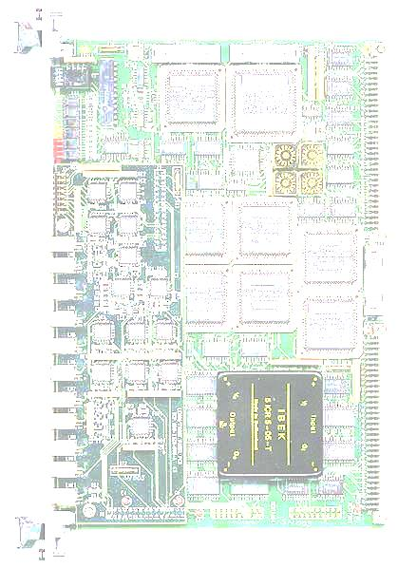
VME extender/serialiser
GOLD (and early L1Topo) module control via a chain 9U-crate CPU → BLT → GOLD (fibre, 1-2Gb/s) (Andreas)
Long term replacement by Ethernet control (2014 ?) → IPBus workshop next week (Bristol) (or Zynq based scheme)
Need medium term solution, since 9U/BLT approach not viable at CERN (early system tests)
Build 6U VME extender
6U VME module
Daughter module concept ?
Almost passive 6U mainboard ~4 layers, carrying level translators, possibly a CPLD (XC95?), ~4 SFPs ?, FPGA module
Enclustra Mars AX3 ?
SO-DIMM form factor seems suitable
VME slot width ~20mm
Not sure about availability of MGT links
Documentation seems outdated since it refers to XC7A30T which has been withdrawn by Xilinx
Let’s try and design for the AX3 pinout, if we can get hold of it. If Enclustra aren’t able to deliver, we will build our own module (production silicon available from Jan.2013 ?
Reinhold (h/w) + NN (A.R. ? h/w, f/w)… → start now !

Slide 10
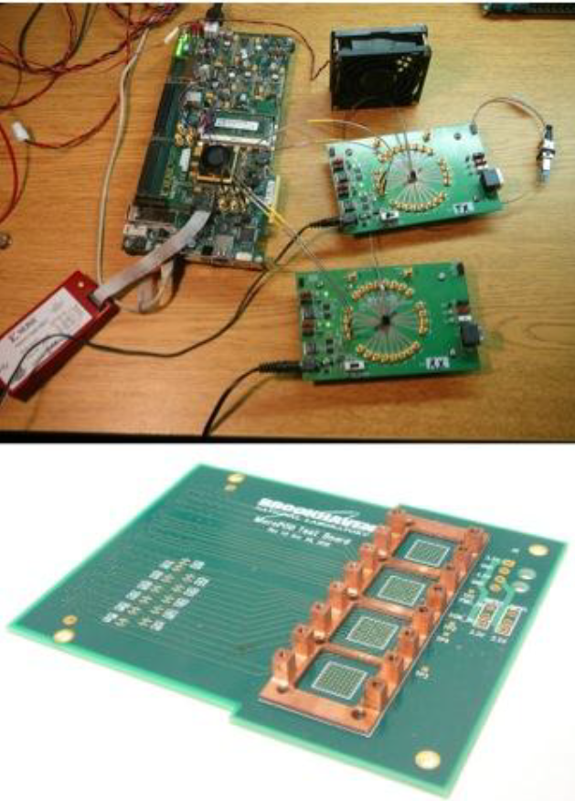
Other…
http://www.mcc-us.com/iportfaq.htm
IPORT : Tools to control I2C from a PC (for lab / debug purposes)
Other people are already working on microPOD
Evaluation board
Test board BNL
Uli away (Nov. 27-29) for IPBus workshop !

