Slide 1
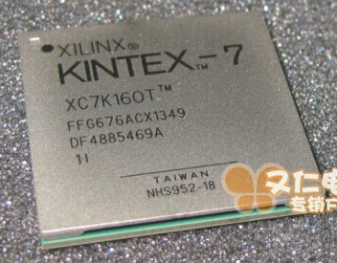
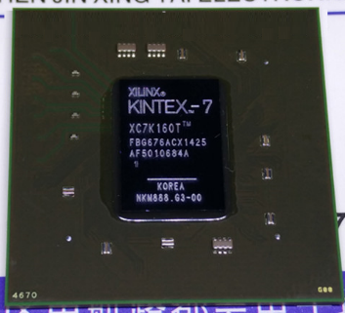
FPGA XC7K160T - 676 balls
Two packages available, same footprint:
FBG vs. FFG, slightly different supply decoupling and VccAuxIO use
Cost vs. I/O speed (6.6/12.5Gb/s) (~25% in cost ?)
Thermal properties 8.9 vs.7.5 °C/W. heat sink type ?
Suggestion: try to make power distribution system
compatible to both packages and decide later
What type has been on the first iteration ?
Anybody available to double check compatibility?
Design changes:
Add MGT uplinks to future MARS replacement
Require separate supply voltages / regulators (1V, 1.2V, 1.8V)
Need to choose suitable cable type/socket (see below)
4 FPGAs → 3 FPGAs : redistribute I/O lines
→ Decision on use of High Range and High Performance I/O HR: 2.5V, no output delay tuning, HP: 1.8V, all LVDS
HR and HP have different I/O delays (mixed in design ?)
Single ended / DCI ?

Slide 2
Further mods
Operation in mag field
Linear regulators only on active daughter
Requires separate at least two external supplies of ~1.2-1.5V and ~4V to keep dissipation down.
Exact grouping depends on power requirements per individual voltage node (1.0, 1.2, 1.8, 2.5, 3.3 … ???)
Extend MARS interconnect with cable links : length vs. bitrate. Example : Current ATLAS L1Calo PPM to jFEX links: > 10m @ 480Mb/s per pair (with passive pre-compensation and high-end cable)
Future iteration: Use small number of MGT links (up to 6.6 (or 12.5) Gb/s ) built-in equalizer, length vs. bitrate ???????
Aim at industry standard connection → correlation between cable and socket type. RJ45/USB3.0/3.1/SATA/…
Firmware mods:
In Apr. 2017 there seemed to be quite a lot of flexibility on Jiri K’s end, not quite so @ HH… will need kind of review ?!?!

