Slide 1
CALICE / Silicon PM activities
Detector and readout electronics development
Development of a system for mass production of AHCAL “HBU” scintillator/PCB sandwich
P. Chau
Data aggregator and timing unit for CALICE / AHCAL
A. Welker, R. Spreckels, J. Caudron
Optimization of scintillator tile geometries for surface mount (digital) SiPMs
Y. Liu
Generic Silicon PM R&D
S. Krause
Technical Support :
B. Bauss, R. Degele, K.-H. Geib
Supervision:
V. Büscher, L. Masetti, U. Schäfer, S. Tapprogge, R. Wanke

Slide 2
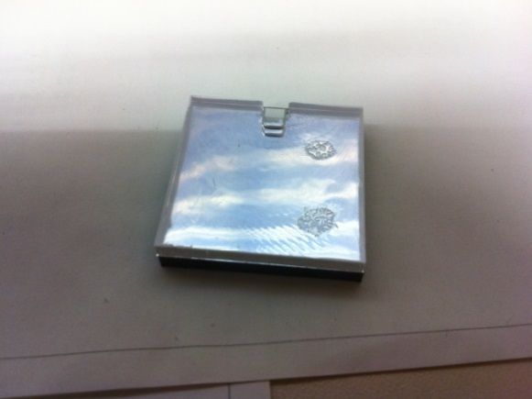
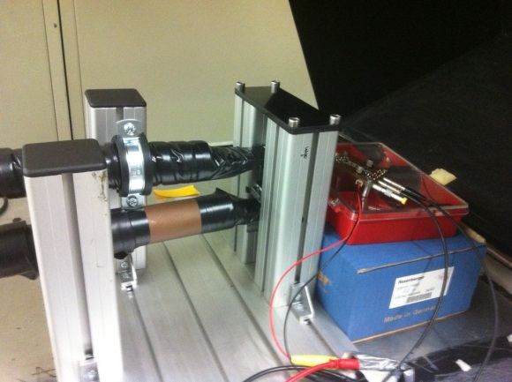
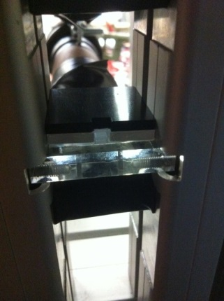
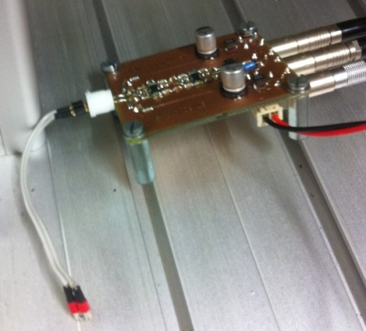
Mass Assembly of AHCAL
Motivation:
About 8.000.000 tile scintillators have to be placed on boards
→ Automatic assembly is needed
Status:
Procedure for fast mass assembly has been defined
→ Mass assembly requires numerous design modifications
Tests of modified tile design (optical properties) are running with cosmic rays
→ First results: Better/similar properties than with current design
Camera tests (for tile detection) are successful
HBU board design changes for automatic soldering process are defined
Outlook:
Temperature tests, optimization of modified tile design
Functionality tests for assembled boards
Amplifier
Amplifier
Tile glued on reflector foil
Trigger scintillator
Tile
SiPM
Notes:
Format noch korrigieren

Slide 3
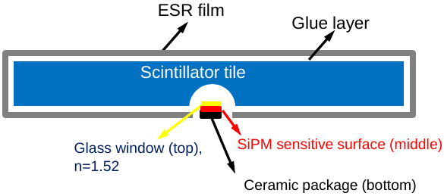
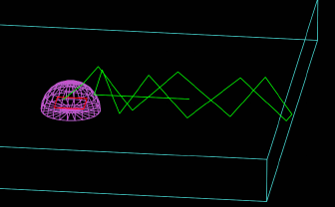
Study of scintillator tiles geometry using Surface Mounted SiPM
Motivation:
Surface mounted SiPM are easier to
solder on HBU board automatically
SiPM can be placed at the centre of
the tile → Better uniformity
Status:
Exploration of a large quantity of scenarios:
Geometry, optical surface, reflectivity of the wrapping, …
Based on simulation (Geant4)
with consistent modelling
(PDE, Scintillator Emission Spectra, …)
Computing power required
Comparison with Data recorded
in Aug 2013 by MPI Physik, Munich
Outlook:
Few scenarios have been ruled out
Some parameters seem promising
Comparison with Data on-going
Development of more realistic modelling
<<< Activities throughout 2013/14 >>>

Slide 4
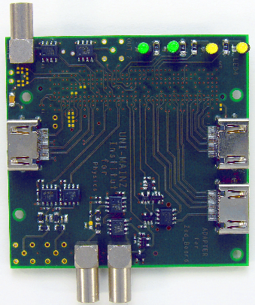
AHCAL wing LDA and CCC
Development of a data aggregator for the “Analogue” HCAL of CALICE
Consolidation of data received from the HBU active detector units (~ millions of channels)
FPGA and Xilinx Zynq based
Data transmission into DAQ via Ethernet
PCB geometries adapted to final detector geometry
→ 1.1m long structure consisting of central body and two wings
Status
Initial prototype successfully built
Firmware work, software integration and tests on-going
Development of a timing unit for CALICE
Distribution of central clock
Synchronous commands to all sub-detectors
Busy handling, asynchronous trigger (for beam tests)
Status
Successful operation in ECAL beam tests
Initial version made available to AHCAL collaboration
+ Development of various test and support modules (FPGA/Zynq based)
>>> ongoing development throughout 2013/14 <<<

Slide 5
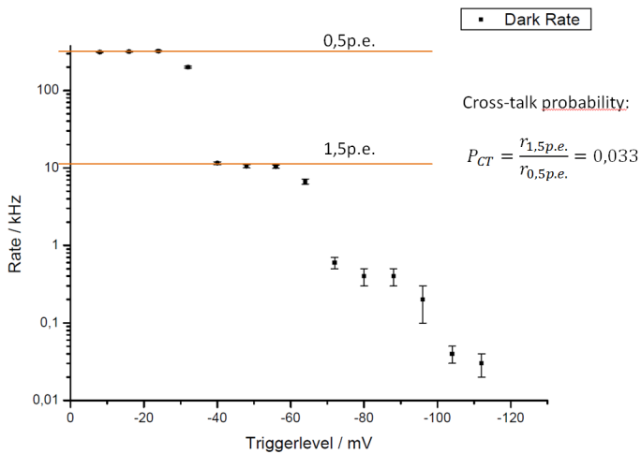
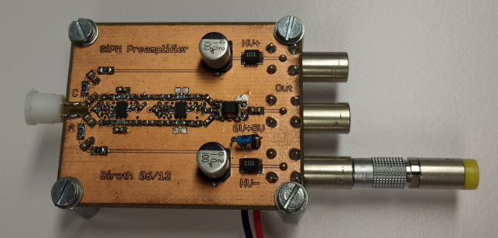
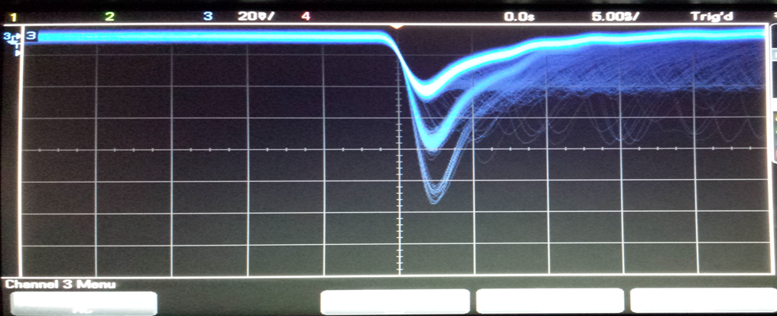
Characterisation of SiPMs
Explore properties of analogue SiPMs
Signal shapes
After pulses
Cross talk
Dark rates
Absolute gain calibration
Uniformity in sensitivity, gain and cross talk
Thermal properties
Require
Readout chain for charge measurement
Pre-Amp (provided by KPH)
Pulse shape determination with FADC
Pulsed laser diodes
Optical table, positioning stage / stepper control
Absolute charge measurements via pico-amp current readout (Xe-Lamp / monochromator, calibrated reference diode)
Status
First simple readout chain working
Simulating signal response
Working on fast calibration pulser design
Components procurement on-going
<<< Activities throughout 2013/14 >>>

