Slide 1
Die folgenden slides werden zur Zeit noch überarbeitet
1 slide pro aktivität
Wichtig ist die Information:
1. Motivation: worum geht es? Was sind die Ziele?
2. Arbeiten: was ist bislang passiert?, Ergebnisse, Veröffentlichungen (?)
3. Pläne im kommenden Jahr.

Slide 2
CALICE / Silicon PM activities
Detector and readout electronics development
Development of a system for mass production of AHCAL “HBU” scintillator/PCB sandwich
P. Chau
Data aggregator and timing unit for CALICE / AHCAL
A. Welker/R. Spreckels
Optimization of scintillator tile geometries for surface mount (digital) SiPMs
Y. Liu
Generic Silicon PM R&D
S. Krause

Slide 3
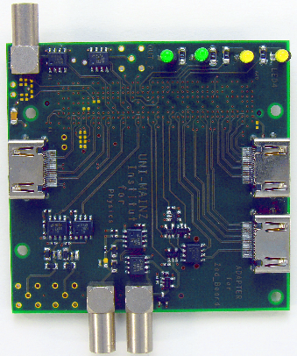
AHCAL wing LDA and CCC
Development of a data aggregator for the “Analogue” HCAL of CALICE
Consolidation of data received from the “HBU” active detector units
FPGA and Xilinx Zynq based
Data transmission into DAQ via Ethernet
PCB geometries adapted to final detector geometry
→ 1.1m long structure consisting of central body and two wings
Status
Initial prototype successfully built
Firmware work, software integration and tests on-going
Development of a timing unit for CALICE
Distribution of central clock
Synchronous commands to all sub-detectors
Busy handling, asynchronous trigger (for beam tests)
Status
Successful operation in ECAL beam tests
Initial version made available to AHCAL collaboration
+ Development of various test and support modules (FPGA/Zynq based)
>>> ongoing development throughout 2013/14 <<<

Slide 4
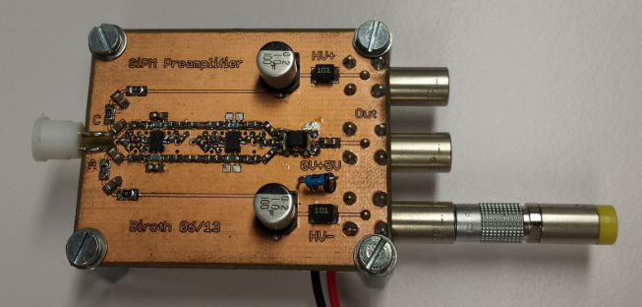
Characterisation of SiPMs
Explore properties of analogue SiPMs
Signal shapes
After pulses
Cross talk
Uniformity
Absolute gain calibration
Dark rates
Thermal properties
Require
Optical table, positioning stage / stepper control
Pulsed laser diodes
Pre-Amp
Readout chain for charge measurement
Pulse shape determination with FADC
Absolute charge measurements via pico-amp current readout (Xe-Lamp / monochromator, calibrated reference diode)
Status
Setting up readout chain
Simulating signal response
Working on fast calibration pulser design
Components procurement on-going
<<< Activities throughout 2013/14 >>>

