Slide 1
Clock module for TB spring 2012
R.Degele, P.Kiese, U.Schäfer, A.Welker
Mainz

Slide 2
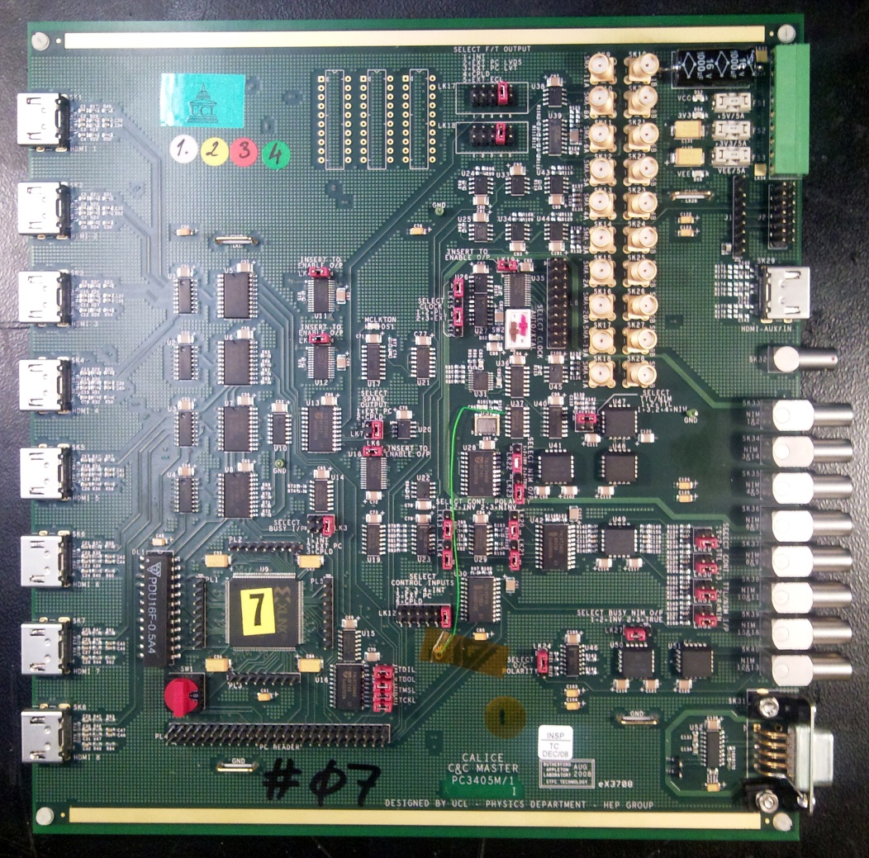
Clock module: CCC
Handling of trigger and machine signals, trigger fan-out, busy logic.
Current status:
UK-developed CCC exists and is being used for clock distribution in beam tests and in the lab
Mature design, based on CPLD and discrete fan-out / drivers
Jitter specs seem rather unclear
CPLD seems rather full
Not designed for future use : Calice integration with EUDET / AIDA TLU (“Timing Logic Unit”) / beam telescope
(Disclaimer: That’s my personal level of (mis-)understanding)

Slide 3
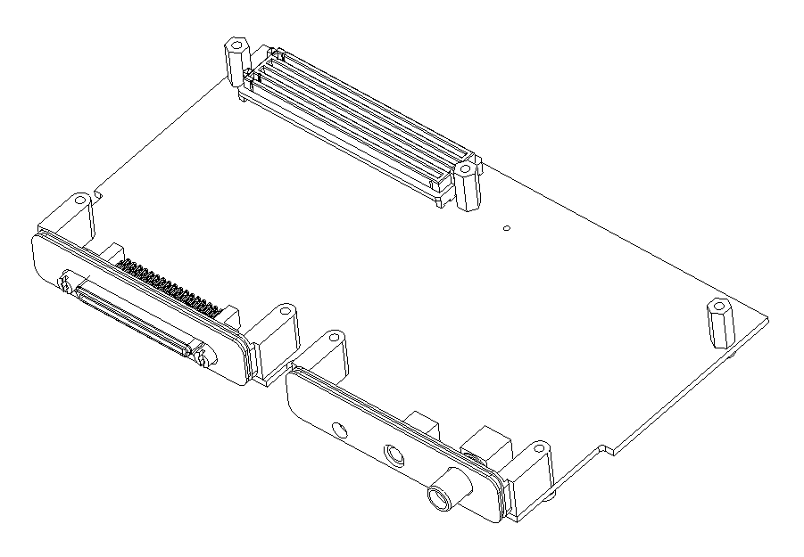
Clock module
HDMI IN
CCC situation has been discussed at CALICE & AIDA mini workshop (9/10 Nov, 2011, Palaiseau)
Provide improved/extended module at a timescale spring 2012 (beam test), addressing main issues. Scope for further improvements thereafter.
Mini TLU design has been presented by D. Cussans/Bristol
Meanwhile: discussions with D. Cussans on a common hardware development for Calice clock module / mini TLU
CCC simplified scheme
SMA LEMO
level
trans lation
CPLD
combina torial
global clock
trigger
local clock
MUX
8 HDMI fanout
mTLU

Slide 4
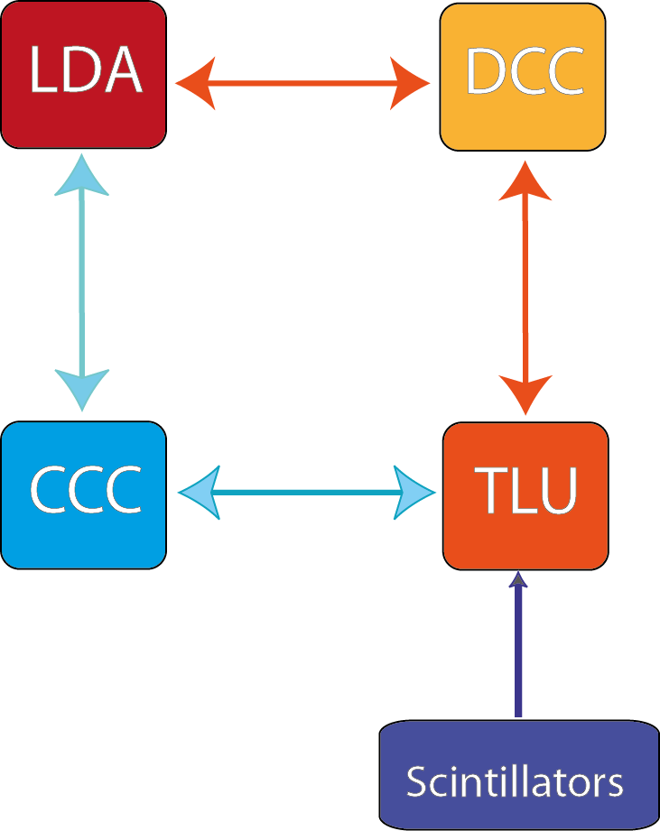
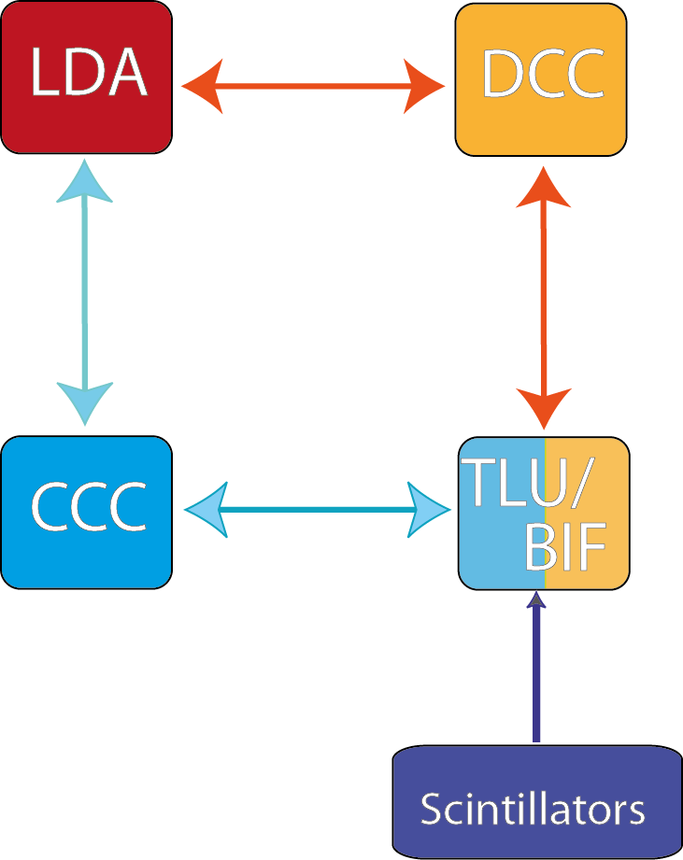
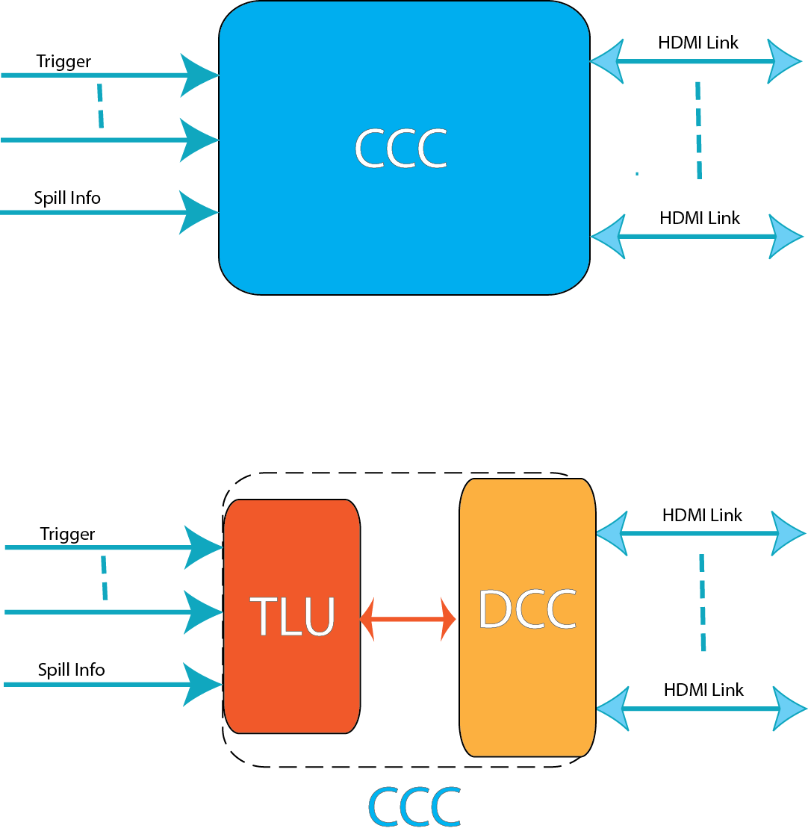
TLU integration
Sketch by D. Cussans:
Combining TLU / BIF and CCC

Slide 5
Some preferences / issues
As of Nov.2011 (Palaiseau) for future electronics we would consider:
FPGA based modules
Custom designs make use of FMC standard (mezzanine modules)
Think about crate based modules rather than table-top (VME-6U?)
For readout and control consider Ethernet (direct FPGA-based, not micro controller(core))
Medium term (common test beams): Remember need for integration of Calice clock modules with EUDET/AIDA TLU
Agreed with UoB on common hardware development effort for Calice clock module / mini TLU
TLU distributing synchronous triggers, Calice (CCC) triggers are asynchronous signals !!!
FMC

Slide 6
Something to think about (for the experts)
It has been suggested to go for FPGA based modules
Asynchronous code in FPGAs is horrible.
TLU is operating on synchronous signals for exactly that reason
Can we operate Calice detectors/electronics on synchronous triggers ?
Measure phase of all incoming signals on machine interface (scintillators, test beam signals,…) wrt to global clock (TDC)
Issue synchronized (to global clock - or multiple - ) trigger signals to LDAs → detectors
These triggers have a maximum jitter of one clock tick
Send TDC data into DAQ for offline corrections
Questions:
What’s acceptable trigger jitter if not using offline correction ?
What’s required resolution of TDC if using offline correction ?

Slide 7
Quick fix TB spring 2012
Go ahead with module development as discussed:
Functionality → FPGA (Xilinx ML605 evaluation board)
Connectivity (connectors, drivers/level translators) → mezzanine (FMC)
Route all signals through FPGA (In case it turns out later that we do require asynchronous operation, bite the bullet and do that horrible code)
Control jitter and skew to required levels (???)
Replicate CCC functionality
Integrate TLU functionality for connection to beam telescope
Control via Ethernet (IPBus / Bristol)
Your input is required:
In case there were a strong bias against synchronous triggers we’d rather know now. Might have to go for quite different scheme
Need to verify need for replication of full CCC functionality
Need to learn about insufficiencies of current CCC

Slide 8
Clock module
HDMI OUT
external fanout
6 HDMI fanout
HDMI IN
local clock
FPGA
Virtex 6
SMA
LEMO
level
trans lation
diff
Ethernet link to control/DAQ
global clock
trigger
Xilinx ML605-Board
RJ45
TLU

Slide 9
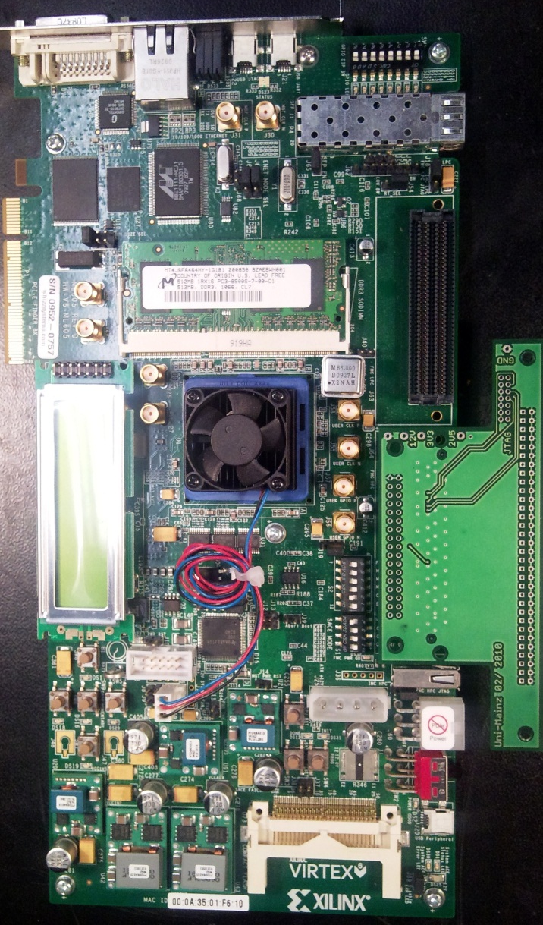
ML605/mezzanine -- FPGA internal
local clock
FPGA
clk
fanout
MUX
clocks
to HDMI
trigger
fanout
algorithms/
combinatorial
trigger
etc.
busy
FPGA
mezzanine
from HDMI

Slide 10
Clock module: current status
Reverse engineered current CCC no requirements, no specs, just schematics
Schematic capture almost finished
Initial floor plan available
Layout started
Machine interface and trigger generation well isolated from trigger replication
Using both FMC connectors on ML605 board
“HPC” connector to machine interface and TLU style interface
“LPC” connector to HDMI trigger fanout
www.staff.uni-mainz.de/degele/Calice/CCC/CCC_XILINX.SCH.pdf

Slide 11
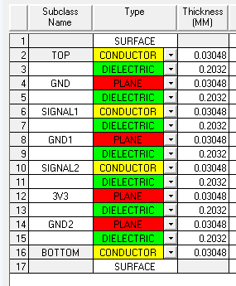
Layout and PCB Stack

Slide 12
Summary
Initial version of new/interim clock module ready for production
Open for modifications/improvements
To be finalised very soon
Input required now
Some firmware required
Online-software ?
To be ready for 2012 beam test

