Slide 1
Mainz hardware activities
- clock module for TB spring 2012 -
R.Degele, P.Kiese,U.Schäfer, A.Welker
Mainz

Slide 3
CCC
Current status:
UK-developed CCC exists and is being used for clock distribution in beam tests and in the lab
Mature design, based on CPLD and discrete fan-out / drivers
Jitter specs seem rather unclear
CPLD seems rather full
Not designed for future use Calice integration with EUDET / AIDA TLU / beam telescope
(Disclaimer: That’s my personal level of (mis-)understanding)
CCC situation has been discussed at CALICE & AIDA mini workshop (Nov.2011, Palaiseau)
→ Provide improved/extended module at a timescale spring 2011 (beam test), addressing main issues. Scope for further improvements thereafter.

Slide 4
Some preferences / issues
As of Nov.2011 (Palaiseau) for future electronics we would consider:
FPGA based modules
Custom designs make use of FMC standard (mezzanine modules)
Think about crate based modules rather than table-top (VME-6U?)
For readout and control consider Ethernet (direct FPGA-based, not micro controller(core))
Medium term (common test beams): Remember need for integration of Calice clock modules with EUDET/AIDA TLU
Discussions with D. Cussans (Bristol) : Common hardware development Calice clock module / mini TLU
TLU distributing synchronous triggers,
Calice (CCC) triggers are asynchronous signals !!!

Slide 5
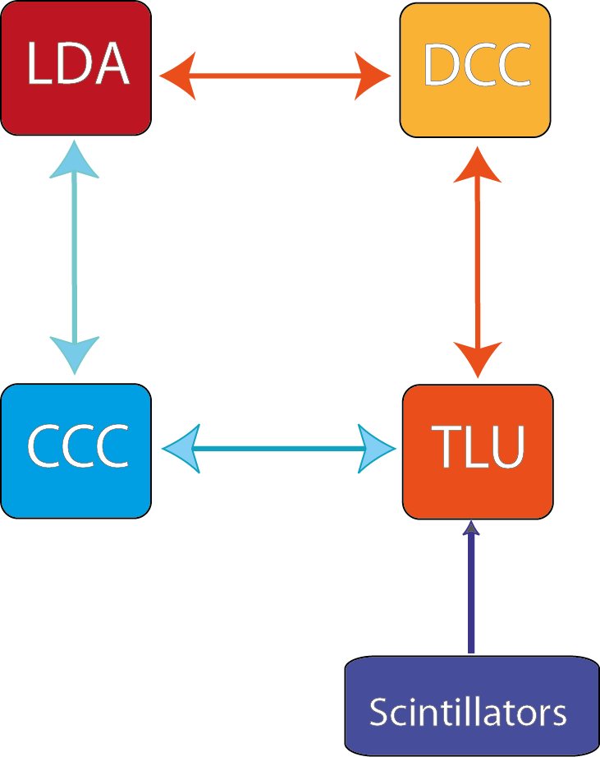
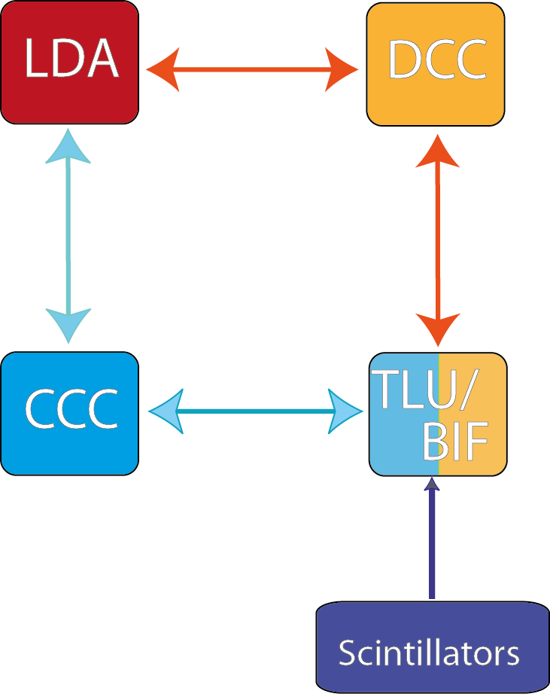
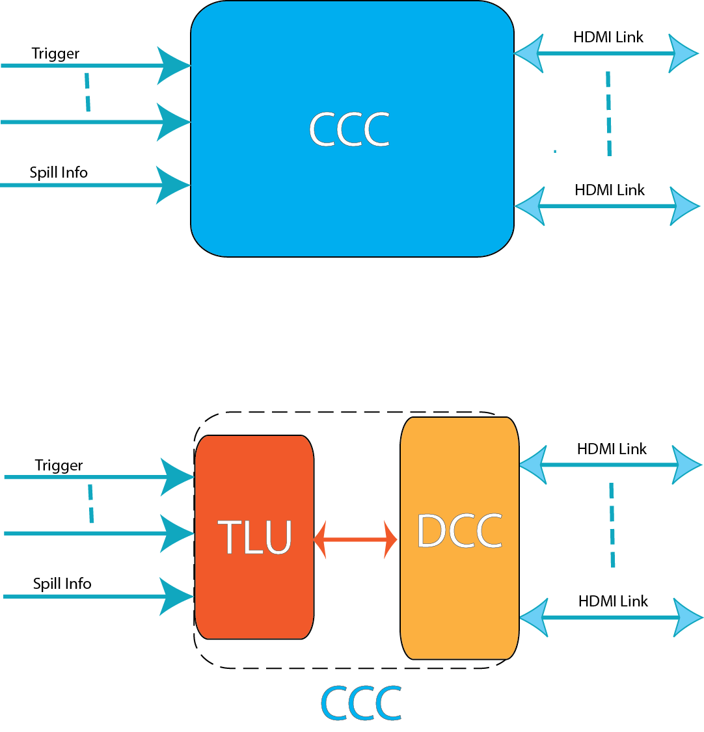
TLU integration
Sketch by D. Cussans:
Combining TLU and BIF

Slide 6
Something to think about (for the experts)
It has been suggested to go for FPGA based modules
Asynchronous code in FPGAs is horrible.
TLU is operating on synchronous signals for exactly that reason
Can we operate Calice detectors/electronics on synchronous triggers ?
Measure phase of all incoming signals on machine interface (scintillators, test beam signals,…) wrt to global clock (TDC)
Issue synchronized (to global clock) trigger signals to
LDAs → detectors
Send TDC data into DAQ for offline corrections
Questions:
What’s acceptable trigger jitter if not using offline correction ?
What’s required resolution of TDC if using offline correction ?

Slide 7
Quick fix TB spring 2012
Build a rather dumb module (connectors, drivers/level translators) to be plugged on Xilinx ML605 evaluation board (FMC)
Route all signals through FPGA
Control jitter and skew to required levels (???)
Replicate CCC functionality
Integrate TLU functionality for connection to beam telescope
In case it turns out later that we do require asynchronous operation, bite the bullet and do that horrible code
Your input is required:
In case there were a strong bias against synchronous triggers we’d rather know now. Might have to go for quite different scheme
Need to verify need for replication of full CCC functionality
Need to learn about insufficiencies of current CCC

Slide 8
Clock module: current status
Reverse engineered current CCC
no requirements, no specs, just schematics
Schematic capture almost finished
Initial floor plan available
Machine interface and trigger generation well isolated from trigger replication
  Using both FMC connectors on ML605 board
  HPC connector to machine interface and TLU style interface
  LPC connector to HDMI trigger fanout
Seriously consider separate modules for trigger generation and trigger replication in a future incarnation

Slide 9
CCC saga, so far…
no requirements known → no specifications written
  „improve reliability, connectivity, jitter, and logic resources“
Current CCC schematics available from the Web
  Reverse-engineer the CCC (A.W.+R.D.)
  Put “all” active components into single FPGA
  Xilinx evaluation board (V6/7) + FMC daughter(s)
Reinhold & Andre working on initial scheme/layout
Open questions :
What active components cannot be moved into FPGA (level translators, comparators…) ?
Protection of FPGA signal lines (2.5V maximum…) ?

Slide 10
CCC vs. TLU
30.11.11: phone call D. Cussans
Build an „AIDA style TLU“, followed by a simple fan-out, i.e. trigger replicator is distinct from trigger generator
Do the h/w in Mainz
TLU-cum-CCC is FMC daughter
Use reprogrammed DCC for fan-out (not finally agreed)
Understand what asynchronous vs. synchronous trigger means for designers and consumers of clock unit
Non-existent TLU design is non-documented at http://www.ohwr.org/projects/fmc-mtlu/wiki (will improve)
Preferably CERN Cadence libraries to be used for common design(s) – trying to get access to CERN repositories
Hope for some s/w & f/w support from Bristol (how realistic ?)

Slide 11
Some issues…
Either have to rely on LAPP for providing and programming DCCs (Spartan-3?)
Or MZ build both the clock and the fan-out module with FMC connectors to hook up on Xilinx ML605
Or Mainz provide hard wired fan-out board
  Understand fan-out/busy scheme and AC coupling (bias might be different for asynchronous trigger line, A.W./R.D.)
  Long-term plans (Palaiseau meeting) are assuming crate based rather than table-top installations. Could be 1st candidate. 6U-VME format ?
Fully synchronous processing strongly recommended for FPGA based designs
Synchronous triggering requires additional TDC firmware on all asynchronous inputs (machine interface), plus readout of measured TDC values…
If compatibility to asynchronous triggers were required there would be quite some bias towards a design that is *not* fully FPGA based (discrete replicators at least for the trigger line)

Slide 12
Before / at DESY meeting
Come to a conclusion what we want and talk to David again
Try to get more information on Kintex-7 board (connectivity!), assuming that we’d rather not buy additional V6 hardware
Finalise (any) one suggested scheme/layout
Will most likely never be built as designed
Get prepared for discussions on synchronous trigger
Prepare slides on clock module development and future LDA ! Who will go / who will present ?
Collect input for
  Number of HDMI fan-out channels
  Jitter
  Form factor
next:
- Reinhold status clock module
- Bruno drawing LDA++
- ???

