Slide 1
ATLAS L1Calo Trigger Upgrade .
in 2020 …
jFEX directly fed with digital data, ~8 ATCA modules × 4 FPGAs 1 Tbit/s per FPGA
bypass analogue front-end
µ µ
jFEX
analog front end
pre- processor
topology
central trigger
calorimeters
e/m clusters
readout system
Level-1 Accept
ATLAS @ CERN

Slide 2
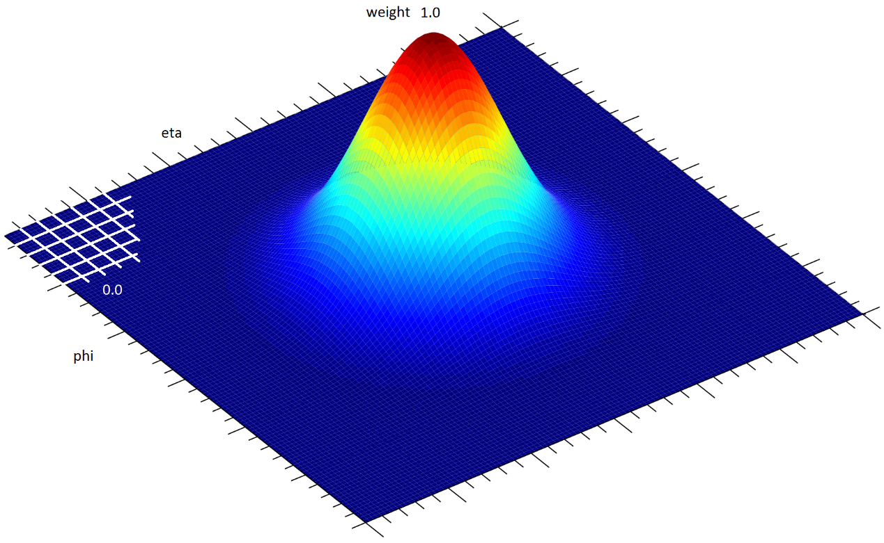
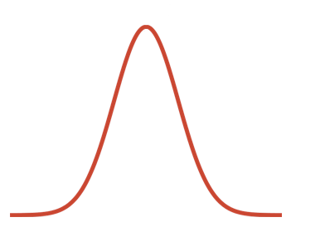
Sliding Window w. Gaussian Weighting
$$\sum_{i,j}^{ }{\left(E_{ij}w(i,j){ }\right)}$$
Find jets in eta, phi space
Algorithms:
Calculate weighted energy sum for each eta, phi bin
Move the centre of Gaussian by 1 bin and repeat. Again. Again. Again… Concurrently !
For a 17 × 17 window we need 289 multiplications per point, plus 288 adders.
16 × 8 core cells per FPGA → 36992 multipliers. Just 1800 multipliers on largest FPGA ! ☹
need some optimization of the algorithm…
Data transmission:
Real-time (trigger) path: >200 optical links (~10Gb/s each) per module

Slide 3
Module control
Set parameters and read status
Module according to ATCA standard:
No classical control bus scheme (ALEPH : FASTBUS, ATLAS VMEbus)
Module control via Ethernet: 2 options
IPbus (external PC talking to FPGA-based IP stack)
Zynq based module control
Zynq @Mainz:
Calice test-beam clock unit (CCC) : Zedboard
Calice readout demonstrator module (“wing LDA”) : MARS module (Enclustra)

