Slide 1
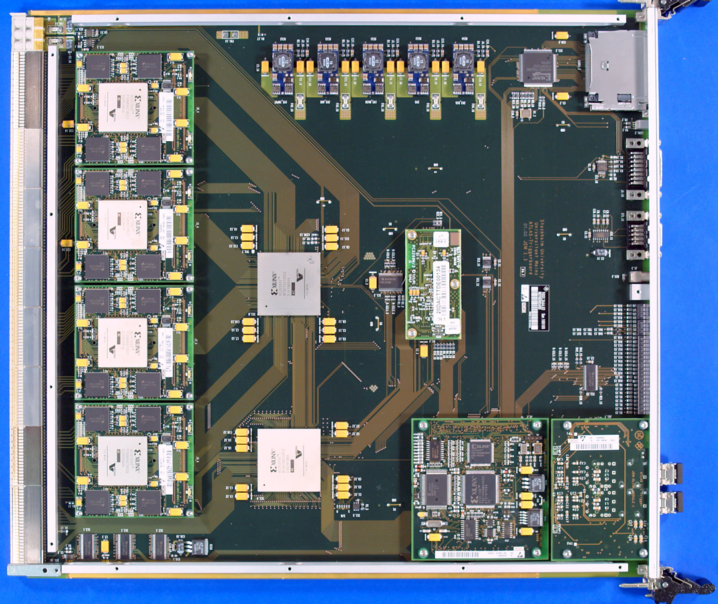
JEM Mezzanines – the details
Currently four input modules per JEM
88*10-bit input from four PreProcessors total
32 electromagnetic and 32 hadronic core channels plus environment
Replace with single module
Early replacement in case of excessive failures of current daughters
Otherwise in time for phase-1
Rigid / flex PCB
Single large Virtex FPGA to support required connectivity
Receive 960 Mb/s electrically
Loop through to MGTs w/o processing
Run through MicroPOD opto-transmitters
5 fibres worth of incoming tile data at 6.4 Gb/s baseline
4 copies to FEXes via front panel (MPO/MTP)
Replacement required on all JEMs (32 plus spares)

Slide 2
Cost and effort
Small module, 40-off production
If pre-phase 1 functionality is to be kept alive, large FPGA is required
FPGA dominates cost at ~7,500€/chip
Per-module cost well below 10k€
Discarding pre-phase 1 functionality will allow for mid range Kintex FPGA at < 5k€/module
Effort required / available in Mainz :~1.5 FTE total sum for Kintex approach
Another half FTE on firmware for integration with existent JEM functionality

