Slide 1
Proposal for a versatile Readout for Scintillator Test Stands
Uli Schäfer, Rainer Wanke
PRISMA Photodetector Lab
April 4, 2013

Slide 2
Why a Common Readout?
Typical test setup:
Scintillator/fibre/PMT/SiPM/... shall be tested for light yield, time resolution, uniformity, etc.
Light sources may be cosmics, LEDs, laser, or radioactive sources.
Triggering usually done by 1 or 2 trigger scintillators + light guides + PMTs (or just by e.g. the LED trigger).
Common readout very useful for all different test setups
(Trigger for this proposal: Test measurements for CALICE, NA62 Muon Veto, and NA62 Hodoscope)

Slide 3
Requirements for a common Readout System
Wish list for a common multi-purpose readout system:
Charge, amplitude, and time resolution as good as possible to be suitable for all different applications. (σQ ~ 0.1 pC, ≥ 10 bit ADC, σt ≪ 1 ns for pulse widths of O(10 ns))
Discriminators, coincidence units, fan-out, amplifier, etc. for triggers and multi-purpose use.
"Plug & play" for fast and simple use.
Software should be reusable, but also easy to expand for non-experts.
Mobility for use of different test stands.

Slide 4
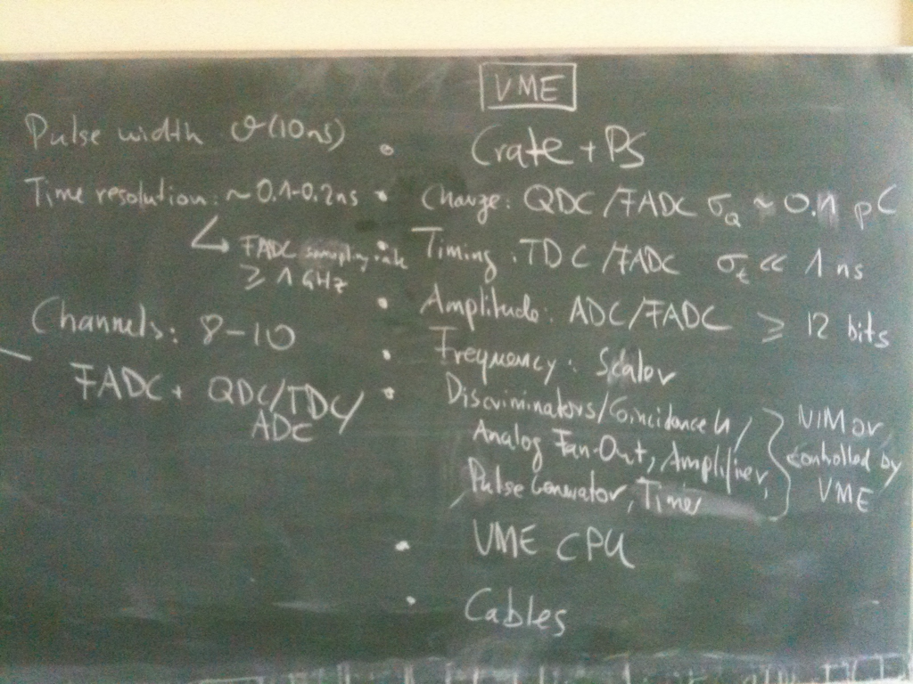
Requirements for a common Readout System

Slide 5
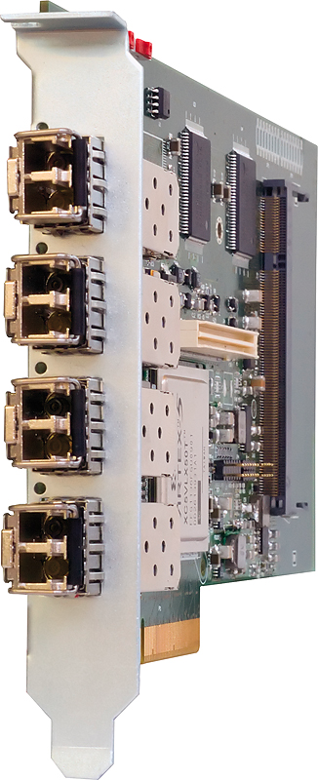
Modules
One common VME crate, controlled by a CPU or similar with (possibly) a multi-channel FADC or digitizer and other modules for amplification, discrimination, coincidence, etc.
Crate Controller: e.g.: CAEN V2718/VX2718 + A3818 for connection to PC

Slide 6
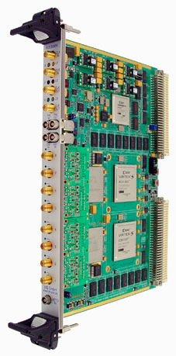
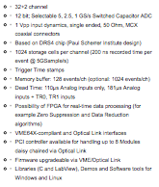
Modules
FADC/ADC: e.g.: Struck SIS 3305 10-bit FADC or CAEN V1742 digitizer
Single width 6U VME card
2/4/8 channels
5 GS/s/2.5 GS/s/1.25 GS/s per channel
512/256/128 MSamples/channel memory
2 GHz bandwidth
Internal/External clock
readout in parallel to acquisition
Multi event mode
Sparsification
Pre/Post trigger capability
Trigger or output (4 individual thresholds)
A32/D32/BLT32/MBLT64/2eVME/SST
1/2/4 GBit/s optical link option
In field JTAG and VME firmware upgrade capability
(also in use by Xenon group)

Slide 7
Very rough Cost Estimate
VME 64x standard Crate: 7 k€
VME master module/CPU: 5 k€
10-bit FADC or equivalent: 14 k€
→ In total: ~ 26 k€
Other VME-controlled modules (trigger logic, discriminator, ...): ~ 2 – 3 k€ each
Decision on specific modules to be taken after discussion with all participating groups (and solid offers, of course).

Slide 8
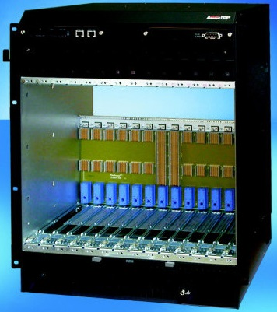
… extend for upcoming R&D
Large scale experiments (most CERN experiments including ATLAS) moving on to xTCA shelf architecture
First ATCA based R&D projects imminent
Complement the “classic” VME based systems by ATCA equipment
ATCA shelf incl. shelf manager and power supplies ~ 10k€

Slide 9
Further needs (general use)
For any kind of lab we require
Oscilloscope (1.5GHz + probes) 20 k€
Pulse generator ~5 k€
Meters… k€
…

