Slide 1
Quite some GOLD...
News from upgrade meeting (US,CM)
GOLD h/w status (BB)
Data transmission firmware and tests for the GOLD (AE,IK,JK)
Design environment
GOLD Control path : optical extension of VME --
RTDP : latency measurements / estimate for CMM++ → topo processor

Slide 2
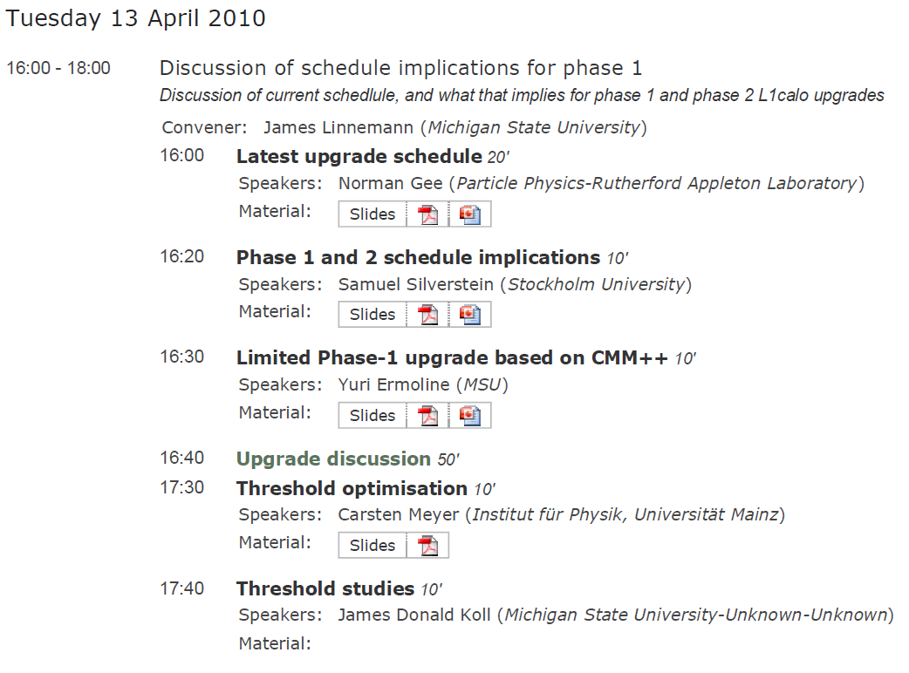
Upgrade meeting 13.04.2010
http://indico.cern.ch/conferenceDisplay.py?confId=91199

Slide 3
Upgrade meeting 13.04.2010
Phases A/B/C (topo/full digital/track) in 2015/17/19 ?
Long shutdowns (machine) 15/17/20 ?
Can we complete full L1Calo replacement in 2017 ? (NG)
Phase I topo ← → phase II processor (NG)
Should we do a CMM++ - only scheme for phase I ? (YE)
Discussion :
Full replacement by 2015 : no , 2017 : possibly
Bricolage scheme of feeding current system from digital frontend disfavoured, in particular since latency advantage (SS) not obvious to others. Need latency assessment !
AFP trigger – what does that mean ? When ?
Is CMM project a h/w or f/w dominated project ?
CMM++ only trigger.
Mainz will do GOLD development line anyway → L1topo → L0Trigger ?
Look into CMM++ local algorithms, AFP ?
Algorithms L0topo ?
Several CMM++s in a custom crate ??????

Slide 4
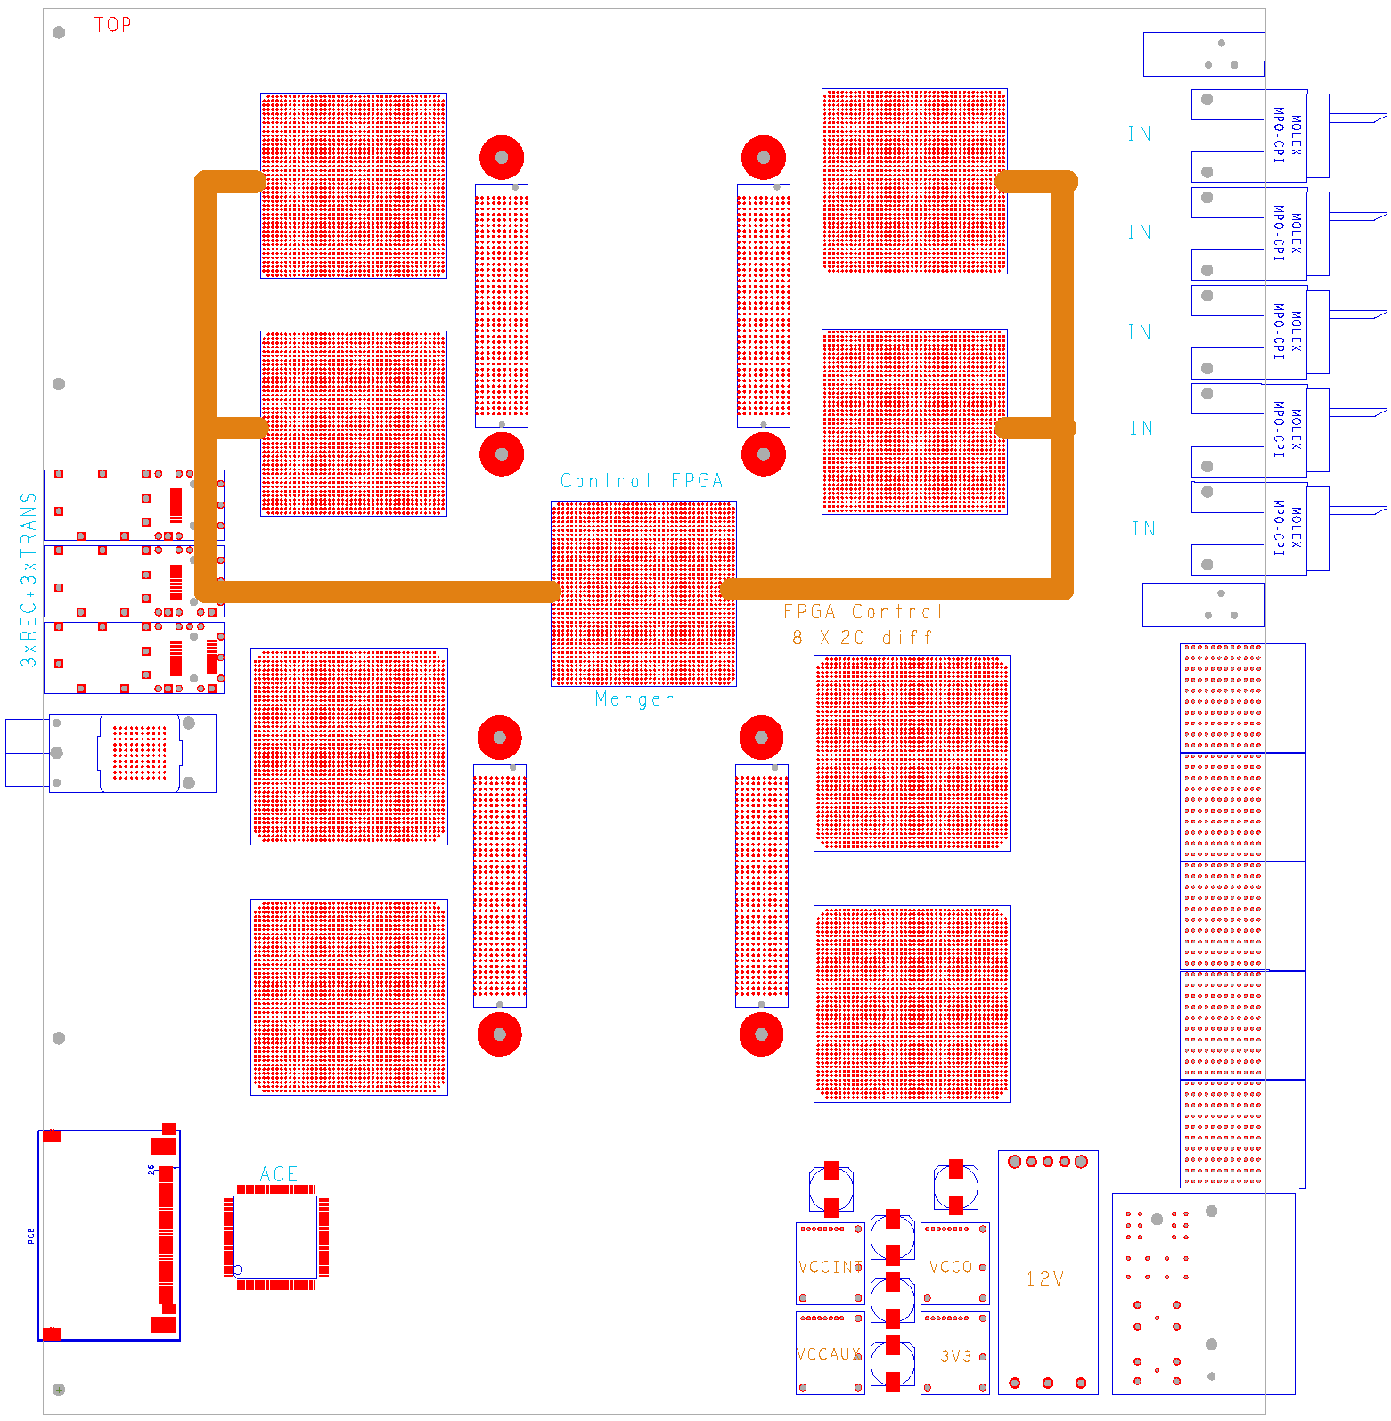
GOLD floor plan (approximate)
Z3
L
5 * XC6VLX (L,M)
4* XC6VHX (H)
144 multigigabit links in zone 2 (equiv. 22300 bit / BC)
L
Opto
L
L
M
Z2
H
H
890Gb/s
total
H
H
Z1

Slide 5
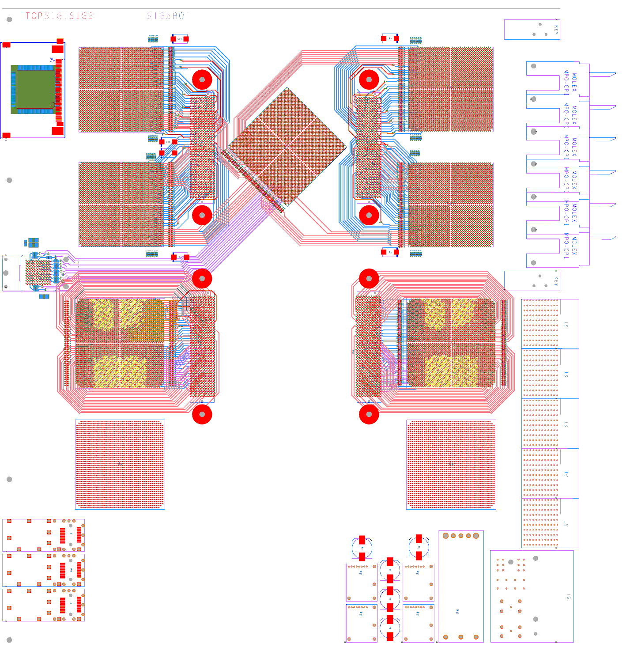
GOLD – current status
Schematics partially done
Routing as shown:
xGb/s links hand routed →
‘Low’ speed links (1Gb/s) to be auto routed

