Slide 1
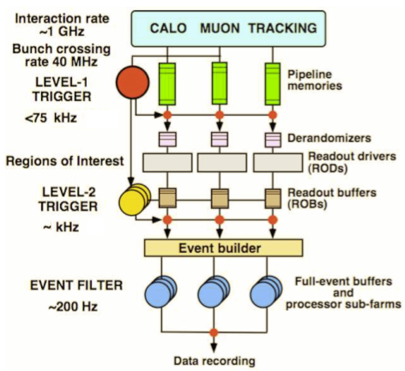
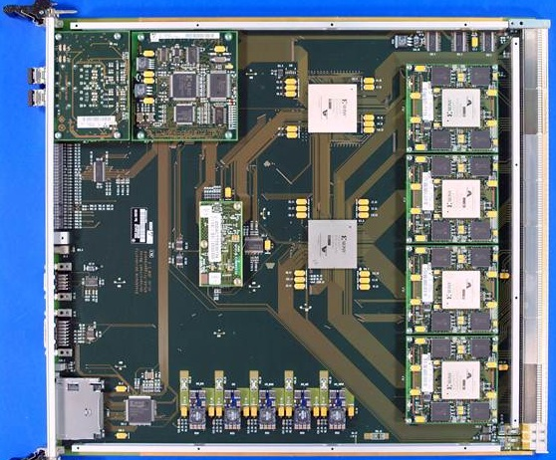
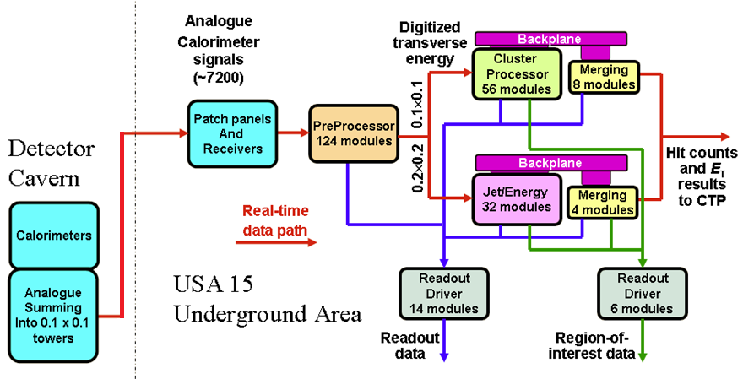
ATLAS Trigger / current L1Calo
L1
Jet/Energy module
µ
calo
CTP

Slide 2
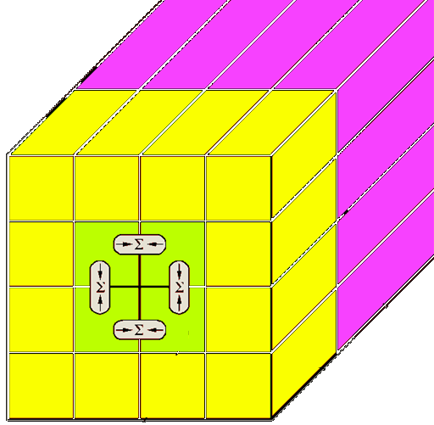
Current L1Calo : digital processors
Sliding windows algorithms for jet and em cluster detection on processor modules at granularity ≥ .1×.1 (η×φ)
Data consolidation by thresholding and counting objects
Data transmission on parallel backplane to mergers
Global results determined by summation trees on daisy-chained merger modules
Final results of electromagnetic and hadronic object count (at given thresholds), and total and missing transverse energy reported to Central Trigger Processor
Topological information (Regions of Interest – ROIs – basically energy sums per window) sent to 2nd level trigger only for all level-1 accepted events

Slide 3
upgrade : Topology
So far topology of identified objects not propagated through 1st level trigger real-time data path for bandwidth reason
Increase RTDP bandwidth and send (almost) full ROI information to a single processor stage where topology cuts are applied and double counting is suppressed by jet/electron/... matching :
Increase backplane bandwidth of existent processor modules 4-fold (40Mb/s→160Mb/s) with modification to FPGA code only
Replace the merger modules by “CMM++” modules
Single FPGA processor
16*25bit*160Mb/s (=64Gb/s) parallel input capability
Possibly up to ~400Gb/s optical I/O
Backward compatible to current merger modules so as to allow for staged installation scenario
Daisy-chain CMM++s electrically or optically similar to current scheme
Star-couple all CMM++s into topological processor for maximum performance

Slide 4
New merger module: CMM++
VME --
VME
CPLD
Legacy DAQ, ROI readout
(Glink)
SNAP12
Topological processor links:
12-fiber bundles,
6.4/10 Gbit/s/fiber
LVDS merger links
Virtex 6
HX565T
SNAP12
SNAP12
SNAP12
Backplane
data from
JEM/CPM
modules
(160 MHz)
Legacy
LVDS outputs
to CTP
SNAP12
SNAP12
9U × 40 cm

Slide 5
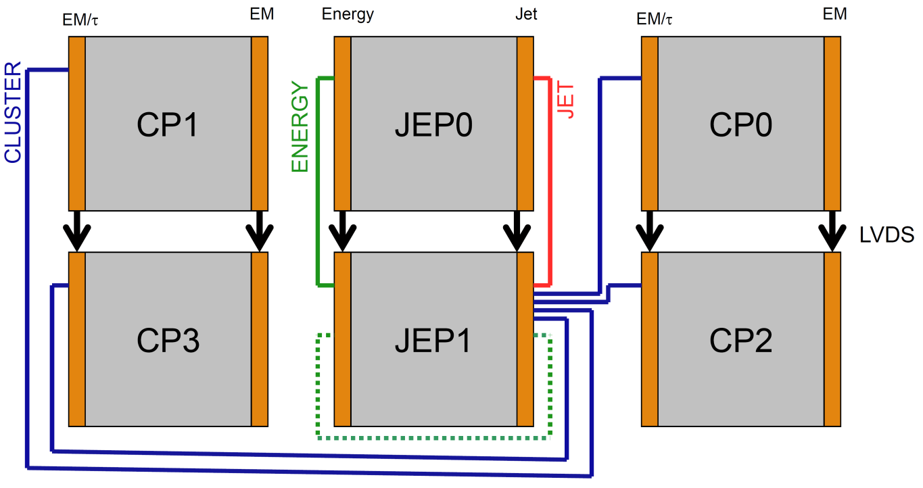
L1Calo Phase-1
Daisy chained
Combination of low-latency LVDS + high bandwidth opto links
CMM++
Full system w. topo processor
single crate

Slide 6
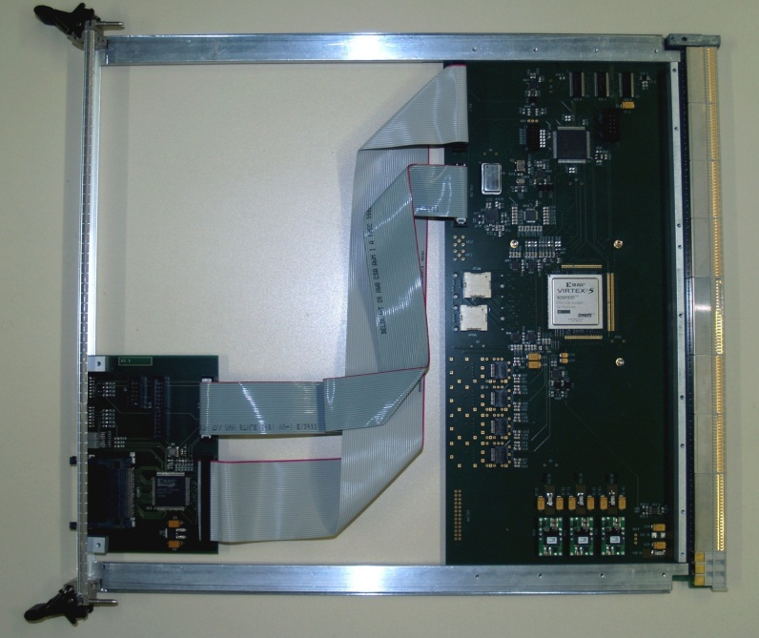
Demonstrators / Prototypes so far…
Work on CMM++ prototype has started recently. Currently at specifications stage. VHDL system modelling started at MSU.
“GOLD” demonstrator (not just) for a topological processor currently being developed in Mainz Latency → data replication schemes Density → processing power, connectivity
Mainz-built “BLT” backplane and link tester successfully verified 160Mb/s data reception on the processor backplane. Equipped with SNAP12 opto-link interface and LHC bunch clock jitter cleaning hardware required on CMM++

Slide 7
GOLD concept
RTM
«data concentrator» scheme: many in – few out
Advanced TCA form factor
Limited connectivity on front panel
Input links via optical connectors in zone 3
12-channel 10Gb/s opto modules on daughter card
Electrical connectivity up to 10Gb/s in zone 2
Power budget ~400W
front
Z3
back
Z2
ATCA

Slide 8
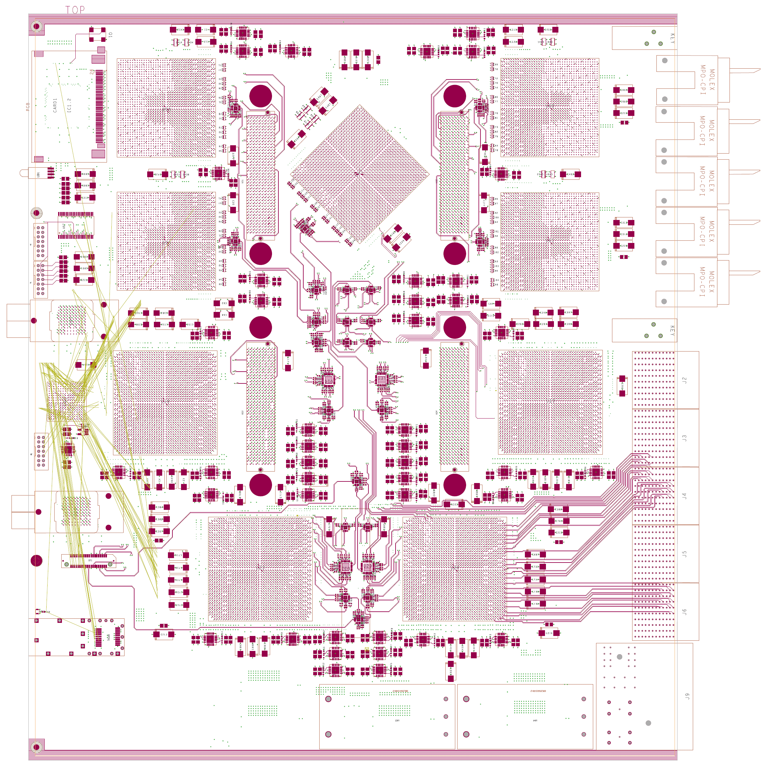
GOLD floor plan
Z3
5 * XC6VLX FPGAs (Processor L, merger M) up to 36 links each
Two pairs of XC6VHX FPGAs (H) 72 links
5+ 12-channel optos on daughter
Clock generation
144 multigigabit links in zone 2 (equiv. 22300 bit / BC)
L
L
M
Opto
L
L
H
H
Z2
890Gb/s
total
H
H
Z1

Slide 9
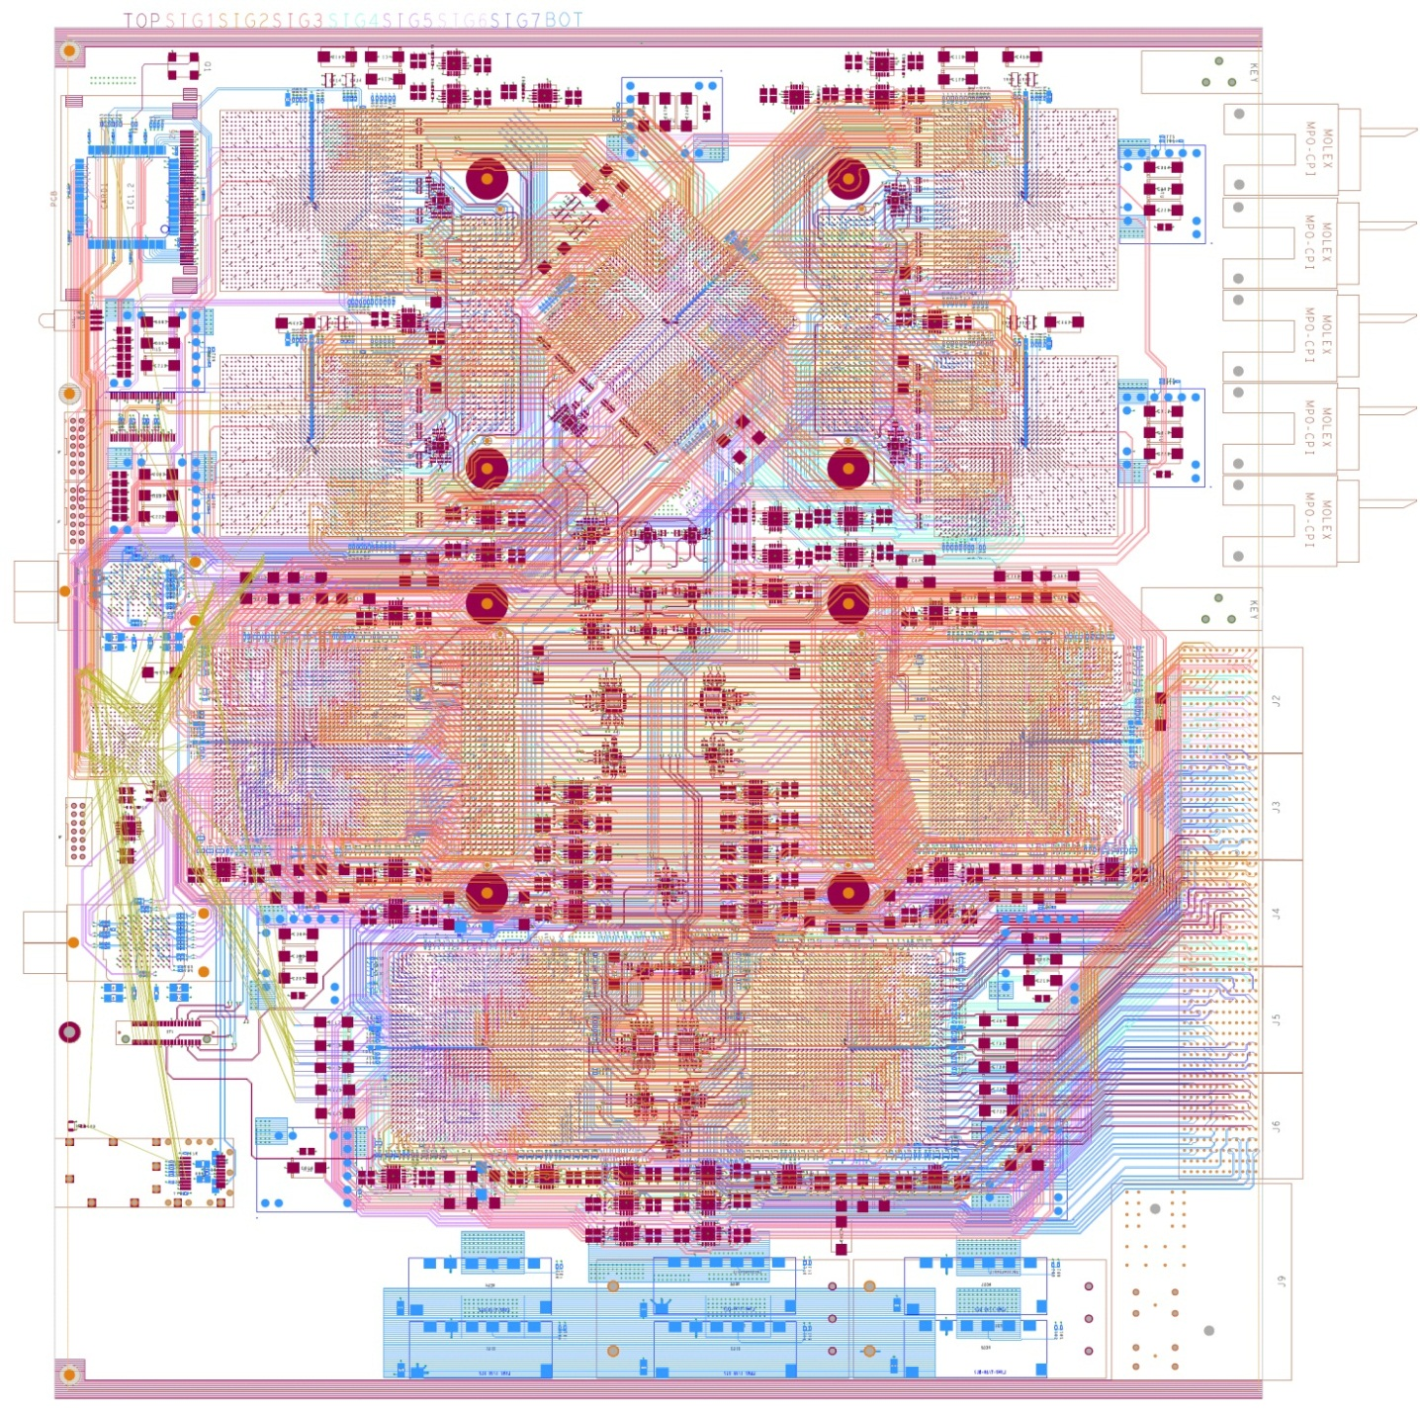
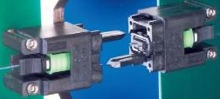
Optics & module status
up to 72 fibres per connector (MPO/MTP)
Module currently being hand-routed (~ 400 differential pairs per FPGA)
Daughter modules yet to be designed

Slide 10
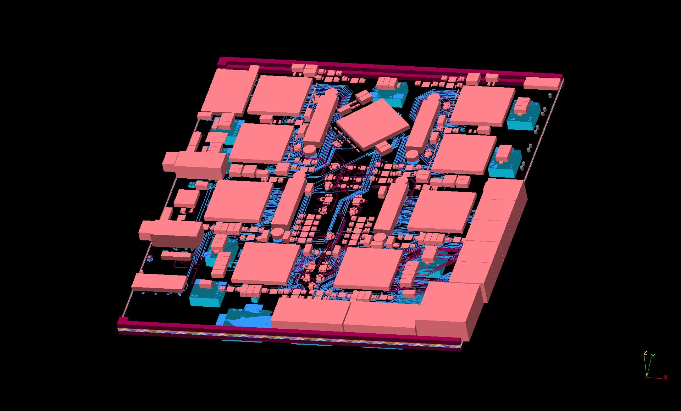
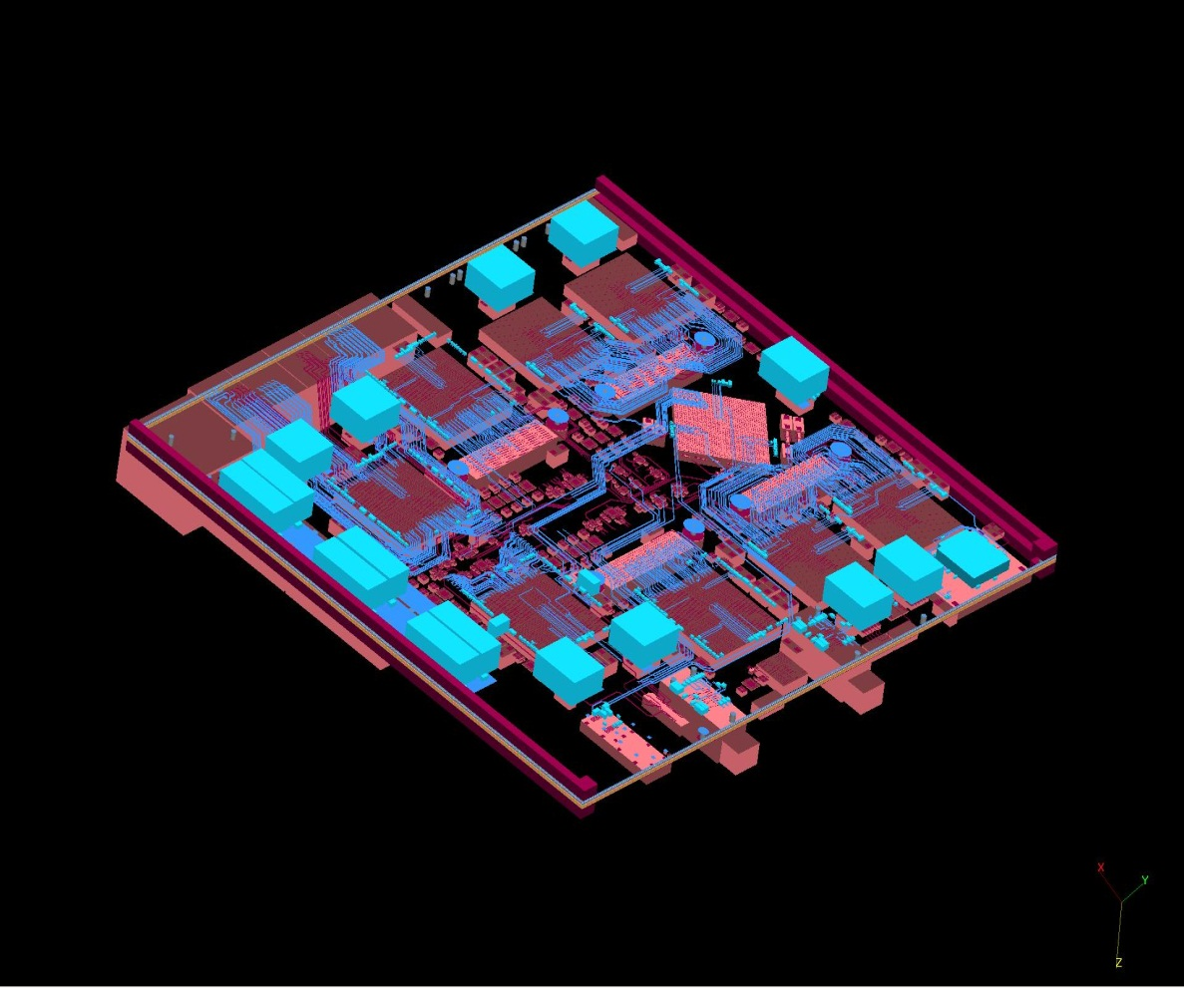
3-d model

Slide 11
Current activities
Write GOLD specs
Get GOLD ready for production (check schematics)
Get started with GOLD firmware : test f/w, → algorithmic f/w
On-line s/w (Linux, VME SBC initially → ???)
Get VME/GOLD adapter ready
Get new copy of BLT up
Add 12-channel opto daughter to BLT : Avago rather than SNAP12

