Slide 1
GOLD down the drain
What’s left after Heidelberg

Slide 2
Strawman design HD-meeting
14-slot ATCA crate with custom backplane
Up to 3 instances of topological processor:
2 dual-quadrant boards
1 merger
Backplane traffic @ 640 Mb/s
LVDS signalling
Up to 600 lanes on a chip
Up to 200 lanes on standard ATCA backplane → double that at the expense of rear transition module → non-ATCA

Slide 3
Topo processor modules
Quadrant processor stage consisting of 2 FPGAs (??) Covering one quadrant each
7*12*6.4 Gb/s from cluster/jet/muon processors
Would require 42 xGb links per processor (??)
Merger stage is single FPGA
Operating on 640Mb/s links

Slide 4
Strawman design
How does it fit MZ processor design (GOLD) ?
→ not at all
Restricted choice of algorithms due to limited bandwidth from quadrant processors to merger
Opto transceivers will have to go onto front panel, that’s a pain in the *** maintenance-wise
→
Try and adopt the unavoidable
Design for a sandwich of two feeder modules and one processor
Avoid the most horrible
Do high speed links (6.4 and 10.4) Gb/s rather than 640 Mb/s to avoid bottlenecks
Keep space in zone 3 for opto links
Adapt GOLD accordingly

Slide 5
GOLD 2.0
ATCA form factor (8U x 280 mm)
Standard Zone1 connectivity (2*-48V supply scheme)
Zone2 xGb/s inputs from adjacent feeder modules
Zone3 (RTMs) xGb/s optical links
4 processors XC6VLX240T/550T-FFG1759 : 24/36 * GTX link (6.5Gb/s)
4 processors XC6VHX380T/XC6VHX565T : 48*GTX, 24* GTH (10Gb/s) – available ~ Oct. ’10 (?) engineering samples
Supply 2 processors with input data via backplane
Supply 6 processors from daughter module
Might have to mix standard SNAP12 (up to 6.4 Gb/s only?) and Avago transceivers
Merger ???
Optical inputs from backplane via bare fibre ribbons
Electrical link fan-out (*2) with CML buffers (SY58011)
1*SNAP12 out from control/merger FPGA or from processors ?
Everything else stays as planned
Build daughter module and backplane resident feeder module

Slide 6
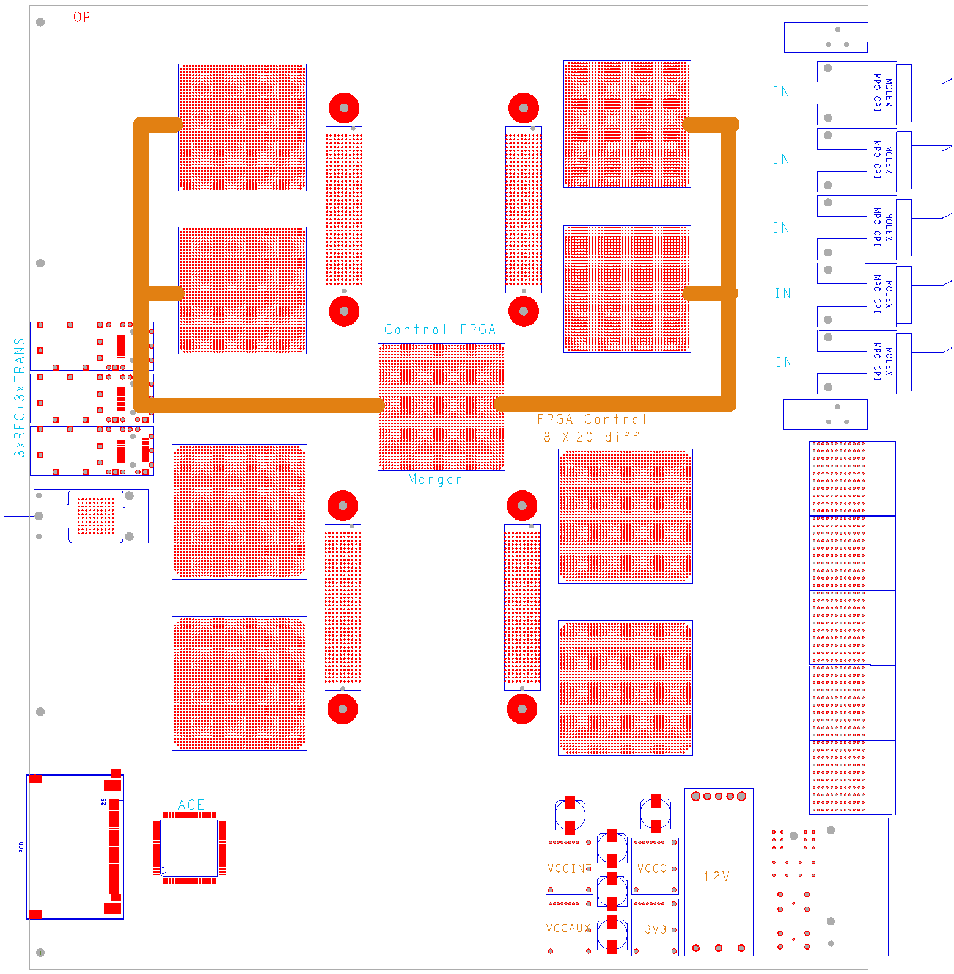
Gold floor plan
Z3
ATCA
daughter module w. 4*FMC connector
8 processors
SFP / SNAP12 out
Merger / control ??
SystemACE config
Local routing
Opto
?
Z2
Z1

Slide 7
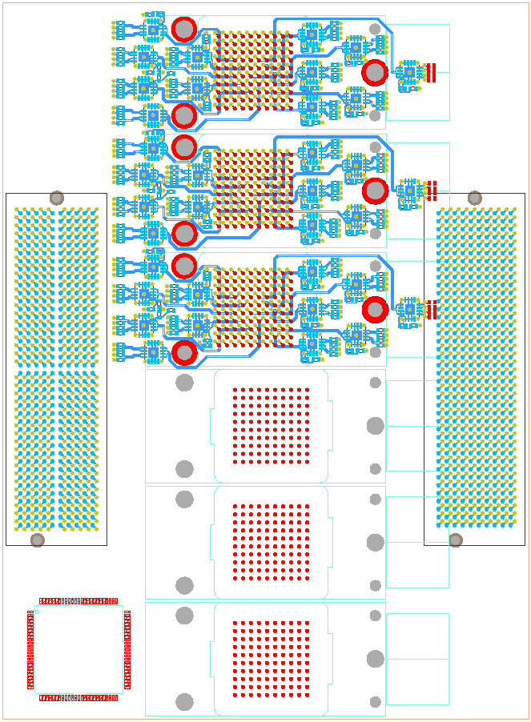
Test daughter
Half size module
3* SNAP12 receive
36 * fanout (*2, CML)
2 FMC connectors
3 * SNAP12 transmit
SNAP12 control CPLD

