Slide 1
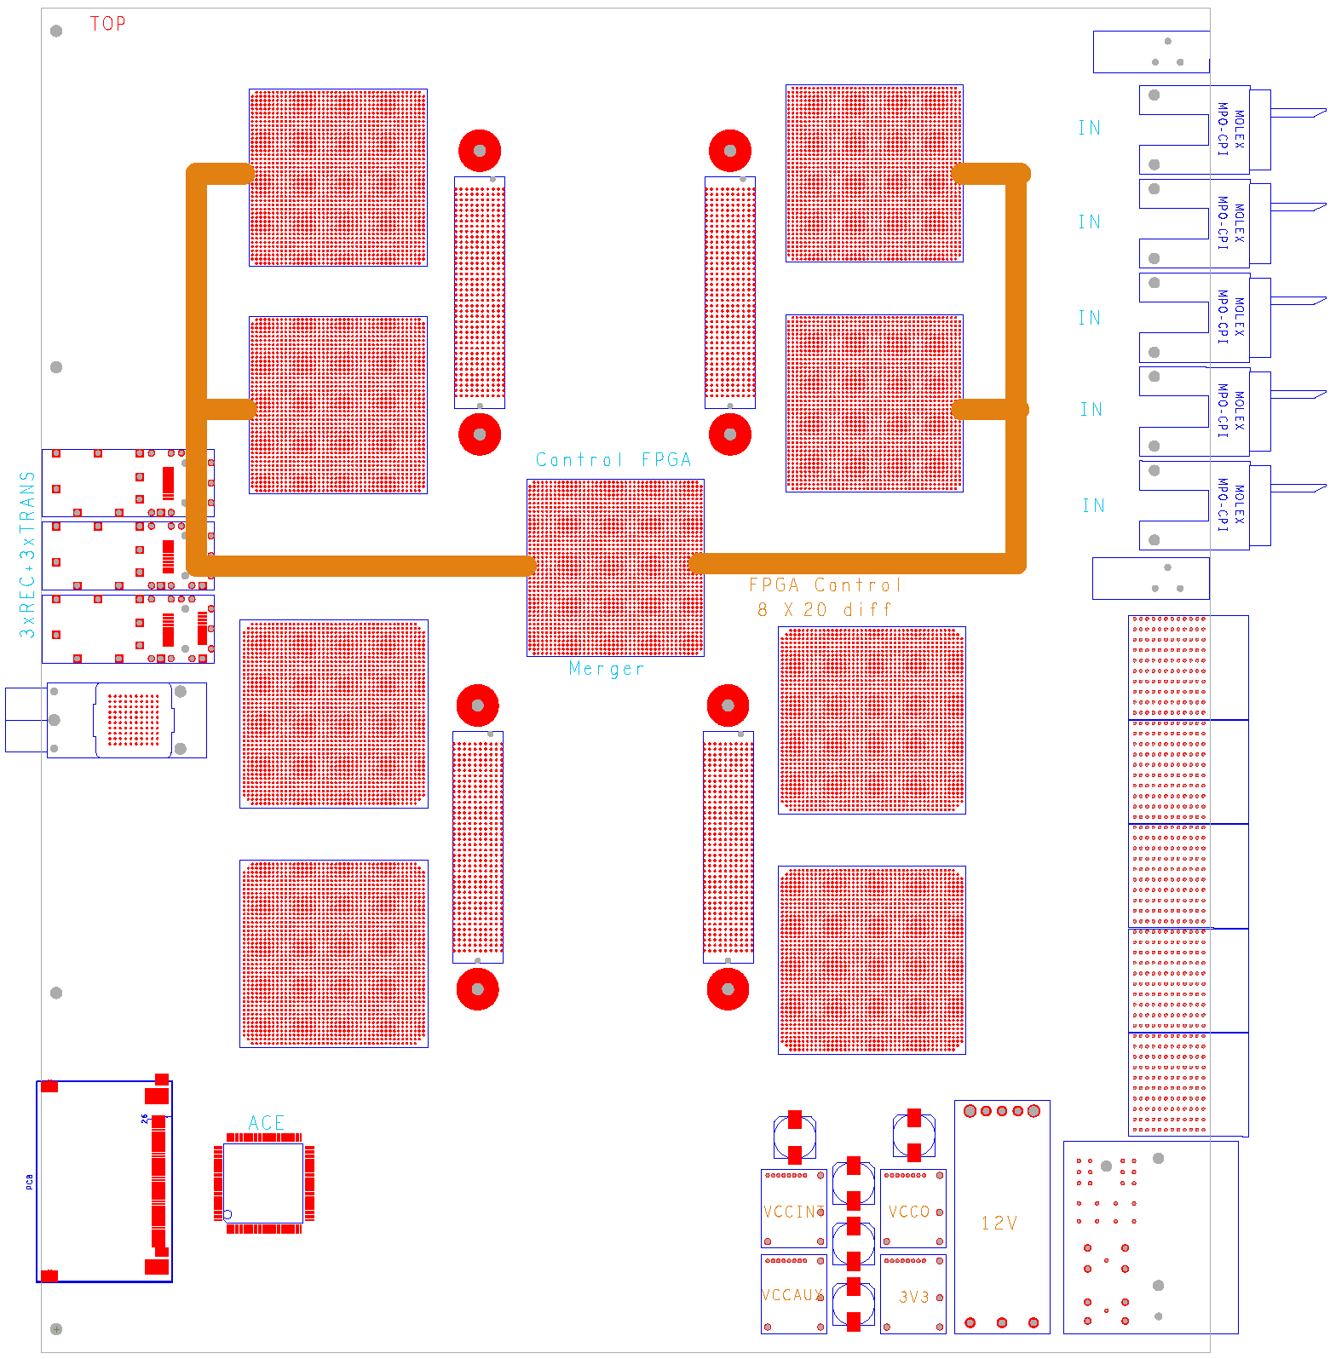
Gold floor plan
Z3
ATCA
daughter module w. 4*FMC connector
8 processors
SFP / SNAP12 out
Merger / control
SystemACE config
Local routing
Opto
Z2
Z1

Slide 2
VME access
BLT lives in a ‘standard’ VME⁻⁻ slot
BLT carries an SFP module
→ Use BLT as a VME extender to feed GOLD with optical serialised VME
Link the GOLD merger chip to BLT via xGb/s port
Link up individual processor FPGAs via low speed differential lines
Format:
Address 15 bit
Data 16 bit
Run synch characters (comma) when no VME transfer in progress
-- latency ?

