Slide 1
Hardware status GOLD
Generic Opto Link Demonstrator
Assess the use of optical backplane connectivity for use on L1Calo

Slide 2
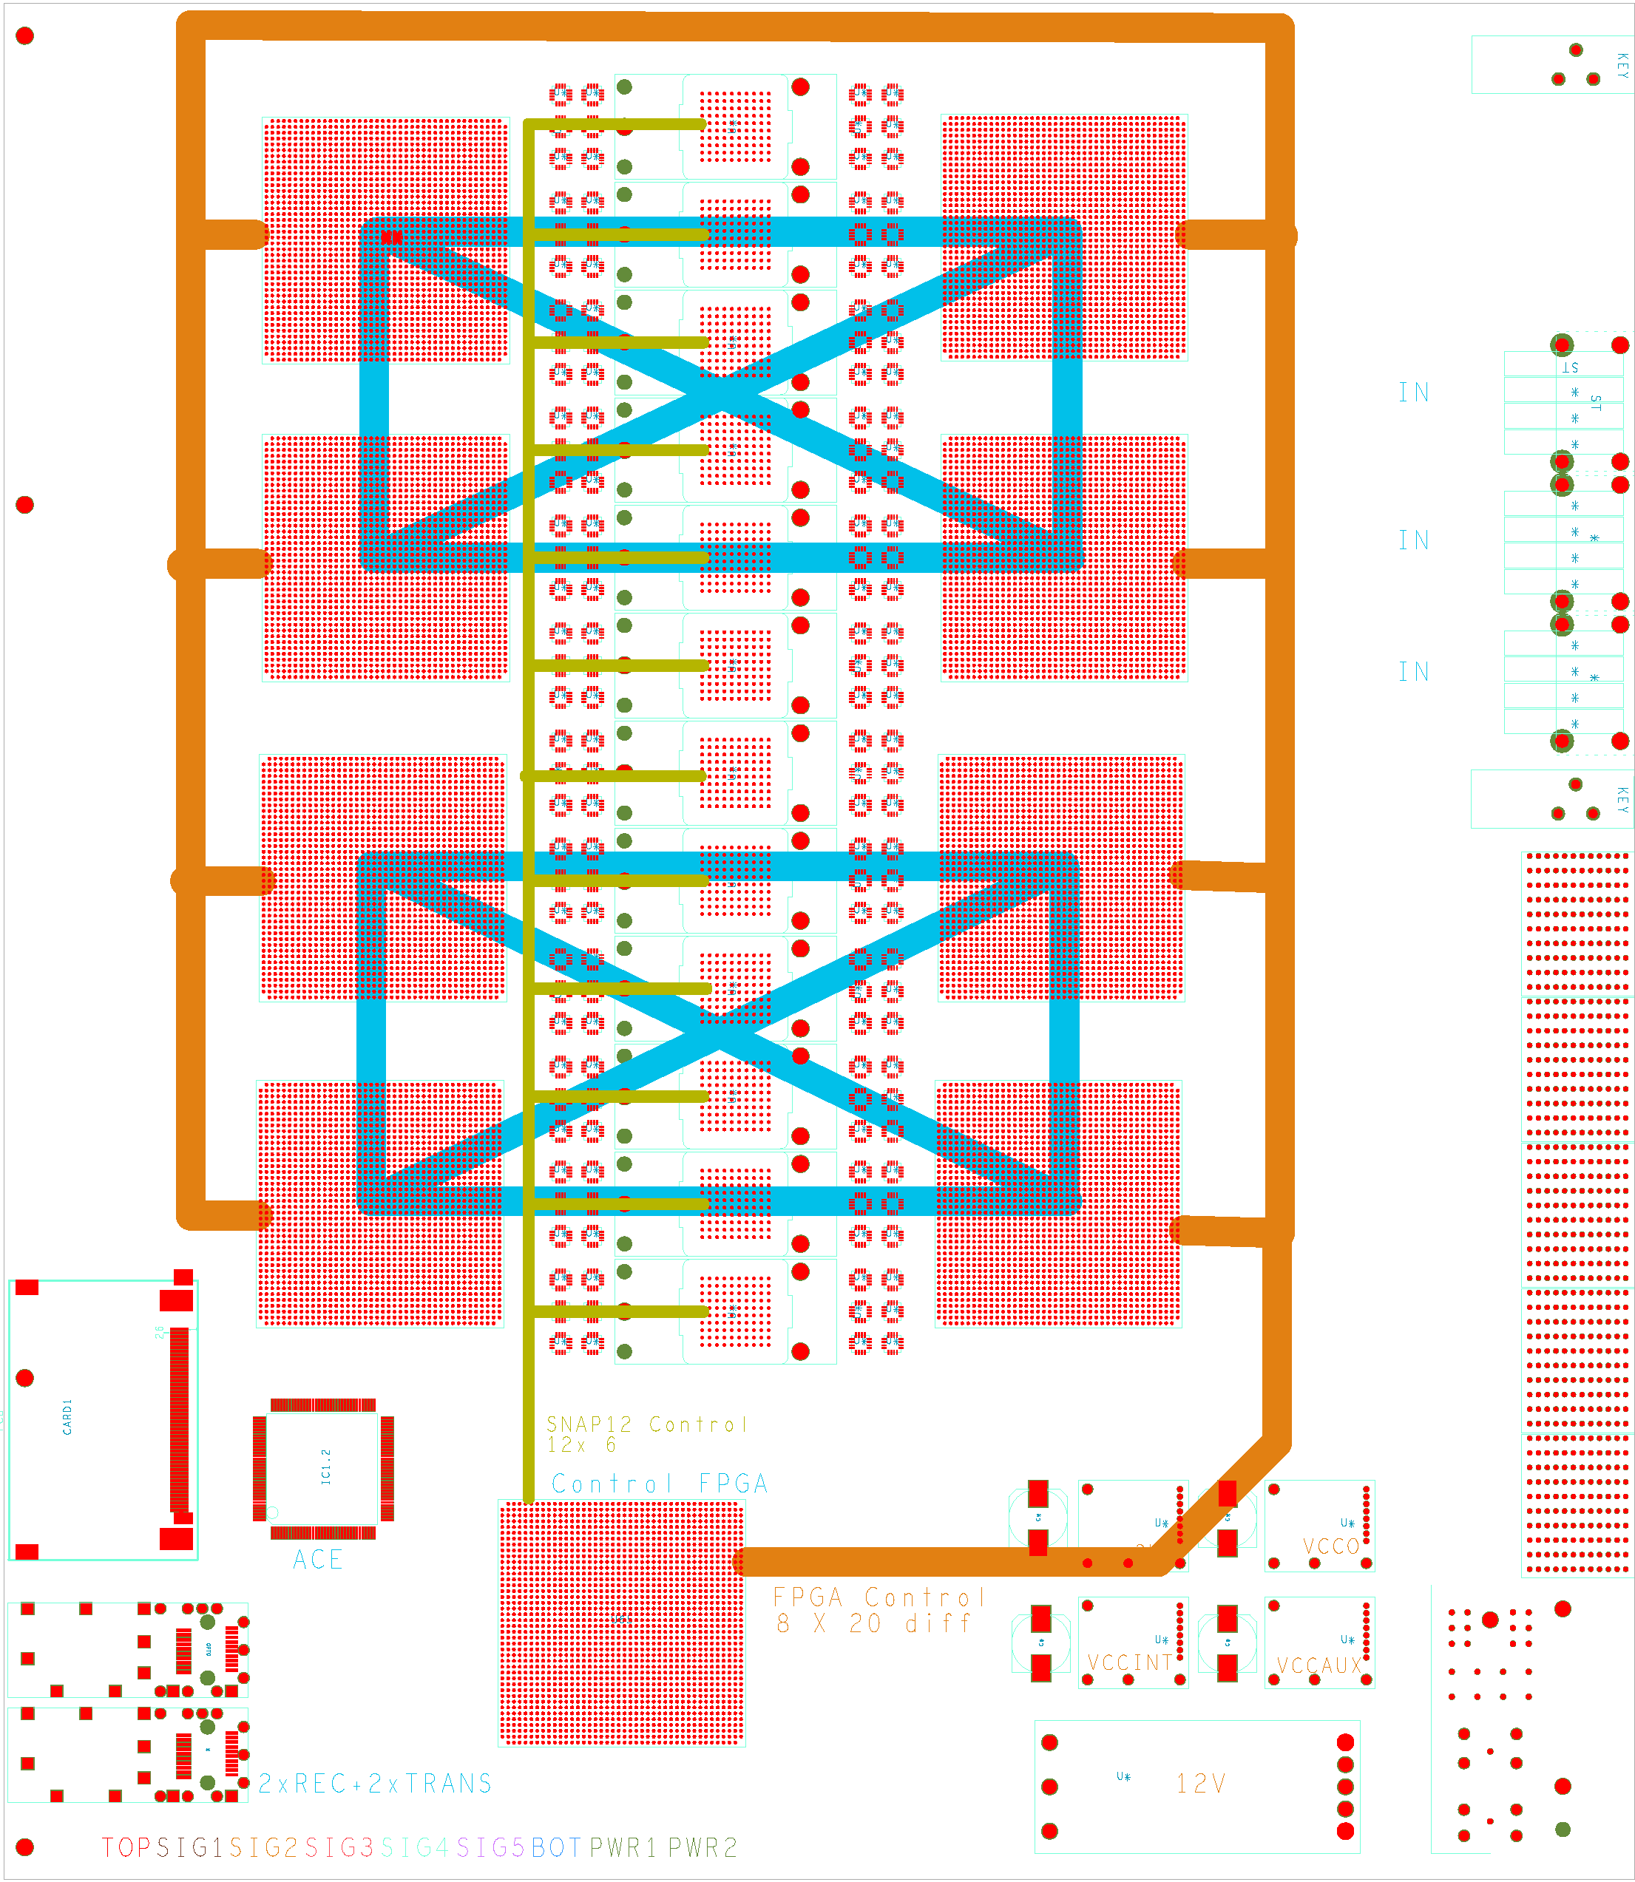
Gold floor plan
Z3
Opto
ATCA
8 processors
12 * SNAP12 receiver
Fanout 6.5Gb/s
SystemACE config
Control/Merger
SFP opto
Z2
Z1

Slide 3
GOLD
Data concentrator scheme : many in, few out
ATCA form factor
  8U x 280 mm
  Standard Zone1 connectivity (2*-48V supply scheme)
  Currently no plans for use of Zone2 electrical connectivity
  Zone3 (RTMs) 6.5Gb/s optical links
8 processor FPGAs, 1 control/merger FPGA
XC6VLX240T/550T-FFG1759 (24/36 * GTX link)
Optical inputs from backplane via bare fibre ribbons, 144 fibres
12 * SNAP12 optical receivers (standard pin-out, not Avago)
Electrical link fan-out (*2) with CML buffers (SY58011 or similar)
  Fanout scheme not yet defined.
  ‘Realistic’ scheme would require knowledge of algorithms
  Consider daughter connectors for half of the high speed links
    AMC daughters not useful due to lack of optical connectivity
    Use FMC daughters carrying SNAP12 modules and fanout chips
  In case of problems the daughters could be re-designed for Avago transceivers
2 GTX outputs per processor into merger FPGA
1*SNAP12 out from control/merger FPGA
Couple of SFP links for control purposes (incl. serialised VME)
Clock recovery, jitter cleaner and clock fanout as on BLT
Parallel connectivity (up to 1Gb/s) via differential lanes only
  20 lanes to/from control/merger
  Two blocks of 4 FPGAs linked locally
  ~ 120 lanes to each neighbour
Configuration via SystemACE (CompactFlash)

Slide 4
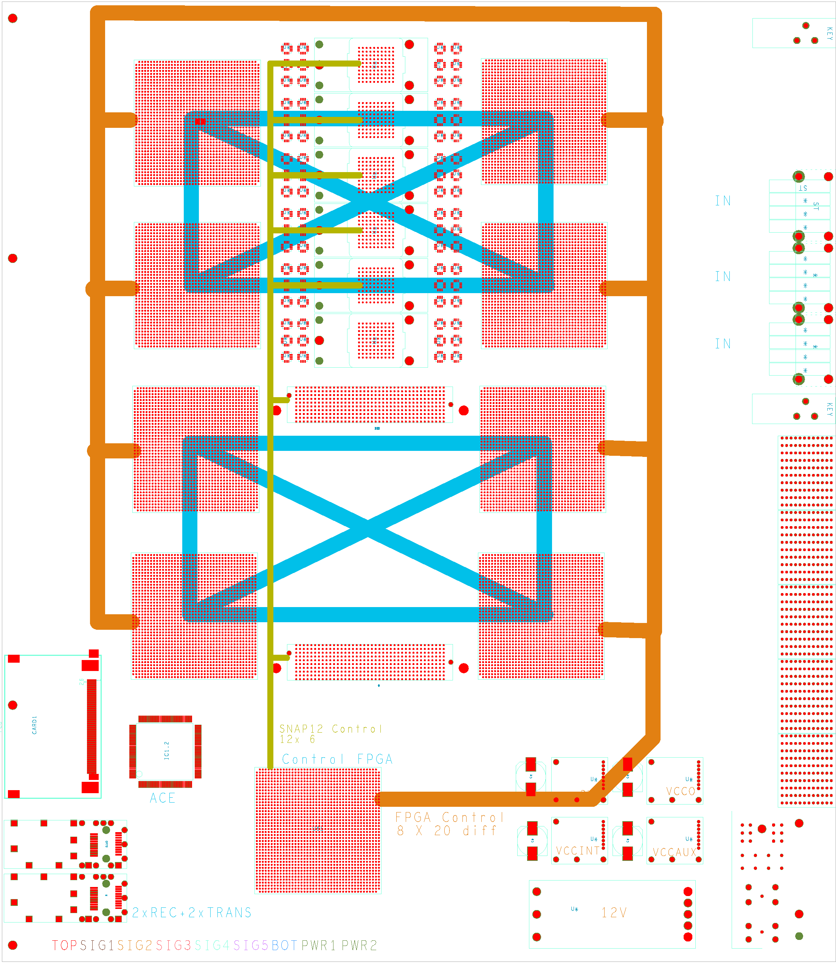
Gold floor plan

Slide 5
Optical backplane connectors
Available from a couple of manufacturers
Individual or 4-connector housings available
MT connectors for 12-36 fibres each, dependent on manufacturer (proprietary)
  MT-to-MTP cable assemblies available from manufacturer only
  expensive
MTP/MPO connectors for 12-72 fibres in single-connector housing
  Takes more space than proprietary approach
  12-fibre ribbon will yield insufficient connection density on ATCA RTM boards
  24-fibre ribbons starting to become popular
  Have a local supplier for custom made MTP 24-fibre ribbons and fanout cords (from January?)
Decide on baseline design very soon and order components
Opto/PCB purely mechanical interface only, allow for change of concept later

Slide 6
GOLD status / outlook
Components have been identified, including optical backplane connectors
Floor planning under way
Schematic capture started
Design along the lines of Xilinx ML605 (V6 specific) and BLT
Build module according to ATCA standard and with baseline backplane opto connector
Should provide input to L1Calo prototyping
Reconsider module size and optical interface upon transition from demonstrator to prototyping phase.

