Slide 1
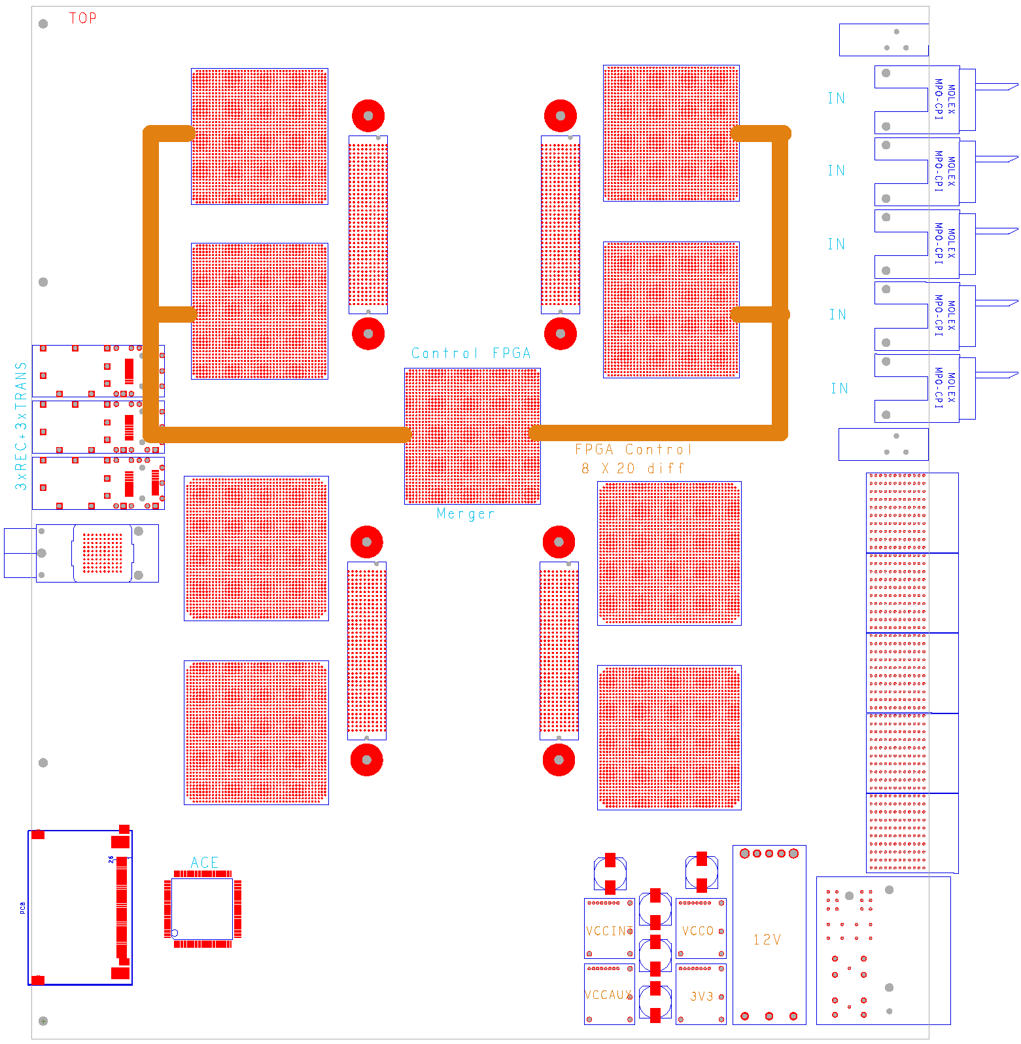
GOLD floor plan
(approximate)
Z3
L
5 * XC6VLX (L,M)
4* XC6VHX (H)
144 multigigabit links in zone 2 (equiv. 22300 bit / BC)
L
Opto
L
L
M
Z2
H
H
890Gb/s
total
H
H
Z1

