Slide 1
Programmable logic devices / tools
Programmable logic devices are digital logic devices, providing combinatorial logic (gates, look-up tables) and flip-flops that can be interlinked via routing / switch matrices. The switches are controlled / programmed via a “bitfile” / “configuration” / firmware downloaded to the device. Modern devices can contain millions of gates and additional macro blocks (RAM/SerDes/clock managers…)
Devices: FPGAs (volatile configuration storage) / CPLDs
Manufacturer: Xilinx, Altera, Lattice, Achronix,…
Languages: VHDL / Verilog
Design flow: HDL design entry, simulation / synthesis, implementation (translate, map, place&route, bitfile generation, bitfile download)
Tools: ISE, Mentor, Quartus Modelsim

Slide 2
projects
ATLAS L1Calo (Level-1 Calorimeter Trigger) at CERN (Xilinx VirtexII / Virtex-6 →Virtex-7, VHDL)
Timepix readout (into Ethernet) for the ILC (Virtex-5, -6), VHDL
Another Ethernet based readout for the ILC (Xilinx, VHDL)
NA62 readout / trigger based on “Tell” module (Altera, VHDL)
Xenon analog readout (~ Gs/s Flash ADC with FPGA based digital post processing) (Xilinx? VHDL?)

Slide 3
L1Calo upgrade / Topological Processor
Calorimeter Trigger system for the ATLAS detector at CERN / Geneva
L1Calo Trigger system designed and built towards beginning of this century
LHC continually improving Luminosity → interaction rate
Simulations suggest a need for topological trigger criteria, so as to keep Level-1 trigger effective at high luminosities.
Example algorithms:
Angular correlations (jets, direction of missing energy)
Muon isolation
…
Hardware implementation
→ Need to feed a maximum of data into a
single point (module, FPGA)
Input from L1Calo and Muons
  ~ 1 Tb/s aggregate bandwidth
  Do not partition into multiple modules for reason of latency.
TOPO

Slide 4
Phase 0 Scheme
TOPO
Muon
CP
6.4/10Gbps
PPr (nMCM)
CTP
analog
480Mb/s
JEP
real-time paths shown only
New CMX module with two interconnect options
  Chained (legacy and opto links)
  Star topology with all opto links into topological processor
Muon information included on topo processor

Slide 5
Phase-0 Topo Processor floor plan
front panel connectors
opto
Z3
Z3: opto connectors for real-time input
12-chan
M
Mezzanine connector
Z2
Z2: electrical connectors
A / B FPGAs XC7VX690T-FFG1927
A
B
Power supply and control
Z1
AdvancedTCA
322x280 mm

Slide 6
Topo Processor
Hardware : Virtex-7
Firmware :
Physics algorithms (angular correlations of physics objects: jets, e/m clusters, muons
High-speed link code
Module control, parameter download (VME bus/Ethernet)
Service code: Error checking, clock handling,…
Algorithms require
Sorting of objects to size
Cuts in η,φ
Possibly cuts for absence of objects in given η,φ bin
Choose reference algorithm and put in hardware !
Since we are the trigger, LATENCY !

Slide 7
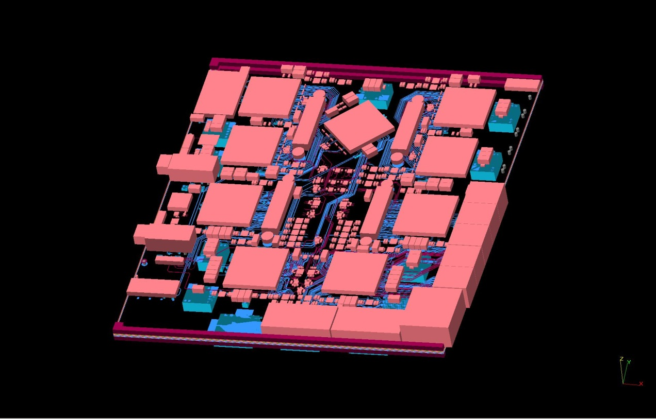
Current demonstrator: GOLD
Module currently under production (PCB, assembly)
Firmware design under way

